Slide 1
The chess club
<joke>
It’s not a chess themed stick for hitting objects with.
</joke>

Slide 2
How are chess clubs now?
Focusing on school chess clubs
  Mostly elementary school
Currently there are many successful chess clubs.
Success largely determined by talent of who ever is running the club.

Slide 3
How clubs work
Generally are after school activities that happen once or twice a week.
Can range from 5 kids to over 100 kids.
Large clubs will mostly be comprised of beginners with a small group of more advanced players.
Club tournaments, ranking, and ratings.
  Often messy or tedious to run and maintain.

Slide 4
Personal Experience
Club A:
  Had over 100 students
  Run well by very small body of teachers and parents.
    Club was broken into groups
    Groups would rotate having a lesson
    Everyone in a group without a lesson would play a tournament round
    Everyone had a ranking in the club
  Things ran very smoothly despite the disparity between number of students and adults present.

Slide 5
Personal Experience (cont.)
Club B:
  Has over 150 students
  Run by small group of somewhat experienced adults
    Has groups of ~30 students each
    Each group has a ‘teacher’ and a lesson every club session
    Has a tournament game played within the groups after the lesson.
      Tournament is complete chaos
    Rankings exist, but are widely inaccurate and get messed up often

Slide 6
What was the difference?
Club A had better management of it’s data.
  They had a rating, ranking, and even an unrelated ‘point’ system for rewarding students.
  Club B has a ranking, but it’s inaccurate and poorly maintained, rating and point system are completely missing.

Slide 7
Enter my innovation
My chess club program will keep track of any data that might be desired by the club
  Club rating, USCF rating, membership dues, point systems, rankings, etc.
It will be highly customizable and easy to use
It will support running multiple different tournament formats.
  This will take into account the fact that often students may miss a day unannounced, where in a standard tournament missing a round is not as common.

Slide 8
Target audience
I expect most well established chess clubs like Club A or B would be hesitant to start using my software as it would require them to change how they have been operating.
The real target for this software then is anyone who is new to starting a club.
  Once a club starts using the software it will be unlikely for them to stop.
Larger clubs will start to adopt this software once smaller/newer clubs have proven that it works well, however many will continue to use their systems as they have already been working for them.

Slide 9
Marketing plan
To target new clubs the program will:
  Give an outline for a successful way to run a club that anyone could follow.
  Be easily modifiable to support common situations a club may start out as.
    Anywhere from a handful of students without any funding to roughly 100 students with significant funding.
  Must be easy to use.
  Most importantly the program should be cheap.
    I want someone who is thinking about running a club to buy my program
    The act of buying my program should feel like a strong commitment to running the club.
    I’m thinking about $5 for a year long license.
    I would like to sell permanent licenses, but it would be infeasible to support the updating and maintenance of the program if that were to be the case as the market may likely become saturated quite quickly.

Slide 10
Marketing plan (part 2)
I have significant connections within the chess community, especially pertaining to schools.
My mother runs a couple clubs and I know she would use the software (this was originally her idea)
I would talk to other friends of mine who run clubs and my mother would do the same to support the product.

Slide 11
Where to go?
The product is specifically targeting school chess clubs.
Once it has been demonstrated that the product is desired then an adapted version will be developed to support other kind of competitive clubs.
Additionally Swissys is the current standard for running chess tournaments around the world.
  There is a fair chance to take some of that market as this program will be cheaper and have a much nicer more updated user interface.

Slide 12
What’s the market like?
Initially it will be slow to catch on.
  In the first year I wouldn’t expect more than 5 licenses to be sold.
  After about 5 years, if the product works well, I would expect to be selling as 20 licenses to be sold.
    It is worth noting that initially the product will not work well and won’t look nice, this will significantly stunt the growth of the product, however this is how development goes when learning on the way.
  There is a possibility the product is very popular and spreads outside MN and then as many as 100 or more licenses might be sold.

Slide 13
Isn’t that a tiny market?
Yeah. It is.
Even if it gets huge and I’m selling >100 licenses then expected profit really peeks at maybe $1k per year.
I think the fact that this supports a good cause, helping to bring chess to children, makes it more than worth it.
However if the product is successful (> 20 licenses a year), then I would research what other sort of sports might desire and expand the product to support them as well.

Slide 14
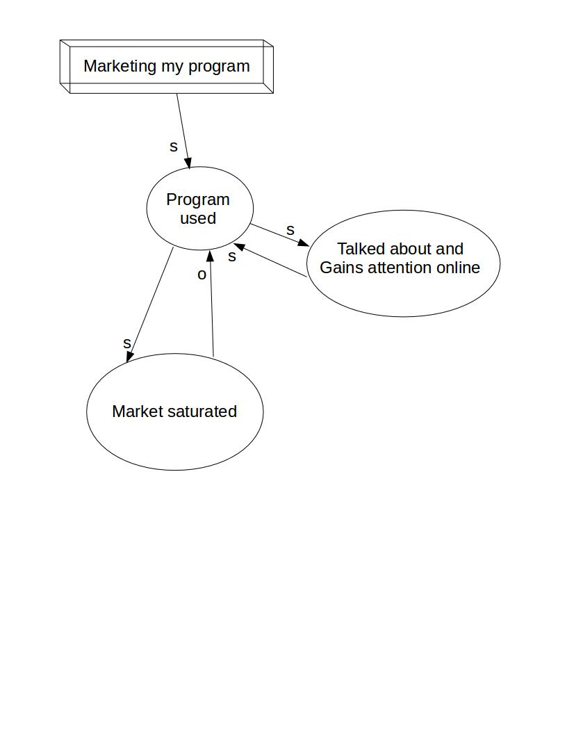
Systems thinking

