Slide 1

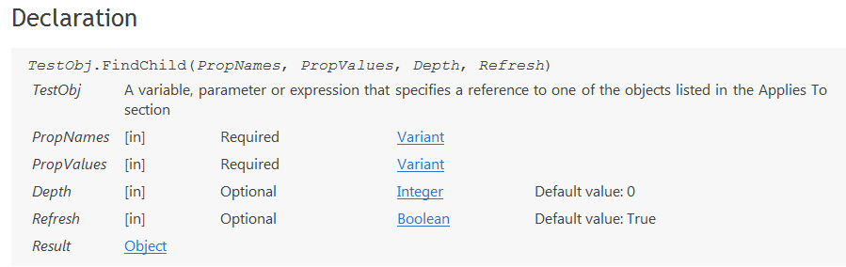
FindChild

Slide 2
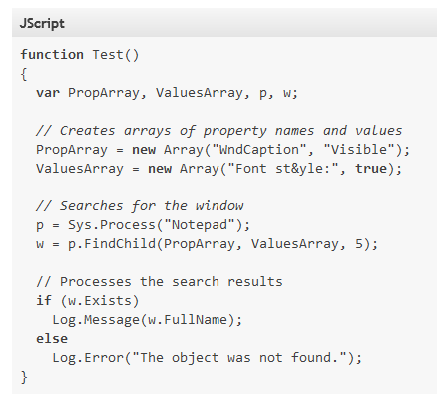
FindChild

Slide 3
*Seek
seek(container, crit, crit, crit, timoutMs, depth);
seek(container, crit, crit, crit, timoutMs);
seek(container, crit, timoutMs);
seek(container, crit);
seek(page, {ObjectType: 'Link', contentText: '*Home*'});
* uses waitRetry and findChild

Slide 4
Seek's Web Relatives
seekInPage(crit, crit, crit, timoutMs, depth);
seekInPage({contentText: 'Logout'});
seekByProperty('contentText', 'LogOut');
seekByIdStr('CustomerNumberTextbox');
seekByObjectIdentifier('CustomerNumberTextbox');
seekByIdStr('CustomerNumberTextbox')

Slide 5
DO
read, set, verify, click
Do === Seek + Do
readByIdStr('CustomerNumberTextbox');
setByIdStr('CustomerNumberTextbox', 'User Name');
verifyByIdStr('CustomerNumberTextbox', 'User Name');
clickByIdStr('CustomerNumberTextbox');
clickByIdStr({ObjectType: 'panel'}, 10000, 10, 'CustomerNumberTextbox');

Slide 6
Seek and Read
readInPage(crit, crit, crit, timoutMs, depth);
readInPage({contentText: 'Logout'});
readByProperty('contentText', 'LogOut');
readByIdStr('CustomerNumberTextbox');
readByObjectIdentifier('CustomerNumberTextbox');
readByIdStr('CustomerNumberTextbox')

Slide 7
Seek and Set
setInPage(crit, crit, crit, timoutMs, depth, newVal);
setInPage({contentText: 'Logout'}, newVal);
setByProperty('contentText', 'LogOut', newVal);
setByIdStr('CustomerNumberTextbox', newVal);
setByObjectIdentifier('CustomerNumberTextbox', newVal);
setByIdStr('CustomerNumberTextbox','User')

Slide 8
Seek and Verify
verifyInPage(crit, crit, crit, timoutMs, depth, expectedVal);
verifyInPage({contentText: 'Logout'}, expectedVal);
verifyByProperty('contentText', 'LogOut', expectedVal);
verifyByIdStr('CustomerNumberTextbox', expectedVal);
readByObjectIdentifier('CustomerNumberTextbox', expectedVal);
verifyByIdStr('CustomerNumberTextbox', 'user')

Slide 9
Seek and Click
clickInPage(crit, crit, crit, timoutMs, depth);
clickInPage({contentText: 'Logout'});
clickByProperty('contentText', 'LogOut');
clickByIdStr('CustomerNumberTextbox');
clickByObjectIdentifier('CustomerNumberTextbox');
clickByIdStr('CustomerNumberTextbox')

Slide 10
All seek-and-do functions can take optional seek params
setByIdStr(crit, crit, crit, timoutMs, depth, idstr, value)
setByIdStr(30000, 'txtPassword', 'password')

Slide 11
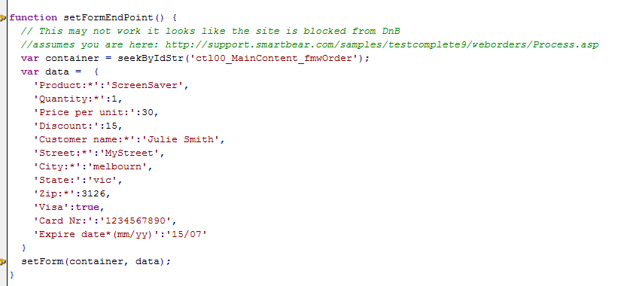
setForm
Matches Property (key)
idStr on standard data ui object
=> then ObjectIdentifier on standard data ui object
=> then “text” on “label like” ui object
=> then
a standard data ui object close by

Slide 12
setForm cont.
function setForm(container, data, setFunctionOverride)
Container – optional default: activePage
data – required key* ~ uiObj
value ~ value
*Quotes can be used if the key has a space
setFunctionOverride - optional default: set
*useful to work around javascript issues

Slide 13
More Unusual Seek Functions

Slide 14
seekAll
seekAll(testObjOrAliasStr, propValsObj, depth, refresh)
      No timeout
      Only takes a criteria object (not a function)
      Returns an array
      A wrapper around TC function FindAllChildren
seekAll(containerObj, {ObjectType: 'Form'})

Slide 15
seekParent
seekParent(childObject, parentPropValsObj, refresh);
seekParenth(childObject, parentPropValsObj, refresh);
      No depth
      No timeout
      Only takes a criteria object (not a function)
seekParent(childObj, {ObjectType: 'Form'})

Slide 16
