Slide 1
RESTARTS
NORMAL
EXECUTION
Restart behaviour is not invoked when running tests with mocked data

Slide 2
TestCaseList
UNI T REFERENCES
//USEUNIT DoNothingRestart
//USEUNIT Demo_Excel_Data_Driven_Test
//USEUNIT SmartBearSampleRestart
//USEUNIT Demo_Test
//USEUNIT Demo_Login_Test
/***** Test Case List ****
DoNothingRestart
Demo_Excel_Data_Driven_Test
Demo_Login_Test
SmartBearSampleRestart var1 var2
Demo_Test
*/

Slide 3
Unit Name ...Restart
RESTART FUNCTIONS
var RESTART_CONFIGURATION = {
id: -10
}
function rollOver(runConfig, paramStr){
}
function goHome(runConfig, paramStr){
}
function isHome(runConfig, paramStr){
return started(runConfig, paramStr);
}
function close(runConfig, paramStr){
}
;(function register(){
registerTestRunElement(RESTART_CONFIGURATION);
}())

Slide 4
Unit Name ...Restart
FUNCTION DETAILS
rollOver
  Back end changes to rollback the test environment prior to running the application (e.g. replace a database, reset a device on the network)
  Does not start the application
goHome
  Starts the application under test if required (e.g. opens browser goes to url and logs in)
  Returns a started application to its “home” state (e.g. clicking a home link on a website)
  isHome() === true after running the start function
isHome
  Returns true when the application is in it's home state
  All tests in a batch must finish with the application in the isHome state or in a state such that goHome() can be successfully execute
close
  Closes / terminates the application – after which isHome() === false unless the Restart script does nothing

Slide 5
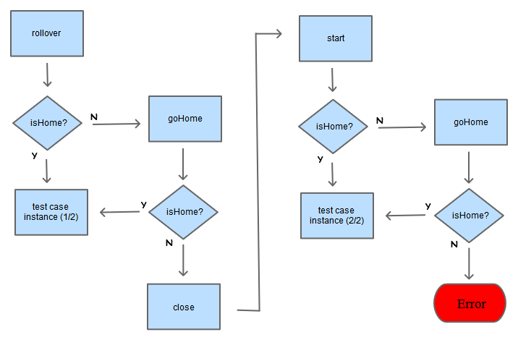
TEST
BATCH
START

Slide 6

BETWEEN
TEST
S

Slide 7
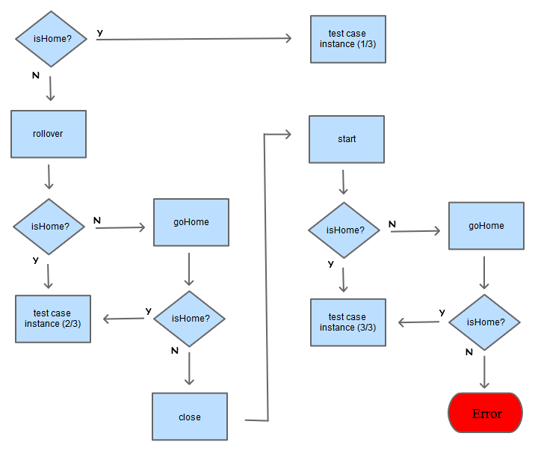
TESTCAS
E ENDPOINT

Slide 8
WARNING
You will not get a clear callstack when restart functions fail or throw exceptions
=> Put a breakpoint on the failing function and step through

