Slide 1
Eniac Project Part 2
Haripriya, Lana, Raju

Slide 2

ENIAC Revenue Insights : The Impact of Discounts
“Are discounts driving sustainable revenue growth?”
Haripriya, Lana, Raju

Slide 3
Agenda
%
Main Question
Business Performance Overview
Monthly Revenue & Order Trends
Product Categorization
Products & Revenue Contribution
Price Segmentation
Conclusion
Appendix
%

Slide 4
Main questions
%
Main Question
Is discounting truly beneficial for the company’s long-term growth and profitability?
Supporting Business Questions
How should products be categorized for analysis?
What is the price distribution across categories?
How many products are discounted, and by how much (%)?
How do seasonality and special events (Christmas, Black Friday) affect sales?
%

Slide 5
Key Statement
%
Our analysis shows that discounting can drive customer acquisition and sales volume, but aggressive or frequent discounts reduce revenue and margin.
Sustainable growth requires a balanced, targeted discount strategy aligned with product categories and timing.
%

Slide 6
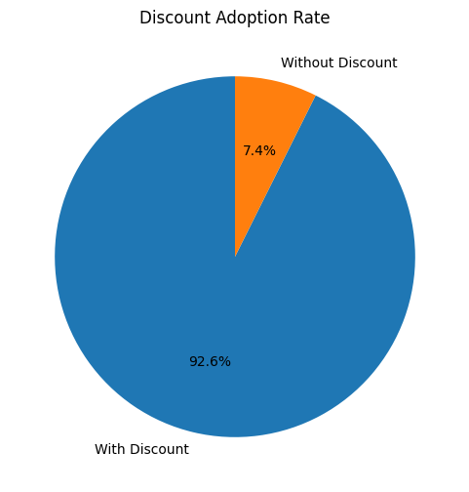
Overall Business Performance
%
€ 6.48M
Total money customer spent
€ 6.33M
Total Product Revenue
€ 6.77M
Revenue without Discounts
“Discount drives Orders”
%

Slide 7
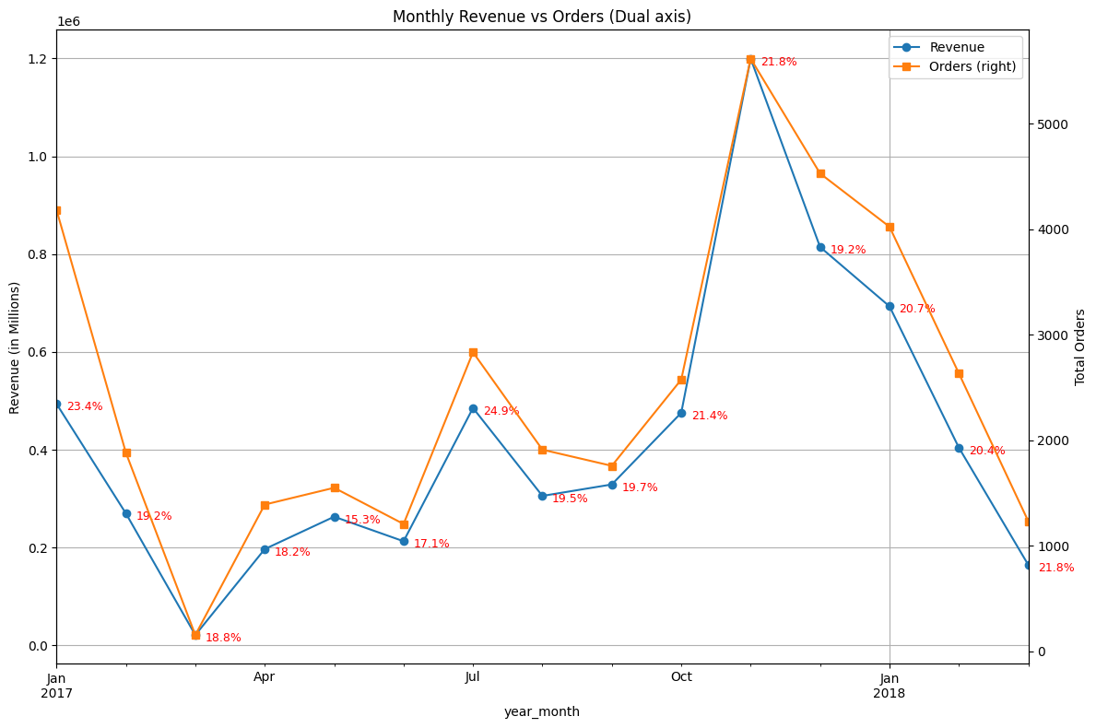
Monthly Revenue & Orders Trend
%
Revenue & Orders move proportionally
( more Orders, more Revenue)
Seasonal Peaks
(Oct - Jan, July)
Steady Discounts at ~18-22%
(despite seasonal fluctuations)
“Sales Volume is seasonal, but discounts remain constant”
%

Slide 8
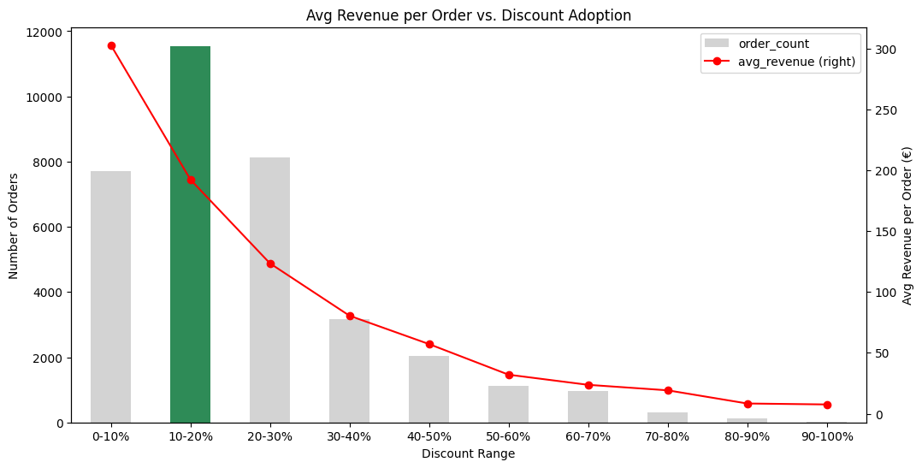
How Discounts impact Revenue
%
10-20% discounts give most Orders & Revenue doesn’t fall too sharply
Higher Discounts = Lower Revenue
“More discount doesn’t mean more revenue.”
%

Slide 9
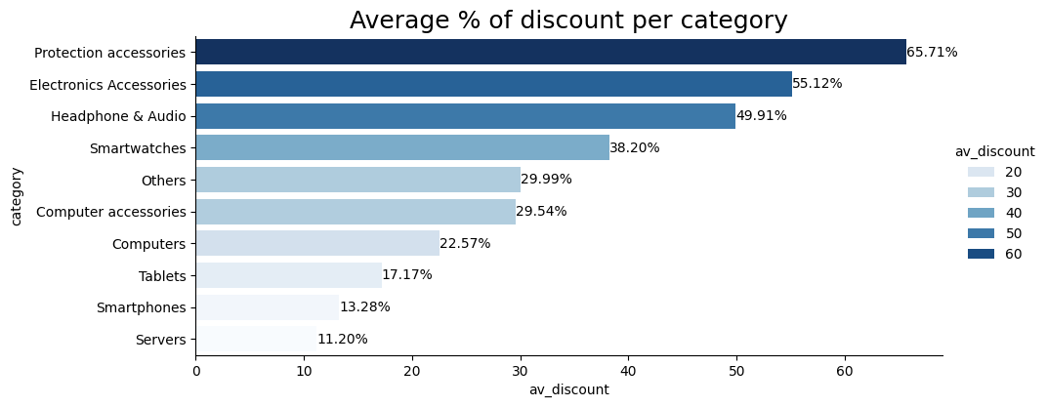
Product Categories
%
“Accessories categories are most discounted”
%

Slide 10
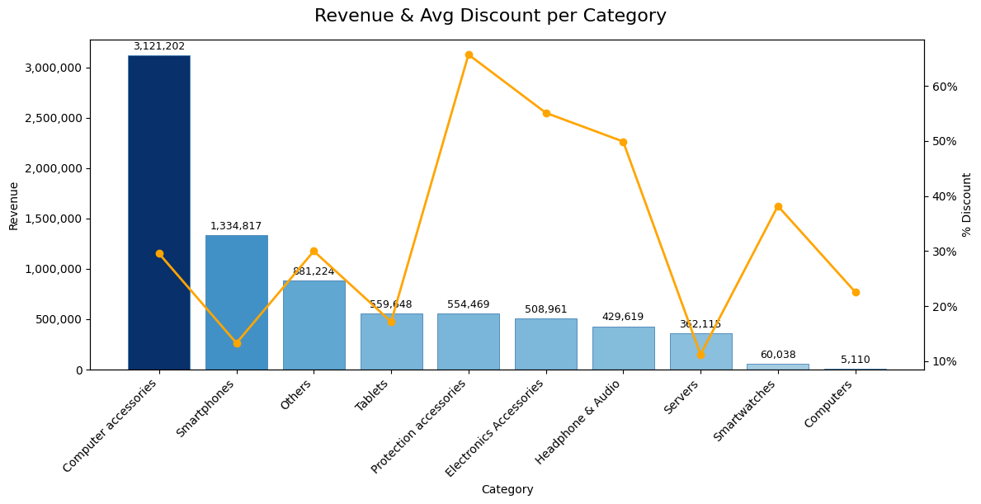
Product Categories
%
“Current discount separation is not proportional”
%

Slide 11
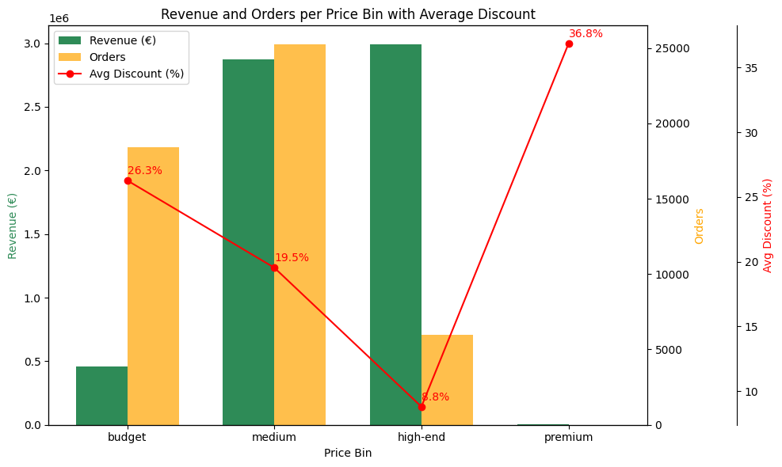
Revenue & Discounts by Price Segment
%
Budget
(<50€)
Medium
(50-300€)
High-end
(300-1200€)
Premium
(>1200€)
Only 7 orders in 15 months
“Budget and Medium drive orders, High-End drives revenue, Premium holds untapped potential.”
%

Slide 12
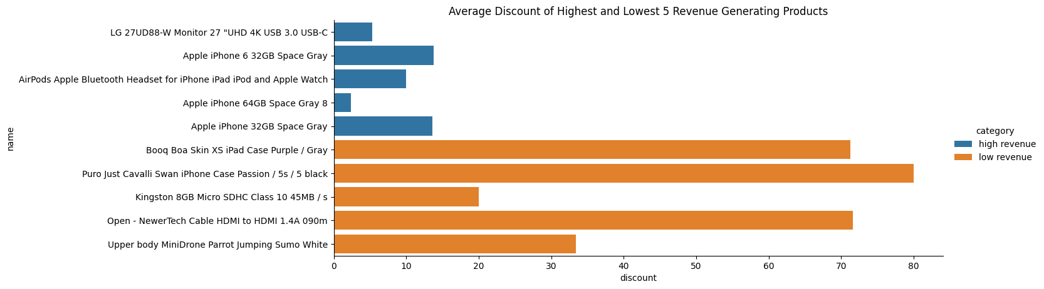
Products: Highest and Lowest Revenue
%
Highest
Lowest
Average discount for the 5 highest revenue generating items: 9.01%
Average discount for the 5 lowest revenue generating items: 55.30%
Very Low Revenue
“Higher Discount does not Guarantee High Revenue”
%

Slide 13
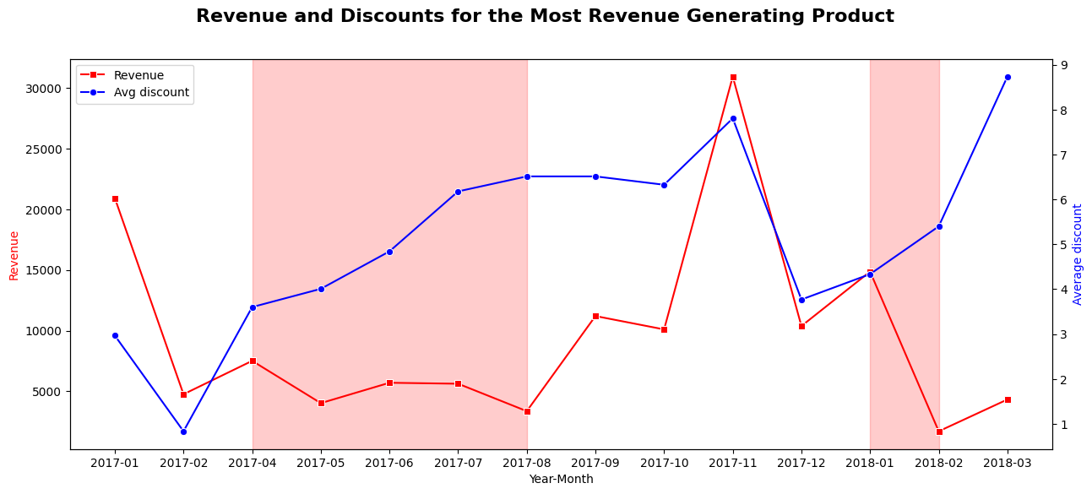
Product Generating Highest Revenue
%
“Discounts Do Not Always Lead to Higher Revenue”
%

Slide 14
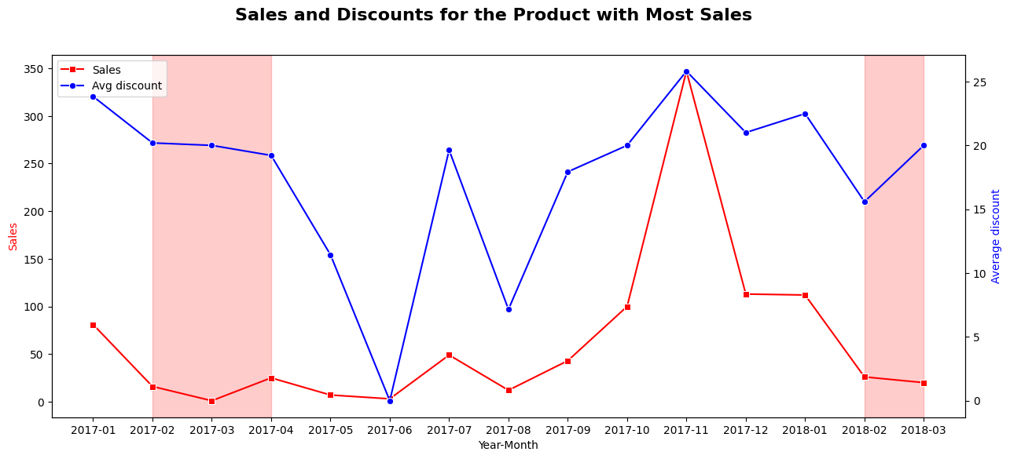
Product with Highest Sales
%
“Discounts Do Not Always Lead to Higher Sales”
%

Slide 15
Conclusion
%
Discounts support sales and order growth, but overly aggressive discounting reduces revenue impact.
The 10–20% discount range delivers the healthiest balance — deeper discounts do not translate into higher sales.
Seasonality
Apply moderate discounts in low seasons to stimulate demand.
In high seasons (e.g., Black Friday, July), reduce discount depth — sales occur naturally without heavy promotions.
Category Strategy
Top 3 revenue-driving categories: keep discount levels stable — they perform well with fewer discounts.
Other categories with heavy discounting: lower discount rates to ~20% — flat sales with lower revenue show limited effectiveness.
Overall Recommendation Adopt a targeted, moderate, and seasonal discounting approach, while strengthening premium product positioning to maximize sustainable profitability.
%

Slide 16
Thank you !
The team is happy to address any questions you may have.

Slide 17
Thank you!
Haripriya, Lana, Raju

Slide 18
%
Appendix
%

Slide 19
Appendix
%
Smartphones: iphone, smartphone, apple iphone
Tablets: ipad, apple ipad, tablet (excludes: airpods)
Computers: mcbook, macbook, imac, mac mini, mac pro, desktop, laptop
Servers: server, nas, raid, synology
Computer accessories: keyboard, mouse, trackpad, hard drive, flash drive, pendrive, hard disk, memory, storage, ssd, modules, ssd expansion, monitor, pointer, stand, support, ram
Smartwatches: apple watch, smartwatch, smart watch, watch, strap, armband, belt, bracelet
Headphone & Audio: ipod, headset, headphones, headphone, speaker, music system
Electronics Accessories: charger, cable, connector, lightning to usb, wall socket, power strip, adapter, dock, hub, connection, expansion box, battery
Protection accessories: case, funda, housing, casing, folder, protect, cover, sleeve, screensaver, shell, screen protector
Others: everything not categorized above
%

