Slide 1
What’s
FOSS
and
Why should it matter
to Students ?

Slide 2
Who am I?
VINESH IYAPPAN (theHari08)
Self-taught Android Rom and Kernel Developer
Content Writer at LinuxandUbuntu.com
Senior Member at XDA Developers, world’s biggest android
community.
a dumb programmer who sits before Laptop nearly
15 hours a day.
FOSS lover, especially Linux and Android.
And the worst part is
am still a STUDENT.

Slide 3
What are your Fundamental Rights ?

Slide 4
Right against Discrimination
Right to Equality
Right against Exploitation
Right to Freedom of Religion
Right to Constitutional Remedies
Right to Liberty
Right to Politics
Right to Welfare
Right to Security
Right to Due Process
Right to Group & Ethnicity

Slide 5
But
we are talking about
FREEDOM of
Software and Services

Slide 6
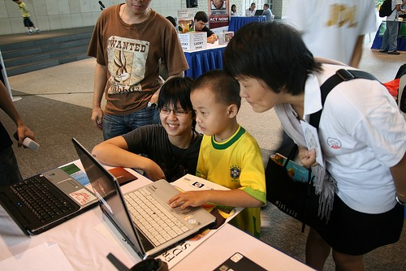
Freedom
to run the program for any purpose.
to study how the program works, and change it
to make it do what you wish.
to redistribute copies so you can help your neighbour.
to improve the program,
and release your improvements to the public,
so that the whole community benefits.
ruiwen/Software Freedom Day, Singapore

Slide 7
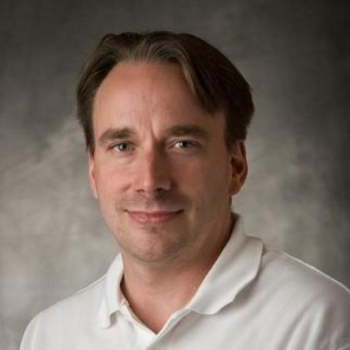
A 19 year old Finnish college student started
one of the most important open source projects.

Slide 8
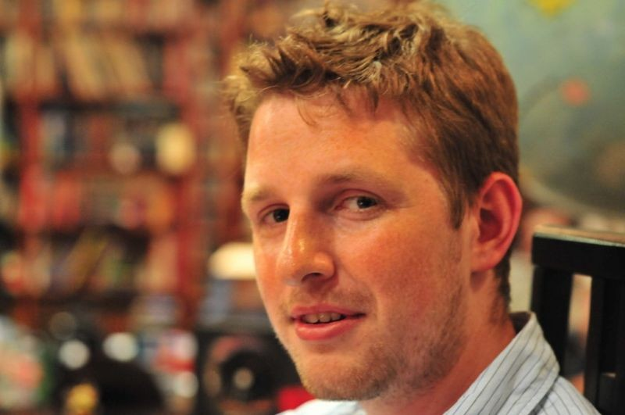
A 19 year old American student created
one of the most popular Blogging Platform

Slide 9
What was different about them and their software ?

Slide 10
What the freedoms can do for you?
You can run the program.
You get access to source code.
You can explore the program and
find out how they work in real.
You can learn the algorithms and
data structures they have used.
You can explore the system design.

Slide 11
The licenses which ensures that
Freedom are

Slide 12
GNU Public License and derivatives
Apache License
Simplified/Modified BSD License
MIT License
Many other licenses

Slide 13



Most famous FOSS softwares
VLC Media Player
Mozilla Firefox
Chromium Project

Slide 14
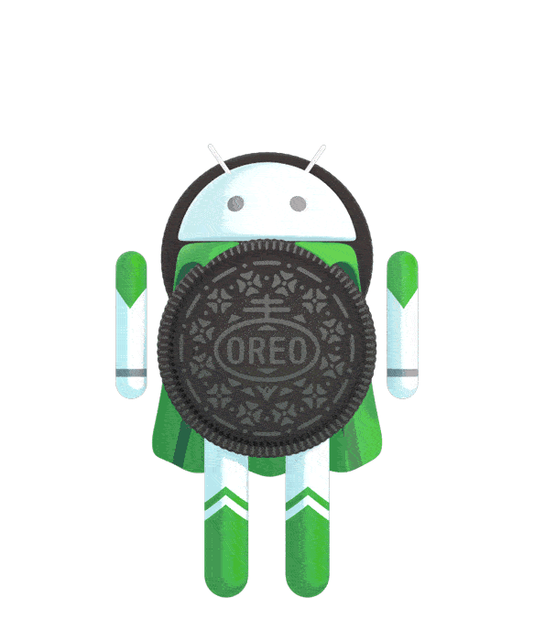


Most famous FOSS softwares
AOSP
(Android Open Source Project)
7zip Archiever
F-Droid

Slide 15
So, What can you do ?

Slide 16
Pick* up a FOSS project
* Don't reinvent the wheel

Slide 17
Contribute!
Contribute!
Contribute!

Slide 18
Why Contribute ?
To
Learn Programming Languages
Learn Software Development Concept
Learn Software Architecture
Build Skillsets

Slide 19
Get a Job in Google* !

Slide 20
* There is no shortage of opportunities for
talented people in any field of endeavour
What is important is: Do you deserve it?

Slide 21
How to Contribute ?

Slide 22
Source Code
Bug Reports
Patch Reviews

Slide 23
Documentation
Localisation

Slide 24
Help & Support

Slide 25
Spread the word

Slide 26
Use the Software
Enjoy the Freedom
Respect It
Love It

Slide 27
FOSS can ensure the Freedom
But you have to do and be
Free!

Slide 28
Wake up!

Slide 29
This whole presentation is done using the FOSS software,
LIBRE OFFICE in the FOSS Operating System LINUX
and all fonts used are FOSS
All are licensed under GPL and GNU licenses.
This presentation is very minimal.
So it needs your contribution too.
This is made Open and uploaded in
https://github.com/theHari08/FOSSppt.git
Feel free to contribute further more ☺

