Slide 1
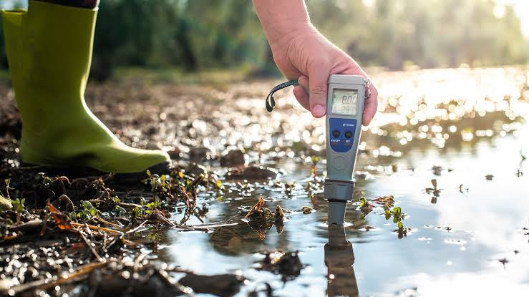
PROJECT MEMBERS:
PROJECT
Course Code/Course Name: U18ECP7701 - Project Phase I
Department of Electronics and Communication Engineering
10/4/2023
1

Slide 2
PROBLEM Definition & Objectives
PROBLEM Definition:
Designing a system that utilizes both fingerprint and face recognition for user identification and integrates IoT connectivity to remotely monitor and manage vehicle access. The challenge is to create a reliable and seamless authentication process that enhances vehicle security while providing user convenience.
Objectives:
To create a robust authentication system that combines fingerprint and face recognition, ensuring that only authorized users can start vehicles.
To integrate IoT technology to enable remote monitoring and control of vehicle access, allowing users to manage permissions and receive alerts in real-time.
To establish a multi-layered security approach that prevents unauthorized users from gaining access to vehicles, reducing the risk of theft and misuse.

Slide 3
INFERENCE FROM THE LITERATURE
Highlight the urgency to enhance vehicle security and mitigate road accidents through innovative biometric authentication.
Contribute to the overall safety of the road environment.
Integration of biometric techniques enable real-time authentication and remote monitoring, enhancing the effectiveness of vehicle security measures.
Biometric verification, coupled with other technologies like RFID and GSM modules, provides a robust solution to verify driver identity and control access.
Emphasize the importance of accurate and real-time authentication processes.

Slide 4
Review I – Outline & Comments

Slide 5
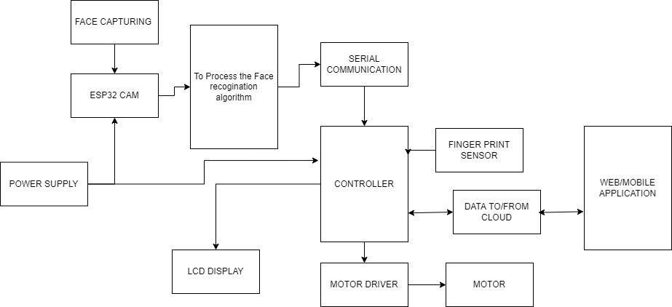
Block Diagram

Slide 6
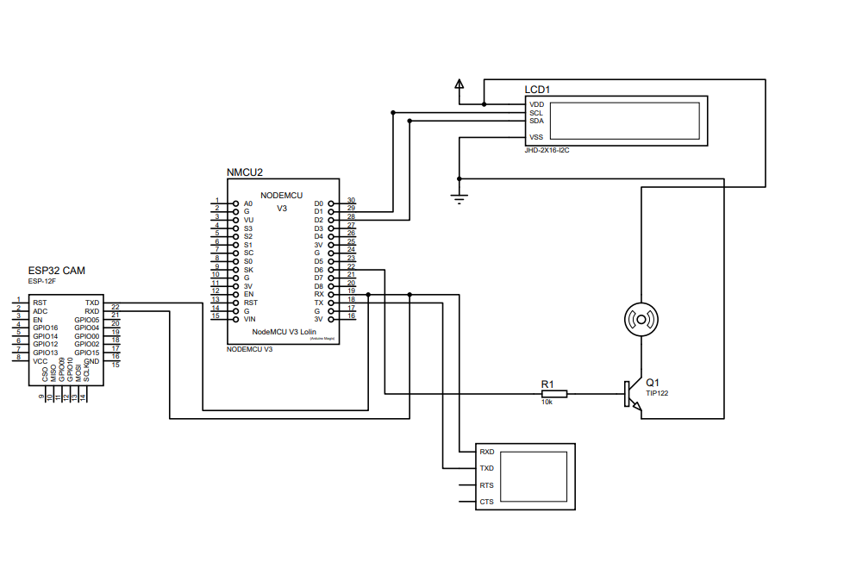
CIRCUIT DIAGRAM

Slide 7
METHODOLOGY
The process begins with designing the system architecture, which includes integrating components like ESP32-CAM for face recognition, Nodemcu with a fingerprint sensor, an IoT module, and a web application.
Data collection and preparation are essential to curate a diverse dataset for training the fingerprint and face recognition algorithms.
These algorithms are developed using suitable libraries.
Hardware integration involves configuring microcontrollers, establishing communication, and enabling IoT connection.
The system's integration ensures seamless interaction between the biometric algorithms, IoT module, and web application.
Testing and validation are carried out to ensure accuracy, robustness, and efficiency.
Security measures are implemented to safeguard data and communication channels, maintaining privacy regulations.

Slide 8
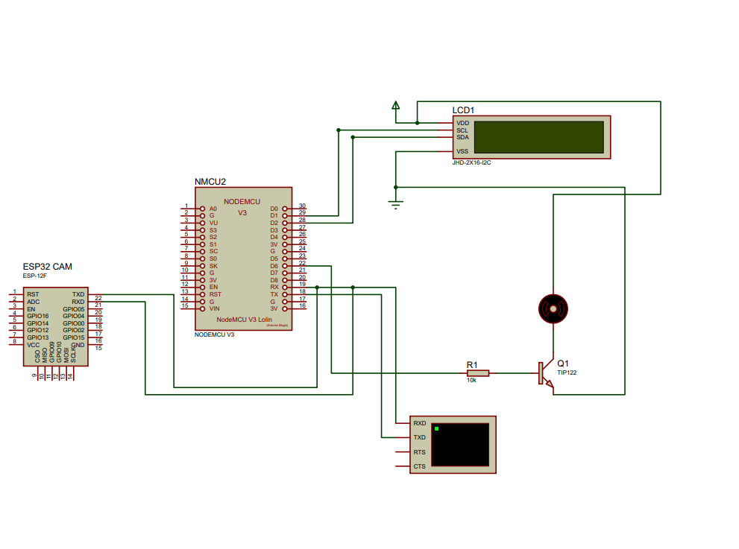
Simulation

Slide 9
GANTT CHART
TASKS​ MONTHS​ | AUGUST​ | SEPTEMBER​ | OCTOBER​ | NOVEMBER​ | DECEMBER​
PLANNING​ AND RESEARCH | X​ | ​ | ​ | ​ | ​
DESIGN AND HARDWARE INTEGRATION | X​ | X​ | ​ | ​ | ​
SOFTWARE IMPLEMENTATION | ​ | X​ | X​ | ​ | ​
PROTOTYPE TESTING | ​ | ​ | X​ | X​ | ​
FINAL REPORT SUBMISSION | ​ |  | ​ | X | ​ X

Slide 10
Review Paper / Applying for Competition / Funding status

Slide 11
Plan for Review III
Hardware Interfacing and Real time implementation

Slide 12
REFERENCE(IEEE FORMAT)
[1]S. Prema, Mohamed Riyas V. S. Deen, Murali V. P. Krishna, S. Praveen, "Vehicle And License Authentication Using FingerPrint",2019 5th International Conference on Advanced Computing & Communication Systems (ICACCS)
[2]Prajeesha,Rakshith B S, Nidhi Nagabhushan, Tangirala Madhavi, "Fingerprint-based Licensing for Driving",2021 6th International Conference for Convergence in Technology (I2CT)
[3]Ahmed Sherif, Mohamed Elsersy, Mahmoud Nabil, Mohamed Mahmoud, Khaled H. Almotairi, "Privacy-Preserving Biometric-based Authentication Scheme for Electric Vehicles Charging System",2021 3rd IEEE Middle East and North Africa COMMUNICATIONS Conference (MENACOMM)
[4]Kirtika A P S Parameswaran, Mazlina Abdul Majid, Md. Shohidul Islam, "Fingerprint Authentication-based Traffic Offence Control and Enforcement System on Smart Mobile Devices for Smart City",2022 International Conference on Intelligent Technology System and Service for Internet of Everything (ITSS-IoE)
[5]Nayana Hegde, Rani S Rashmi, Abdul Azeez, Jebran P Mohamed, J. Surendiran, "IoT Based Biometric Supported Vehicle User Identification System",2022 IEEE International Conference on Data Science and Information System (ICDSIS)
[6]C. Thirumarai Selvi, A Amruthamathi, P.S Surabhi, N.M Motheswar, D Pavithra, "Smart Authentication of Documents Using RFID and Fingerprint Modules",2021 7th International Conference on Advanced Computing and Communication Systems (ICACCS)
7.N.N. Nagamma, M.V. Lakshmaiah, T. Narmada, "Raspberry Pi based biometric authentication vehicle door locking system",2017 IEEE International Conference on Power Control Signals and Instrumentation Engineering (ICPCSI)

Slide 13
a
[8]Mrinmoy Dey, Md. Akteruzzaman Arif, Md. Asif Mahmud, "Anti-theft protection of vehicle by GSM & GPS with fingerprint verification", 2017 International Conference on Electrical Computer and Communication Engineering (ECCE)
[9] A. Singh, C. Vashist, P. Gaurav and A. Nigam, “A generic framework for deep incremental cancelable template generation,” Neurocomputing, vol. 4, no. 6, pp. 83–98, 2022.
[10] Chaudhary, U., Patel, A., Patel, A., & Soni, M. Survey paper on Automatic Vehicle Accident Detection and Rescue System. SpringerLink. Retrieved January 13, 2023
[11]Ali, A. M., Awad, H. M., & Abdalgader, I. K. (2020). Authenticated access control for vehicle ignition system by drivers license and fingerprint technology. In 2020 International Conference on Computer, Control, Electrical, and Electronics Engineering.
[12]Khalimov, R., Rahimbayeva, Z., Shokayev, A., Kamalov, B., & Ali, M. H. (2020). Development of intelligent door locking system based on face recognition technology. In 2020 11th International Conference on Mechanical and Aerospace Engineering (ICMAE)
[13]Sawant, N., Sutar, S., & Ghumare, G. (2021). FINGERPRINT BASED CAR IGNITION SYSTEM USING ARDUINO AND RFID
[14]Huang, Y.; Fu, B.; Peng, N.; Ba, Y.; Liu, X.; Zhang, S. RFID Authentication System Based on User Biometric Information. Appl. Sci. 2022
[15] Khalid, U., Asim, M., Baker, T., Hung, P. C. K., Tariq, M. A., & Rafferty, L. (2020). A decentralized lightweight blockchain-based authentication mechanism for IoT systems. Cluster Computing,

Slide 14
Thank you

