Slide 1
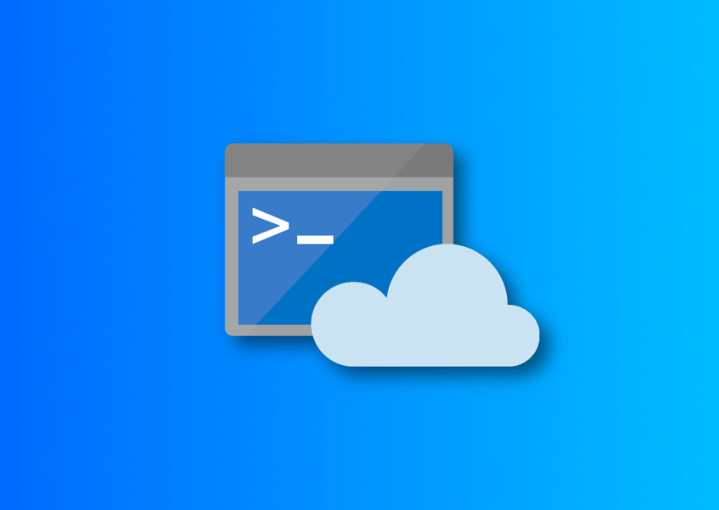
Azure Cloud Shell

Slide 2
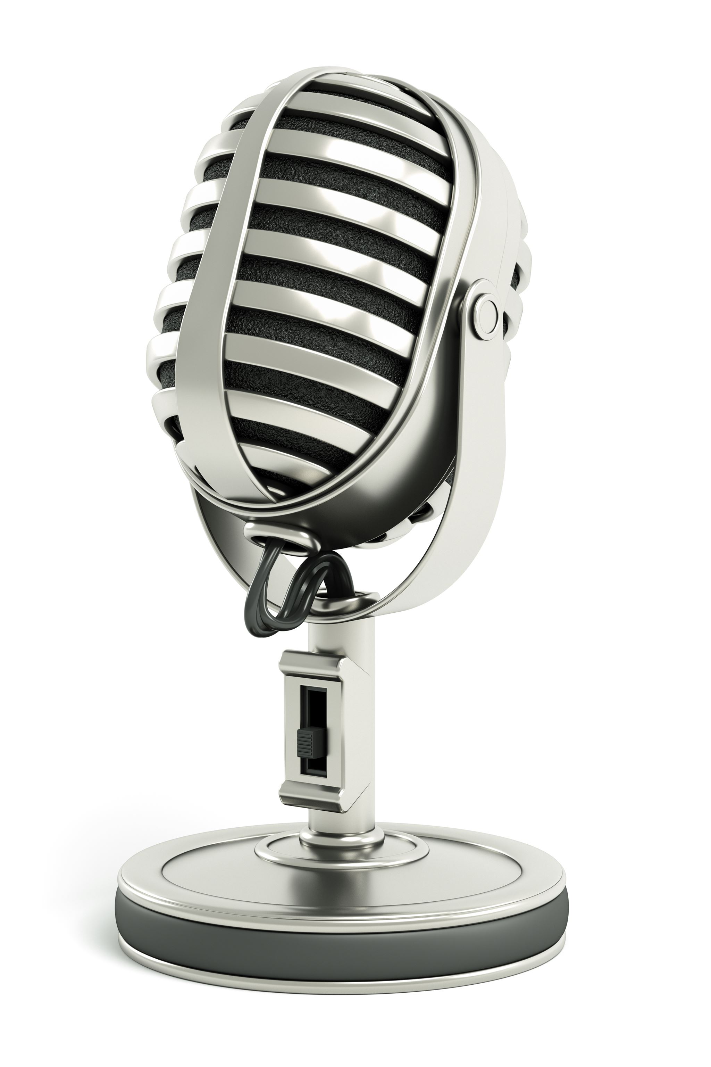
Welcome!
Steven Judd
Jason Helmick
Sr. Product Manager | PowerShell
Microsoft | Cloud + AI
@theJasonHelmick
Notes:
Good morning/afternoon/evening, everyone! My name is [Presenter Name] and I'm here with my colleague [Presenter Name]. We are excited to present to you today on the topic of [Presentation Topics]. Thank you for joining us!

Slide 3

Welcome to Azure Cloud Shell

Slide 4
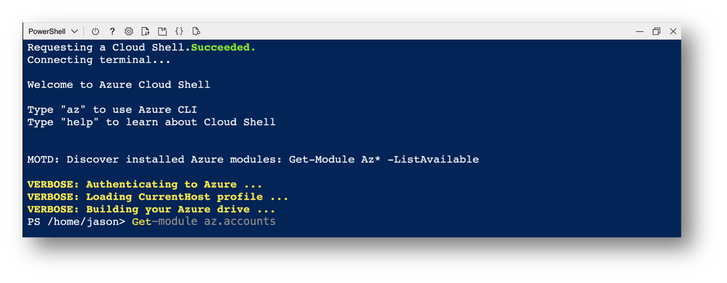
Azure Cloud Shell (aka. Cloud Shell) is an interactive, authenticated, browser-accessible shell for managing Azure resources. As a web-based environment, Cloud Shell provides immediate management access to any device with a network connection. Cloud Shell provides access to a range of tools including bash, PowerShell, Azure PowerShell and Azure CLI.
https://github.com/Azure/CloudShell/

Slide 5
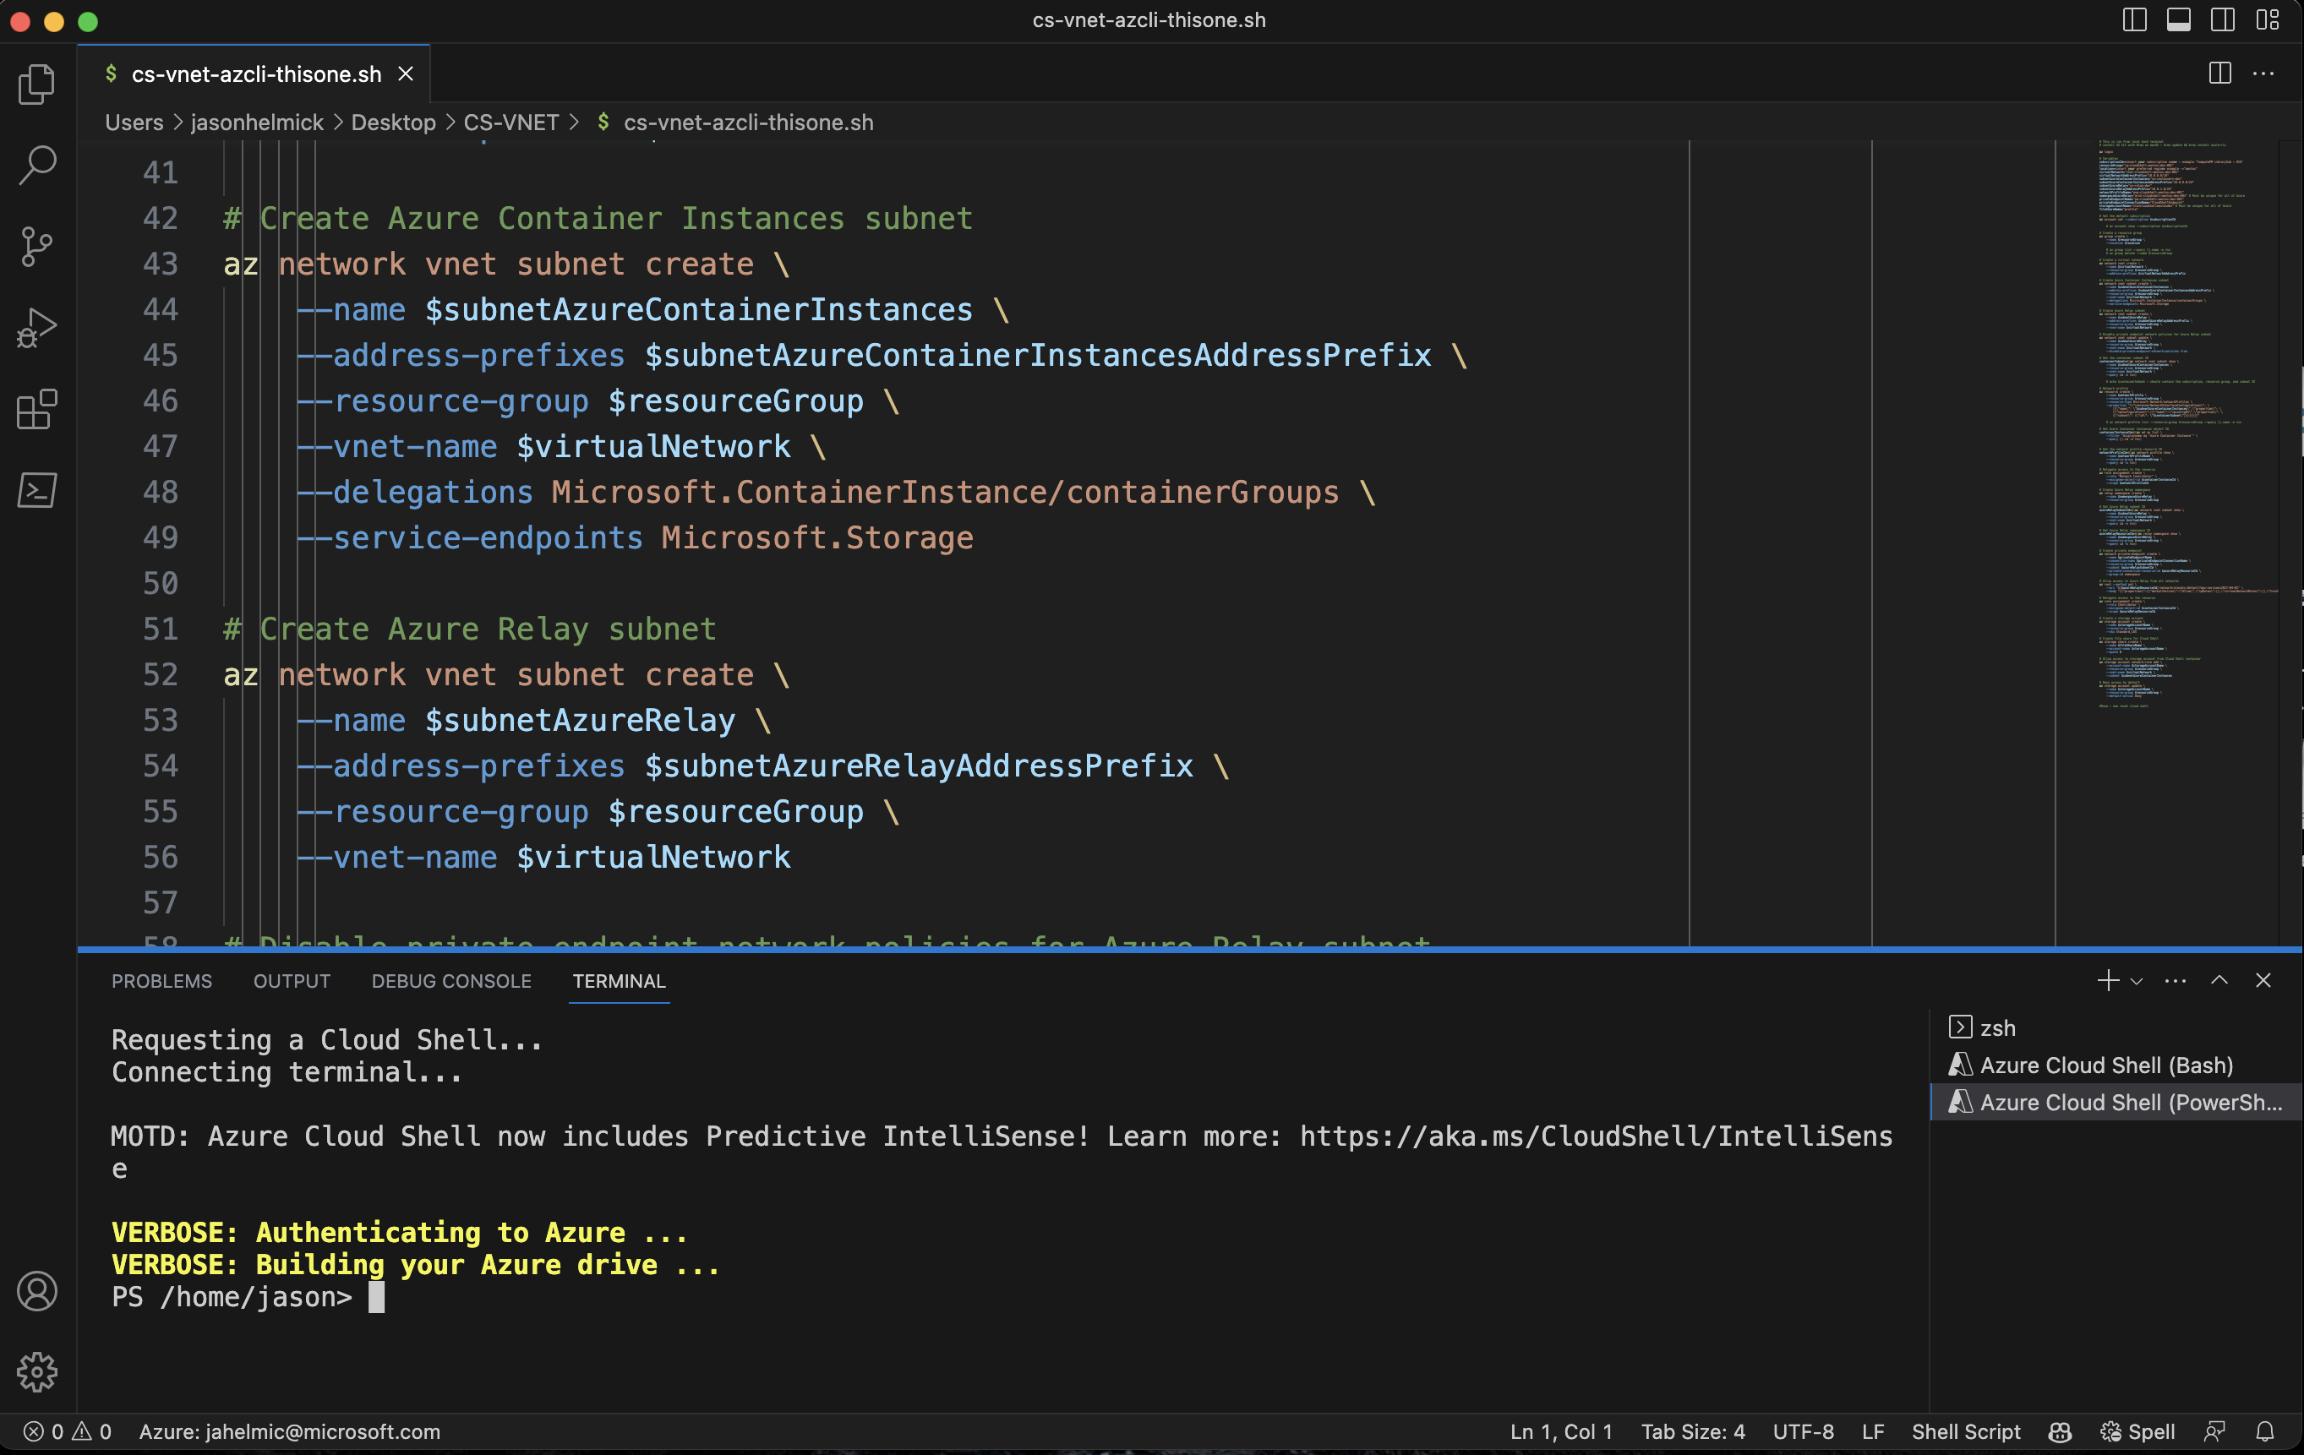
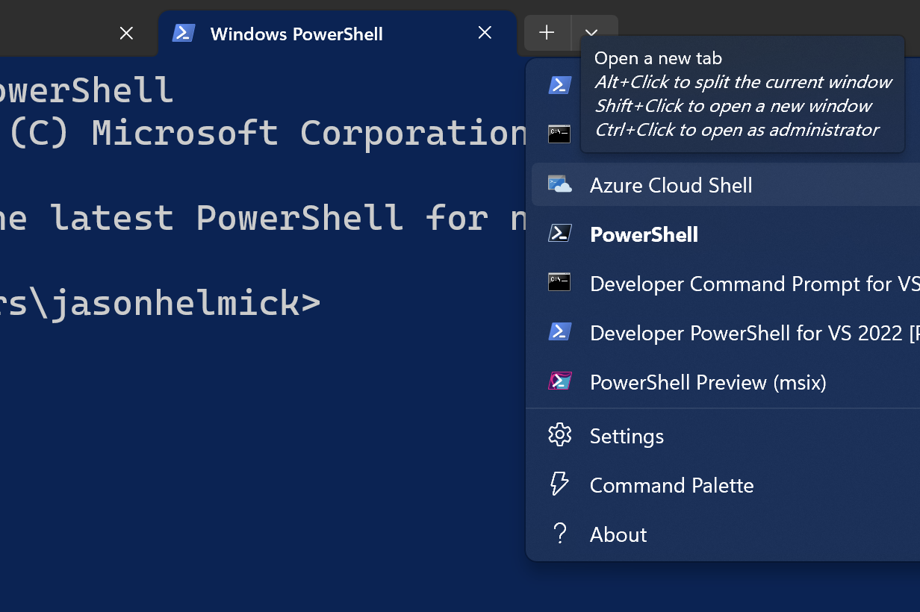
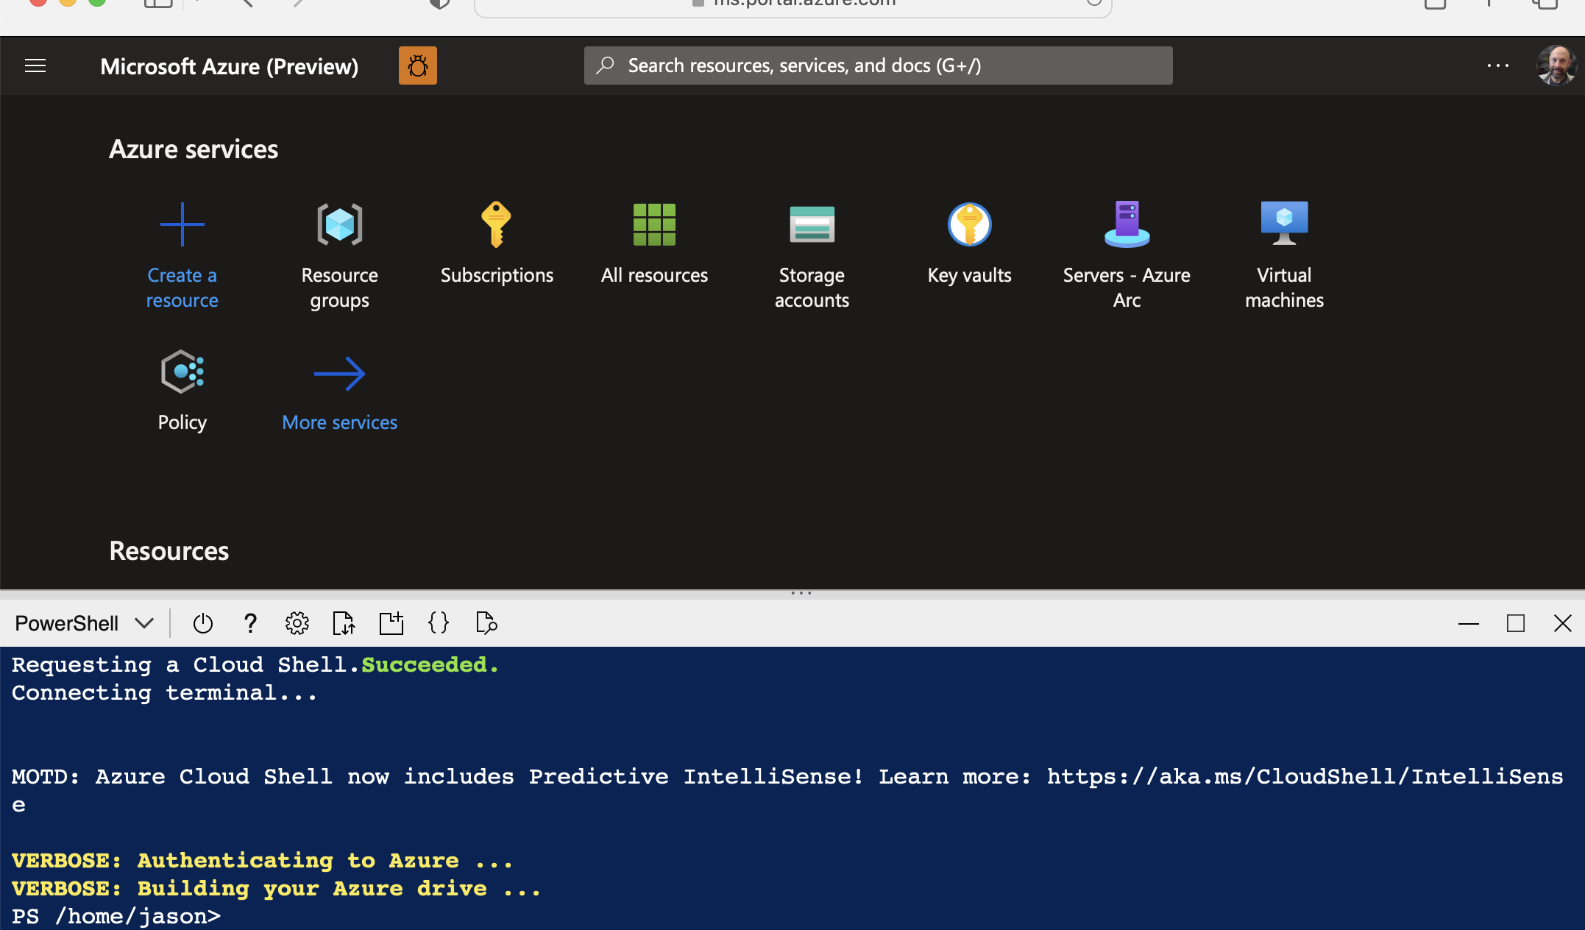
Azure cloud Shell is accessible with favorite tools:
Azure Portal
Visual Studio Code
Windows Terminal
Azure Cloud Shell

Slide 6
But wait…what is Azure Cloud Shell
The Docs: https://learn.microsoft.com/en-us/azure/cloud-shell/overview
It’s a container based on Azure Linux (previously Mariner)
Original two containers, Windows & Linux
Today, Linux container – cause PowerShell is cross platform
Pick your favorite!
Tooling updates
Azure Cloud Shell is updated on a monthly bases….
Well….they actually do tooling updates weekly ☺
Get-PackageVersion (or tdnf info)

Slide 7
Get Started with Azure Cloud Shell
Here we go!

Slide 8
Demo
Ephemeral

Slide 9
Demo
New Storage account

Slide 10
Demo
Existing Storage account

Slide 11
Using Azure Cloud Shell

Slide 12
Demo
Existing Storage account

Slide 13
Demo
Existing Storage account

Slide 14
Enterprise VNET isolation

Slide 15
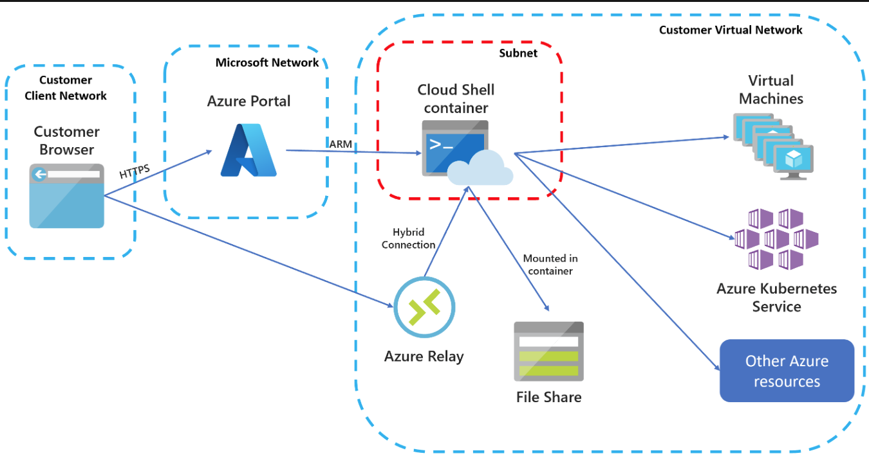
Azure Cloud Shell VNET Isolation
Docs: https://learn.microsoft.com/en-us/azure/cloud-shell/vnet/overview

Slide 16
Demo
VNET isolation

Slide 17
Additional notes
Best practices
Storage account names and location
Premium verus standard storage
Backups
Security
Logging

