Slide 1
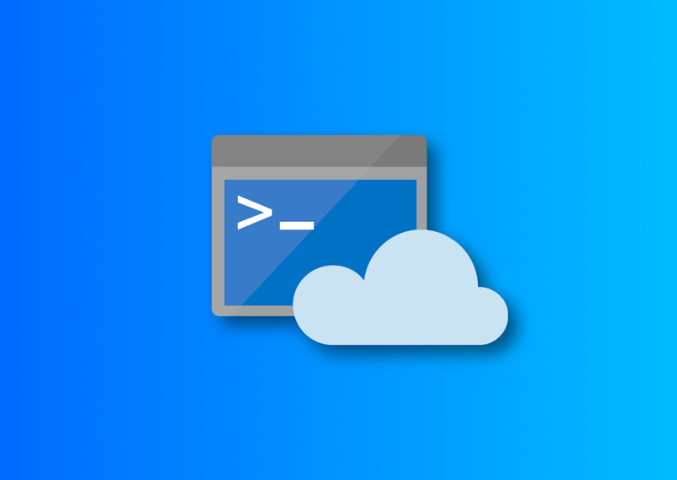
Azure Cloud Shell

Slide 2
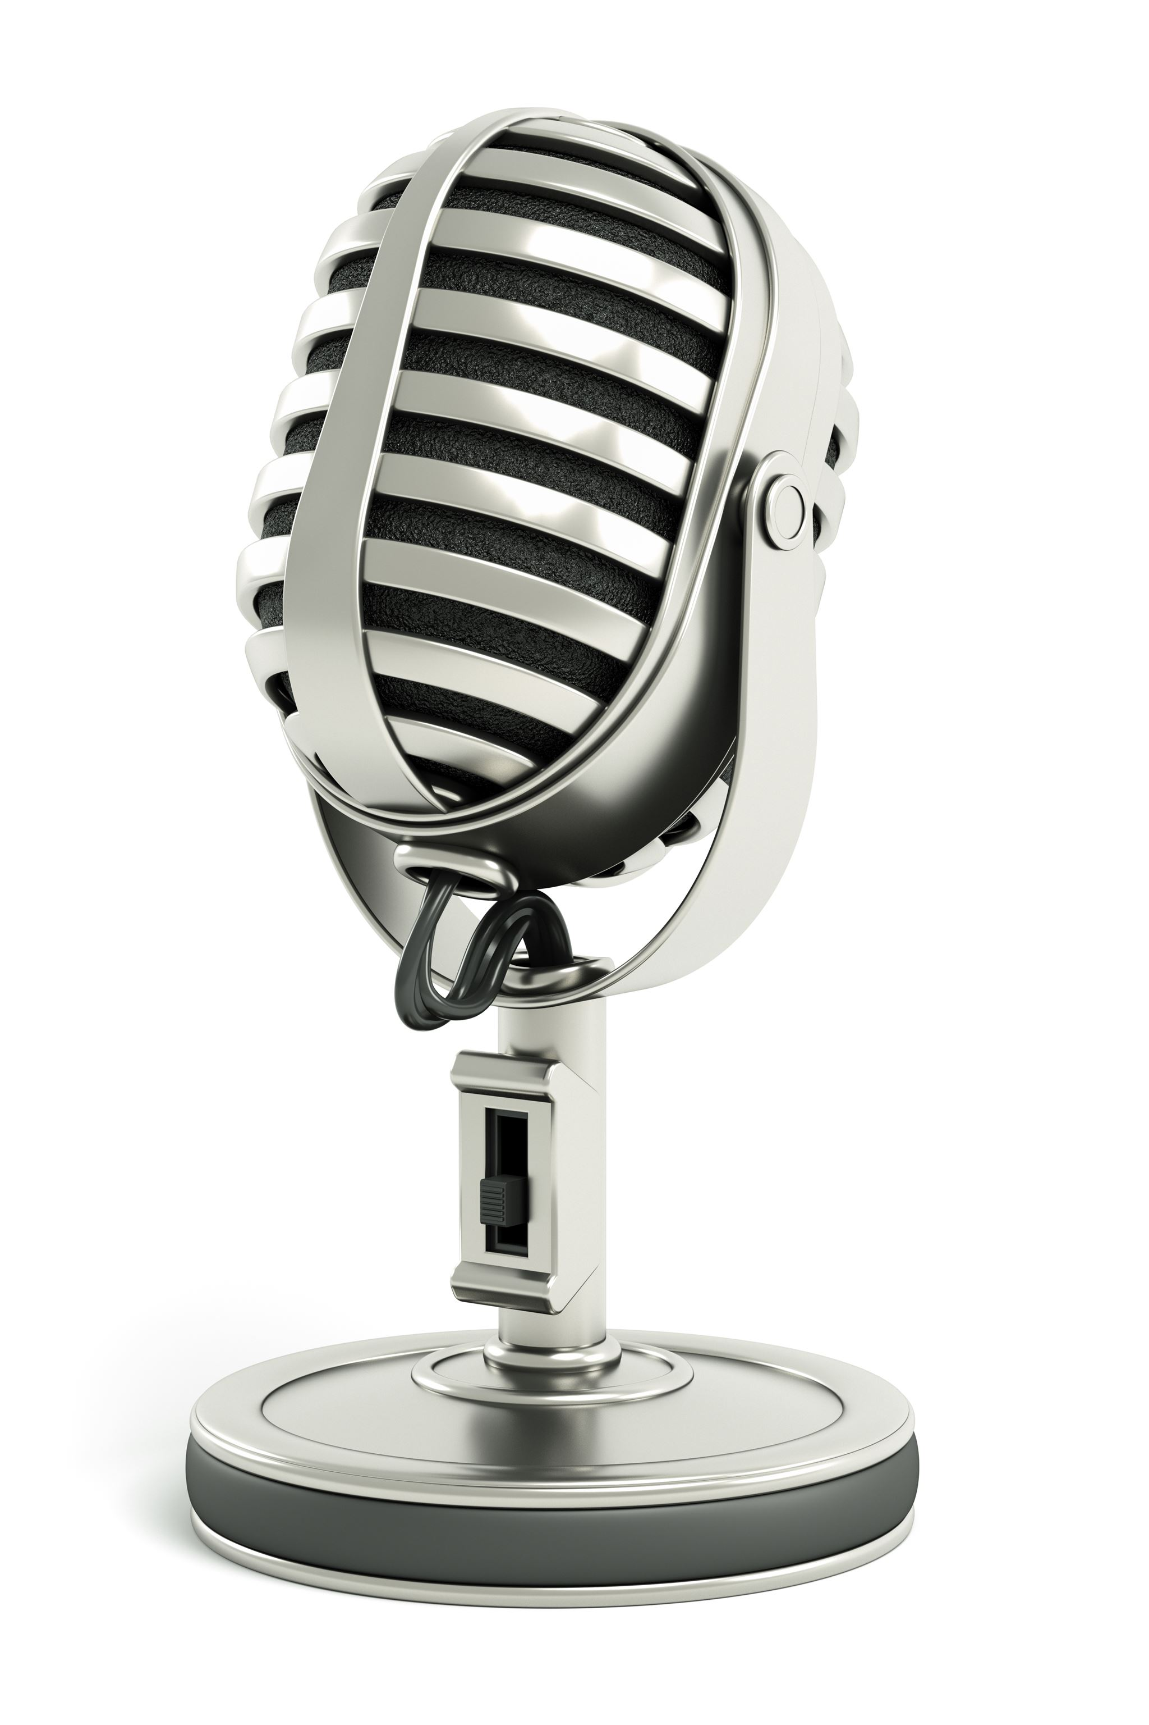
Welcome!
Steven Judd
Infrastructure Engineer
Tenstreet
@stevenjudd (no “the” req’d)
Jason Helmick
Sr. Product Manager | PowerShell
Microsoft | Cloud + AI
@theJasonHelmick
Notes:
Good morning/afternoon/evening, everyone! My name is [Presenter Name] and I'm here with my colleague [Presenter Name]. We are excited to present to you today on the topic of [Presentation Topics]. Thank you for joining us!

Slide 3

Welcome to Azure Cloud Shell

Slide 4
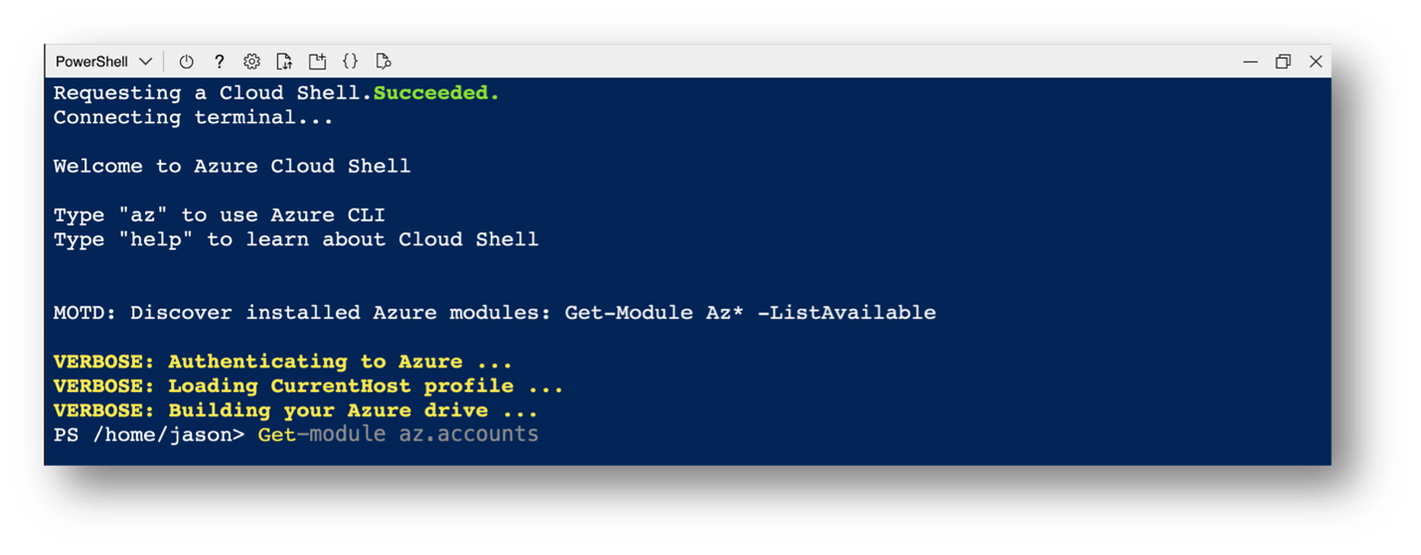
Azure Cloud Shell (aka. Cloud Shell) is an interactive, authenticated, browser-accessible shell for managing Azure resources. As a web-based environment, Cloud Shell provides immediate management access to any device with a network connection. Cloud Shell provides access to a range of tools including Bash, PowerShell, Azure PowerShell and Azure CLI.
https://github.com/Azure/CloudShell/
Notes:
Steven

Slide 5
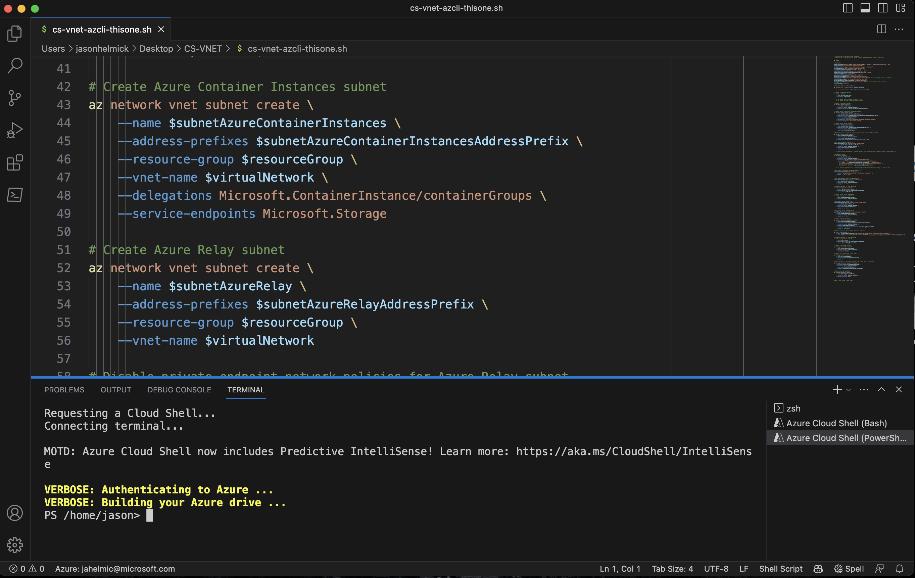
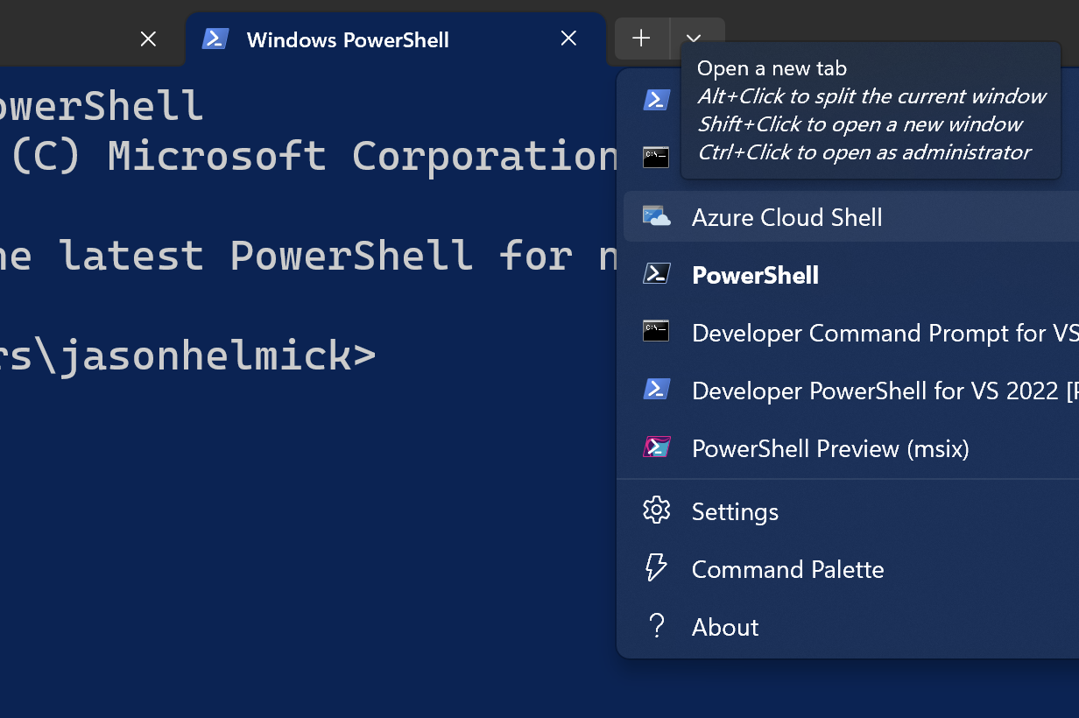
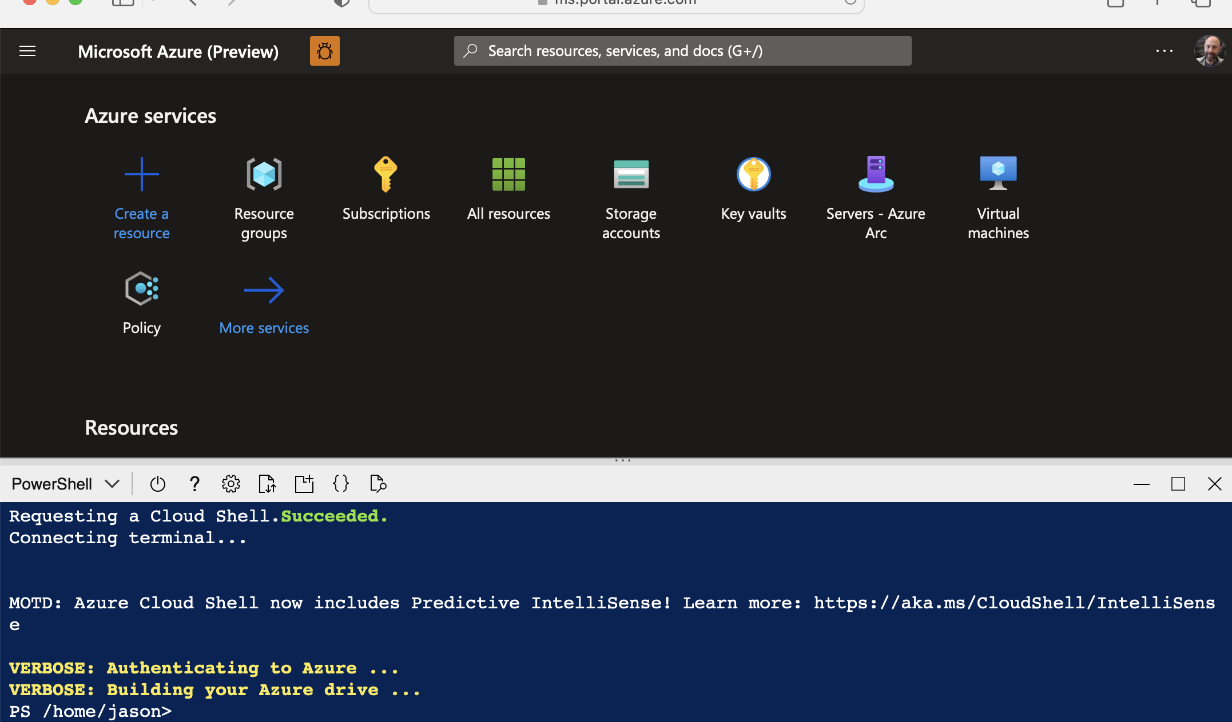
Azure Cloud Shell is accessible with your favorite tools:
Visual Studio Code
Windows Terminal
Azure Portal (https://shell.azure.com)
Azure Cloud Shell
Notes:
Jason

Slide 6
But wait…what is Azure Cloud Shell?
It’s a container based on Azure Linux (previously Mariner)
Originally two containers: Windows & Linux
Today, a Linux container – ‘cause PowerShell is cross platform
Pick your favorite!
Tooling updates
Azure Cloud Shell is updated on a monthly basis
Well…actually, tooling updates are done weekly ☺
Get-PackageVersion (or tdnf info)
The Docs: https://learn.microsoft.com/en-us/azure/cloud-shell/overview
Notes:
Steven: (two containers) You can still see an artifact of the Windows container when you start Azure Cloud Shell from the text “Requesting a terminal (this might take a while)...” The Windows container took longer to load than the Bash container, which was Linux based. Now, they take the same amount of time to load.

Slide 7
Get Started with Azure Cloud Shell
Here we go!

Slide 8
Demo
Ephemeral
Notes:
Jason

Slide 9
Demo
New Storage account
Notes:
Steven

Slide 10
Demo
Existing Storage account
Notes:
Steven

Slide 11
Using Azure Cloud Shell

Slide 12
Demo
Accessing Cloud Shell
Notes:
Jason: Browser
Jason: Windows Terminal
Steven: Tablet
Steven: Phone
Steven: how did you change PSReadLineOption PredictionViewStyle?

Slide 13
Demo
Existing Storage account

Slide 14
Enterprise VNET isolation

Slide 15
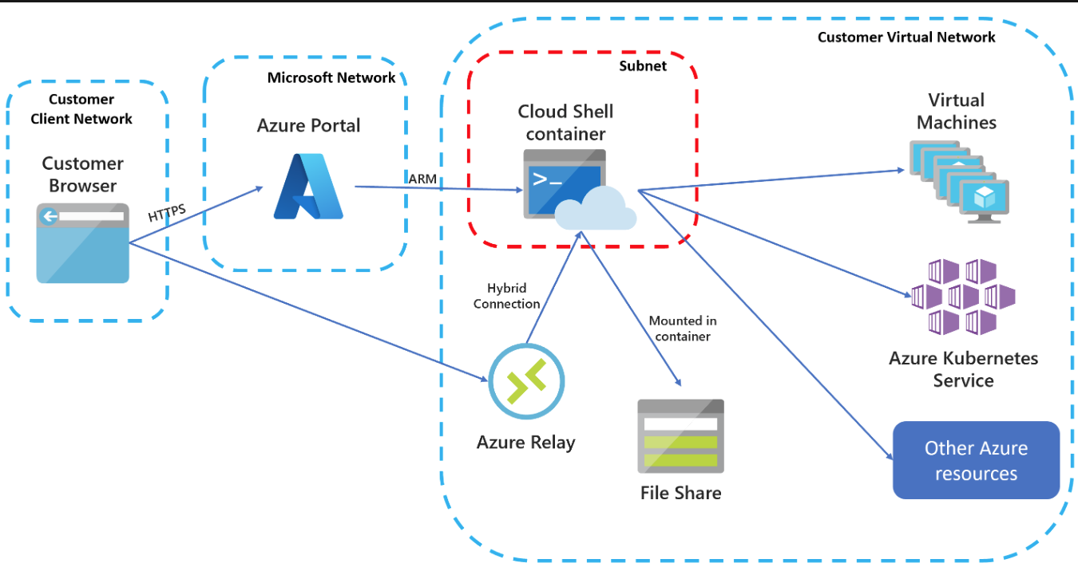
Azure Cloud Shell VNET Isolation
Docs: https://learn.microsoft.com/en-us/azure/cloud-shell/vnet/overview
Notes:
Jason

Slide 16
Demo
VNET isolation
Notes:
Jason

Slide 17
But wait…one more thing…..
Azure Cloud Shell is available as a local shell ☺
Everything you need: https://github.com/Azure/CloudShell
Neat Article: https://powershellisfun.com/2024/02/16/running-azure-cloud-shell-locally-using-docker/
Demo
Notes:
Steven: (two containers) You can still see an artifact of the Windows container when you start Azure Cloud Shell from the text “Requesting a terminal (this might take a while)...” The Windows container took longer to load than the Bash container, which was Linux based. Now, they take the same amount of time to load.

Slide 18
Thank you!!!!!
Azure Cloud Shell Docs: What is Azure Cloud Shell? | Microsoft Learn
Jason’s GitHub: https://github.com/theJasonHelmick/Summit2024
Questions!

