Slide 1
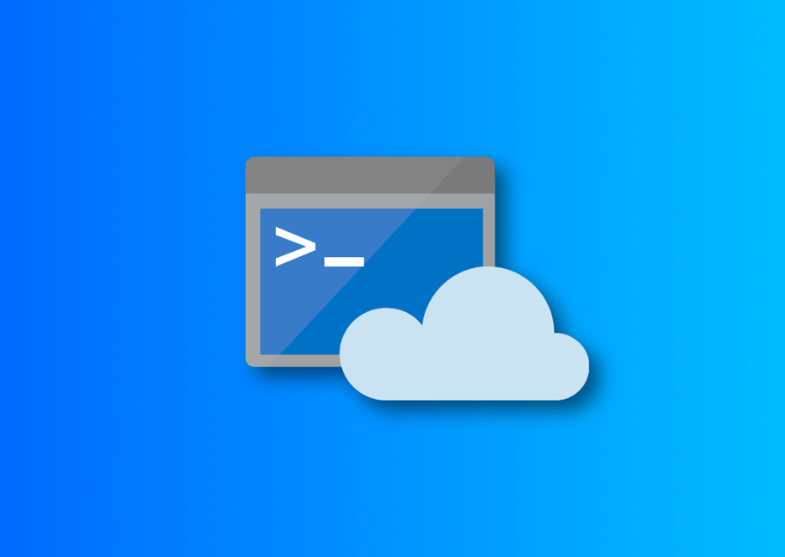
Azure Cloud Shell

Slide 2
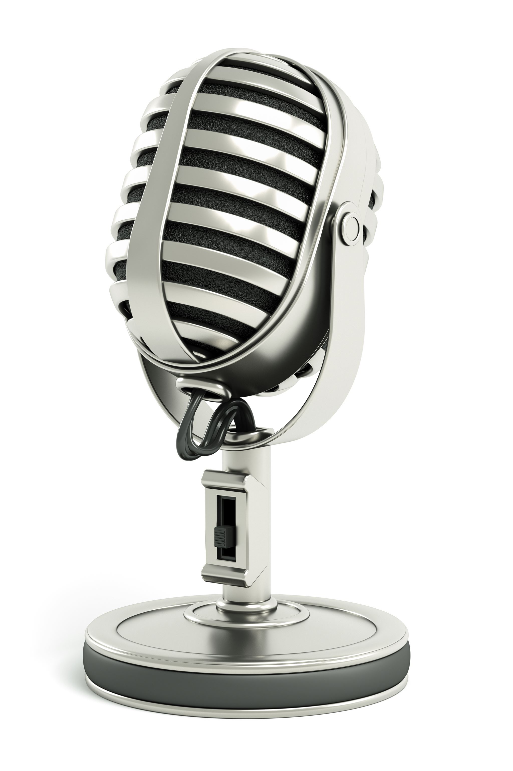
Welcome!
Steven Judd
Infrastructure Engineer
Tenstreet
@stevenjudd (no “the” req’d)
Jason Helmick
Sr. Product Manager | PowerShell
Microsoft | Cloud + AI
@theJasonHelmick
Notes:
Good morning/afternoon/evening, everyone! My name is [Presenter Name] and I'm here with my colleague [Presenter Name]. We are excited to present to you today on the topic of [Presentation Topics]. Thank you for joining us!

Slide 3

Welcome to Azure Cloud Shell

Slide 4
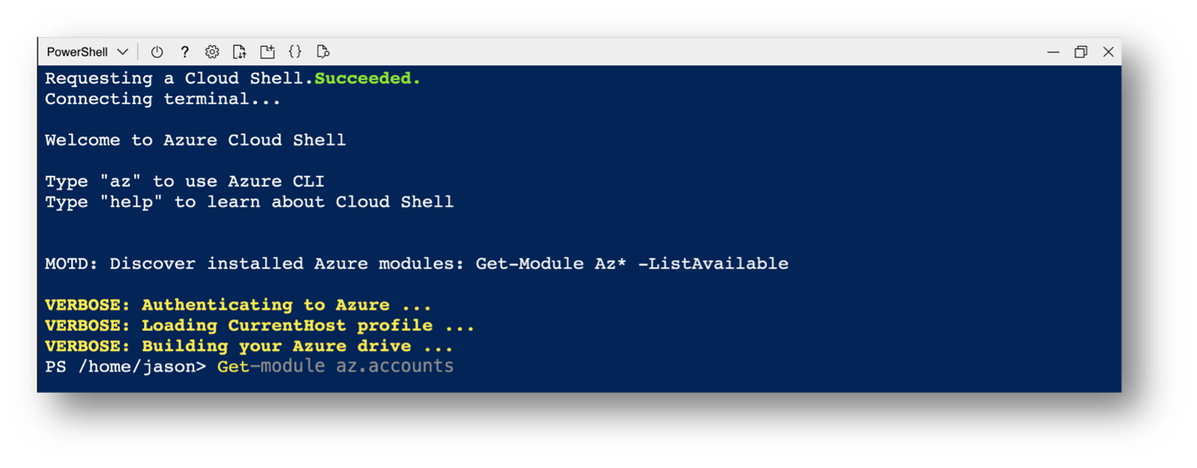
Azure Cloud Shell (aka. Cloud Shell) is an interactive, authenticated, browser-accessible shell for managing Azure resources. As a web-based environment, Cloud Shell provides immediate management access to any device with a network connection. Cloud Shell provides access to a range of tools including Bash, PowerShell, Azure PowerShell and Azure CLI.
https://github.com/Azure/CloudShell/
Notes:
Steven

Slide 5
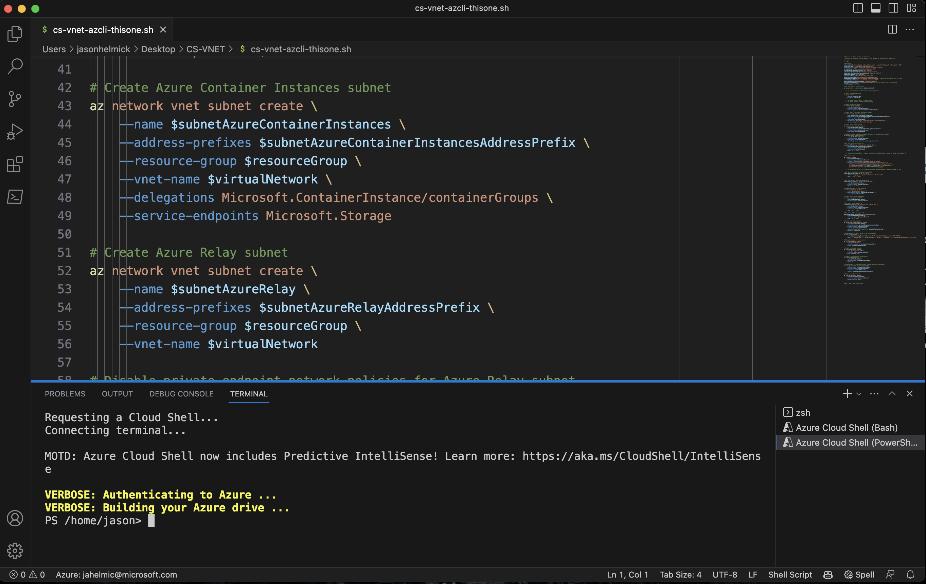
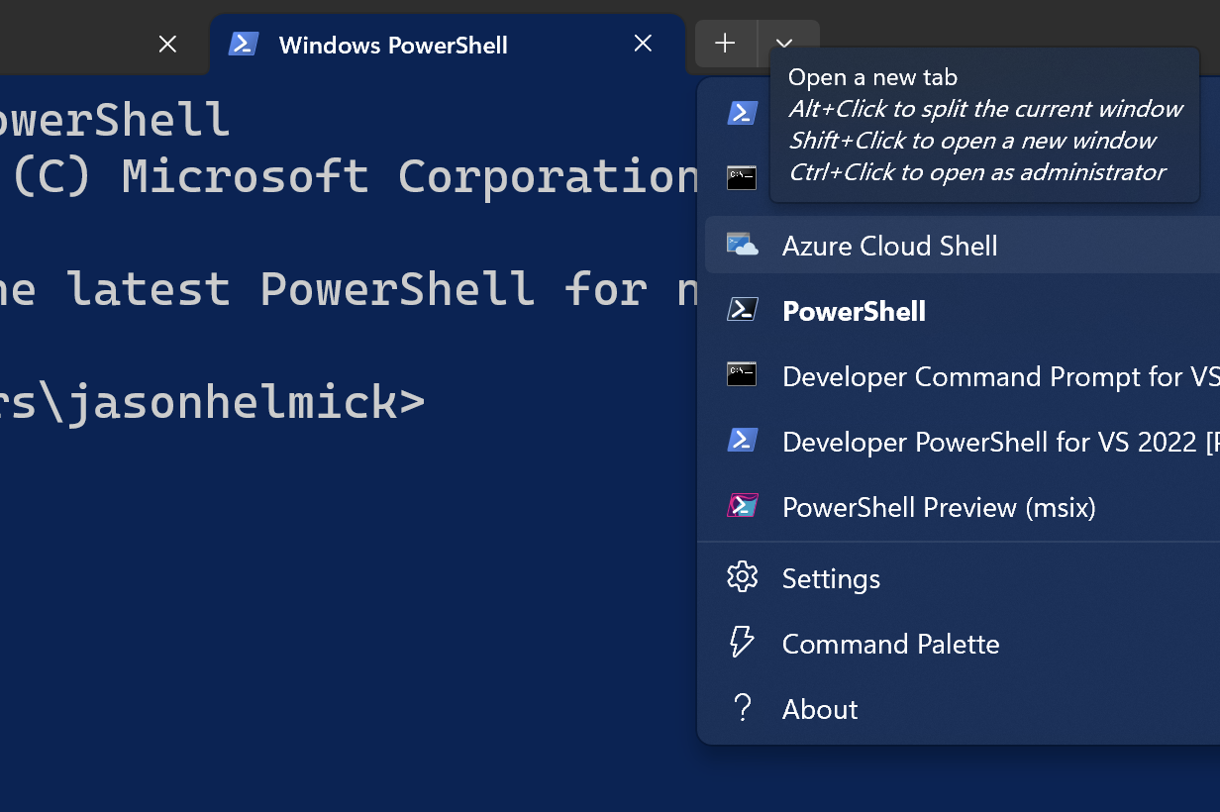
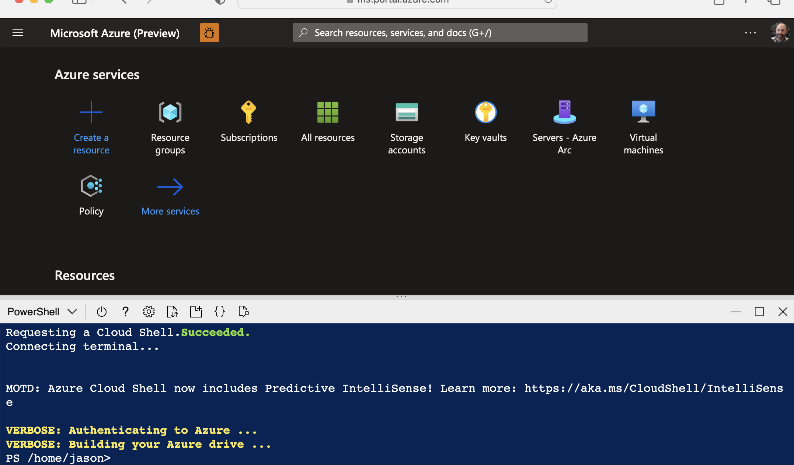
Azure Cloud Shell is accessible with your favorite tools:
Visual Studio Code
Windows Terminal
Azure Portal (https://shell.azure.com)
Azure Cloud Shell
Notes:
Jason

Slide 6
But wait…what is Azure Cloud Shell?
It’s a container based on Azure Linux (previously Mariner)
Originally two containers: Windows & Linux
Today, a Linux container – ‘cause PowerShell is cross platform
Pick your favorite!
Tooling updates
Azure Cloud Shell is updated on a monthly basis
Well…actually, tooling updates are done weekly ☺
Get-PackageVersion (or tdnf info)
The Docs: https://learn.microsoft.com/en-us/azure/cloud-shell/overview
Notes:
Steven: (two containers) You can still see an artifact of the Windows container when you start Azure Cloud Shell from the text “Requesting a terminal (this might take a while)...” The Windows container took longer to load than the Bash container, which was Linux based. Now, they take the same amount of time to load.

Slide 7
Get Started with Azure Cloud Shell
Here we go!

Slide 8
Demo
Ephemeral
Notes:
Jason

Slide 9
Demo
New Storage account
Notes:
Steven

Slide 10
Demo
Existing Storage account
Notes:
Steven

Slide 11
Using Azure Cloud Shell

Slide 12
Demo
Accessing Cloud Shell
Notes:
Jason: Browser
Jason: Windows Terminal
Steven: Tablet
Steven: Phone
Steven: how did you change PSReadLineOption PredictionViewStyle?

Slide 13
Demo
Existing Storage account

Slide 14
Enterprise VNET isolation

Slide 15
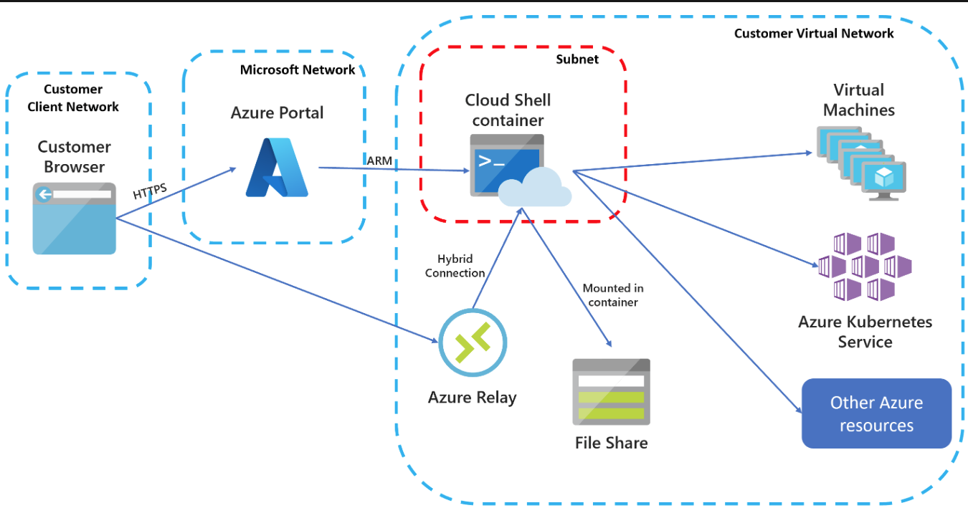
Azure Cloud Shell VNET Isolation
Docs: https://learn.microsoft.com/en-us/azure/cloud-shell/vnet/overview
Notes:
Jason

Slide 16
Demo
VNET isolation
Notes:
Jason

Slide 17
Additional notes
Best practices
Storage account names and location
Premium verus standard storage
Backups
Security
Logging

