Slide 1
CS423 Software Testing Group K1 Continuous Integration
Tô Bạch Tùng Hiệp – ID: 1451018
Lê Quang Tiến – ID: 1451058

Slide 2
Introduction
+ Tools: Travis CI, Jenkins
+ Software under test: Calculator web app

Slide 3
Continuous Integration
+ The practice of automatically building and testing code changes of each commit
+ Providing immediate feedback on the testing outcome

Slide 4
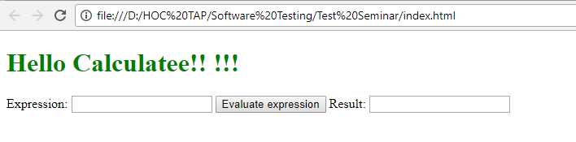
Software under test
+ Basic Calculator App

Slide 5
Travis ci
+ A hosted, distributed continuous integration service used to build and test software projects hosted at GitHub
+ Configured by adding a file named .travis.yml a format text file, to the root directory of the repository

Slide 6
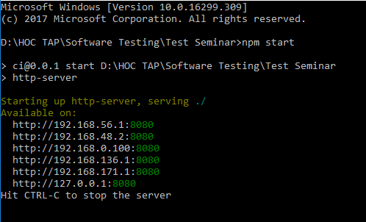
INSTALL AND RUNNING

Slide 7
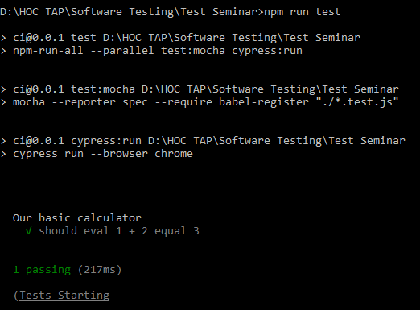
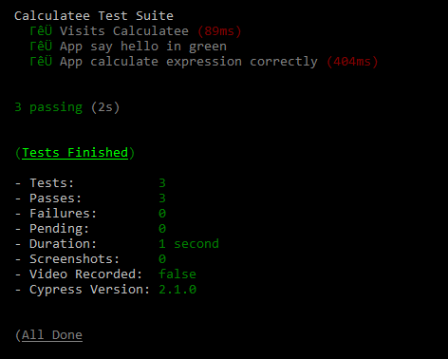
INSTALL AND RUNNING

Slide 8
Unit test
+ One unit test tests if calculator calculate 1+2 correctly (calculator.test.js)
+ Can create your own test by editing that file

Slide 9
Functional test
+ Using Cypress
+ Run 2 tests in our example
Checking if the app contains a green title saying "Hello Calculatee!! !!!".
Tests the scenario when types into the "Expression" input box "1+2+3+4", clicks the "Evaluation expression“ => correct result will appear

Slide 10
HOW TO GET STARTED
+ Sign in Travis-ci.org
+ Synchronizes your GitHub repositories and enable the repository you want to use CI
+ Add a .travis.yml file to your repository
+ Commit, Push and visit build status pages to see the result

Slide 11
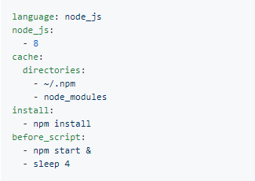
HOW TO GET STARTED
+ Example of .travis.jml file

Slide 12
JENKINS CI
+ Jenkins is a self-contained, open source automation server
+ Jenkins can be installed through native system packages, Docker, …

Slide 13
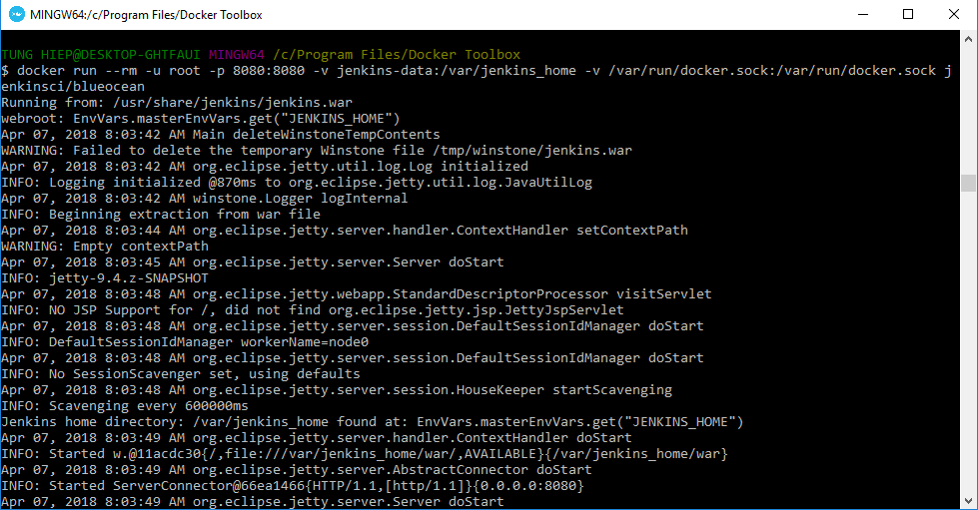
Install and running

Slide 14

Install and running
Get your ip address and open in browser

Slide 15
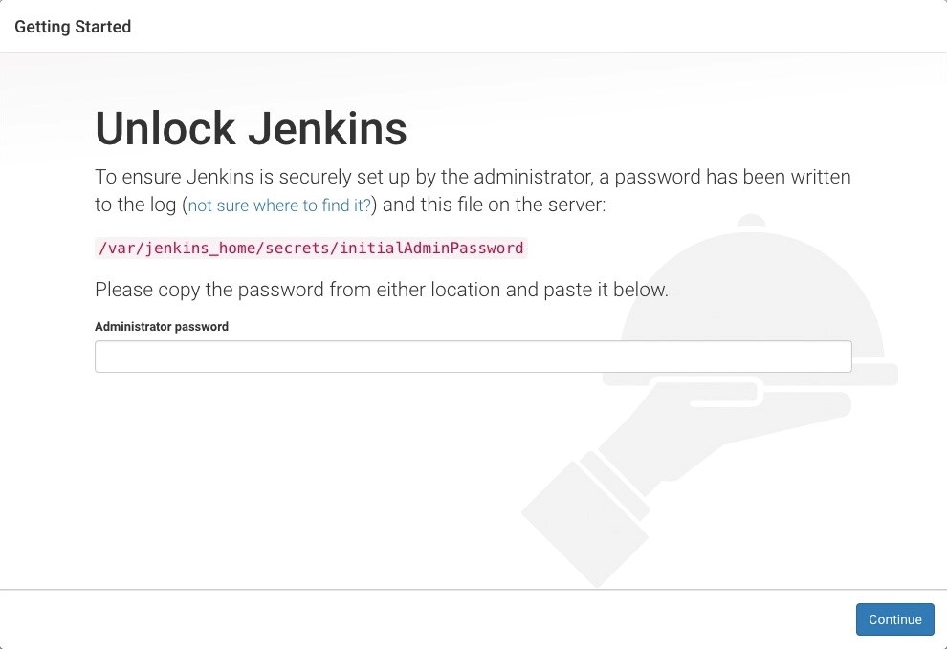
Install and running

Slide 16
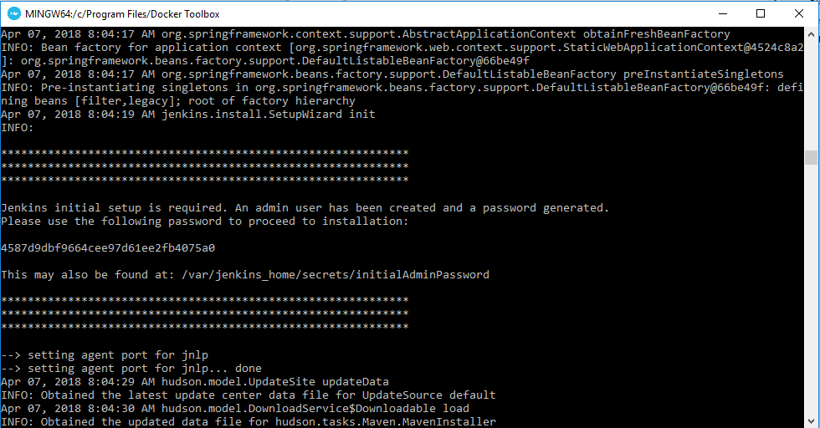
Install and running

Slide 17
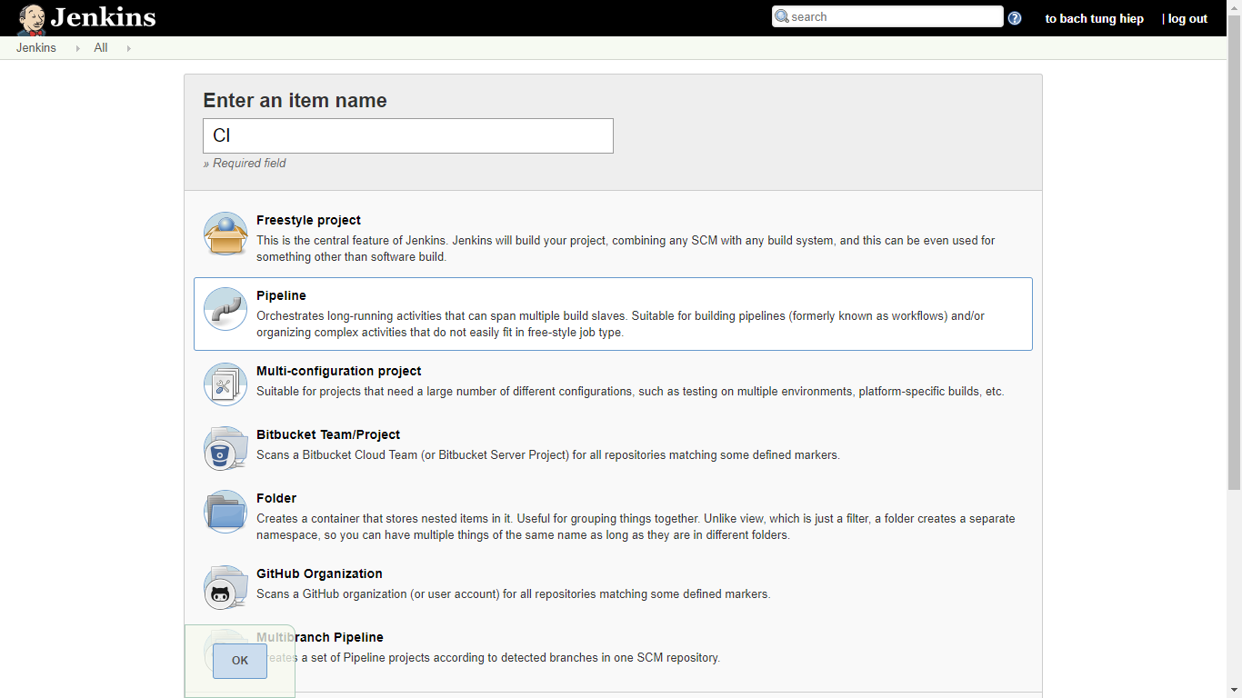
Create your first Jenkins test

Slide 18
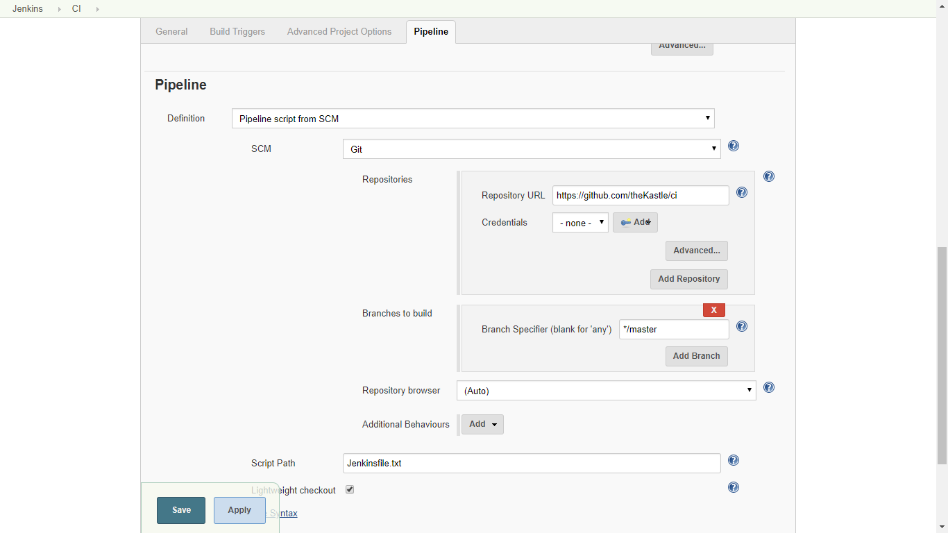
Create your first Jenkins test

Slide 19
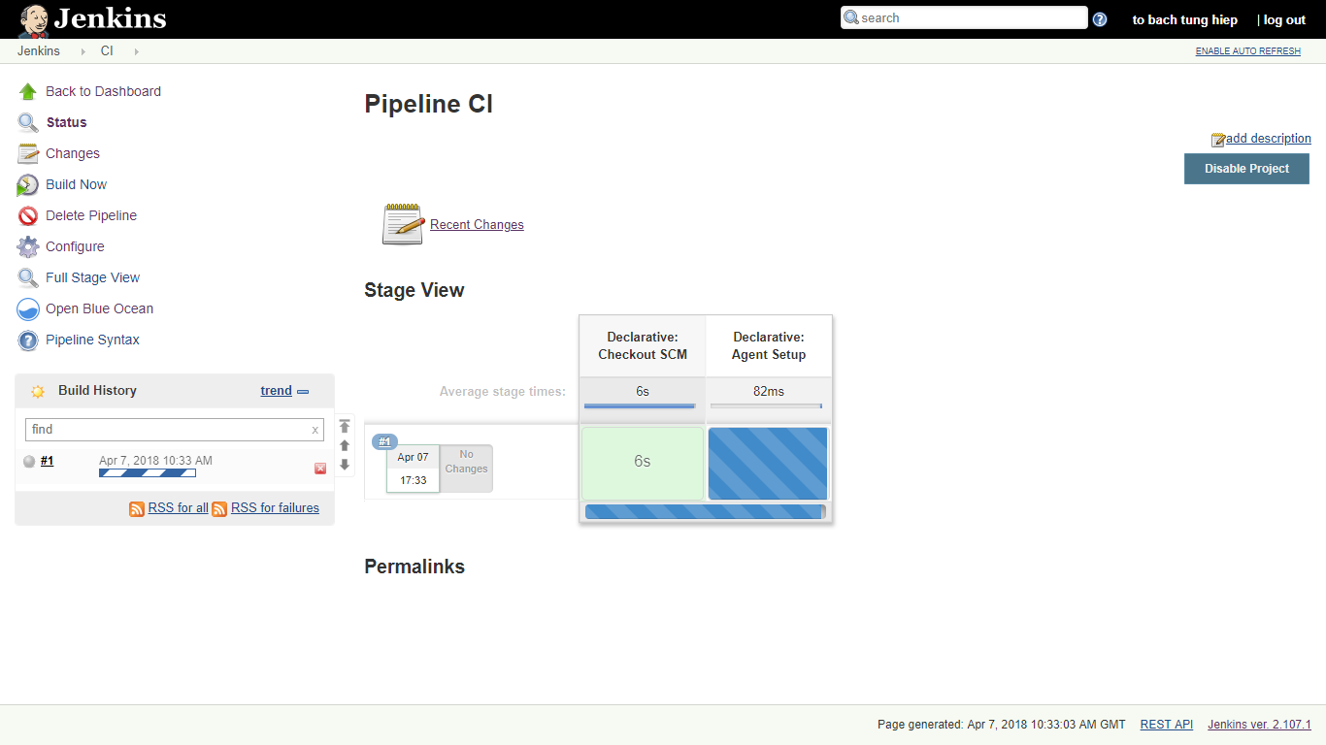
Run Jenkins test

Slide 20
Run Jenkins test

Slide 21
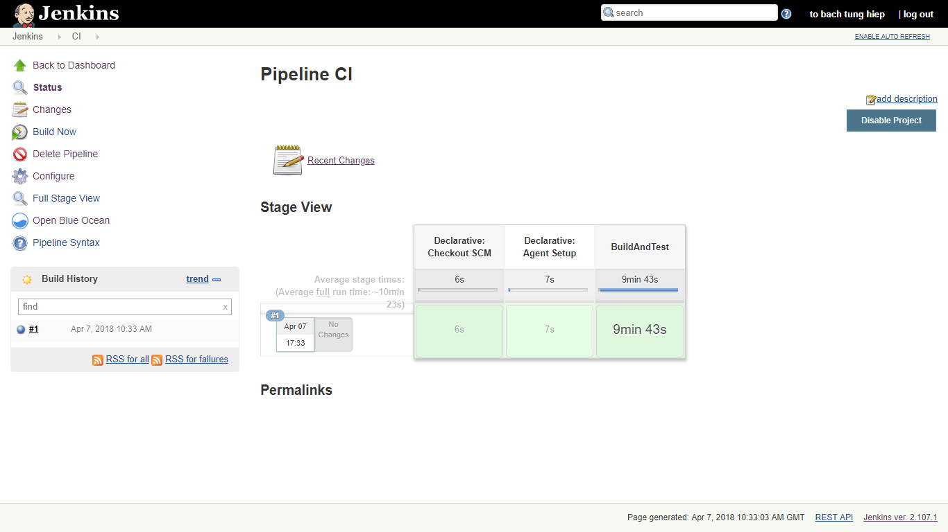
FINISH Jenkins test

Slide 22
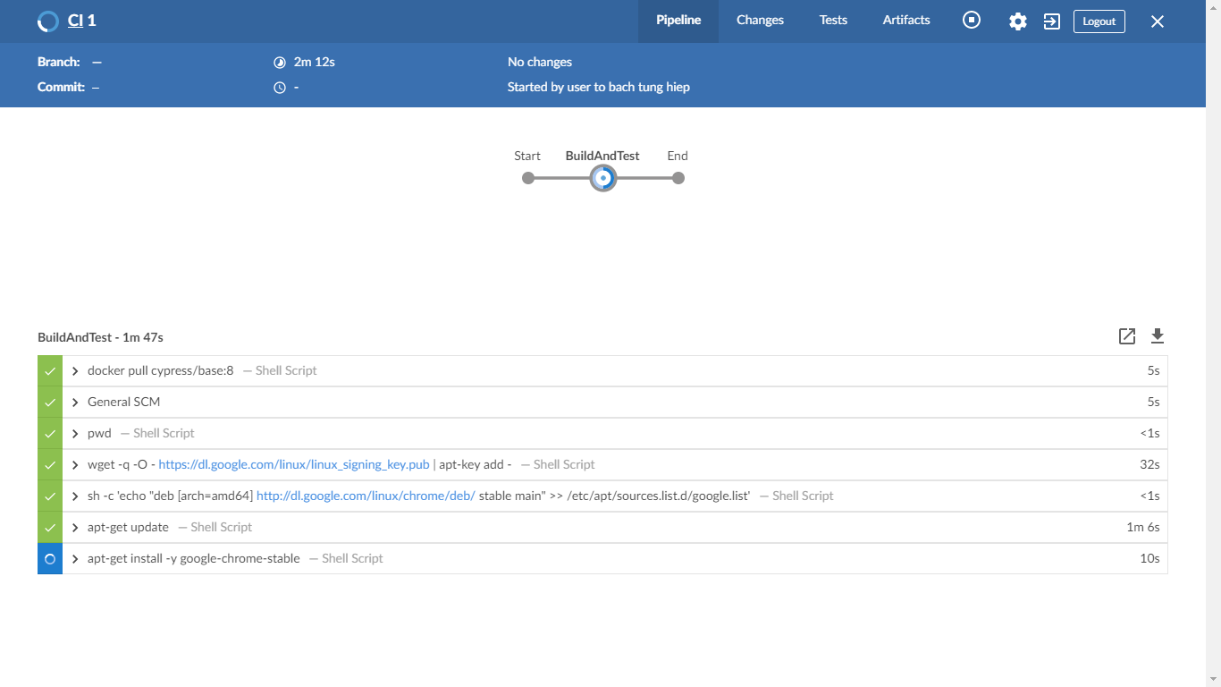
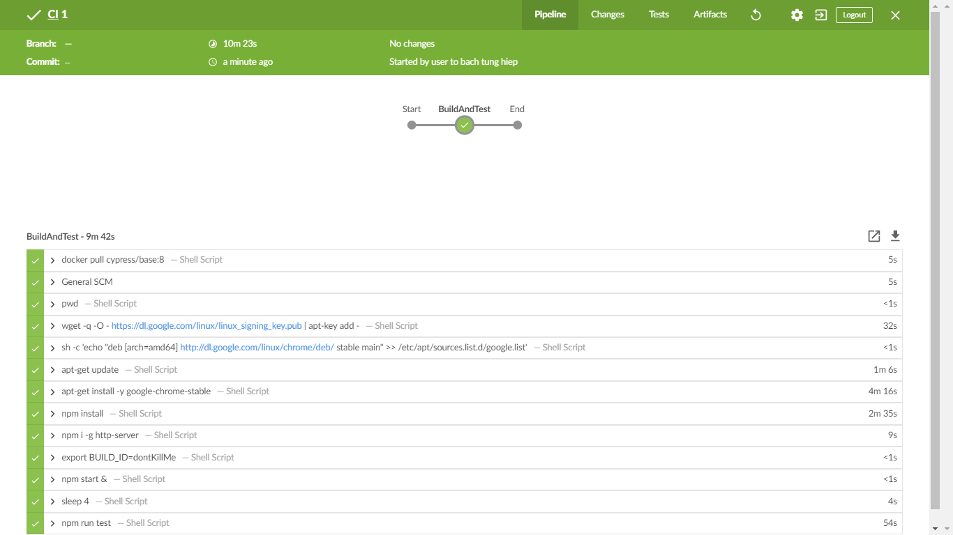
FINISH Jenkins test

Slide 23
compare
Jenkins:
Pros:
Free to download and use
Practically endless options for customization
An ever-growing collection of plugins
Cons:
Requires a dedicated server, which may entail an extra expense
Can take a while to configure and customize
Travis CI:
Pros:
Lightweight and easy to set up
Free for open source projects
No dedicated server needed
Build matrix feature
Cons:
Enterprise plans come with a cost
Limited options for customization

Slide 24
THANK YOU FOR LISTENING

