Slide 1
CS423 Software Testing Group K1 Continuous Integration
Tô Bạch Tùng Hiệp – ID: 1451018
Lê Quang Tiến – ID: 1451058

Slide 2
Introduction
+ Tools: Travis CI
+ Software under test: Calculator web app

Slide 3
Continuous Integration
+ The practice of automatically building and testing code changes of each commit
+ Providing immediate feedback on the testing outcome

Slide 4
Travis ci
+ A hosted, distributed continuous integration service used to build and test software projects hosted at GitHub
+ Configured by adding a file named .travis.yml a format text file, to the root directory of the repository

Slide 5
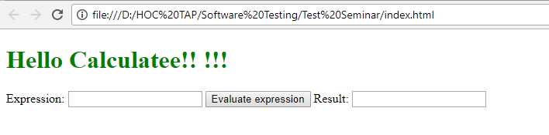
Software under test
+ Basic Calculator App

Slide 6
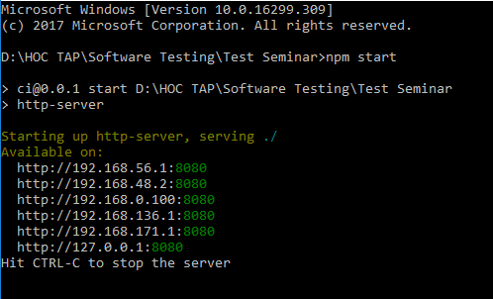
INSTALL AND RUNNING

Slide 7
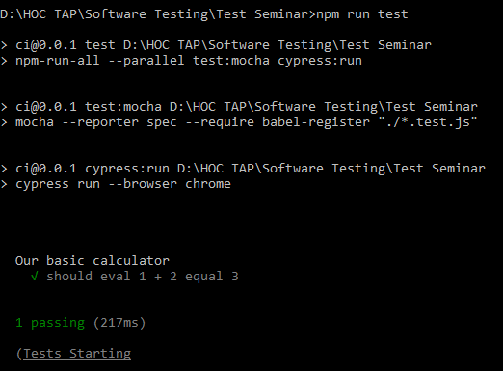
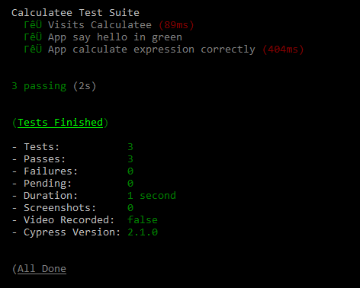
INSTALL AND RUNNING

Slide 8
Unit test
+ One unit test tests if calculator calculate 1+2 correctly (calculator.test.js)
+ Can create your own test by editing that file

Slide 9
Functional test
+ Using Cypress
+ Run 2 tests in our example
Checking if the app contains a green title saying "Hello Calculatee!! !!!".
Tests the scenario when types into the "Expression" input box "1+2+3+4", clicks the "Evaluation expression“ => correct result will appear

Slide 10
HOW TO GET STARTED
+ Sign in Travis-ci.org
+ Synchronizes your GitHub repositories and enable the repository you want to use CI
+ Add a .travis.yml file to your repository
+ Commit, Push and visit build status pages to see the result

Slide 11
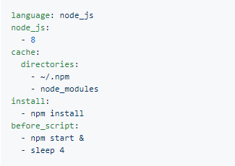
HOW TO GET STARTED
+ Example of .travis.jml file

Slide 12
THANK YOU FOR LISTENING

