Slide 1
AfriSenti Multilingual Sentiment Analysis
Swahili | Amharic | English

Slide 2
Project Overview (README)
AfriSenti Multilingual Sentiment Analysis
This workspace contains a Jupyter notebook `AfriSenti_sentiment_analysis.ipynb` that performs EDA, preprocessing, modeling (XLM-R/AfriBERTa fine-tuning and an LSTM baseline), evaluation, ablations, and cross-lingual experiments on the AfriSenti Twitter dataset (Swahili, Amharic, English).
How to use
1. Create a Python 3.8+ environment and install dependencies:
pip install -r requirements.txt
2. Place AfriSenti dataset files (CSV/JSON) in `data/` or use the Hugging Face `datasets` loader if you have network access.
3. Open `AfriSenti_sentiment_analysis.ipynb` in Jupyter/Colab and run cells sequentially. GPU is recommended for fine-tuning.
Files
- `AfriSenti_sentiment_analysis.ipynb`: Notebook scaffold for experiments.
- `requirements.txt`: Python package requirements.
- `REPORT.md`: Short report summarizing dataset, models, results, and insights (created after running experiments).
Notes
- The notebook contains placeholders for dataset paths and model checkpoints. If you want me to wire the notebook to download AfriSenti automatically from a specific URL or HF dataset id, tell me the exact dataset id or provide the files and I'l
(Truncated; see REPORT.md for full details)

Slide 3
Short Report (Summary)
Short Report: AfriSenti Multilingual Sentiment Analysis
(Placeholder) This report will be populated after running the notebook experiments. It will include:
- Dataset overview: number of tweets, language breakdown (Swahili, Amharic, English), and label distributions.
- Model architectures: BiLSTM baseline and XLM-R/AfriBERTa fine-tuning details.
- Training setup: hyperparameters, early stopping, gradient clipping, and training curves.
- Evaluation: accuracy, macro F1, per-class F1, ROC-AUC, confusion matrices, and per-language breakdown.
- Ablation study results: effect of batch size, learning rate, and sequence length.
- Cross-lingual transfer: train-on-Swahili, test-on-English/Amharic results and analysis.
- Conclusions and recommendations for production deployment and further work.
I'll populate this file with results and figures once the notebook experiments are executed.

Slide 4
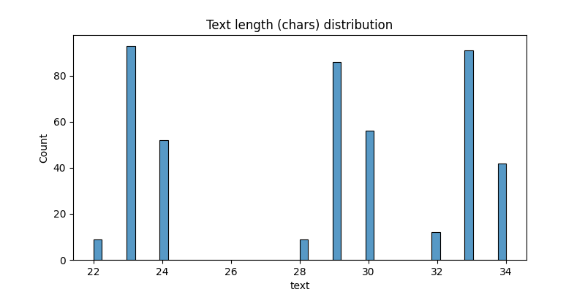
EDA: eda_char_len_dist

Slide 5
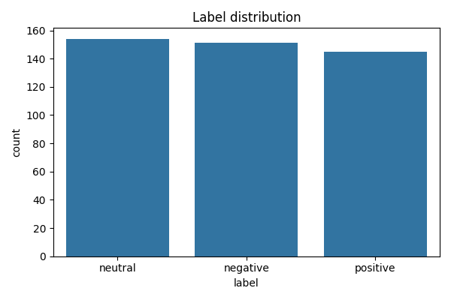
EDA: eda_label_dist

Slide 6
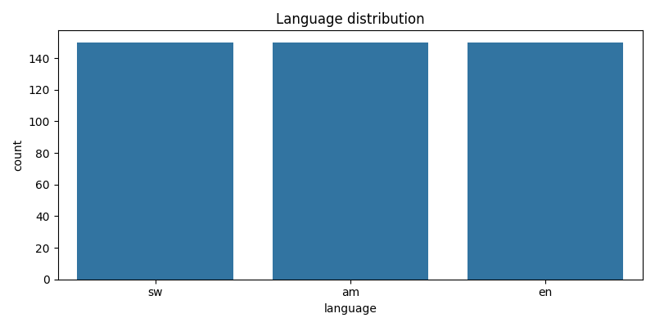
EDA: eda_lang_dist

Slide 7
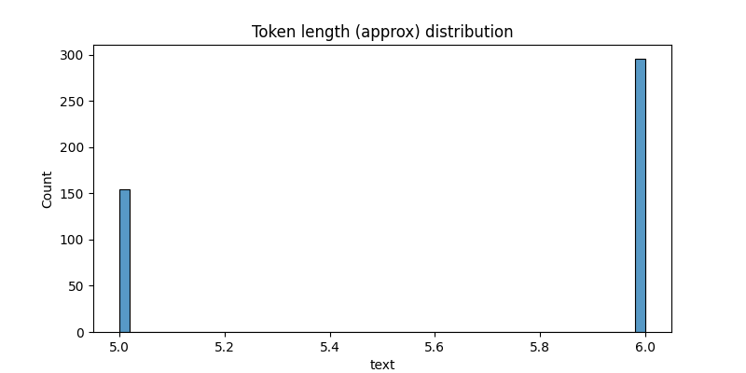
EDA: eda_token_len_dist

Slide 8
Preprocessing (src/preprocess.py)
"""Text preprocessing utilities: normalize, remove URLs, mentions, hashtags, emojis, slang mapping."""
import re
import unicodedata
try:
from emoji import demojize as _demojize
except Exception:
# emoji package not available; fallback to identity
def _demojize(x):
return x
SLANG_MAP = {
"u": "you",
"ur": "your",
"plz": "please",
"pls": "please",
"lol": "laughing",
"omg": "oh my god",
# add more as needed
}
# ... (truncated)

Slide 9
Tokenizers (src/tokenize_utils.py)
"""Tokenizers for multilingual models (mBERT, XLM-R, AfriBERTa)
Provides helper to get tokenizer and to batch-tokenize texts with caching option.
"""
from transformers import AutoTokenizer
MODEL_MAP = {
'mbert': 'bert-base-multilingual-cased',
'xlm-roberta': 'xlm-roberta-base',
# placeholder for AfriBERTa; user can replace with a checkpoint id
'afriberta': 'microsoft/afriberta-base'
}
def get_tokenizer(model_key='xlm-roberta', use_fast=True):
model_id = MODEL_MAP.get(model_key, model_key)
tokenizer = AutoTokenizer.from_pretrained(model_id, use_fast=use_fast)
return tokenizer
def batch_tokenize(tokenizer, texts, max_length=128, truncation=True, padding='longest'):
return tokenizer(texts, truncation=truncation, padding=padding, max_length=max_length)
# ... (truncated)

Slide 10
Models (src/models.py)
"""Model definitions: BiLSTM baseline and Transformer wrapper for fine-tuning."""
import torch
import torch.nn as nn
from transformers import AutoModel, AutoConfig, AutoModelForSequenceClassification
class BiLSTMClassifier(nn.Module):
def __init__(self, vocab_size=None, embedding_dim=300, hidden_dim=256, num_layers=1, dropout=0.3, num_classes=3, embeddings=None):
super().__init__()
if embeddings is not None:
self.embedding = nn.Embedding.from_pretrained(embeddings, freeze=False)
else:
if vocab_size is None:
raise ValueError('vocab_size required if embeddings not provided')
self.embedding = nn.Embedding(vocab_size, embedding_dim)
self.bilstm = nn.LSTM(self.embedding.embedding_dim, hidden_dim, num_layers=num_layers, bidirectional=True, batch_first=True)
self.dropout = nn.Dropout(dropout)
self.classifier = nn.Linear(hidden_dim * 2, num_classes)
def forward(self, input_ids, attention_mask=None):
# ... (truncated)

Slide 11
Run script (src/run_all.py)
"""Example orchestration script showing how to run EDA, preprocessing, tokenization, training and evaluation.
This is a convenience script — for full experiments, run from a notebook and adjust paths and hyperparameters.
"""
import os
from data_exploration import load_afrisenti, simple_eda
from preprocess import simple_clean
from tokenize_utils import get_tokenizer
from dataset import SentimentDataset, collate_fn
from models import TransformerClassifier
from train import Trainer
from eval_utils import compute_metrics, plot_confusion, compute_roc_auc
from torch.utils.data import DataLoader
import torch
def small_run(data_dir='data', model_key='xlm-roberta', max_length=128, batch_size=16, epochs=3):
print('Loading data...')
df = load_afrisenti(data_dir=data_dir)
print('Running EDA...')
# ... (truncated)

Slide 12
Artifacts & Next Steps
When you run the notebook, save artifacts:
- Model checkpoint: best_xlmroberta.pt
- Tokenizer: tokenizer.save_pretrained(path)
- EDA plots: saved as PNGs in project root or data/
Run the presentation generator and attach the generated PPTX to reports or slides.

