Slide 1
Swahili Speech Classification
Preprocessing • Modeling (CNN/Wav2Vec2) • Evaluation • Robustness • Exploration

Slide 2
Problem & Objective
Task: Classify Swahili speech (keywords/intents).
Datasets: Common Voice (Swahili) or Swahili Words Parallel Dataset.
Deliverables: Notebook, Report, and Slide Deck with comparisons and plots.

Slide 3
Dataset Overview
Audio sampled near 16 kHz; variable durations.
Labels: derive keyword classes or use folder-based labels.
Inspect sample rate, duration, and label distribution.

Slide 4
Metadata Overview
[Figure not found: None]

Slide 5
Preprocessing
Resample to 16 kHz; normalize features.
Extract MFCC and Mel-spectrograms.
Augment with noise and pitch shifts; optional time-stretch.

Slide 6
Waveform & Mel-spectrogram
[Figure not found: None]

Slide 7
Modeling
1D CNN over MFCC/Mel features (Conv-ReLU-Pool).
Wav2Vec2 fine-tuning (classification head).
Experiment with conv layers, kernel sizes, activations.

Slide 8
Training & Regularization
Train 10–15 epochs; monitor train/val loss.
Apply dropout, early stopping, and LR scheduling.
Hyperparameter search on architecture and features.

Slide 9
CNN Training Losses
[Figure not found: None]

Slide 10
Evaluation
Metrics: Accuracy, Macro-F1, Confusion Matrix.
Embedding visualization via PCA and t-SNE.
Compare CNN vs Wav2Vec2 performance.

Slide 11
Confusion Matrix (CNN)
[Figure not found: None]

Slide 12
Embeddings (PCA & t-SNE)
[Figure not found: None]

Slide 13
Exploration & Comparisons
Sampling rates: 8 kHz vs 16 kHz.
Mel resolution: 40, 64, 128 bins.
Attempt transfer learning from English Common Voice.

Slide 14
SR/Mel Comparison
[Figure not found: None]

Slide 15
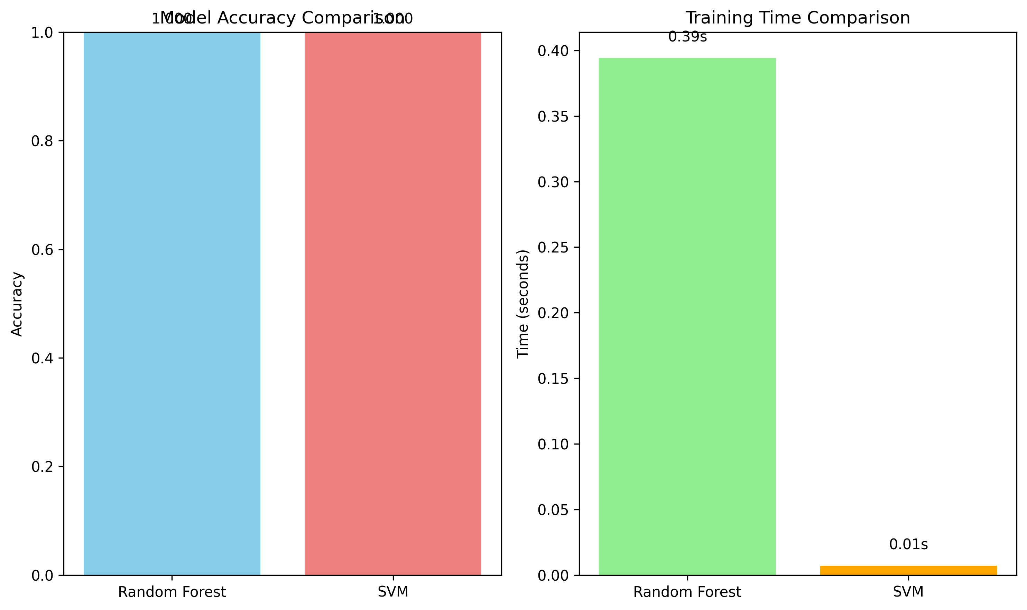
Model Comparison
Accuracy and training time across models

Slide 16
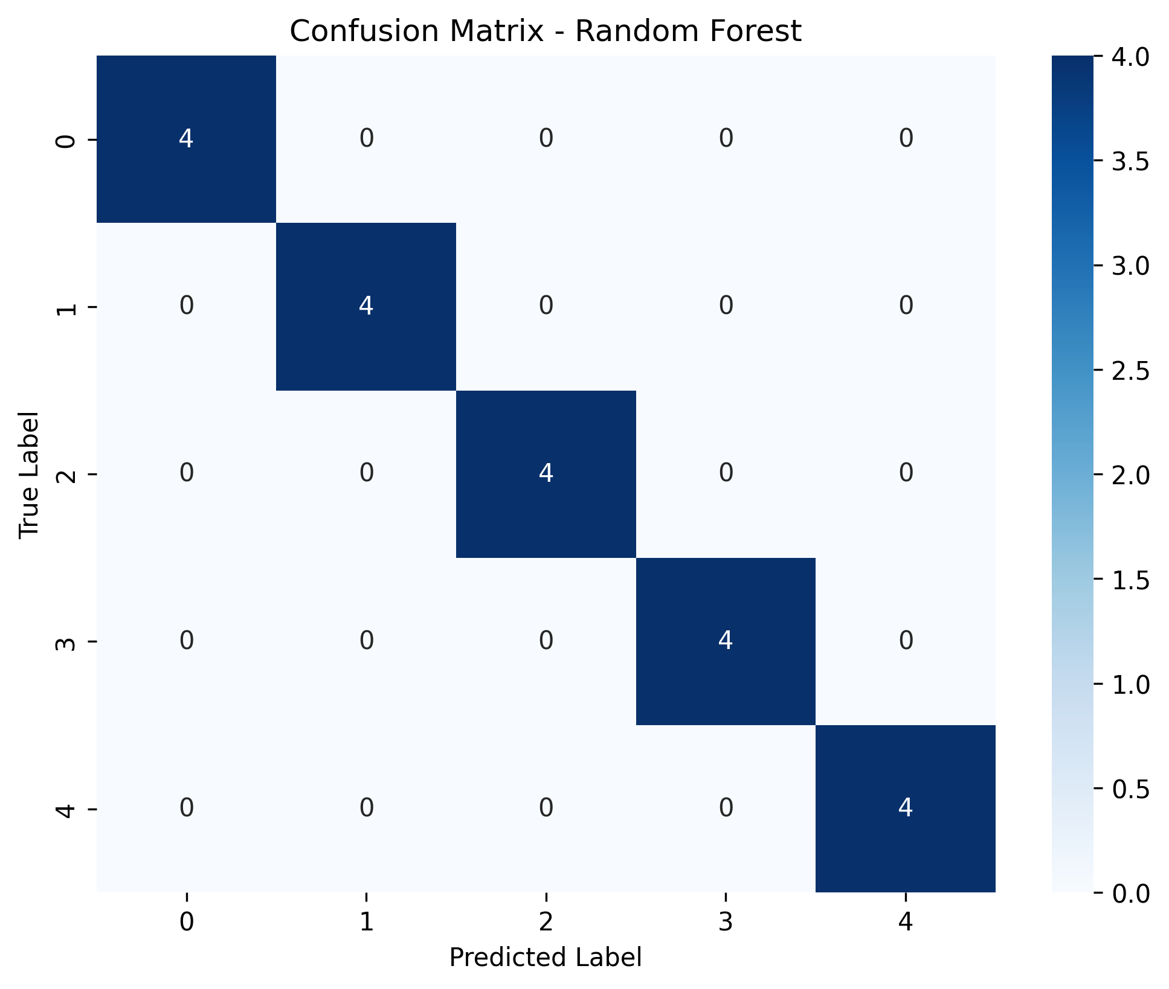
Confusion Matrix (Random Forest)
Confusion matrix for Random Forest

Slide 17
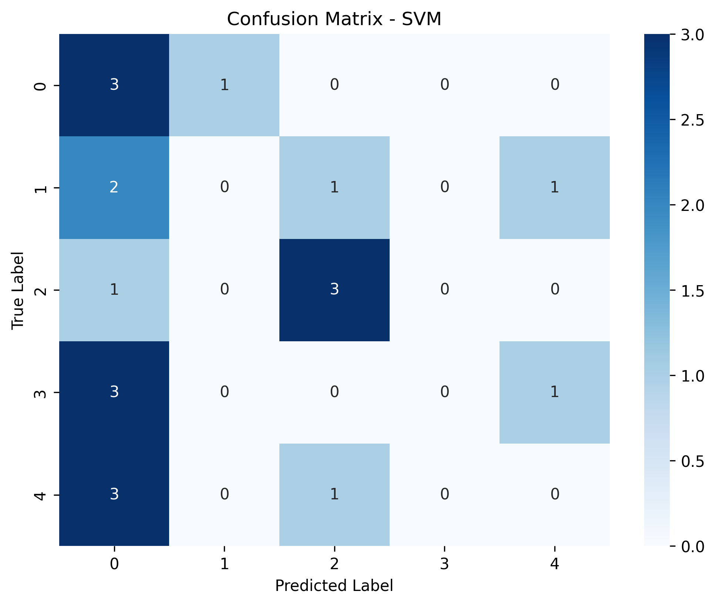
Confusion Matrix (SVM)
Confusion matrix for SVM

Slide 18
Robustness & Generalization
Augmentations improve noise/pitch resilience.
Speaker-wise splits for fair evaluation.
Test-time augmentation and domain shifts (devices/environments).

Slide 19
Extension: ASR + Sentiment Pipeline
ASR to transcribe Swahili (Whisper / Wav2Vec2).
Optional translation (Sw → En).
Sentiment model on text output.

Slide 20
Attribution & Licensing
Figures generated from experiments in this project.
Dataset: Mozilla Common Voice (Swahili) — Clips licensed CC0 1.0.
Ensure any external images used are properly licensed and attributed.

Slide 21
Conclusions & Next Steps
CNN is a solid baseline; Wav2Vec2 excels with GPU/data.
Refine label schema and expand datasets.
Deploy robust evaluation and production pipeline.

