Slide 1



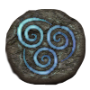
Clash of the Elements
Distributed Systems 2015 – Open Project by
Miriam Tschane, Yan Wang,
Jonas Putschert, Valentin Scherer, Omar Lone

Slide 2
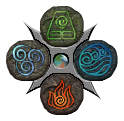

Clash of the Elements
A co-op tower defense game for Android
Defend against the monsters for as long as you can
Up to four players
Made with

Slide 3
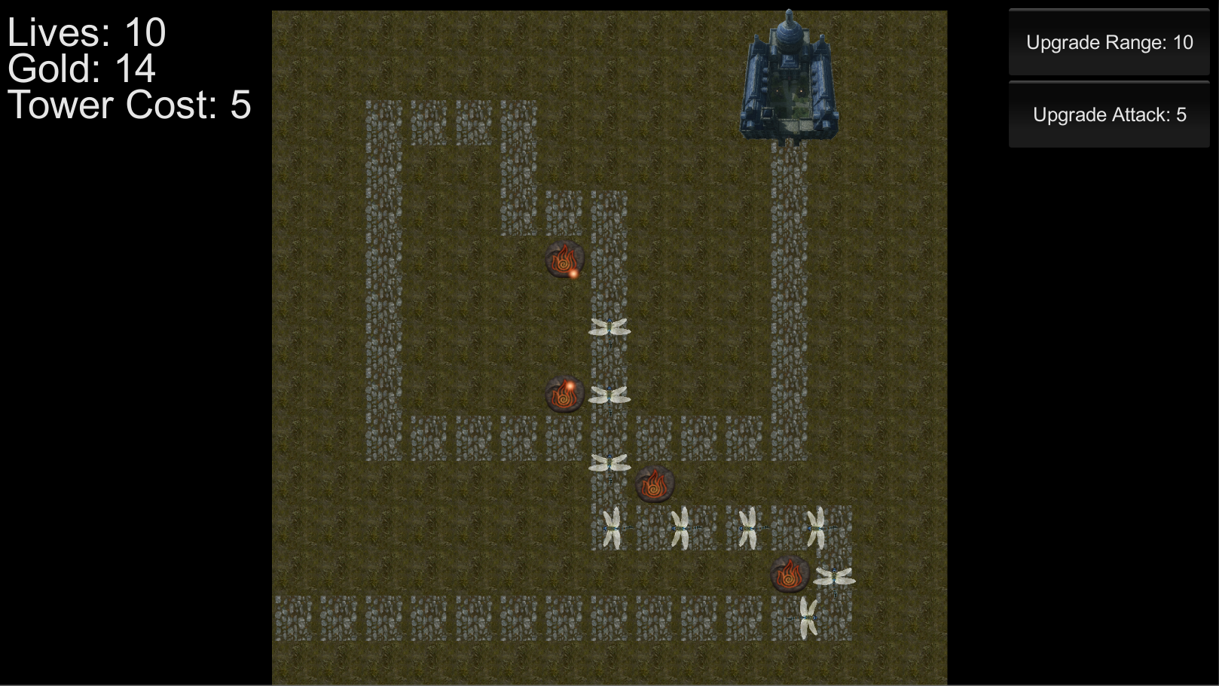
Gameplay

