Slide 1


Vulnerability Assessment of Metasploitable 2
and DVWA
By Pankaj Poudel

Slide 2
Overview of the Report
Objective
Identify and assess vulnerabilities in Metasploitable 2 and DVWA.
Provide remediation for all vulnerabilities.
Scope
Analyze SQL Injection and Reflected XSS in DVWA.
Evaluate services and ports on Metasploitable 2 for potential risks.
Tools Used
Burp Suite, Sqlmap, Nmap, Metasploit framework, Drib.

Slide 3
Tools Used
Tools | Explanation
Brup suite | Vulnerability Scanning and web application pentesting tool. It allows interception, manipulation and automated testing.
SQLmap | An automated SQL Injection tool. Detects and exploits SQL injection vulnerabilities in web applications.
Nmap | A powerful open-source network scanning tool. Identifies open ports, services, and potential vulnerabilities.
Metasploit Framework | A penetration testing framework for developing and executing exploit code against target systems. It includes an extensive library of exploits and auxiliary modules.
Dirb | A command-line directory scanner. Searches for hidden files and directories on web servers.

Slide 4
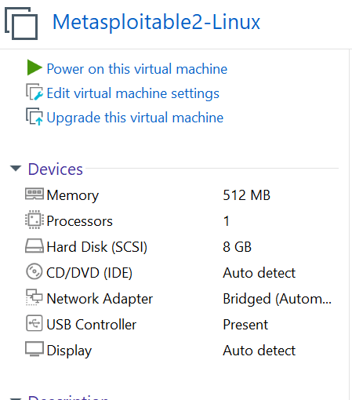

Lab enviroment
Target system
Metasploitable 2, DVWA (Security is medium) hosted in Metasploitable 2
Network setup Target system is hosted in a virtual environment accessed via a Windows machine running Ubuntu WSL.
Attacking machine
Ubuntu WSL: Acts as the primary attacking machine for running tools like Nmap, SQLmap, Metasploit Framework and Dirb. Windows Machine: Hosts Burp Suite, used for web vulnerability testing (SQL Injection in DVWA).

Slide 5
Key findings
Findings in DVWA
Vulnerability | Details | Impact
SQL injection | Input field allows injection of malicious SQL queries. | Data exposure and unauthorized access to database.
Reflected XSS | Input field allows injection of JavaScripts. | Phishing and unauthorized access on application can be gained
Findings in Metasploitable 2
Vulnerability
Port-21 FTP SSH Open Ports Telnet SMTP HTTP Port-139&443 SAMBA 1524 Port-2049 NFS
Vulnerability
1524 Bindshell Port-2121 FTP Port-3306 MySQL Port-5432 Postegresql Port-5900 VNC Port-3632 DISTCCD Port-1099 rmiregistry
Impact
The vulnerabilities identified in Metasploitable 2 highlight critical security flaws, with most cases allowing attackers to achieve remote code execution (RCE) and can compromise the system.

Slide 6
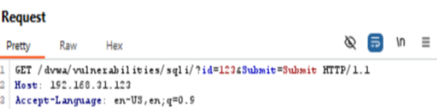
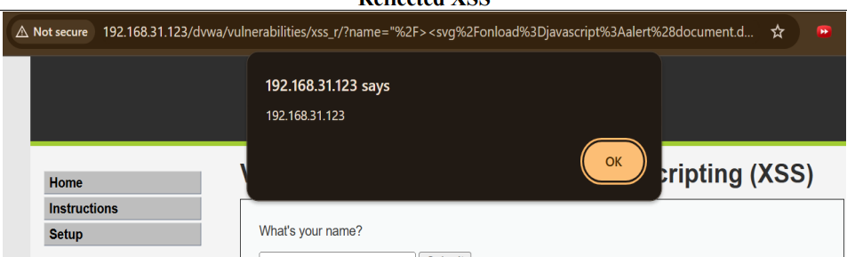
Exploitations steps
For DVWA SQL injection
Start Burp Suite, configure your browser to use Burp as a proxy, and enable Intercept.
Interact with the target application.
Inspect the request and search for the parameters as shown in picture.
After finding parameters open wsl Ubuntu.
Use sql map from wsl Ubuntu and supply the parameter.
We can see the database.
For DVWA XSS
Open DVWA web app and open xss reflected.
Inject javascript code(<svg/onload=javascript:alert('document.domain');>)
We get the popup.

Slide 7
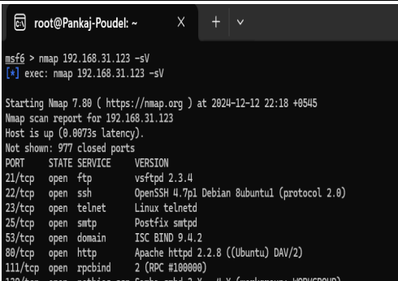
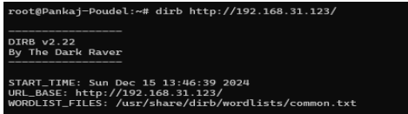
Exploitations steps
For Metasploitable 2
Open Ubuntu wsl and ping the target if accessible proceed if not check network setting.
Install nmap and metasploitable framework
Open msfconsole and login to metasploitable framework
Use Nmap tool to scan the target.
Search for the vulnerabilities of system
Use exploit available in metasploitable for that particular vulnerability.
Configure the exploit
Set RHOST, RPORT, LHOSTS, LPORT etc.
Execute command and check for sessions. If found sessions open it to inject the remote code.
We use Dirb for HTTP from root user as shown in picture→

Slide 8
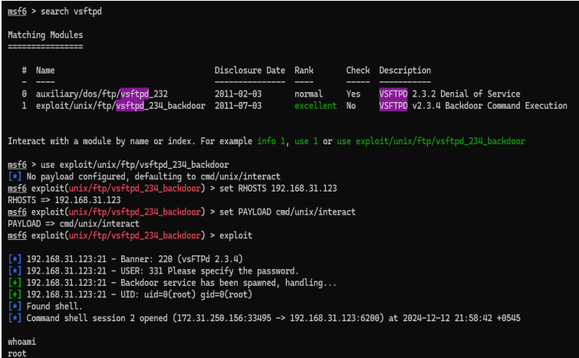

Slide 9
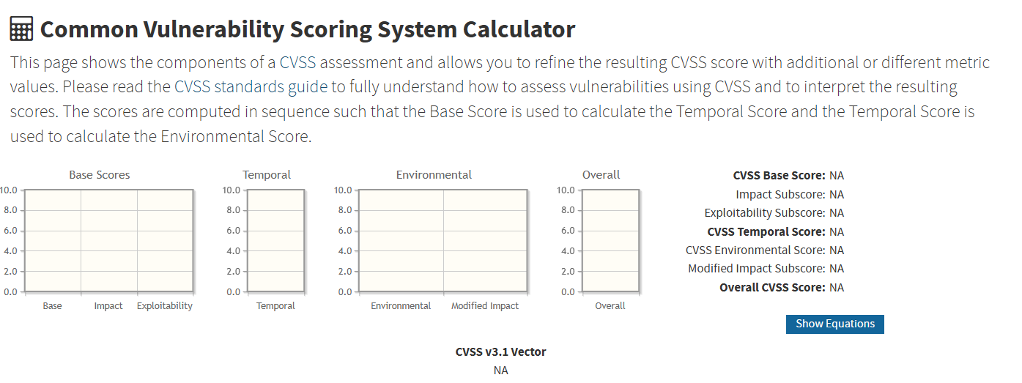
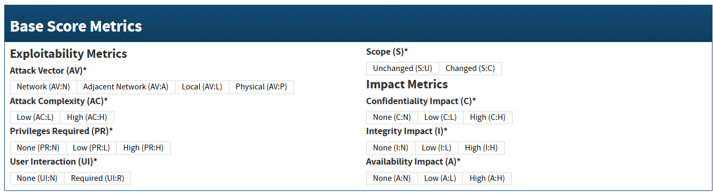
CVSSv3 Metrics
It provides a standardized way to describe the characteristics of a vulnerability, such as its exploitability, impact, and scope

Slide 10
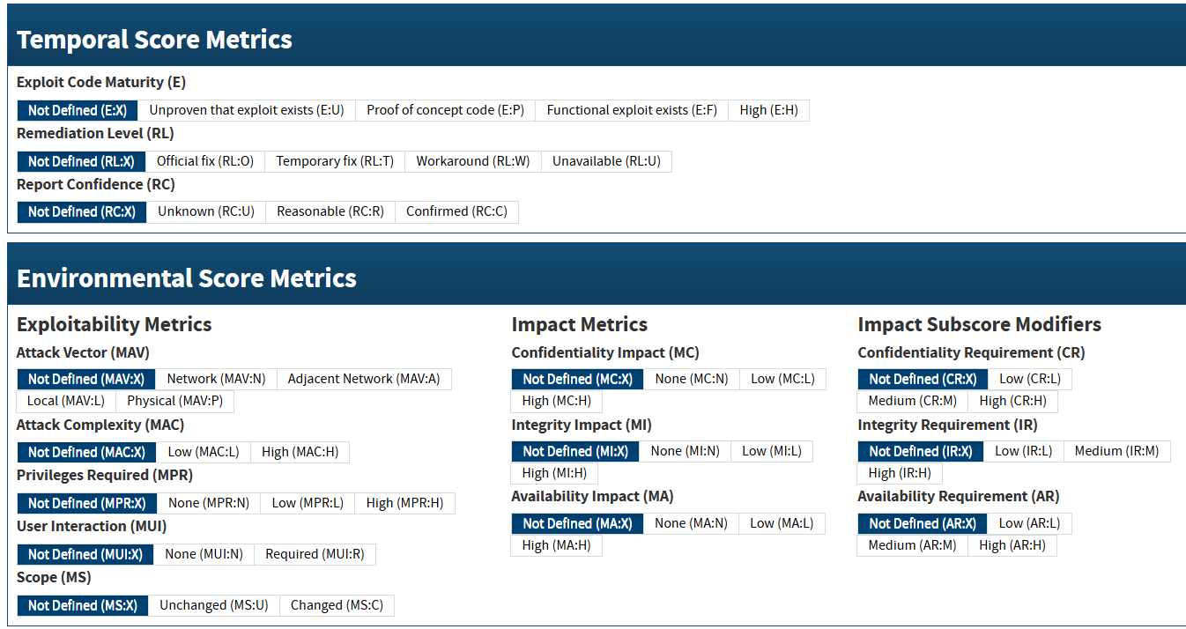

Slide 11
Remediation
Common steps of remediation
Disable unused services.
Patch the system with latest patch available.
Limit access and control traffic
Use strict input validation and sanitation.
Implement proper permission.
Use firewall rules to avoid bindshell attack.
Use strong authentication.
Implement encryption.
Update to latest versions.
Restrict network access to avoid vnc exploit.

Slide 12


Slide 13
Refrences
https://nvd.nist.gov/vuln-metrics/cvss/v3-calculator
https://www.scribd.com/document/535865719/Comprehensive-Guide-on-Metasploitable-2
file:///C:/Users/A%20S%20U%20S/Downloads/Metasploit2%20&%20DVWA%20Report%20intern.pdf Report that was created earlier.
Google

Slide 14


