Slide 1

Predicting Absenteeism using Machine Learning Techniques
Group 2- Zubin Shah
Laxman panthi

Slide 2
Agenda
Introduction
Data Exploration
Prediction Modelling
Model Optimization
Results & Discussion
Q&A

Slide 3

Introduction Courier Company
Expectations
On-Time Delivery
Customer Satisfaction
Cost Effectiveness
Absenteeism
Dissatisfied Customers
Brand Image
High Costs

Slide 4




Reasons for absenteeism

Slide 5
Project Background
Absenteeism Records - July/07 to July/2010
Absences certified with the International Classification of Diseases - 21 categories
Various other parameters:
Individual identification (ID),
Month of absence, Day of the week, Seasons,
Transportation expense, Distance from Residence to Work, Service time
Age, Work load Average/day, Hit target, Disciplinary failure
- Absenteeism time in hours (target) – Classified into 7 Groups
Education, Son, Social drinker, Social smoker, Pet,
Weight, Height, Body mass index

Slide 6
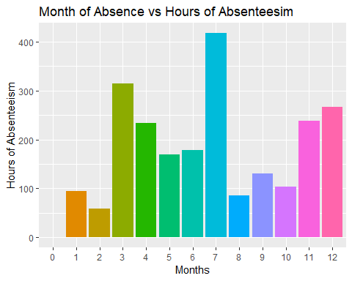
Data Exploration
In which month are the hours of absenteeism the highest & lowest?
740 observations, 21 features
Encoding Categorical Variables to Factors
Outlier & NA check
Descriptive Analytics

Slide 7
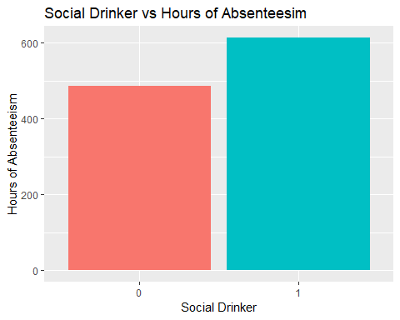
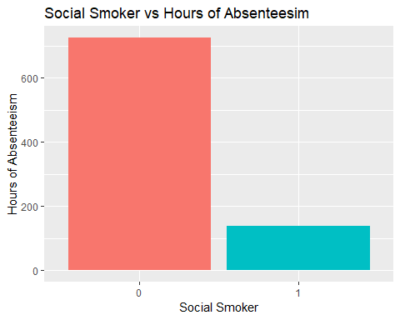
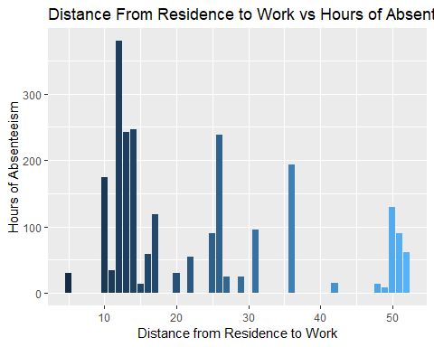
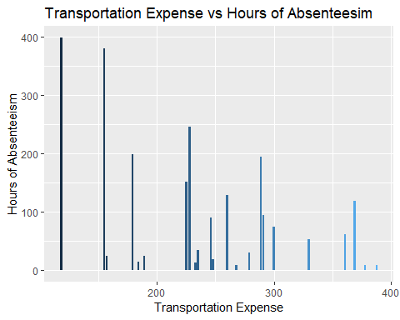
Data Exploration
2. Are Social Drinker & Smoker absent more hours compared to who don’t?
3. Does travel have any impact on hours of absenteeism?

Slide 8
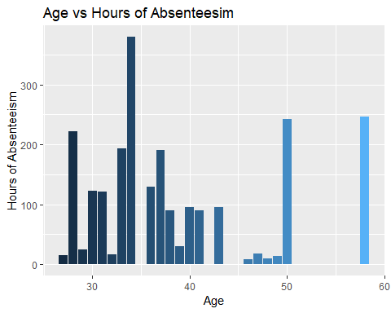
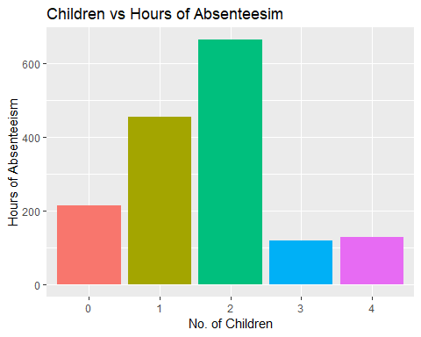
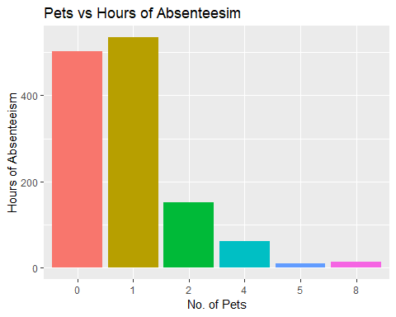
Data Exploration
These insights might be useful while hiring a new employee when their personal information is shared. But what happens if you already have an employee and you don’t want to lose him?
Does Age, Children & Pet impact the hours of absenteeism?

Slide 9

SOLUTION: Predictive Modelling
Predict the number of hours of absenteeism & save our business being hampered by having some temp workers to cover it up.
Classification Techniques used as Hours of Absenteeism was Grouped
Models Used:
K-Nearest Neighbor (KNN),
Support Vector Machines (SVM -Linear & Kernel),
Naïve Bayes,
Random Forest

Slide 10

Classification Models
80% Training Data Set & 20% Testing Data Set
Feature Scaling - Normalization
Model trained and Validated using Test Set
Confusion Matrix
Accuracy Determined
Model | KNN | SVM | Naïve Bayes | Random Forest
Accuracy | 42.3% | Linear – 50.3% Kernel – 36.2% | 39.6% | 47%

Slide 11
Model Optimization
Model optimization helps us maximize our objective function.
Methods of Model Optimization
Feature Selection
Hybrid Models
Tuning Hyper Parameters

Slide 12
Feature selection
Removing Highly Correlated variables
Generating composite variables

Slide 13
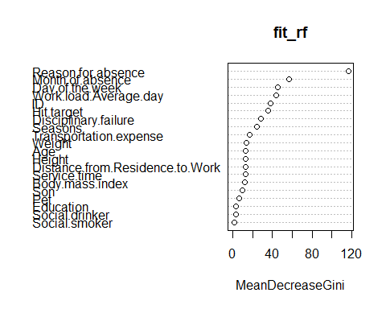
HYBRID MODELS
Using Unsupervised Algorithms
Dimensionality Reduction
PCA (non-categorical)
GINI Index
Clustering
K-means

Slide 14
TUNING HYPER Parameters
What are hyper parameters?
No of Max Iteration
No of Trials
Activation function

Slide 15
Results & Discussion
Model Evaluation
Best accuracy achieved:
50.3% (base model)
54.4 (TUNED)

Slide 16

Q&A

