Slide 1
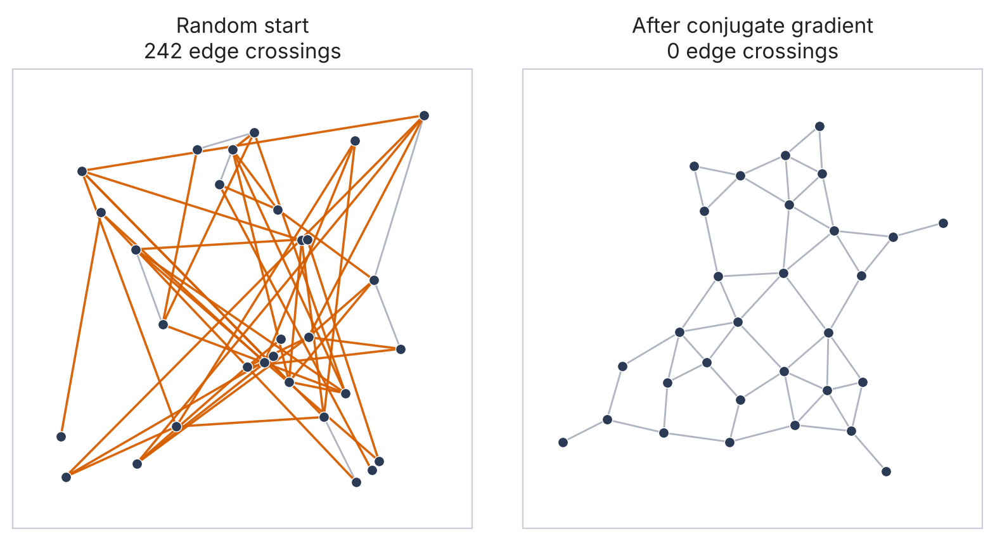
Untangling Graphs with Optimization
Force-directed layout as unconstrained minimization of an energy function
30 nodes, 52 edges: 242 crossings from a random start, 0 after optimization
Optimization | Mini project
Notes:
Introduce the idea: drawing a graph nicely is an optimization problem. Left to right in this picture is what our code does in about a quarter of a second.

Slide 2
Nodes repel, edges pull
Nodes are charged particles
1
Every pair pushes apart, so nodes never pile up on each other.
Springs pull connected nodes together
Edges are springs
2
Each connected pair is pulled toward a rest length of 1.
Best picture = lowest energy
3
Find all coordinates (x, y) that minimize the total energy E.
Charges push every pair apart
Notes:
Same intuition as Obsidian's graph view or a network diagram tool. The only thing we add is to make it precise: one number, the total energy, and minimize it.

Slide 3
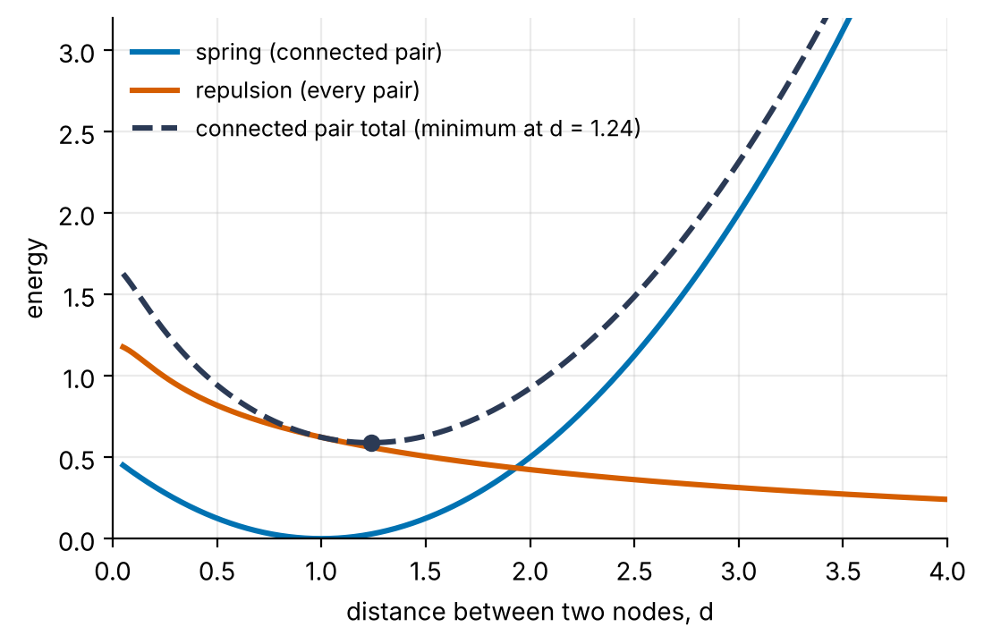
One number to minimize: the total energy
E(z) with z = (x1, y1, ..., xn, yn): 2n unknowns, no constraints
Springs (edges)
½ · k · (d − L)²
Repulsion (all pairs)
½ · c · L² · ln(1 + R² / (d² + ε²))
Gravity (centering)
d = distance between two nodes. A connected pair settles where spring and repulsion balance. Constants: L = 1, k = 1, c = 0.3, R = 8.
½ · g · |z|²
Notes:
Repulsion is a smooth version of the classic Fruchterman-Reingold law (force ~ 1/d). It is written so that E is a sum of squares, which is what makes Levenberg-Marquardt applicable later.

Slide 4
Where the syllabus shows up
Module 1
Module 2
Line search
Steepest descent
Bounding phase plus golden-section search pick the step length along every direction.
Follow the negative gradient. Simple, but zig-zags in narrow valleys.
Module 2
Module 2
Fletcher-Reeves conjugate gradient
Levenberg-Marquardt
Blend in the previous direction to stop the zig-zag, with no matrix needed.
E is a sum of squares, so J^T J approximates the Hessian and λ blends Newton with gradient steps.
Also used: analytic gradient and Jacobian (checked against finite differences), convergence rate and rate constant, local versus global minima of a non-convex function.
Notes:
Module 3 (dynamic programming) is not used here. Everything is Modules 1 and 2.

Slide 5
Three optimizers, one energy function
Steepest descent
Fletcher-Reeves CG
Levenberg-Marquardt
Direction
Direction
Step
d = −∇E
d' = −g' + β · d
β = |g'|² / |g|²
(J^T J + λ · D) δ = −J^T r
D = diag(J^T J)
Step length
Step length
Step length
golden-section line search
same line search; restart every 2n steps
none: λ adapts to the gain ratio
Behaviour
Behaviour
Behaviour
Zig-zags along narrow valleys, so it is slow (rate q = 0.99).
Remembers the last direction and avoids the zig-zag (q = 0.80).
Gauss-Newton when λ is small, gradient descent when large (q = 0.98).
q = geometric-mean ratio of successive gradient norms near the end of the run (smaller is faster).
Notes:
All three start from the same random layout. SD and CG share the same line search so the comparison isolates the choice of direction.

Slide 6
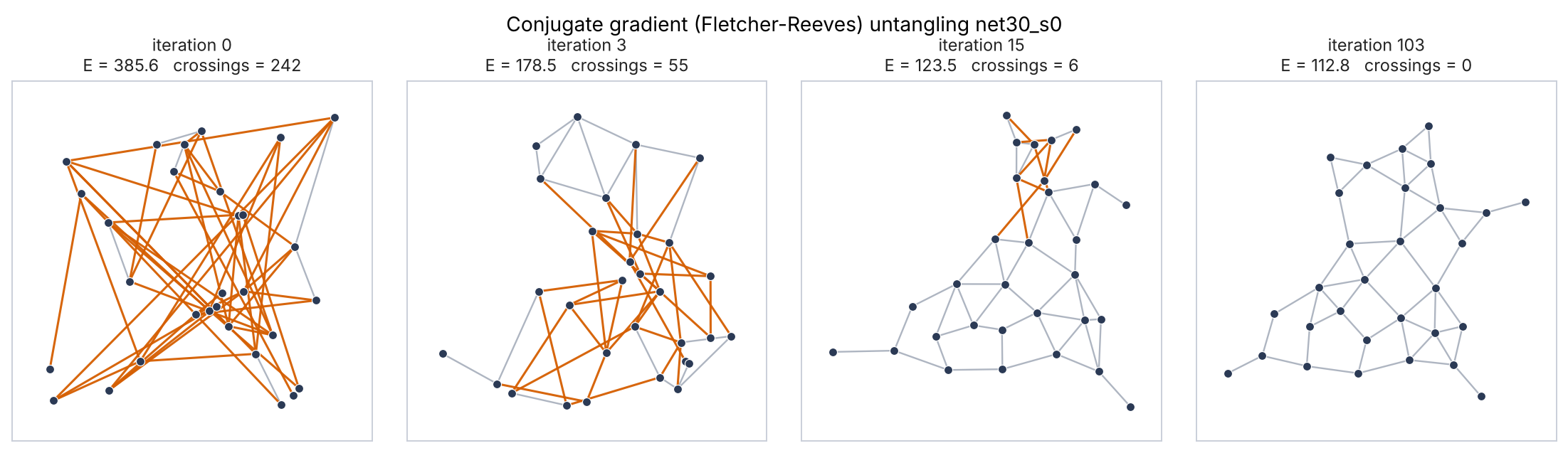
Untangling in four snapshots
Conjugate gradient on a 30-node planar network. Orange edges cross another edge: 242 crossings at the start, 0 after 103 iterations (0.26 s).
Notes:
Most of the untangling happens in the first 15 iterations; the rest is polishing edge lengths until the gradient is tiny.

Slide 7
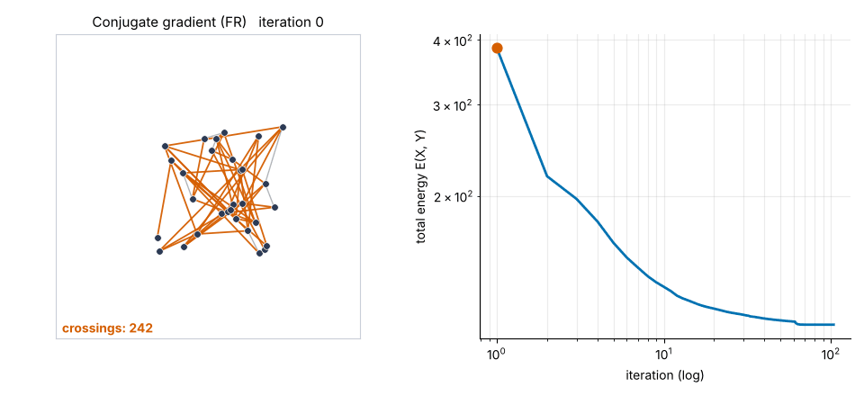
Watch conjugate gradient untangle it
242 to 0
edge crossings
103
iterations
0.26 s
Press F5 (slideshow) to play. Right: total energy E on log-log axes; the red dot is the current iteration.
wall-clock time
Notes:
Play the GIF in slideshow mode. If the animation does not play in your viewer, the four-snapshot slide before this one shows the same thing.

Slide 8
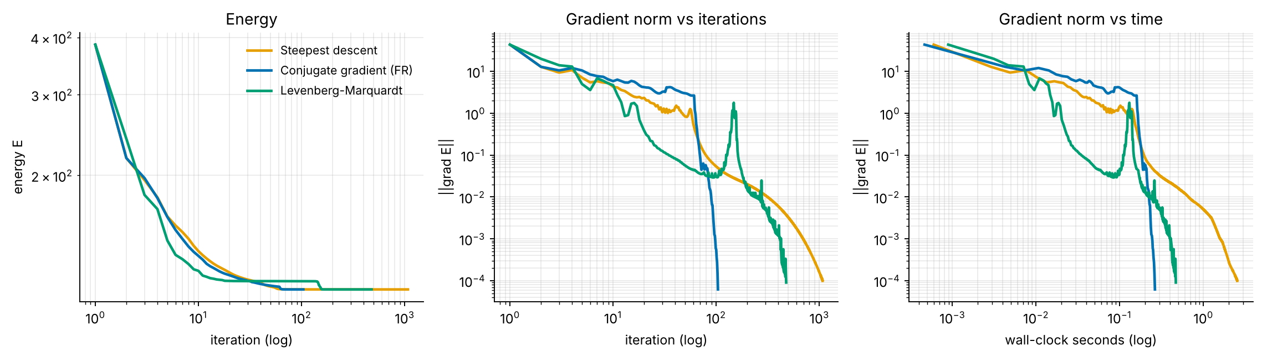
Same minimum, very different cost
Steepest descent
Conjugate gradient (FR)
Levenberg-Marquardt
1,074 iterations
103 iterations
476 iterations
2.54 s, E = 112.79, 0 crossings
0.26 s, E = 112.79, 0 crossings
0.47 s, E = 112.79, 0 crossings
Notes:
All three reach E = 112.79, the same layout up to rotation. The difference is only how long it takes. LM has a bump in the gradient norm where it takes a large trust-region step across a saddle.

Slide 9
240 runs: CG needs about 9x fewer iterations
Steepest descent / CG, median of 80 paired starts: 9.1x iterations, 9.3x time. LM: 250 iterations (2.4x CG), similar time to CG.
Notes:
Benchmark: 4 graphs x 20 random starts x 3 methods. Same start for all three methods, same 3000-iteration budget, stop when the gradient norm is below 1e-4. All 240 runs converged.

Slide 10
Speed differs, layout quality does not
Same quality
Crossing-free layouts on planar graphs: SD 87%, CG 90%, LM 83%. With 20 starts per graph these gaps are within run-to-run noise.
Usually the same minimum
Steepest descent and CG ended in the same local minimum in 91% of the 80 paired runs.
A non-convex energy
Which minimum you reach depends on the start, not the method: trees fold in 20-30% of starts. Remedy: several random starts, keep the lowest energy.
Notes:
Crossings are only meaningful for planar graphs (a crossing-free drawing exists), so the clustered graph with K6 cliques is excluded from this chart.

Slide 11
What went wrong first, and what we learned
1
2
3
Fix the model before the optimizer
LM is not magic
Compare fairly
Our first benchmark gave 0% crossing-free layouts on a dense Delaunay mesh. Even starting from the true planar drawing, the optimizer moved to a folded layout with lower energy. So the energy was wrong, not the optimizer. We switched to long-range log repulsion and a sparse planar network, tuning on separate seeds.
Its J^T J step drops second-order residual terms, which is a likely reason it was slower here: spring and repulsion forces balance at a good layout instead of vanishing. Measured: LM converged linearly (q = 0.98) and needed 2.4x the iterations of CG (median 250 vs 106).
All methods get the same start and the same 3,000-iteration budget. LM was first capped at 300 iterations and looked like it failed; it was only slow. We report iterations and wall-clock time, because one CG iteration costs a line search of about 20 energy evaluations and one LM iteration costs a Jacobian.
Notes:
Be upfront about these in the viva: the first model did not work, we diagnosed it by starting the optimizer from the known-good drawing, and we fixed the energy rather than tuning the optimizer.

Slide 12
Implementation and reproducibility
forcelayout/
graphs.py test graphs, random starts
energy.py E, gradient, residuals, J
linesearch.py bounding + golden section
optimizers.py SD, FR-CG, LM
metrics.py crossings, edge CV, rate
viz.py snapshots, GIF, plots
scripts/
run_demo.py figures + animation
benchmark.py multi-start comparison
make_deck.js this presentation
tests/ automated tests
Analytic gradient and Jacobian
Verified against finite differences in the tests.
Optimizers written from scratch
NumPy only; no scipy.optimize.
Reproducible
Fixed seeds. run_demo.py and benchmark.py regenerate every figure and table in this deck.
Notes:
Skip this slide if you are short on time; the repository README has the same information.

Slide 13
Takeaways
1
Layout is optimization
Minimize a spring plus repulsion energy over 2n coordinates, using the Module 1 and 2 toolbox.
2
CG is the sweet spot
About 9x faster than steepest descent, with no Jacobian or matrix solve.
3
The landscape is non-convex
All methods reach the same quality; use several random starts and keep the lowest energy.
Next: Barnes-Hut approximation for O(n log n) repulsion, momentum methods, and constraint-based layouts.
Notes:
Close on the three takeaways, then take questions.

