Slide 1


“Gheorghe Asachi” TECHNICAL UNIVERSITY OF IAȘI
FACULTY OF AUTOMATIC CONTROL AND COMPUTER ENGINEERING
FIELD: COMPUTERS AND INFORMATION
TECHNOLOGIES
Search for a complete vacation package using multi-agent negotiation
Scientific coordinator
s.l. dr. ing. Florin LEON
Graduate
Emilian MIHAILOV

Slide 2
Summary
Proposed subject
01
Alternative solutions
02
Proposed solution
03
Application design
04
Technologies
05
Application development and testing
06
Conclusions
07
Future directions of development
08

Slide 3
Why this subject?
It’s a topical subject
The field of tourism is quite popular
Multi-agent system increasingly popular among researchers
Discovering a new way to solve problems using MAS systems

Slide 4
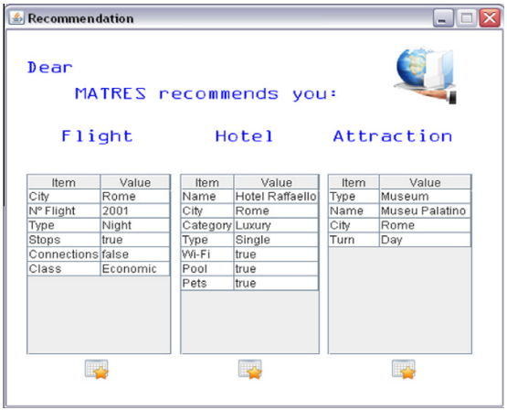
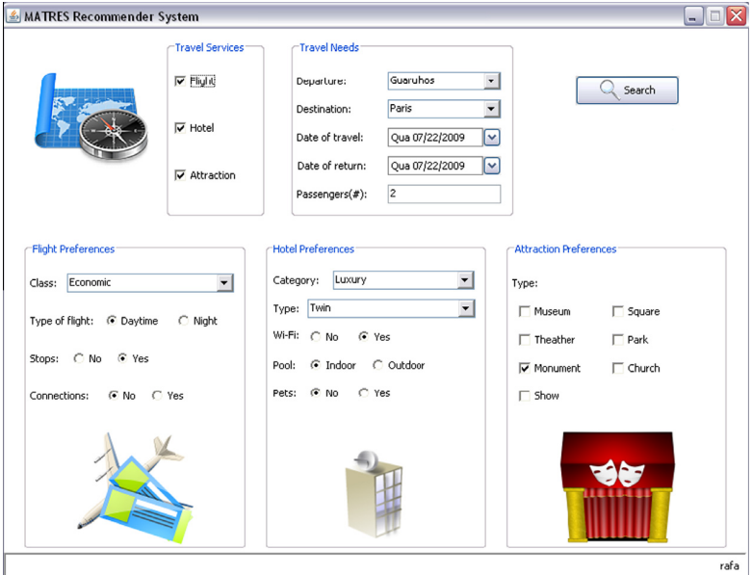
Alternative projects
MAPWEB
CASIS
MATRES
Figure 1. MATRES example of the recommendation presented to the user [image taken from [1]]
Figure 2. MATRES main interface. [image taken from [1]]

Slide 5
Proposed solution
Create a service that provides a full vacation package
Architecture based on client-server communication
The core of the project to be a MAS
The business logic should be handled only on the server side

Slide 6
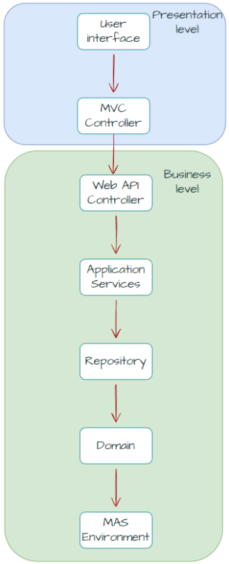
Application Design
Presentation layer
Application layer
Server layer

Slide 7

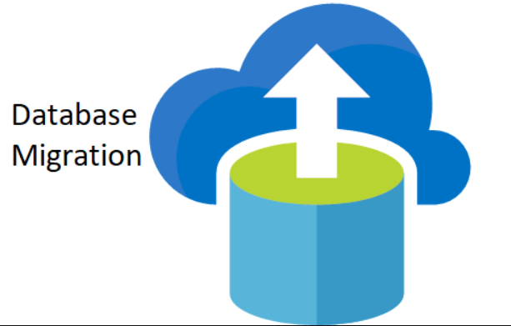


Technologies
ActressMAS
.NET
ASP.NET Core
Fluent Migrations Framework
OpenTripMap API
PostgreSQL
Figure 2. Image taken from [2]
Figure 3. Image taken from [3]
Figure 4. Image taken from [4]
Figure 5. Image taken from [5]

Slide 8

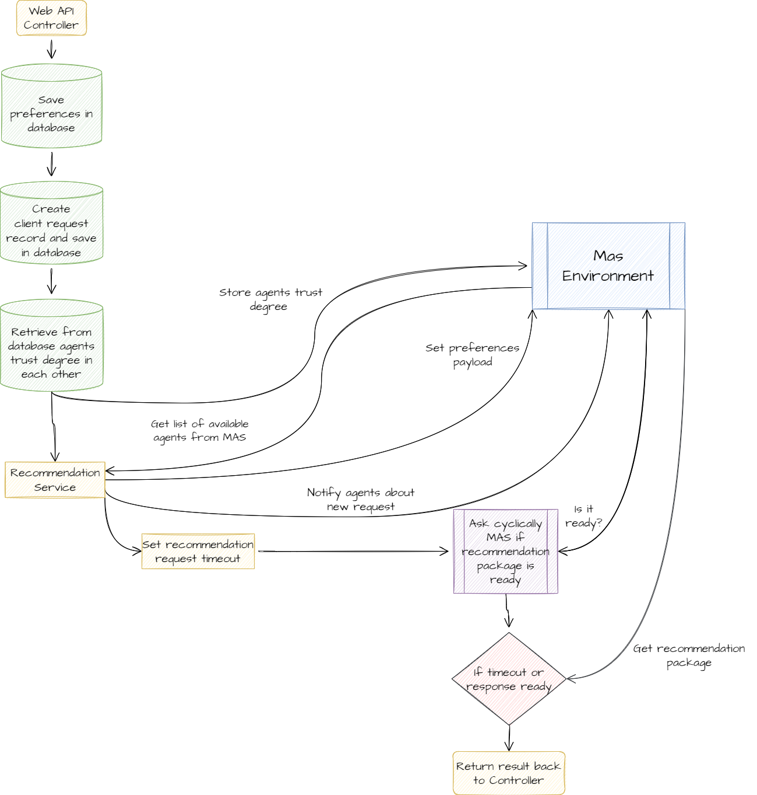
Application development

Slide 9
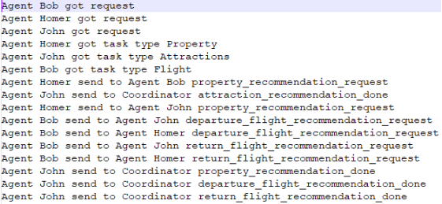
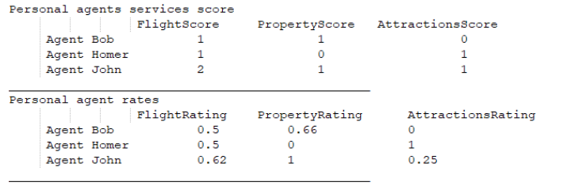
API testing
Using Console Application as HTTP client
Log data and analyze them
Check manually the database

Slide 10
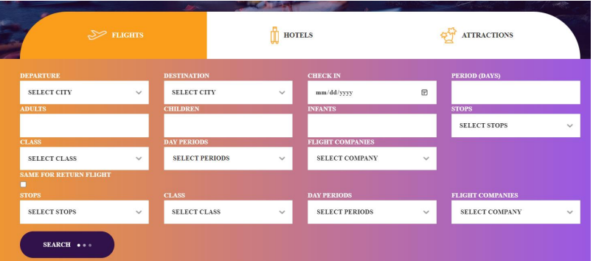
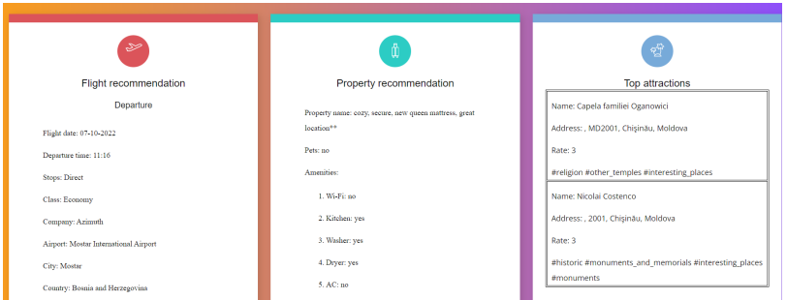
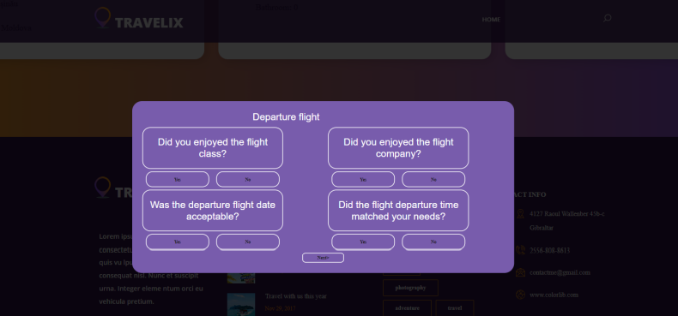
Web page testing

Slide 11
Conclusions
Provided a complete vacation package
Create and use of a MAS
Used a database generator and data populator
Applied architecture patterns
System functionality can be extended

Slide 12
Future directions of the development
Implement
Implement advanced data searching algorithms
Convert
Convert from REST architecture to the Web Socket
Add
Add machine learning for creating user profile
Combine
Combine MAS with cloud services
Optimize
Optimize memory consumption

Slide 13
Thank you for your attention.

Slide 14
Bibliography
[1] Fabiana Lorenzi, Ana L. C. Bazzana, Mara Abel, Francesco Ricci, “Improving recommendations through an assumption-based multiagent approach: An application in the tourism domain”, 2011. Available online at https://www.sciencedirect.com/science/article/abs/pii/S0957417411007937
[2] https://www.webnexs.com/blog/wp-content/uploads/2020/01/ASP.NET-Core-1024x695.png
[3] https://parsstudent.com/wp-content/uploads/2017/12/database-migration.png
[4] https://opentripmap.io/product
[5] https://miro.medium.com/max/1400/1*7AOhGDnRL2eyJMUidCHZEA.jpeg

