Slide 1


“Gheorghe Asachi” TECHNICAL UNIVERSITY OF IAȘI
FACULTY OF AUTOMATIC CONTROL AND COMPUTER ENGINEERING
FIELD: COMPUTERS AND INFORMATION
TECHNOLOGIES
Search for a complete vacation package using multi-agent negotiation
Scientific coordinator
Prof. dr. ing. Florin LEON
Graduate
Emilian MIHAILOV

Slide 2
Project Overview
Proposed subject
01
Alternative solutions
02
Proposed solution
03
Application design
04
Technologies
05
Application development and testing
06
Conclusions
07
Future directions of development
08

Slide 3
Why this subject?
It’s a topical subject
The field of tourism is quite popular
Multi-agent system increasingly popular among researchers
Discovering a new way to solve problems using MAS systems

Slide 4
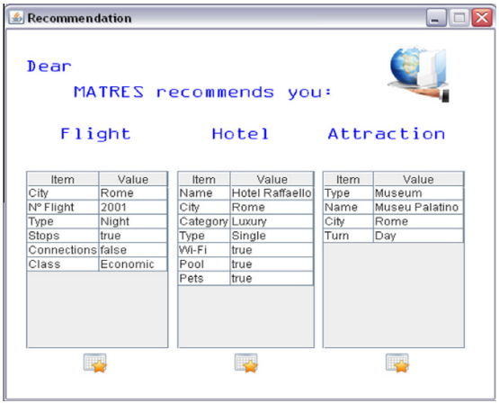
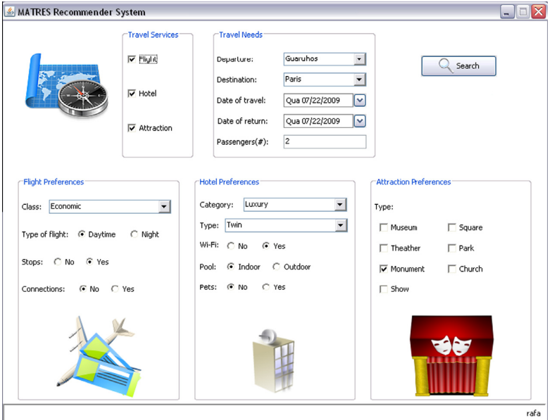
Alternative projects
MAPWEB
CASIS
MATRES
Figure 1. MATRES example of the recommendation presented to the user [image taken from [1]]
Figure 2. MATRES main interface. [image taken from [1]]

Slide 5
Proposed solution
Create a service that provides a full vacation package
Architecture based on client-server communication
The core of the project to be a MAS
The business logic should be handled only on the server side

Slide 6
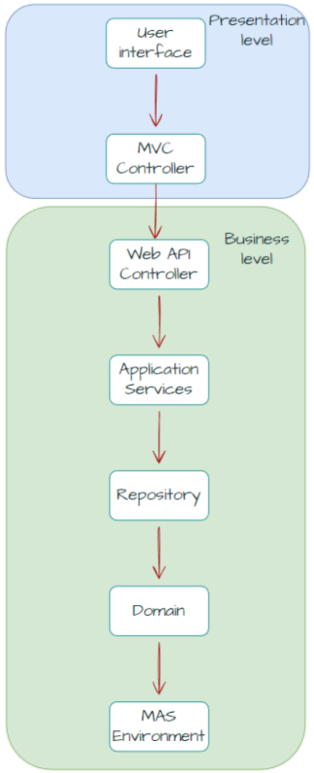
Application Design
Presentation layer
Application layer
Database layer
Figure 3. User request path from UI to MAS.

Slide 7
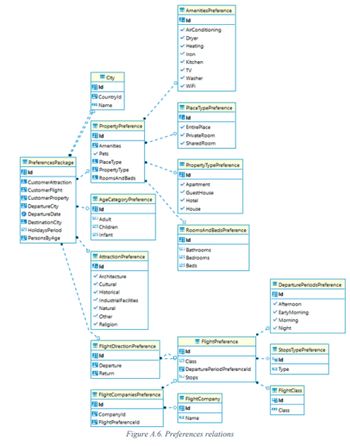
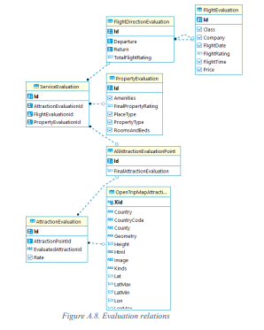
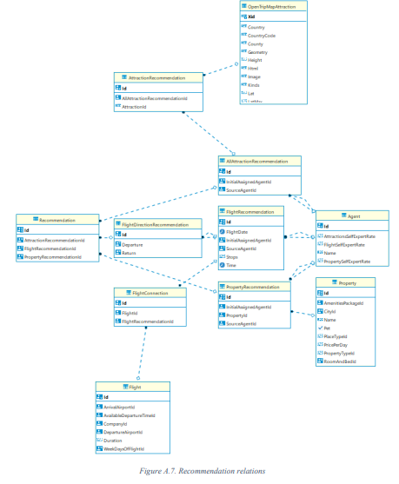
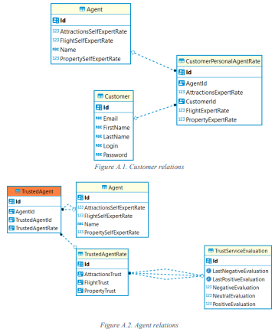
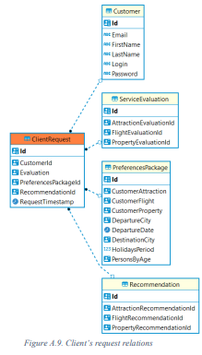
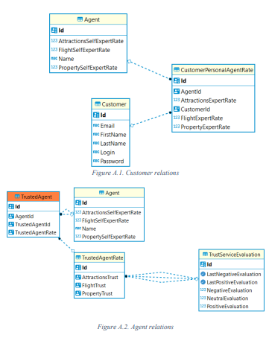
Database design
Developed a realistic and functional database vacation package services (flight, accommodations and attractions) with complex relations.
Populated the database with wide amount of data, including thousands of stays options and flight routes.
Designed the database to support efficient query processing for optimal recommendations.
Recorded agents’ interaction and solutions they bring.

Slide 8

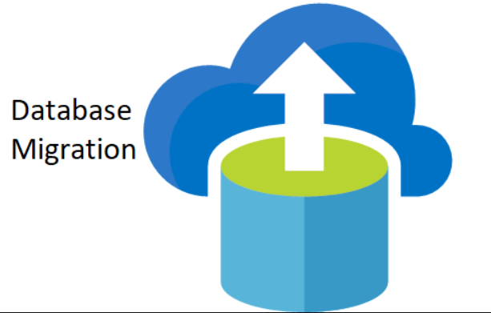


Core Technologies
ActressMAS
.NET
ASP.NET Core
Fluent Migrations Framework
OpenTripMap API
PostgreSQL
Figure 4. Image taken from [2]
Figure 5. Image taken from [3]
Figure 6. Image taken from [4]
Figure 7. Image taken from [5]

Slide 9

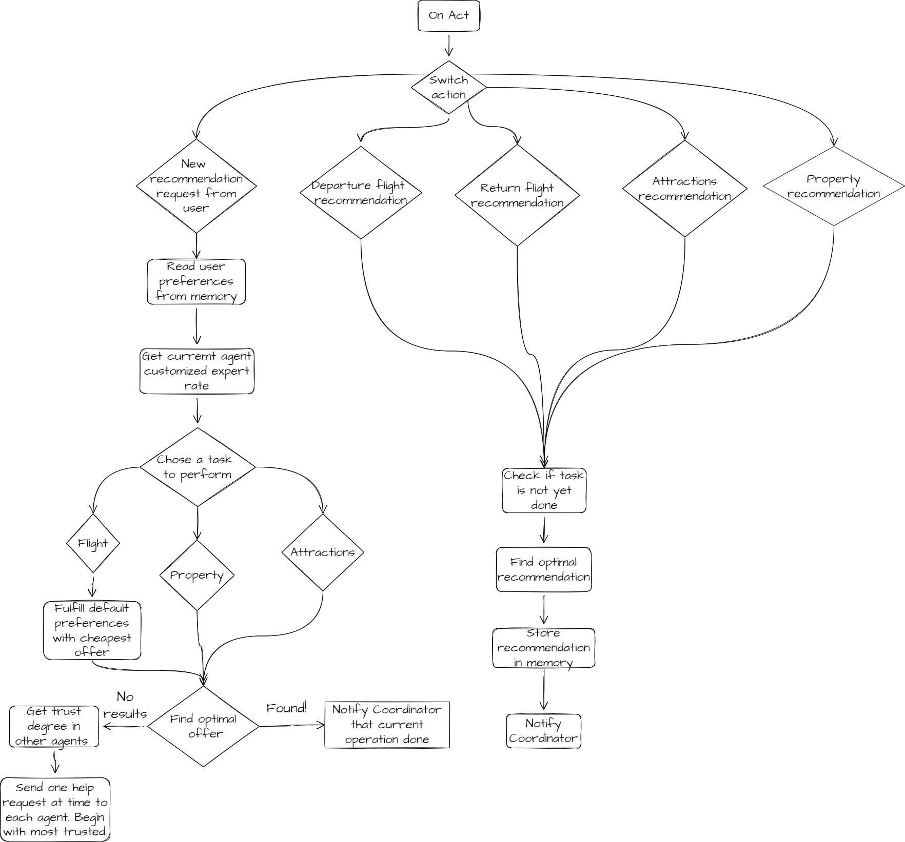
Development Stage

Slide 10


Best recommendation? Hmm...
To choose by a single characteristic?
By several basic characteristic features?
Or by the option that corresponds to most characteristics?
Figure 8. What is the way to go? [image taken from [6]]
Figure 9. Chose what suits best [image taken from [7]]

Slide 11
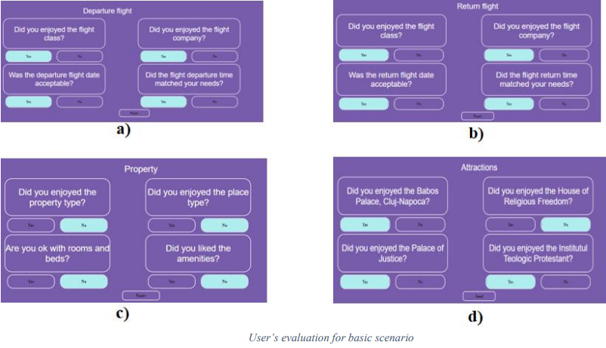
The agent – the expert
Agents choose a task according to their degree of expertness
The more tasks solved, the happier the customer, the more expert the agent.
If an agent helps another agent and the customer is satisfied, the agent increases trust in that agent.

Slide 12
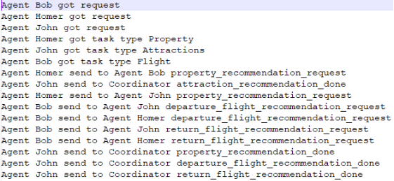
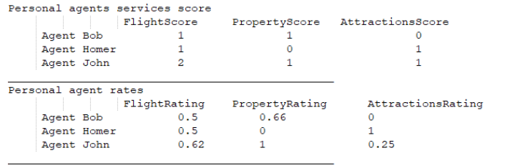
API Testing
Using Console Application as HTTP client
Log data and analyze them
Check manually the database

Slide 13
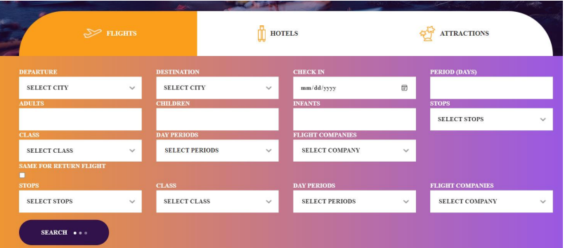
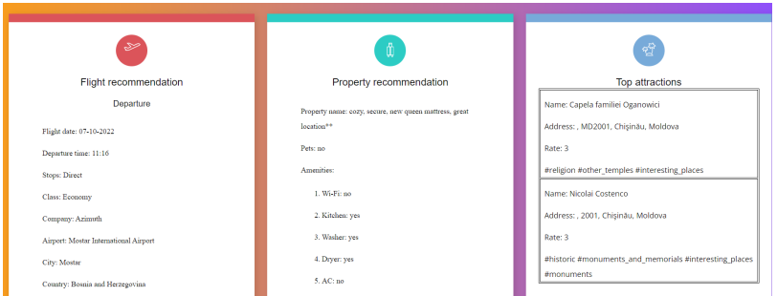
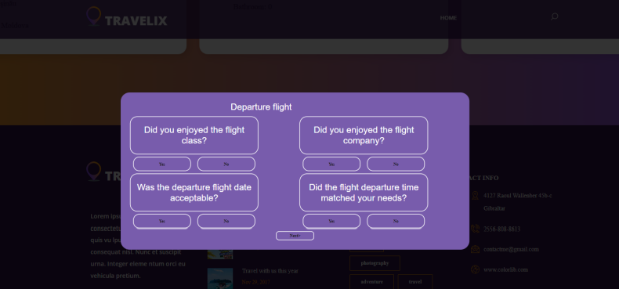
Graphical Interface Testing

Slide 14
Conclusions
Provided a complete vacation package
Create and use of a MAS
Used a database generator and data populator
Applied architecture patterns
System functionality can be extended

Slide 15
Future Improvements
Implement
Implement advanced data searching algorithms
Convert
Convert from HTTP communication to the Web Socket
Add
Add machine learning for creating user profile
Combine
Combine MAS with cloud services
Optimize
Optimize memory consumption

Slide 16
Thank you for your attention.

Slide 17
Bibliography
[1] Fabiana Lorenzi, Ana L. C. Bazzana, Mara Abel, Francesco Ricci, “Improving recommendations through an assumption-based multiagent approach: An application in the tourism domain”, 2011. Available online at https://www.sciencedirect.com/science/article/abs/pii/S0957417411007937
[2] https://www.webnexs.com/blog/wp-content/uploads/2020/01/ASP.NET-Core-1024x695.png
[3] https://parsstudent.com/wp-content/uploads/2017/12/database-migration.png
[4] https://opentripmap.io/product
[5] https://miro.medium.com/max/1400/1*7AOhGDnRL2eyJMUidCHZEA.jpeg
[6] https://funderstanding.com/wp-content/uploads/2011/04/Decision-Making.jpg
[7] https://blog.slido.com/wp-content/uploads/2020/11/blog-slido-team-decision-making-header.jpg

