Slide 1
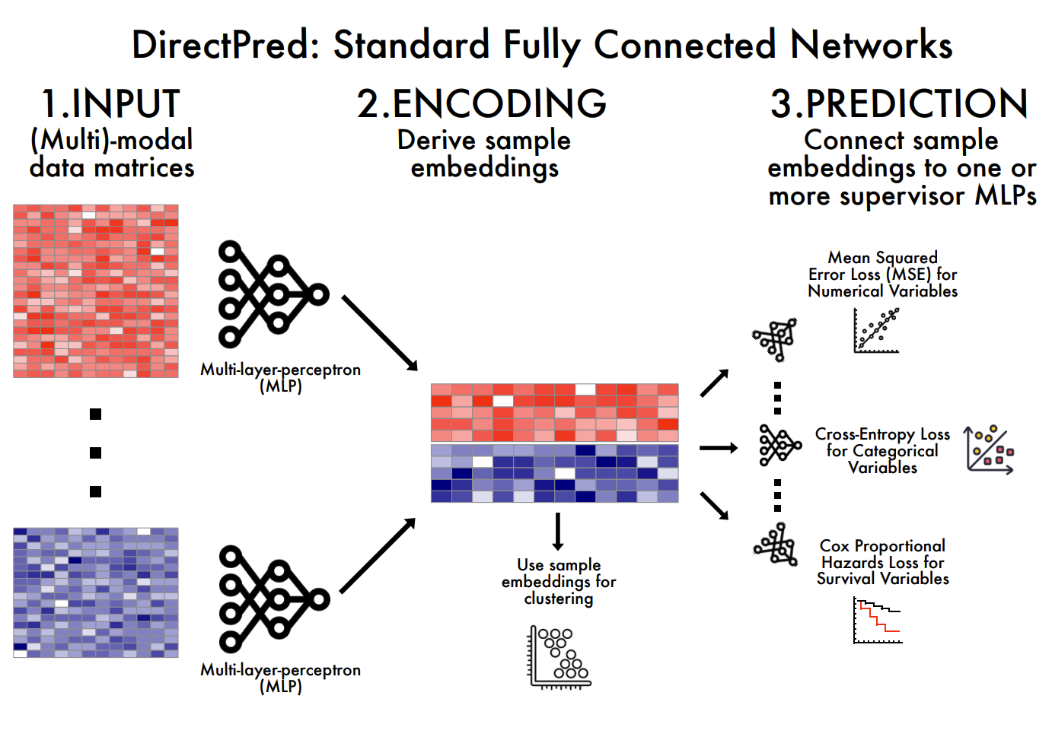

Slide 2
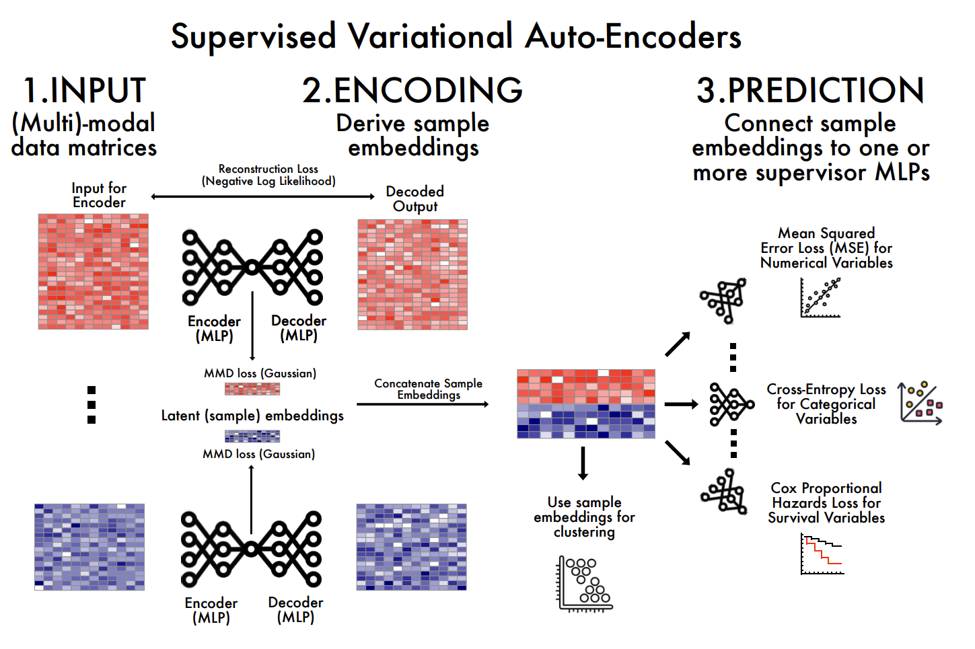

Slide 3
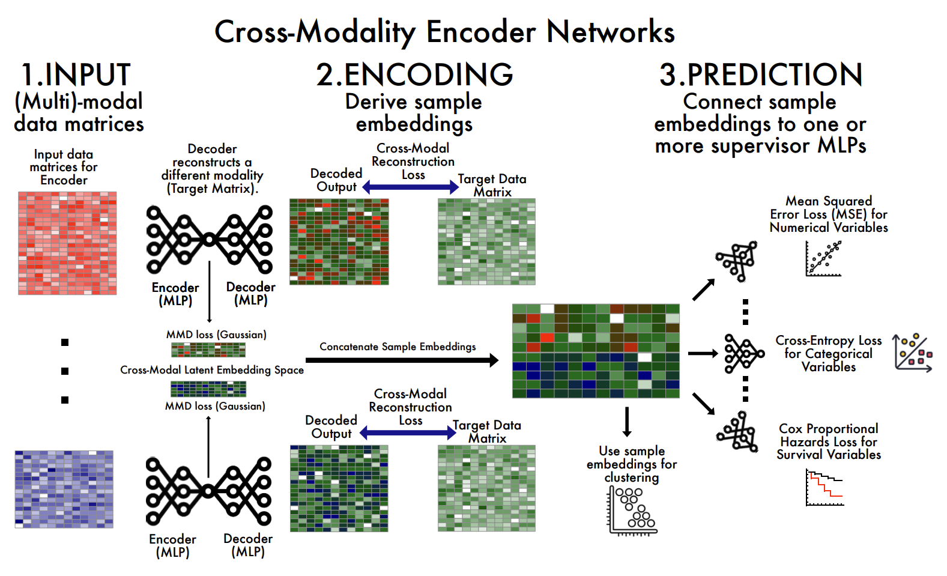

Slide 4
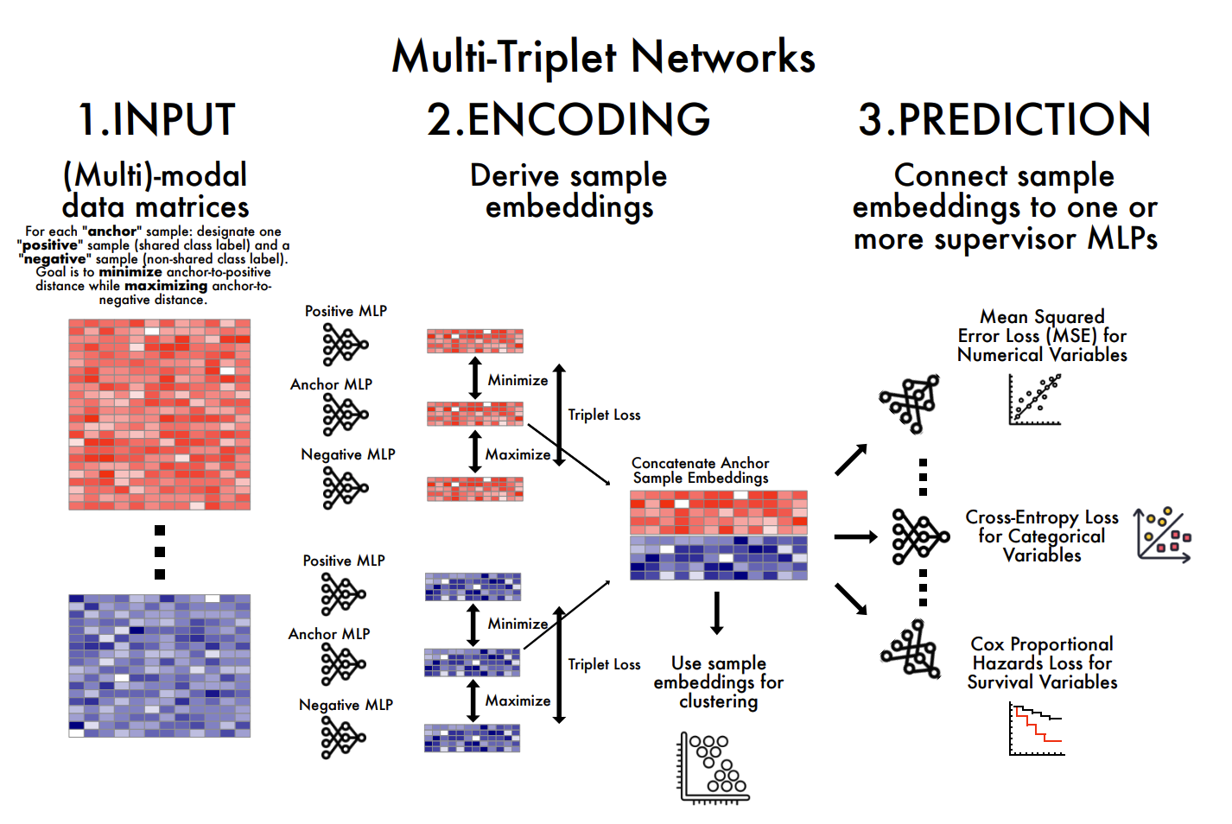

Slide 5
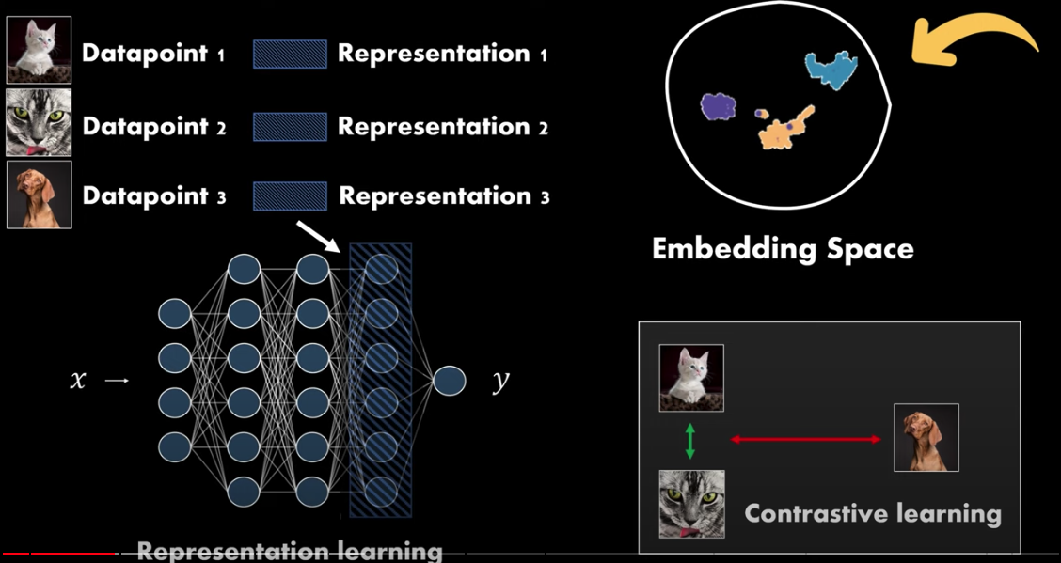
Contrastive Learning
DeepFindr: Contrastive Learning in PyTorch - Part 1: Introduction

Slide 6
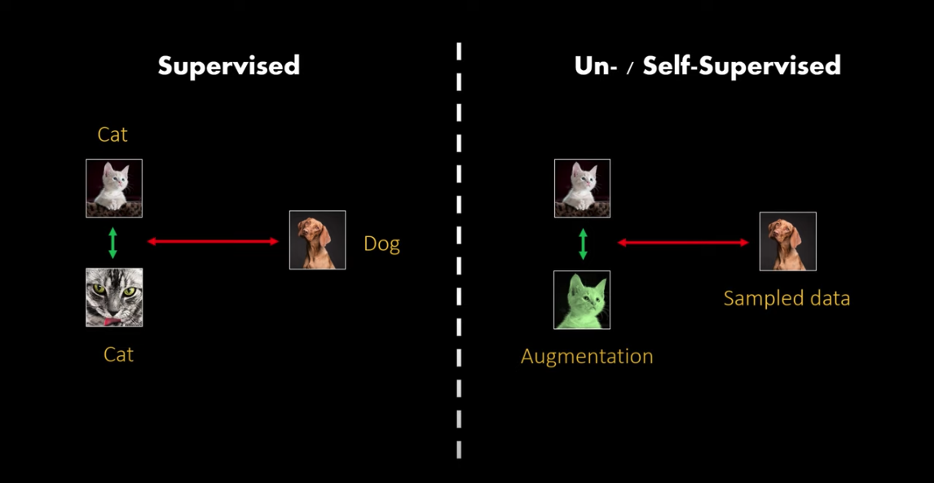
Contrastive Learning
DeepFindr: Contrastive Learning in PyTorch - Part 1: Introduction

Slide 7
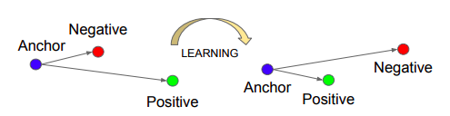
Triplet Loss
https://github.com/adambielski/siamese-triplet

Slide 8
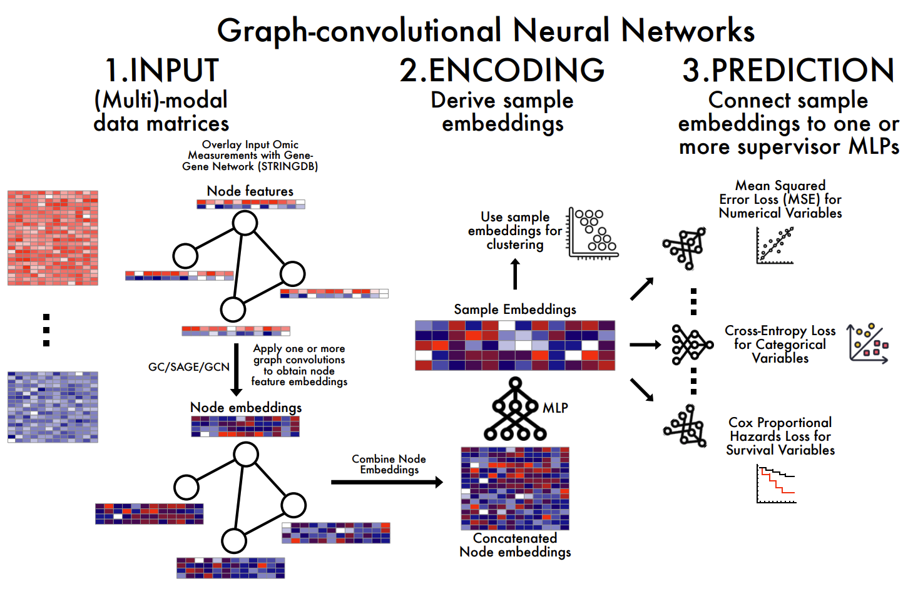

Slide 9
Flexynesis Command-Line Demo

Slide 10
Homework
https://github.com/BIMSBbioinfo/compgen_course_2025_module3/tree/main/homeworks/hw3

Slide 11


