Slide 1

“State-Of-Art Model based
Automatic Question Answering Systems”
Walchand College Of Engineering, Sangli
Department of Computer Science and Engineering
A Project by : 2017BTECS00061 Akash Kore 2017BTECS00099 Komal Jadhav
Under the Guidance of : Mr. K. P. Kamble

Slide 2
“State-Of-Art Model based Automatic Question Answering Systems”

Slide 3
INTRODUCTION
Descriptive Question Answering systems(DQuAS) is a natural language understanding problem, where the goal is to focus on generating effective descriptive answers to the questions based on the context provided.
DQuAS is developed by applying transfer learning approach, by using BERT model as the base and fine-tuning it on the SQuAD dataset to effectively work on question answering task.
The main motivation behind using transfer learning approach is to skip the computationally expensive training process.
The system effectively handles user query and document and generates descriptive answer.

Slide 4
MOTIVATION
In this era of data explosion, where data is streaming at an exponential rate, efficient strategies of data processing have become an important aspect.
There is very less research done on generating descriptive answers till date, there is no open dataset available for descriptive answers.
Manually searching answer into the entire text document for specific query is a tedious task for human to perform. The document can contain even>1 million words.
With that much information, DQuAS will become very handy tool to answer the queries in these scenarios.

Slide 5
RESEARCH PROBLEM
Use Transfer learning approach to improve the state-of-art transformer BERT based models for better functioning in the problem domain
Choose a suitable dataset for a Natural Language Model
Optimize the old approach to make it speed and scale effective.
Extending the performance of model from generating one-liner answer to descriptive answers
Extract information from the text file given as input and is able to answer every descriptive questions based on that

Slide 6
Literature Survey :
Sr. No | Paper | Remarks | Limitations
1. | paper[11]: BERT: Pre-training of Deep Bidirectional Transformers for Language Understanding | As stated in the papers, BERT can be fine-tuned to create “State of the art” models which can be used to perform multiple NLP tasks with our own datasets, such tasks as the Question-Answering system, Sentiment analysis, etc. So BERT has increased our capacity to do transfer learning in NLP. | While handling long text sequences, BERT can only support up to 512 tokens and this becomes one of the disadvantages while working on long-answers prediction tasks.
2. | paper[13]: RoBERTa: A ROBUSTLY OPTIMIZED BERT PRE TRAINING APPROACH. | RoBERTa has introduced a newer approach with BERT giving significantly improved results on various benchmarks such as GLUE (General Language Understanding Evaluation), SQuAD. The longer training with large data and bigger batch size strategy has worked out impressively. | Many newer architectures such as ALBERT, ELECTRA have outperformed RoBERTa on GLUE, and the current proposed architecture has many areas for improvements.
3. | paper[16]: ALBERT: A LITE BERT FOR SELF-SUPERVISED LEARNING OF LANGUAGE REPRESENTATIONS | ALBERT configurations were similar to BERT-large but it had 18x fewer parameters and can be trained about 1.7x faster. Also it was found that ALBERT-xxlarge has significantly better results than BERT-large despite having fewer parameters. | Though ALBERT reduces the parameter size as compared to BERT, but, the time to predict is still the same for both of the models. If ALBERT-xxlarge is used then the prediction time becomes slower.

Slide 7
Literature Survey :
Sr. No | Paper | Remarks | Limitations
4. | paper[17]: ELECTRA: PRE-TRAINING TEXT ENCODERS AS DISCRIMINATORS RATHER THAN GENERATOR | The authors have trained various sizes of ELECTRA modes and also evaluated their downstream performance against their compute requirements. Given the same model size and data ELECTRA model outperforms MLM-based methods like BERT and XLNet. Also, ELECTRA-small performs better than a small BERT model. | In the paper some negative results have been discussed::- 1) The authors attempt to make BERT more efficient by masking out tokens resulting in minor speedups over regular BERT. 2) Neither raising the temperature of the generator’s output softmax nor disallowing the generator from sampling the correct token improved ELECTRA’s result.
5. | paper[8]: An End-to-End Model for Question Answering over Knowledge Base with Cross Attention Combining Global Knowledge | In this paper, the authors state that to represent answers more accurately global KB information is used for maximum advantage. Also, global KB information cancels the out-of-vocabulary(OOV) problem, which is helpful for the cross-attention model. | One of the demerits of the system is on some occasions it is found that some of the attention weights can be unreasonable. It is expected that this is because of the bias of training data. Another challenge found in this paper is that of the complex questions.
6. | paper[10]: BI-DIRECTIONAL ATTENTION FLOW FOR MACHINE COMPREHENSION | With dynamic attention modeling, BiDAF has performed very well on SQUAD and CNN/Daily Mail datasets as it occurs to avoid information loss. | Very complex architecture, which seems to be less optimized as it is assembled together to perform better. And also BiDAF is a closed domain and extractive model, which is not ideal for the long answer based Q-A systems.

Slide 8
Literature Survey :
Sr. No | Paper | Remarks | Limitations
7. | paper[15]: XLNet: GENERALIZED AUTOREGRESSIVE PRE TRAINING FOR LANGUAGE UNDERSTANDING | The main advantage of XLNet was that it overcame the pretrain-finetune discrepancy issue of the BERT model and combine the abilities of the autoregressive language model and autoencoding language model reducing their standalone limitations Also it proved to be a better model for a Question Answering System based on the comparative results obtained from training it with different datasets. | One of the problems faced in XLNet was the standard transformer architecture. For predicting any sequence Xt, it does not depend upon the value of its position i.e Zt, therefore the same distribution was predicted regardless of the position and hence the model was not able to learn useful representations. However, this issue was resolved after the introduction of Two-Stream Self Attention.

Slide 9
OBJECTIVES
A QA system that is able to answer subjective questions of users.
To use appropriate NLP techniques to process user queries.
Use current state-of-art models to maximize efficiency.
Optimizing model to make it speed and scale efficient
Study about various application-based future scope of QA systems.

Slide 10
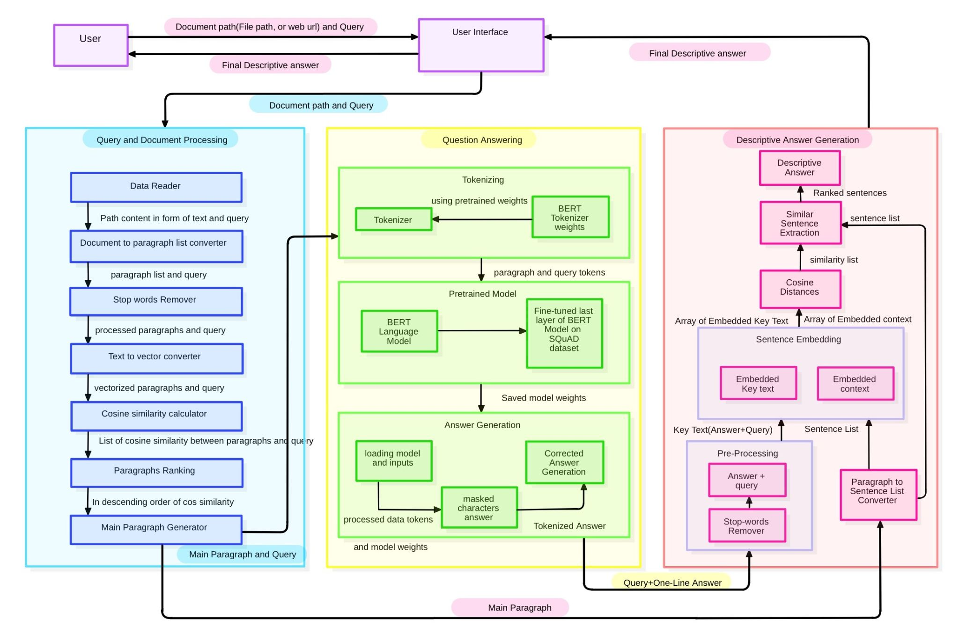
PROPOSED SYSTEM-ARCHITECTURE
Following is the architecture of the system that generates the Descriptive Answer:

Slide 11
PROPOSED SYSTEM- DESCRIPTION
At front-end the system consists:
User Interface
At the back-end there are 3 major components:
Main component: Question Answering Component
Optimizing Component:Query and Document Processing Component
Answer Generating Component: Descriptive answer Generation

Slide 12
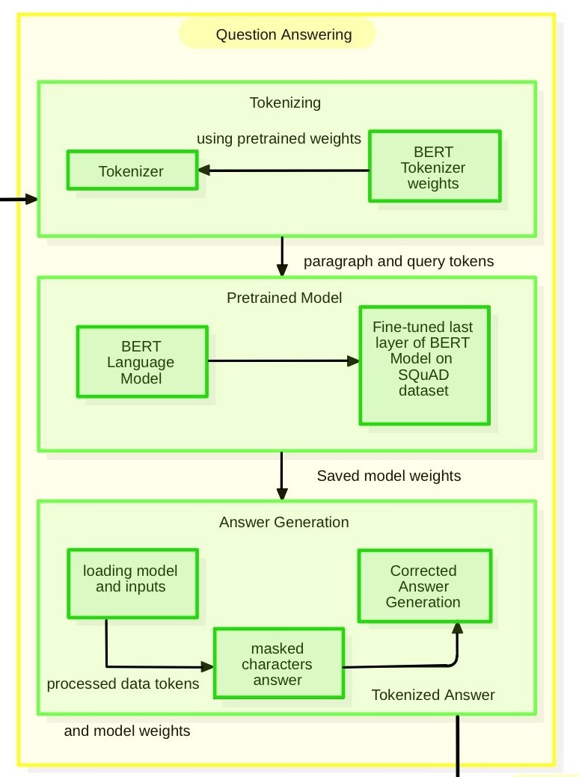
QUESTION ANSWERING COMPONENT
The Question Answering(QA) Component is the main component
Uses BERT model fine-tuned on SQuAD dataset
Inputs:
1. Context containing relevant information
2. Question- based on the Context
Output:
One-Liner answer of the given Question

Slide 13
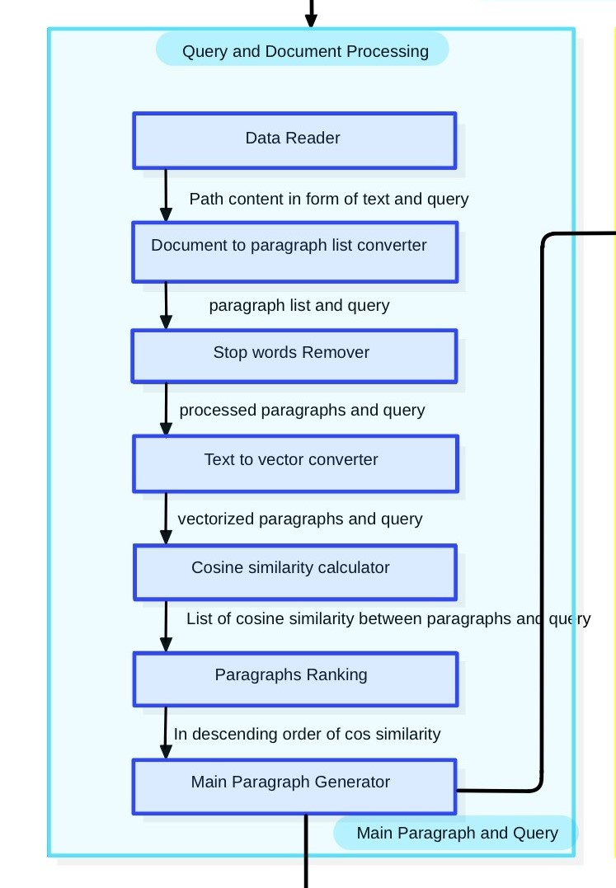
QUERY AND DOCUMENT PROCESSING COMPONENT
The Question Answering model alone is very slow, its time increases greatly with increase in the size of context provided.
Large contexts having lot of data contains small portion which has the answer of the particular query. They also contain lot of paragraphs
Query and Document processing(QnDP) Component extracts only those paragraphs that are most likely to contain the actual answer of the query.
Input:
1. Text document containg large context
2. Query based on the context
Output:
1. main paragraph (concatenating the first 10 ranked paragraphs)
2. Query

Slide 14
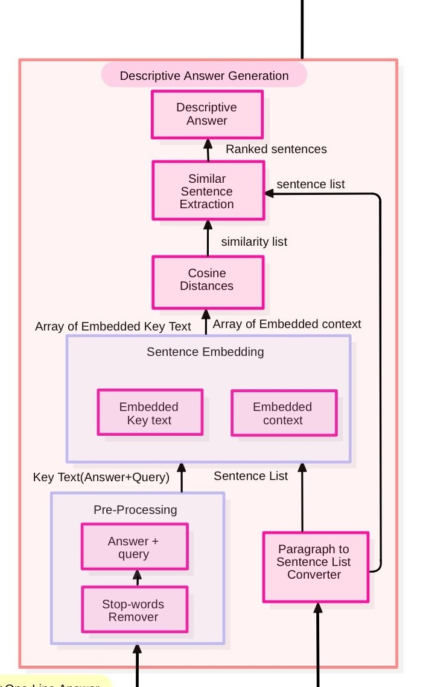
DESCRIPTIVE ANSWER GENERATION COMPONENT
The Question Answering model alone is able to generate only one liner answer.
Objective is to generate a descriptive answer that is closely related to the one-line answer and the query. This task is done by the Descriptive answer Generation Component
Input:
1. Main paragraph generated by QnDP component
2. One-line answer by QA component
3. Query
Output:
1. Descriptive answer of the query.

Slide 15
Tools and Technologies
Techniques:
Natural Language Processing, Machine Learning, Deep Learning
Language:
Python3,
Libraries :
nltk, pyTorch / tensorflow 2.0, pyPDF2, beautifulsoup4
Framework:
Django 3.0(Web Framework)
DATASET:
SQuAD: Stanford Question answering Dataset

Slide 16
TESTING-SYSTEM
The proposed system was tested and results were obtained on following:
Fine-tuning BERT model
Speed and Scale
Descriptive Answer Generation

Slide 17
RESULTS- Fine Tuning BERT Model
Sr. No. | Scenario | Input | Outcome | Result
1 | Setting max_seq_length and batch size | for max_seq_length = 256 and batch_size = 16 for max_seq_length = 128 and batch_size = 8 | On Cloud GPU: Execution terminated due to out-of-memory Successfully executed | Failure Success
2 | Verifying if sentences are embedded properly | dict_embedding[Sentence][index] | array([-0.05209418, 0.07462937, 0.05871293, ..., 0.08557521, 0.00767955, -0.00119523], dtype=float32) | Success
3 | If the model is trained successfully | model.evaluate(model,tokenizer) | { Precision : 0.8381 Recall : 0.7160 Accuracy : 0.9733 F1 Score : 0.7582 } | Success
4 | Answer Prediction | model.predict(context, query) | Answer | Success

Slide 18
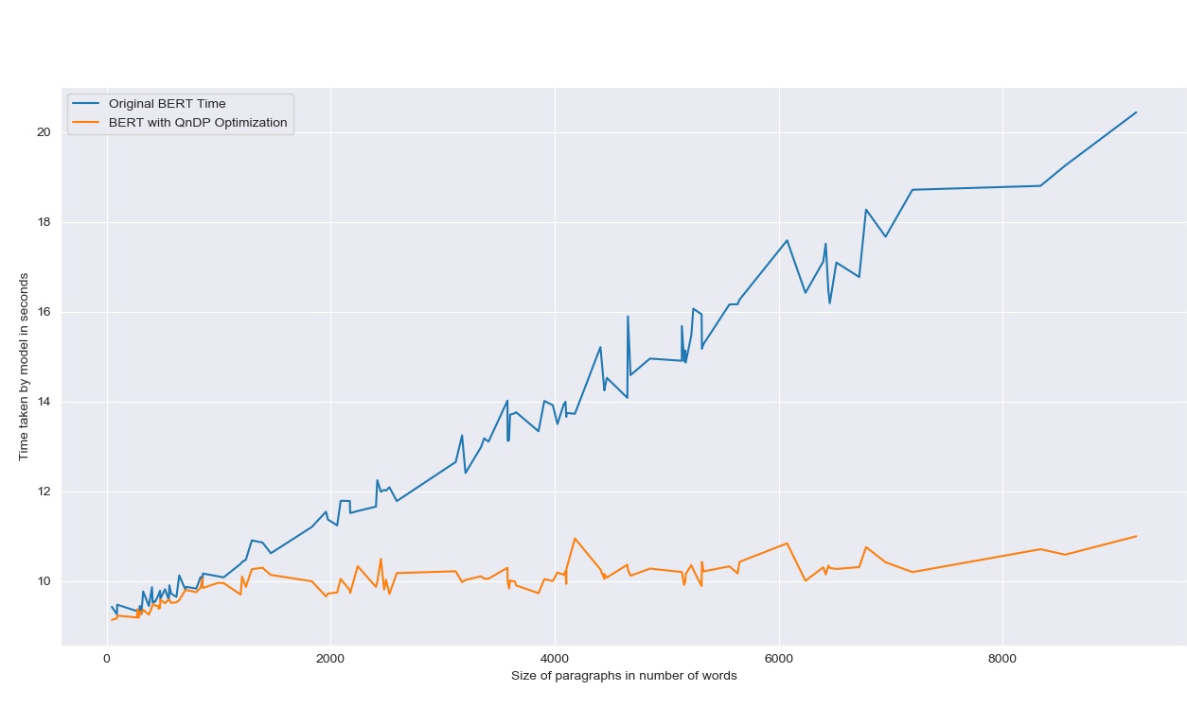
RESULTS- Speed and Scale
Procedure:
112 text documents were created by collecting random articles from the web. Each document consists of a context and two questions based on the context.
The documents were created based on the increasing size of the number of words per document. The minimum number of words were 46 and maximum number of words were 9190.
A csv file was then created, consisting of three columns: Path of document, Question 1 and question 2.
Using the data from the csv file, 2 models were run, one that consists of Stand-alone BERT, fine-tuned on SQuAD dataset, and other with Query and Document processing and BERT fine-tuned on squad.
Time was noted in both the models to process the document to find the answer of the question using following formula:
Time for one document = Average(Time for finding answer of question 1+ Time for finding answer of question 2)
Then the graph of time against size of documents(number of words) was plotted.
Graph of Time comparison between Stand-alone fine-tuned BERT and fine-tuned BERT with QnDP optimization on Custom-made dataset.

Slide 19
Implementation(A)
Article Link : https://en.wikipedia.org/wiki/Artificial_intelligence
Question : What is Natural Language Processing?
One-line answer: allows machines to read and understand human language
Descriptive answer generated :
Natural language processing (NLP) allows machines to read and understand human language. Some straightforward applications of natural language processing include information retrieval, text mining, question answering and machine translation. A sufficiently powerful natural language processing system would enable natural-language user interfaces and the acquisition of knowledge directly from human-written sources, such as newswire texts. The easy problem is understanding how the brain processes signals, makes plans and controls behavior.

Slide 20
Implementation(B)
Article Link : https://en.wikipedia.org/wiki/Artificial_intelligence
Question : What is Artificial intelligence?
One-line answer: intelligence demonstrated by machines
Descriptive answer generated :
Artificial intelligence (AI) is intelligence demonstrated by machines, unlike the natural intelligence displayed by humans and animals, which involves consciousness and emotionality. Colloquially, the term "artificial intelligence" is often used to describe machines that mimic "cognitive" functions that humans associate with the human mind, such as "learning" and "problem solving".AI is relevant to any intellectual task. Modern artificial intelligence techniques are pervasive and are too numerous to list here. These characters and their fates raised many of the same issues now discussed in the ethics of artificial intelligence.The overall research goal of artificial intelligence is to create technology that allows computers and machines to function in an intelligent manner. Oracle CEO Mark Hurd has stated that AI "will actually create more jobs, not less jobs" as humans will be needed to manage AI systems. Superintelligence may also refer to the form or degree of intelligence possessed by such an agent. The general problem of simulating (or creating) intelligence has been broken down into sub-problems.

Slide 21
Descriptive Answer Example 1:
Q. Who is considered as the father of the computer?
Ans:
Charles Babbage, an English mechanical engineer and polymath, originated the concept of a programmable computer. Considered the "father of the computer", he conceptualized and invented the first mechanical computer in the early 19th century. Turing proposed a simple device that he called "Universal Computing machine" and that is now known as a universal Turing machine. While popular usage of the word "computer" is synonymous with a personal electronic computer, the modern definition of a computer is literally: "A device that computes, especially a programmable [usually] electronic machine that performs high-speed mathematical or logical operations or that assembles, stores, correlates, or otherwise processes information." Turing machines are to this day a central object of study in theory of computation. The fundamental concept of Turing's design is the stored program, where all the instructions for computing are stored in memory.

Slide 22
Descriptive Answer Example 2:
Q. What is modern computers?
Ans:
While popular usage of the word "computer" is synonymous with a personal electronic computer, the modern definition of a computer is literally: "A device that computes, especially a programmable [usually] electronic machine that performs high-speed mathematical or logical operations or that assembles, stores, correlates, or otherwise processes information." [citation needed] Conventionally, a modern computer consists of at least one processing element, typically a central processing unit (CPU) in the form of a microprocessor, along with some type of computer memory, typically semiconductor memory chips. A broad range of industrial and consumer products use computers as control systems. The defining feature of modern computers which distinguishes them from all other machines is that they can be programmed. This usage of the term referred to a human computer, a person who carried out calculations or computations. ), output devices (monitor screens, printers, etc. Any device which processes information qualifies as a computer, especially if the processing is purposeful. The control unit, ALU, and registers are collectively known as a central processing unit (CPU). In fact, the number of computers that are networked is growing phenomenally.

Slide 23
Descriptive Answer Example 3:
Q. What is natural language processing ?
Ans:
Natural language processing (NLP) allows machines to read and understand human language. Some straightforward applications of natural language processing include information retrieval, text mining, question answering and machine translation. A sufficiently powerful natural language processing system would enable natural-language user interfaces and the acquisition of knowledge directly from human-written sources, such as newswire texts. Colloquially, the term "artificial intelligence" is often used to describe machines that mimic "cognitive" functions that humans associate with the human mind, such as "learning" and "problem solving". For example, even specific straightforward tasks, like machine translation, require that a machine read and write in both languages (NLP), follow the author's argument (reason), know what is being talked about (knowledge), and faithfully reproduce the author's original intent (social intelligence). A problem like machine translation is considered "AI-complete", because all of these problems need to be solved simultaneously in order to reach human-level machine performance.

Slide 24
Descriptive Answer Example 4:
Q. What is Artificial Intelligence?
Ans:
The overall research goal of artificial intelligence is to create technology that allows computers and machines to function in an intelligent manner. Colloquially, the term "artificial intelligence" is often used to describe machines that mimic "cognitive" functions that humans associate with the human mind, such as "learning" and "problem solving". Artificial intelligence (AI) is intelligence demonstrated by machines, unlike the natural intelligence displayed by humans and animals, which involves consciousness and emotionality. If a machine can be created that has intelligence, could it also feel? Computationalism is the position in the philosophy of mind that the human mind or the human brain (or both) is an information processing system and that thinking is a form of computing. Dick considers the idea that our understanding of human subjectivity is altered by technology created with artificial intelligence.

Slide 25
Descriptive Answer Example 5:
Q. How Python's development is conducted?
Ans:
Python's development is conducted largely through the Python Enhancement Proposal (PEP) process, the primary mechanism for proposing major new features, collecting community input on issues and documenting Python design decisions. As a scripting language with modular architecture, simple syntax and rich text processing tools, Python is often used for natural language processing. Python is commonly used in artificial intelligence projects and machine learning projects with the help of libraries like TensorFlow, Keras, Pytorch and Scikit-learn. Python is used extensively in the information security industry, including in exploit development. Python allows programmers to define their own types using classes, which are most often used for object-oriented programming. Python coding style is covered in PEP 8. The prefix Py- is used to show that something is related to Python. Examples of the use of this prefix in names of Python applications or libraries include Pygame, a binding of SDL to Python (commonly used to create games); PyQt and PyGTK, which bind Qt and GTK to Python respectively; and PyPy, a Python implementation originally written in Python.

Slide 26
Descriptive Answer Evaluation:
The method that will be used to evaluate descriptive answers is Human-Based Evaluation due to following reasons:
There is no open dataset available for Descriptive Answers
The answer generated is in natural language and without standard dataset, only human-based evaluation can evaluate it with good precision.
The methodology to evaluate descriptive answer is based on following rules,
Each question will be evaluated by 4 different volunteers and average of those scores will be considered as final score for that question.
The evaluation will be done on the following parameters :
Is the desired answer present in the given context?
Does the answer satisfy the user’s intent?
Is the answer helpful (contains all keywords and required sentences)?
Is the answer meaningful(The sentences follows each other meaningfully)?
No developer will participate in evaluation process to keep it impartial.

Slide 27
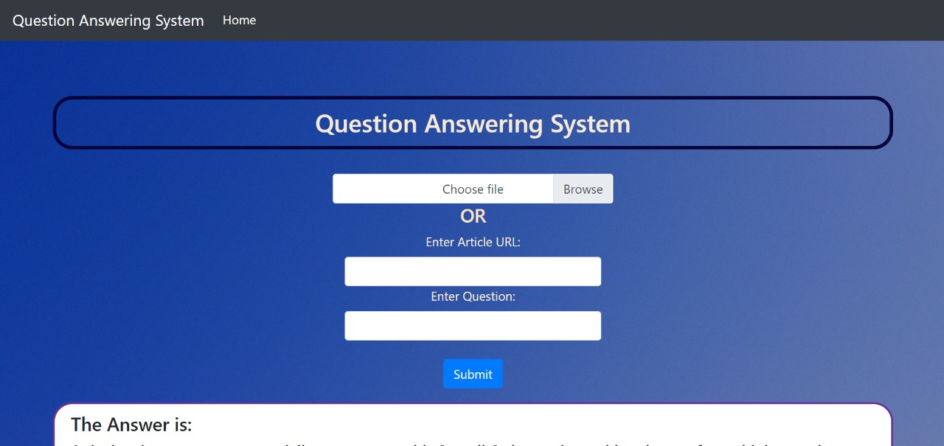
User interface

Slide 28
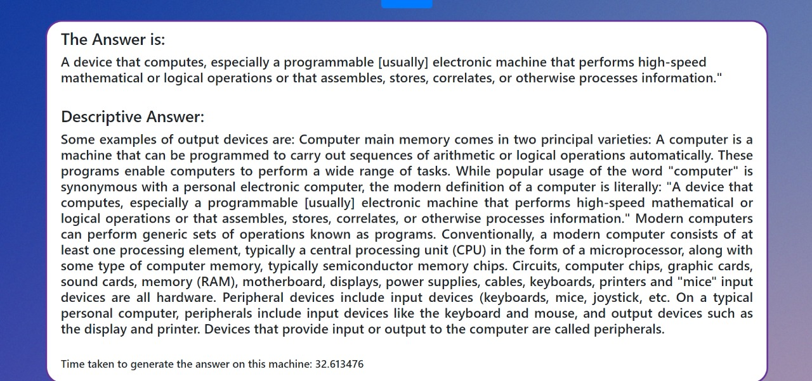
User interface

Slide 29
RESULTS
These are the comparison between old vs new approach to QA systems
Type | Previous Scores (Base Model) | Proposed Scores (Proposed Model)
Precision | 0.776 | 0.840
Recall | 0.5 | 0.719
Corrected | 0.89 | 0.973
F1-Score | 0.608 | 0.761

Slide 30
RESULTS- Descriptive Answer Evaluation:
Phase 1 : 60 wikipedia articles with 2 questions each
Avg. Score(S) Range | No. of Questions | Percentage
S >= 9 | 12 | 10%
9 > S >= 8 | 46 | 38.33%
8 > S >=7 | 40 | 33.33%
7 > S | 22 | 18.33%
Highest avg. score scored by any answer is 9.875
Lowest avg. score scored by any answer is 4.5
Average of overall Evaluation is 7.9
Evaluation Spreadsheet link : https://docs.google.com/spreadsheets/d/1gWAxiFCPudAzwYlvtbM45I2pVPB1KHM7lpJkZl-uFJo/edit?usp=sharing

Slide 31
Conclusion and Future Scope
Conclusion:
We described the need of Descriptive Question Answering systems
How The proposed system improves the overall performance of stand-alone BERT
Came up with the human-based Evaluation of the descriptive answers.
Future Scope:
Currently, we are providing the text document/url of the context along with question, so we can further improve it by searching the relevant document on its own. We can use search engines to extract relevant documents(Top ranked documents) and implement the system.

Slide 32
REFERENCES
[1] B. Green, Jr., A. Wolf, K. Laughery and C. Chomsky, "Baseball, an Automatic Question-Answerer," in Managing Requirements Knowledge, International Workshop on, LOS ANGELES, 1961 pp. 219. doi: 10.1109/AFIPS.1961.20 url: https://doi.ieeecomputersociety.org/10.1109/AFIPS.1961.20
[2] Wang, Auer J., R. Parasuraman, I. Zubarev, D. Brandyberry, and M.P. Harper. 2000.A Question Answering System Developed as a Project in a Natural Language Processing Course. InANLP/NAACL Workshop on Reading Comprehension Tests as Evaluation for Computer-Based Language Understanding Systems
[3] H. Gómez-Adorno, D. Pinto, and D. Vilariño, “A Question Answering System for Reading Comprehension Tests,” in 5th Mexican Conference, MCPR 2013, 2013, vol. 1087, pp. 354–363. doi:10.1007/978-3-642-38989-4_36.
[4] Amit Mishra, Sanjay Kumar Jain, A survey on question answering systems with classification, Journal of King Saud University - Computer and Information Sciences, Volume 28, Issue 3, 2016, Pages 345-361, ISSN 1319-1578, https://doi.org/10.1016/j.jksuci.2014.10.007. (http://www.sciencedirect.com/science/article/pii/S1319157815000890)
[5] S. P. Lende and M. M. Raghuwanshi, "Question answering system on education acts using NLP techniques," 2016 World Conference on Futuristic Trends in Research and Innovation for Social Welfare (Startup Conclave), Coimbatore, 2016, pp. 1-6, doi: 10.1109/STARTUP.2016.7583963.
[6] Pranav Rajpurkar, Jian Zhang, Konstantin Lopyrev, and Percy Liang. 2016. Squad: 100,000+ questions for machine comprehension of text. In Proceedings of the 2016 Conference on Empirical Methods in Natural Language Processing, pages 2383–2392.

Slide 33
REFERENCES
[7] Abdi, A., Idris, N. & Ahmad, Z. QAPD: an ontology-based question answering system in the physics domain. Soft Comput 22, 213–230 (2018). https://doi.org/10.1007/s00500-016-2328-2
[8] Yanchao Hao, Yuanzhe Zhang, Kang Liu, Shizhu He, Zhanyi Liu, Hua Wu, and Jun Zhao. An end-to-end model for question answering over knowledge base with cross-attention combining global knowledge. InProceedings of the 55th Annual Meeting of the Association for Computational Linguistics (Volume 1: Long Papers), volume 1, pp. 221–231, 2017.
[9] Trischler, T. Wang, X. Yuan, J. Harris, A. Sordoni,P. Bachman, and K. Suleman. 2017. NewsQA: A machine comprehension dataset. In Workshop on Representation Learning for NLP.
[10] Minjoon Seo, Aniruddha Kembhavi, Ali Farhadi, and Hannaneh Hajishirzi. 2017. Bidirectional attention flow for machine comprehension. InICLR.
[11] J. Devlin, M.-W. Chang, K. Lee, and K. Toutanova, “Bert: Pre-training of deep bidirectional transformers for language understanding,”arXiv preprint arXiv:1810.04805, 2018.
[12] Tom Kwiatkowski, Jennimaria Palomaki, Olivia Redfield, Michael Collins, Ankur Parikh, Chris Alberti, Danielle Epstein, Illia Polosukhin,Matthew Kelcey, Jacob Devlin, Kenton Lee,Kristina N. Toutanova, Llion Jones, Ming-WeiChang, Andrew Dai, Jakob Uszkoreit, QuocLe, and Slav Petrov. 2019. Natural questions:a benchmark for question answering research.Transactions of the Association of Computa-tional Linguistics (TACL).

Slide 34
REFERENCES
[13] Liu, Y., Ott, M., Goyal, N., Du, J., Joshi, M., Chen, D., Levy, O., Lewis, M., Zettlemoyer,L., & Stoyanov, V. (2019). Roberta: A robustly optimized bert pretraining approach.arXiv preprint arXiv:1907.11692.
[14] Lok Prasad Acharya, A Systematic Approach for Automatically Answering General-Purpose Objective and Subjective Questions, A dissertation submitted to Florida Institute of Technology in partial fulfillment of the requirements for the degree of, Melbourne, Florida December,2019, url: http://hdl.handle.net/11141/2910
[15] Zhilin Yang, Zihang Dai, Yiming Yang, Jaime Carbonell, Ruslan Salakhutdinov, and Quoc V Le. XLNet: Generalized autoregressive pre-training for language understanding. arXiv preprint arXiv:1906.08237, 2019.
[16] Zhenzhong Lan, Mingda Chen, Sebastian Goodman, Kevin Gimpel, Piyush Sharma, and Radu Soricut. Albert: A lite bert for self-supervised learning of language representations. arXiv preprint arXiv:1909.11942, 2019.
[17] Clark, K., Luong, M.-T., Le, Q. V., and Manning, C. D.ELECTRA: Pre-training text encoders as discriminators rather than generators. In International Conference on Learning Representations,2020. arXiv:2003.10555v1 [cs.CL]
[18] Ashish Vaswani, Noam Shazeer, Niki Parmar, Jakob Uszkoreit, Llion Jones, Aidan N Gomez, Lukasz Kaiser, and Illia Polosukhin. 2017. Attention is all you need. In Advances in Neural Information Processing Systems, pages 6000–6010.

Slide 35
Video Link
Project demo can be viewed through following video link
https://drive.google.com/file/d/1xbiDkFRBXKmbaiUyIetQNzPDRLl9EKhY/view?usp=sharing

Slide 36
Thank You

