Slide 1
Common Security Vulnerabilities
Understanding Threats in Modern Computing

Slide 2


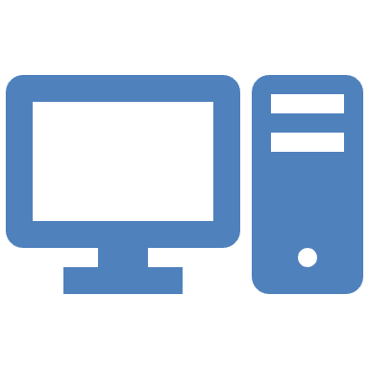

Why Security Vulnerabilities Matter
Data breaches can cost millions
Trust and reputation are at risk
Attackers exploit the weakest link
Understanding is preventing

Slide 3



What is a Security Vulnerability?
A flaw or weakness in a system
Can be exploited to compromise CIA (Confidentiality, Integrity, Availability)
Exists in software, hardware, or processes

Slide 4

What is a Weakness?
Weakness: vulnerability that adversaries can exploit to compromise the security of a system.

Slide 5
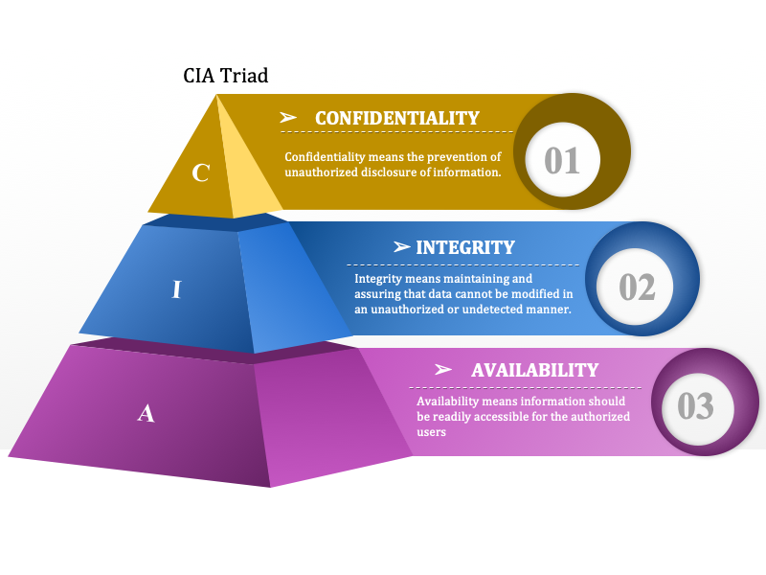
CIA
(Confidentiality, Integrity, Availability)
Photo courtesy of: NATO
Notes:
Confidentiality means the prevention of unauthorized disclosure of information.
Integrity means maintaining and ensuring that data cannot be modified in an unauthorized manner.
Availability means information should be readily accessible for the authorized users.

Slide 6
1. SQL Injection
Malicious SQL code to manipulate databases
Example: `' OR 1=1--`
Impact: Unauthorized access, data leaks
Mitigation: Parameterized queries, ORM, input validation

Slide 7
2. Cross-Site Scripting (XSS)
Injecting malicious scripts into web pages. Types: Stored, Reflected, DOM-based
Impact: Session hijacking, defacement
Mitigation: Encode output, Content Security Policy(CSP)

Slide 8
3. Broken Authentication
Poor session management or weak passwords can lead to account takeover
Impact: Account takeover
Mitigation: MFA, password hashing, session expiration
Notes:
More than 78% of people use the same password for more than one account.

Slide 9
4. Security Misconfiguration
Default
Default settings, open S3 buckets, verbose error messages
Impact
Impact: Easy attack surface
Harden
Mitigation: Harden configurations, regular audits

Slide 10
5. Sensitive Data Exposure
Insecure storage or transmission of PII/PHI
Impact: Identity theft, legal consequences
Mitigation: TLS (Transport Layer Security), encryption at rest, secure key management

Slide 11
6. Insecure Deserialization
Malicious object injection
Impact: Remote code execution
Mitigation: Avoid unserializing untrusted data

Slide 12
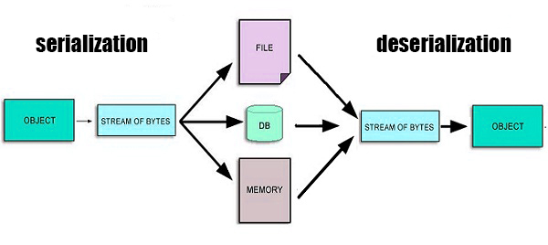
What is deserialization?
Deserialization is the process of converting data from a serialized format (like JSON or XML) back into a usable object or data structure within a program.
Photo courtesy of: Wikipedia

Slide 13
7. Using Components with Known Vulnerabilities
Third-party libraries with CVEs (Common vulnerabilities and exposures)
Impact: Indirect compromise
Mitigation: Software Composition Analysis (SCA), update dependencies

Slide 14
8. Insufficient Logging & Monitoring
No detection or response to intrusions
Impact: Delayed breach discovery
Mitigation: Centralized logging, alerts, incident response plan

Slide 15
OWASP Top 10 Summary
Overview of the latest OWASP Top 10
A1–A10 quick rundown
Use it as a checklist for secure dev

Slide 16
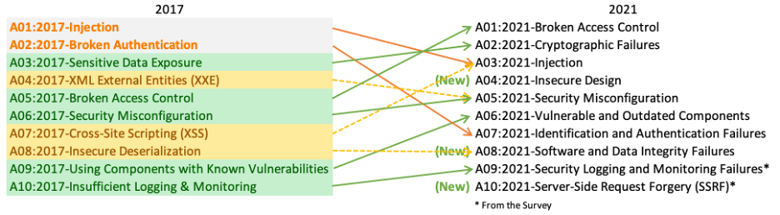
Constantly Evolving Threats
Photo courtesy of: OWASP.org

Slide 17
Tools & Practices for Defense
Static & Dynamic Analysis (SAST/DAST)
Penetration testing
Secure Coding Training
DevSecOps

Slide 18




Key Takeaways
ALWAYS VALIDATE INPUT
SECURE BY DESIGN, NOT AS AN AFTERTHOUGHT
UPDATE AND PATCH REGULARLY
EDUCATE ALL STAKEHOLDERS

