Slide 1
Secure Software Development Lifecycle (SSDLC)
Understanding SSDLC Principles in Software Development

Slide 2
Introduction to SSDLC
Secure Software Development Lifecycle (SSDLC) integrates security at every phase.
It minimizes vulnerabilities and ensures compliance with security standards.
Security is not an afterthought but an integral part of development.

Slide 3
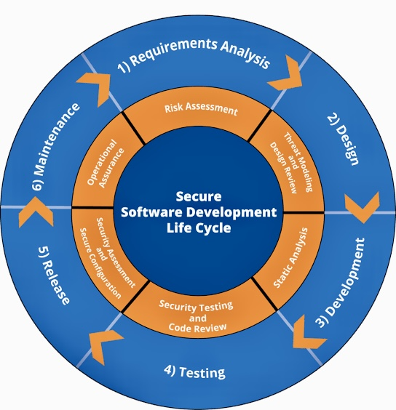
Introduction to SSDLC

Slide 4
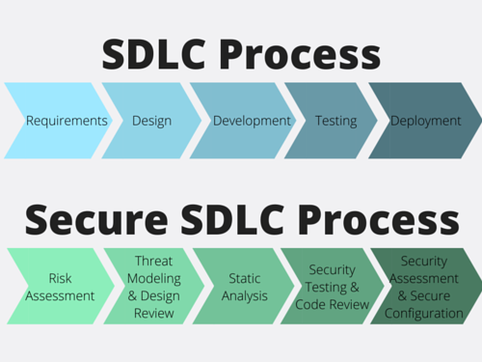
SDLC vs. SSDLC
Photo courtesy of: CheckMarx

Slide 5
Phases of SSDLC
Planning & Requirements – Identify security needs early.
Design – Threat modeling and secure architecture.
Implementation – Follow secure coding practices.
Testing – Conduct static, dynamic, and penetration tests.
Deployment & Maintenance – Secure deployment and patch management.

Slide 6
Key SSDLC Principles
Security by Design – Embed security from the start.
Least Privilege – Restrict access to essential permissions.
Defense in Depth – Use multiple layers of security controls.
Secure Default Settings – Ensure security is enabled by default.
Continuous Monitoring & Improvement – Regular security audits.

Slide 7



Tools & Best Practices
SECURITY TESTING TOOLS – SAST, DAST, IAST FOR CODE ANALYSIS.
DEVSECOPS – AUTOMATE SECURITY CHECKS IN CI/CD PIPELINES.
COMPLIANCE – FOLLOW ISO 27001, NIST, AND OWASP GUIDELINES.

Slide 8



Case Study: SSDLC in Real-World Applications
EXAMPLE: IMPLEMENTING SSDLC IN A FINANCIAL APPLICATION.
THREAT MODELING IDENTIFIES RISKS EARLY.
SECURE CODING PREVENTS VULNERABILITIES.
AUTOMATED SECURITY TESTING ENSURES COMPLIANCE.

Slide 9
Conclusion & Next Steps
SSDLC enhances security throughout the software lifecycle.
Organizations should integrate security at every stage.
Continuous training and security awareness are crucial.
Start implementing SSDLC today for robust software security!

Slide 10
References
NIST. (2022). Secure Software Development Framework (SSDF), Version 1.1. SP 800-218. https://csrc.nist.gov/publications/detail/sp/800-218/final
OWASP. (2023). OWASP Software Assurance Maturity Model (SAMM). https://owaspsamm.org/blog/2025/02/09/owasp-samm-skills-framework/
ISO. (2013). ISO/IEC 27001:2013 – Information Security Management. https://www.iso.org/standard/54534.html
Microsoft. (2021). Microsoft Security Development Lifecycle (SDL). https://www.microsoft.com/en-us/securityengineering/sdl
SANS Institute. (2020). Secure Software Development Life Cycle: A Guide for Developers and Security Professionals. https://www.sans.org/white-papers/
Shostack, A. (2014). Threat Modeling: Designing for Security. Wiley.

