Slide 1
OWASP Top 10 Software Vulnerabilities
Most Common Software Risks in Modern Applications

Slide 2


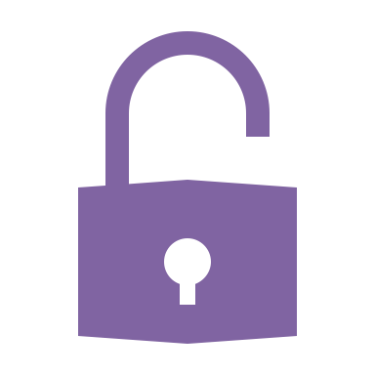
1. Broken Access Control
Users can act outside of intended permissions
Examples: URL manipulation, privilege escalation
Mitigation: Enforce least privilege, deny by default

Slide 3
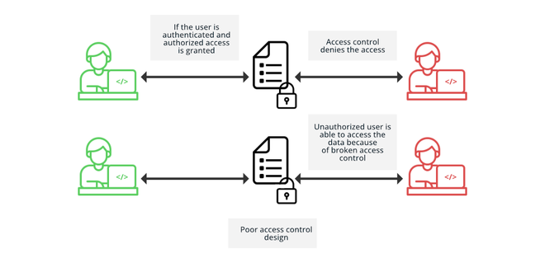
Photo courtesy of: GeeksForGeeks

Slide 4
Cryptographic Failures
Previously known as 'Sensitive Data Exposure'
Examples: Weak encryption, missing HTTPS
Mitigation: Use modern encryption standards, HTTPS everywhere

Slide 5
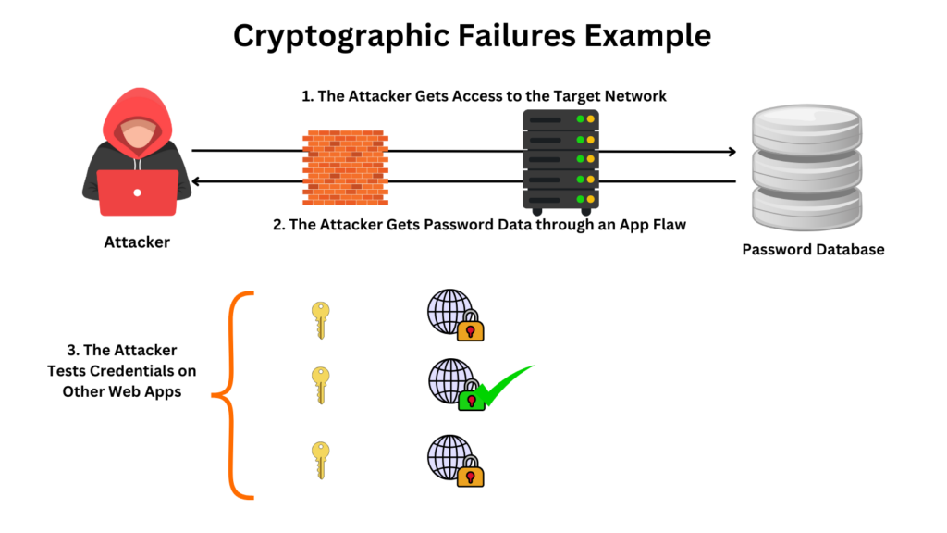
Photo courtesy of: cybersecuritynews.com

Slide 6
Injection
Includes SQL, NoSQL, OS, and LDAP injection
Examples: `' OR 1=1--`
Mitigation: Input validation, use safe APIs (e.g., parameterized queries)

Slide 7
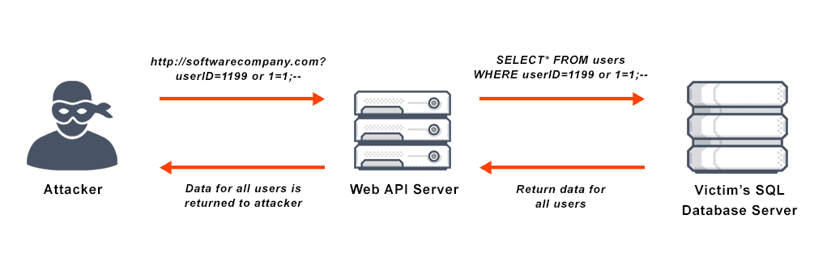
Photo courtesy of: VMWare

Slide 8
Insecure Design
Inherent design flaws rather than implementation bugs
Examples: Missing security controls in workflows
Mitigation: Threat modeling, secure design patterns

Slide 9
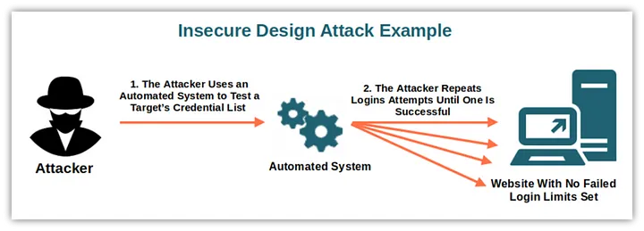
Photo courtesy of: Savvy Security

Slide 10

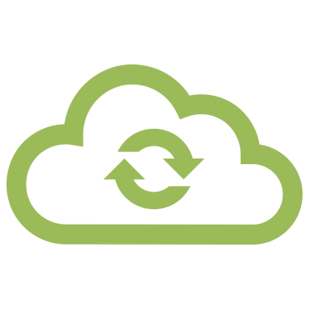
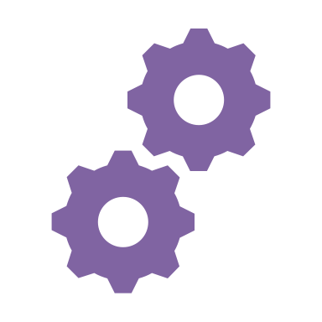
Security Misconfiguration
Default settings, incomplete configurations
Examples: Open cloud storage, verbose error messages
Mitigation: Harden environments, automated configuration management

Slide 11
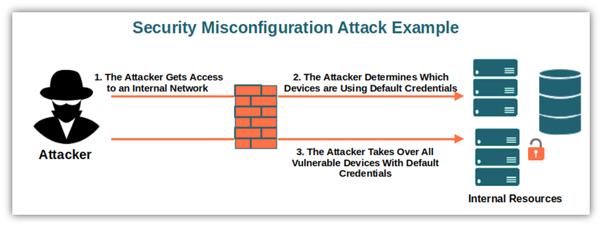
Photo courtesy of: Savvy Security

Slide 12
Vulnerable and Outdated Components
Use of libraries or platforms with known flaws
Examples: Unpatched software, end-of-life dependencies
Mitigation: Dependency scanning, version control

Slide 13
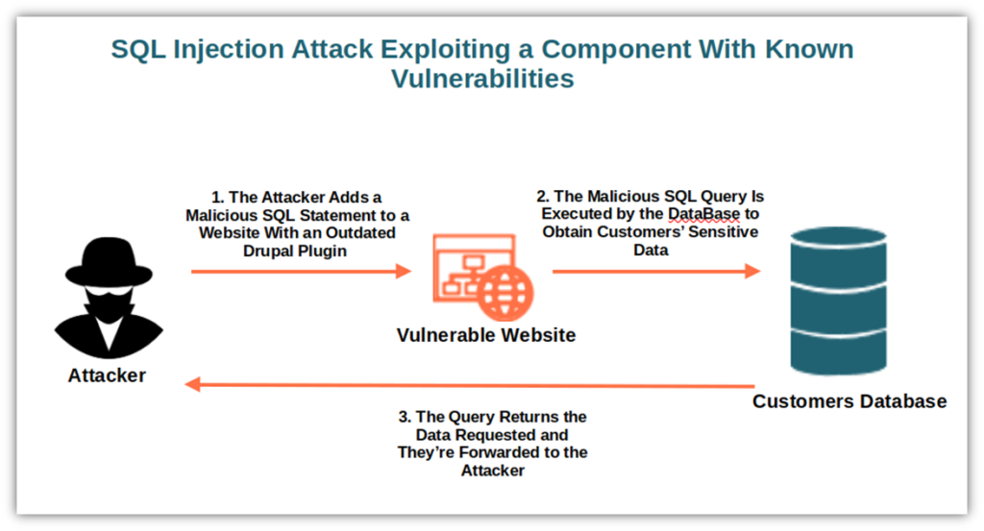
Photo courtesy of: Savvy Security

Slide 14
Identification and Authentication Failures
Issues with user authentication and session management
Examples: Weak passwords, predictable session IDs
Mitigation: MFA, secure session handling

Slide 15
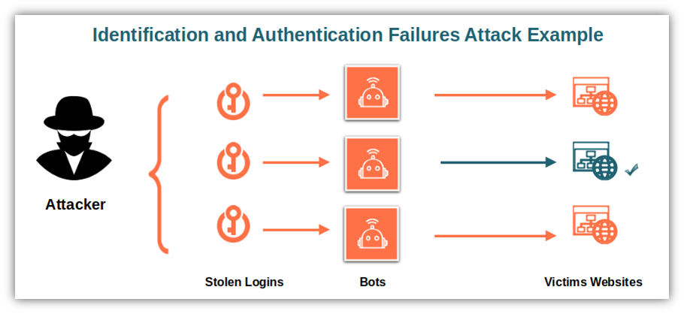
Photo courtesy of: Savvy Security

Slide 16
Software and Data Integrity Failures
Relying on untrusted software updates or plugins
Examples: CI/CD pipeline tampering, unsigned code
Mitigation: Use digital signatures, integrity checks

Slide 17
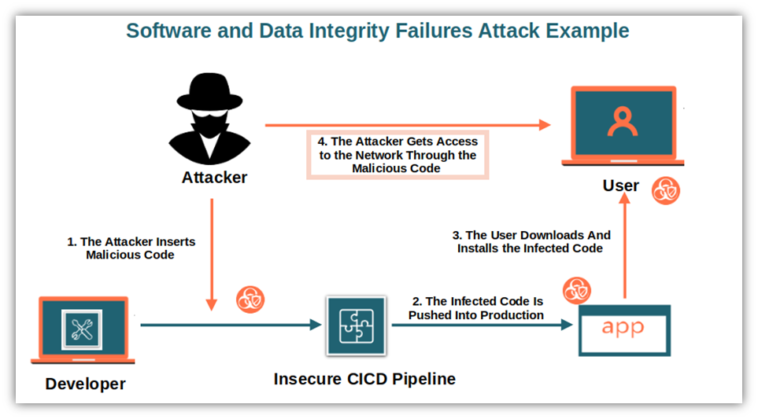
Photo courtesy of: Savvy Security

Slide 18
Security Logging and Monitoring Failures
Insufficient logging or lack of alerting on suspicious activity
Examples: Undetected breaches, lack of forensic data
Mitigation: Centralized logging, real-time alerts

Slide 19
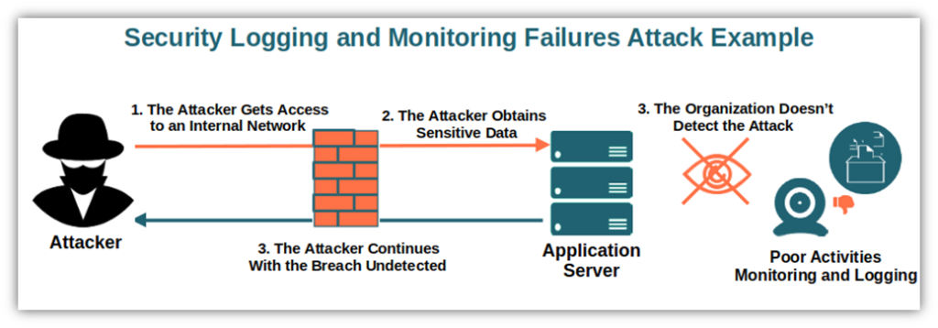
Photo courtesy of: Savvy Security

Slide 20
Server-
Side Request Forgery (SSRF)
Forces server to make unauthorized requests
Examples: Accessing internal resources via crafted URL
Mitigation: Whitelisting, network segmentation

Slide 21
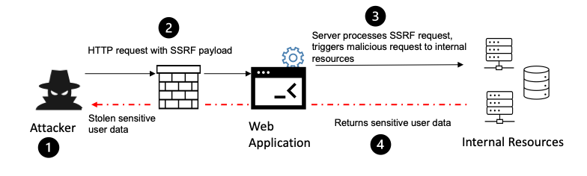
Photo courtesy of: MyF5

Slide 22
Key Takeaways
OWASP Top 10 evolves with the threat landscape
Proactive design, coding, and maintenance reduce risks
Security is everyone's responsibility

Slide 23
References
OWASP Foundation. (2021). OWASP Top 10: The Ten Most Critical Web Application Security Risks. https://owasp.org/Top10/
OWASP Cheat Sheet Series. https://cheatsheetseries.owasp.org/
NIST SP 800-53 Rev. 5. Security and Privacy Controls for Information Systems and Organizations. https://csrc.nist.gov/publications/detail/sp/800-53/rev-5/final
CWE - Common Weakness Enumeration. https://cwe.mitre.org/
OWASP Application Security Verification Standard (ASVS). https://owasp.org/www-project-application-security-verification-standard/

