Slide 1
Secure Software Development Lifecycle (SSDLC)
Best Practices

Slide 2




Learning Objectives
UNDERSTAND THE PURPOSE AND IMPORTANCE OF SSDLC
IDENTIFY SECURITY CONSIDERATIONS IN EACH SDLC PHASE
APPLY BEST PRACTICES TO INTEGRATE SECURITY THROUGHOUT DEVELOPMENT
EXPLORE TOOLS AND TECHNIQUES FOR SECURE DEVELOPMENT

Slide 3
What is SSDLC?
SSDLC = Software Development Lifecycle + Security
Proactive integration of security at each phase
Benefits
Reduced vulnerabilities
Lower cost of remediation
Compliance and risk management

Slide 4
SSDLC vs Traditional SDLC
Traditional SDLC vs Secure SDLC
Security is an afterthought vs Integrated security
Reactive (patch after release) vs Proactive (secure by design)
Focus on functionality vs Focus on security and functionality

Slide 5
Key Phases of SSDLC
Requirements Gathering
Design
Implementation (Coding)
Testing
Deployment
Maintenance

Slide 6
Phase – Requirements Gathering
Identify
Identify security objectives and compliance needs
Perform
Perform threat modeling
Define
Define security acceptance criteria
Use
Use security checklists (e.g., OWASP ASVS)
Involve
Involve stakeholders early

Slide 7
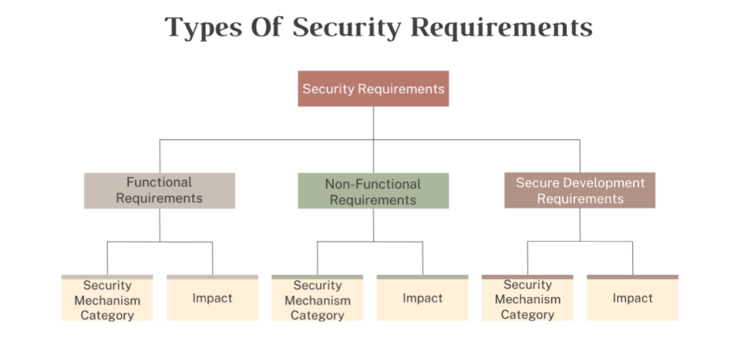
Photo courtesy of: ioSentrix

Slide 8
Phase – Design
Secure architecture review
Data flow analysis
Design for least privilege, secure defaults
Apply STRIDE threat modeling
Use secure design principles (e.g., defense-in-depth)

Slide 9
Phase – Implementation (Coding)
Secure
Secure coding standards (e.g., OWASP, CERT)
Code
Code reviews with security focus
Use
Use static code analysis tools
Educate
Educate developers on secure coding
Avoid
Avoid known vulnerabilities (e.g., OWASP Top 10)

Slide 10
Phase – Testing
Dynamic analysis (DAST)
Penetration testing
Fuzz testing
Automate security testing in CI/CD
Use tools like Snyk, Burp Suite, ZAP

Slide 11
Phase – Deployment
Secure configuration management
Secrets management
Environment hardening
Zero-trust principles
Least privilege for services and users

Slide 12
Phase – Maintenance
Patch management
Continuous monitoring (SIEM, IDS/IPS)
Incident response readiness
Log analysis and anomaly detection
Periodic security audits

Slide 13
Tools & Frameworks
- OWASP SAMM (Software Assurance Maturity Model)
- Microsoft SDL
- BSIMM (Building Security In Maturity Model)
- Tools: SonarQube, Checkmarx, GitHub CodeQL, Aqua, Trivy

Slide 14
Benefits of SSDLC
Fewer security incidents
Reduced cost of remediation
Improved customer trust
Easier compliance (e.g., GDPR, HIPAA, PCI-DSS)

Slide 15
SSDLC Integration in Agile & DevOps
Security in sprints (DevSecOps)
Shift-left testing
CI/CD pipeline security gates
Infrastructure as Code (IaC) security

Slide 16
Common Pitfalls to Avoid
Ignoring secure coding training
Delaying security to the testing phase
Lack of stakeholder buy-in
Over-reliance on tools without manual review

Slide 17
Summary & Key Takeaways
Security must be embedded from the start
Each SDLC phase presents unique security opportunities
Continuous improvement and education are essential
Use standards, tools, and frameworks effectively

Slide 18
References
OWASP Secure Software Development Lifecycle Project
Microsoft Security Development Lifecycle
NIST Secure Software Development Framework (SSDF)
BSIMM Reports

