Slide 1
Common Security Vulnerabilities
Understanding Threats in Modern Computing

Slide 2




Why Security Vulnerabilities Matter
Data breaches can cost millions
Trust and reputation are at risk
Attackers exploit the weakest link
Understanding is preventing

Slide 3



What is a Security Vulnerability?
A flaw or weakness in a system
Can be exploited to compromise CIA (Confidentiality, Integrity, Availability)
Exists in software, hardware, or processes

Slide 4
What is a weakness
According to NIST (National Institute of Standards and Technology), a weakness is a condition in a software, firmware, hardware, or service component that, under certain circumstances, could contribute to the introduction of vulnerabilities.

Slide 5
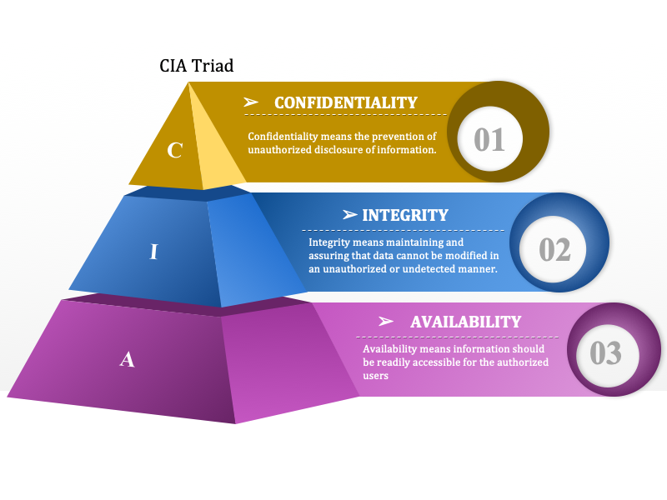
CIA (Confidentiality, Integrity, Availability)

Slide 6
1. SQL Injection
Malicious SQL code to manipulate databases
Example: `' OR 1=1--`
Impact: Unauthorized access, data leaks
Mitigation: Parameterized queries, ORM, input validation

Slide 7
2. Cross-Site Scripting (XSS)
Injecting malicious scripts into web pages
Types: Stored, Reflected, DOM-based
Impact: Session hijacking, defacement
Mitigation: Encode output, Content Security Policy (CSP)

Slide 8
3. Broken Authentication
Poor session management or weak passwords
Impact: Account takeover
Mitigation: MFA, password hashing, session expiration

Slide 9
4. Security Misconfiguration
Default
Default settings, open S3 buckets, verbose error messages
Impact
Impact: Easy attack surface
Harden
Mitigation: Harden configurations, regular audits

Slide 10
5. Sensitive Data Exposure
Insecure storage or transmission of PII/PHI
Impact: Identity theft, legal consequences
Mitigation: TLS, encryption at rest, secure key management

Slide 11
6. Insecure Deserialization
Malicious object injection
Impact: Remote code execution
Mitigation: Avoid unserializing untrusted data

Slide 12
7. Using Components with Known Vulnerabilities
Third-party libraries with CVEs
Impact: Indirect compromise
Mitigation: Software Composition Analysis (SCA), update dependencies

Slide 13
8. Insufficient Logging & Monitoring
No detection or response to intrusions
Impact: Delayed breach discovery
Mitigation: Centralized logging, alerts, incident response plan

Slide 14
OWASP Top 10 Summary
Overview of the latest OWASP Top 10
A1–A10 quick rundown
Use it as a checklist for secure dev

Slide 15
Tools & Practices for Defense
Static & Dynamic Analysis (SAST/DAST)
Penetration testing
Secure Coding Training
DevSecOps

Slide 16




Key Takeaways
ALWAYS VALIDATE INPUT
SECURE BY DESIGN, NOT AS AN AFTERTHOUGHT
UPDATE AND PATCH REGULARLY
EDUCATE ALL STAKEHOLDERS

