Slide 1
Adversarial Attacks vs.
Explainable AI
Presentation by Tushar Prakash
2021

Slide 2
Content
Working of LIME
Working of SHAP
Example of an Outcome
Adversarial Attack
Conclusion

Slide 3
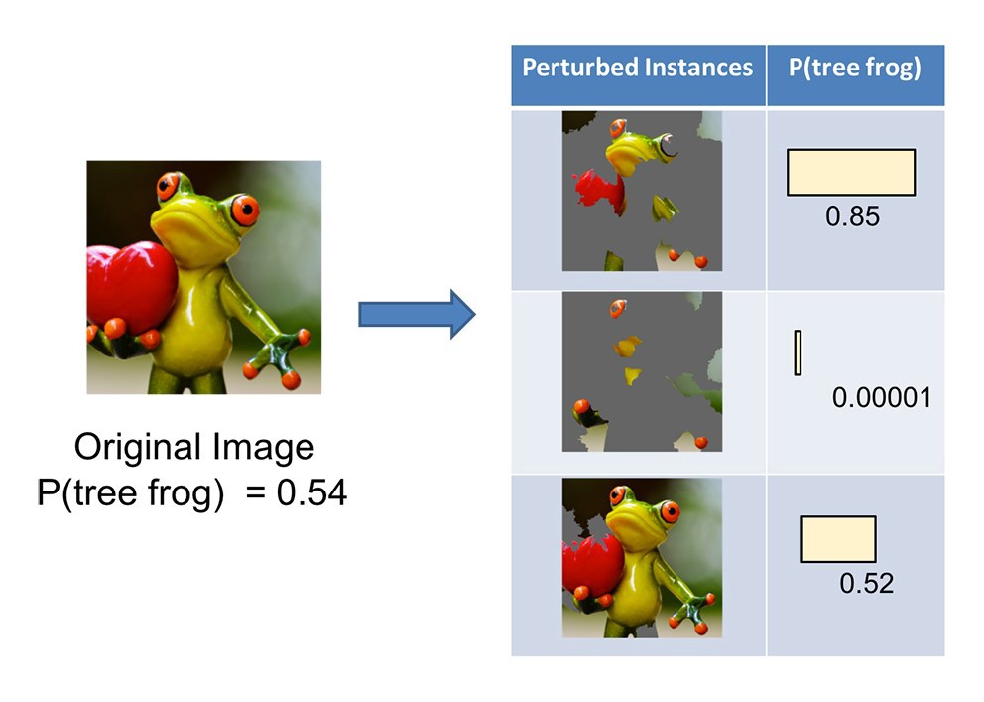
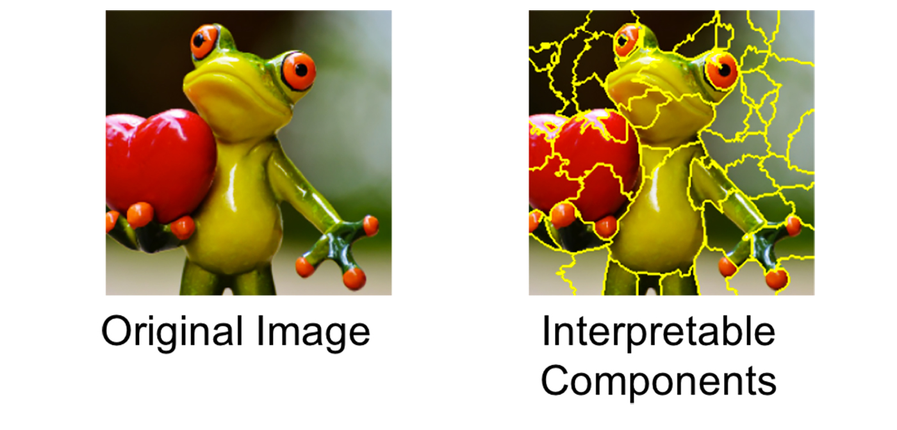
Working of LIME
The technique attempts to understand the model by perturbing the input of data samples and understanding how the predictions change.
LIME modifies a single data sample by tweaking the feature values and observes the resulting impact on the output.

Slide 4
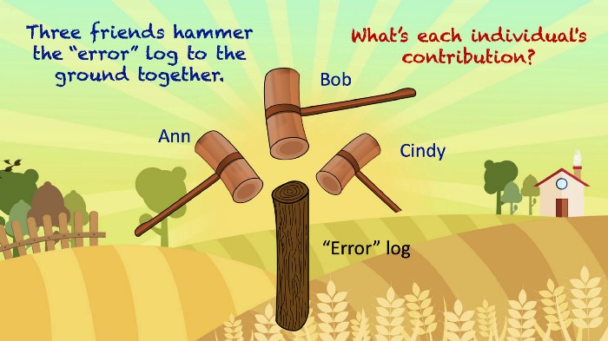
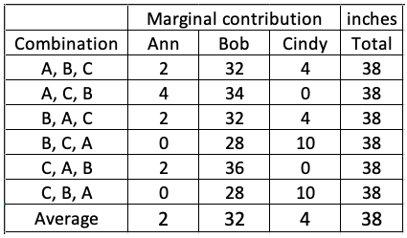
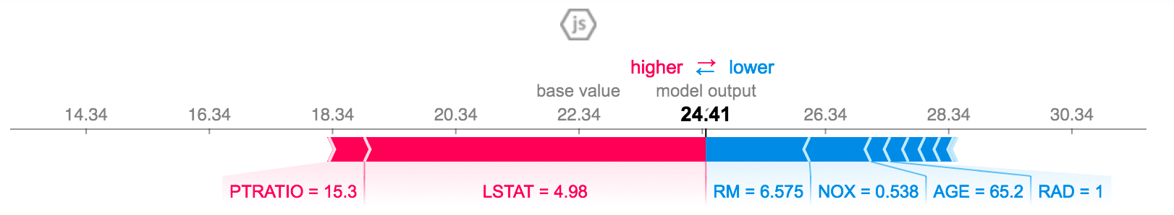
Working of SHAP
It is the average of the marginal contributions across all permutations.
Advantages of SHAP
Global interpretability
SHAP values can be calculated for any tree-based model

Slide 5
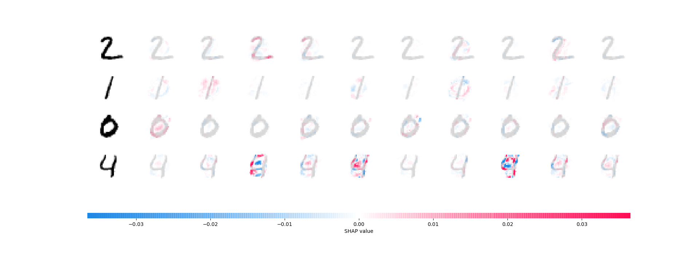
Example of an Outcome(SHAP)
Image 0 1 2 3 4 5 6 7 8 9

Slide 6
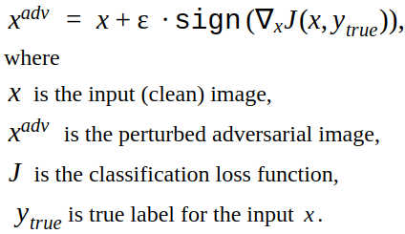
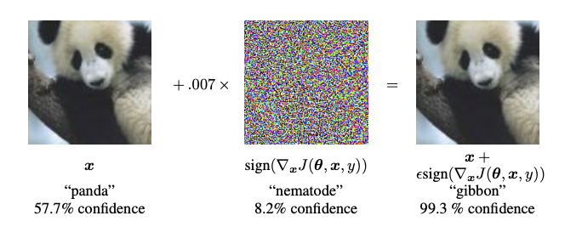
Fast Gradient Sign Method(FGSM)
The idea is simple, rather than working to minimize the loss by adjusting the weights based on the backpropagated gradients, the attack adjusts the input data to maximize the loss based on the same backpropagated gradients.

Slide 7
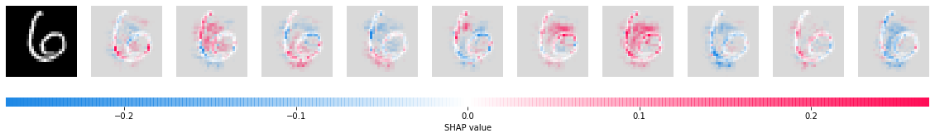
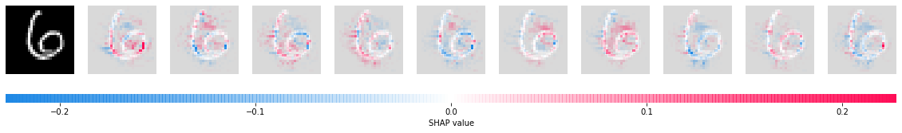
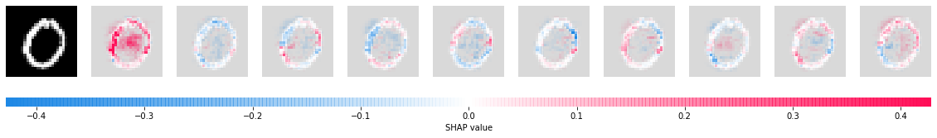
REAL ATTACKED REAL
Adversarial Attacked
Image 0 1 2 3 4 5 6 7 8 9
Here, middle image(6) is attacked and gives 0 as it’s output.

Slide 8
Conclusion
SHAP is an improved version of LIME.
Although LIME has the desirable property of additivity, it has got some criticism on lack of stability, consistency and missingness.
All three properties are fulfilled by SHAP.
On the other hand, SHAP-ley value requires a lot of computing time.
The Shapley value can be misinterpreted and needs access to the data to calculate the value for a new data instance.

Slide 9
Thank You!

