Slide 1


Slide 2


The Problem
Abuse in the MetaVerse makes it tough to enjoy
Bots create a racket and hinder with the Network
MetaVerse can be addictive. People may spend more time in Virtual Reality than Reality Reality
Accessibility for disabled people

Slide 3
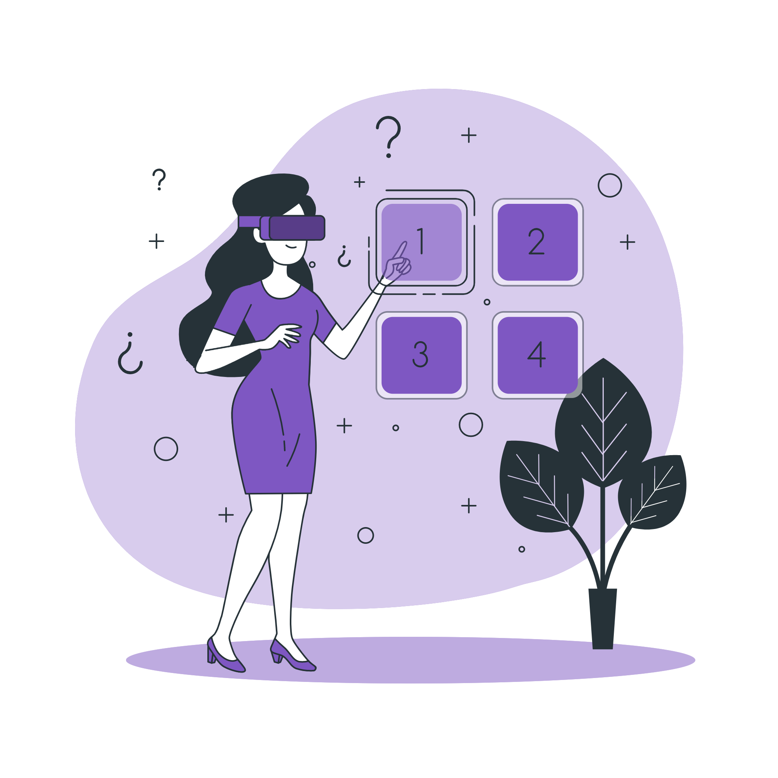
The Solution
Vershield shields the users from abusive language
Identity theft and Bots cannot as exist as long as Vershield does
The software gives the users enough breaks during the experience

Slide 4
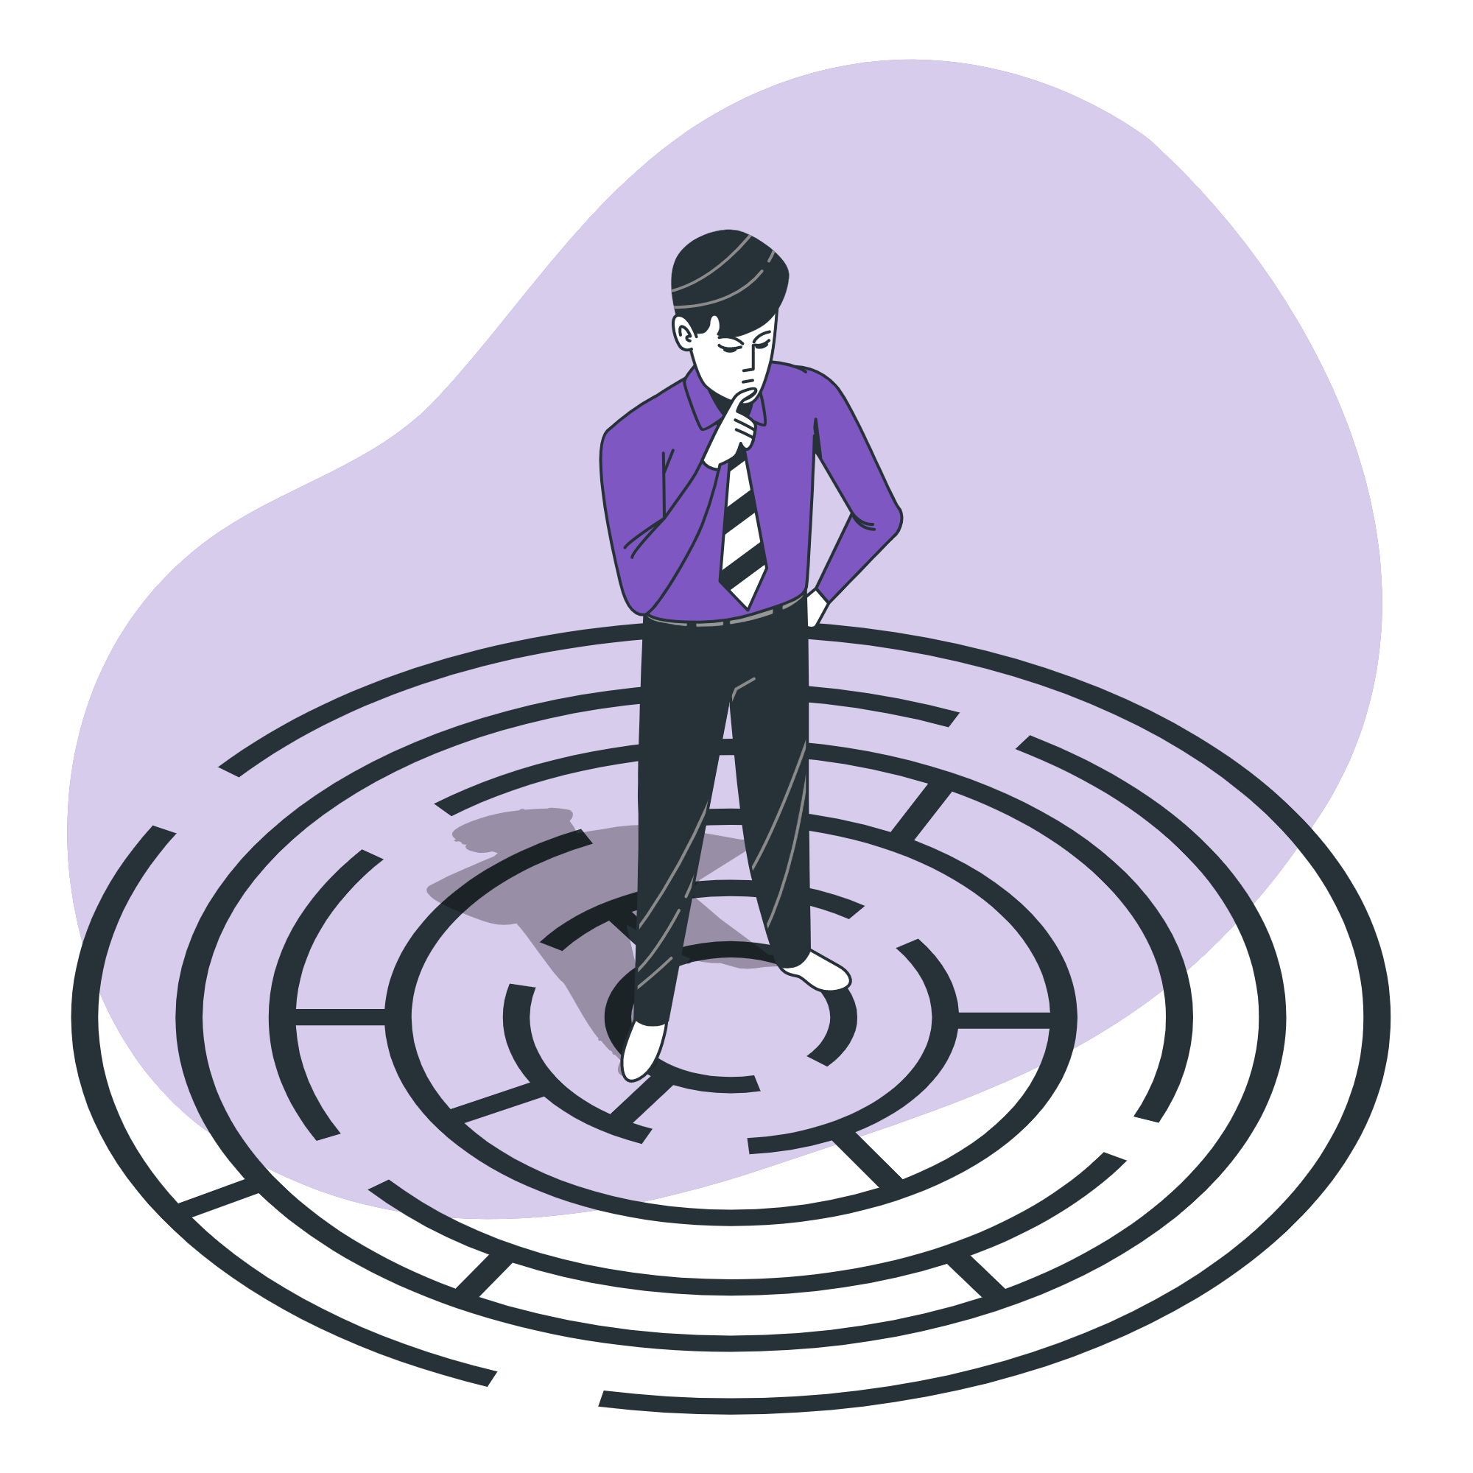
Challenges we faced
The prompt itself was a test of mettle - Our own Virtual world
Making a good looking and easily usable HUD - Transparent objects
Verifying humans based on emotions - Audio & Video overlap
Making a calling system and integrating it with the MetaWorld - Multi-person system connecting with WEBRTC.

Slide 5


Technologies

Slide 6
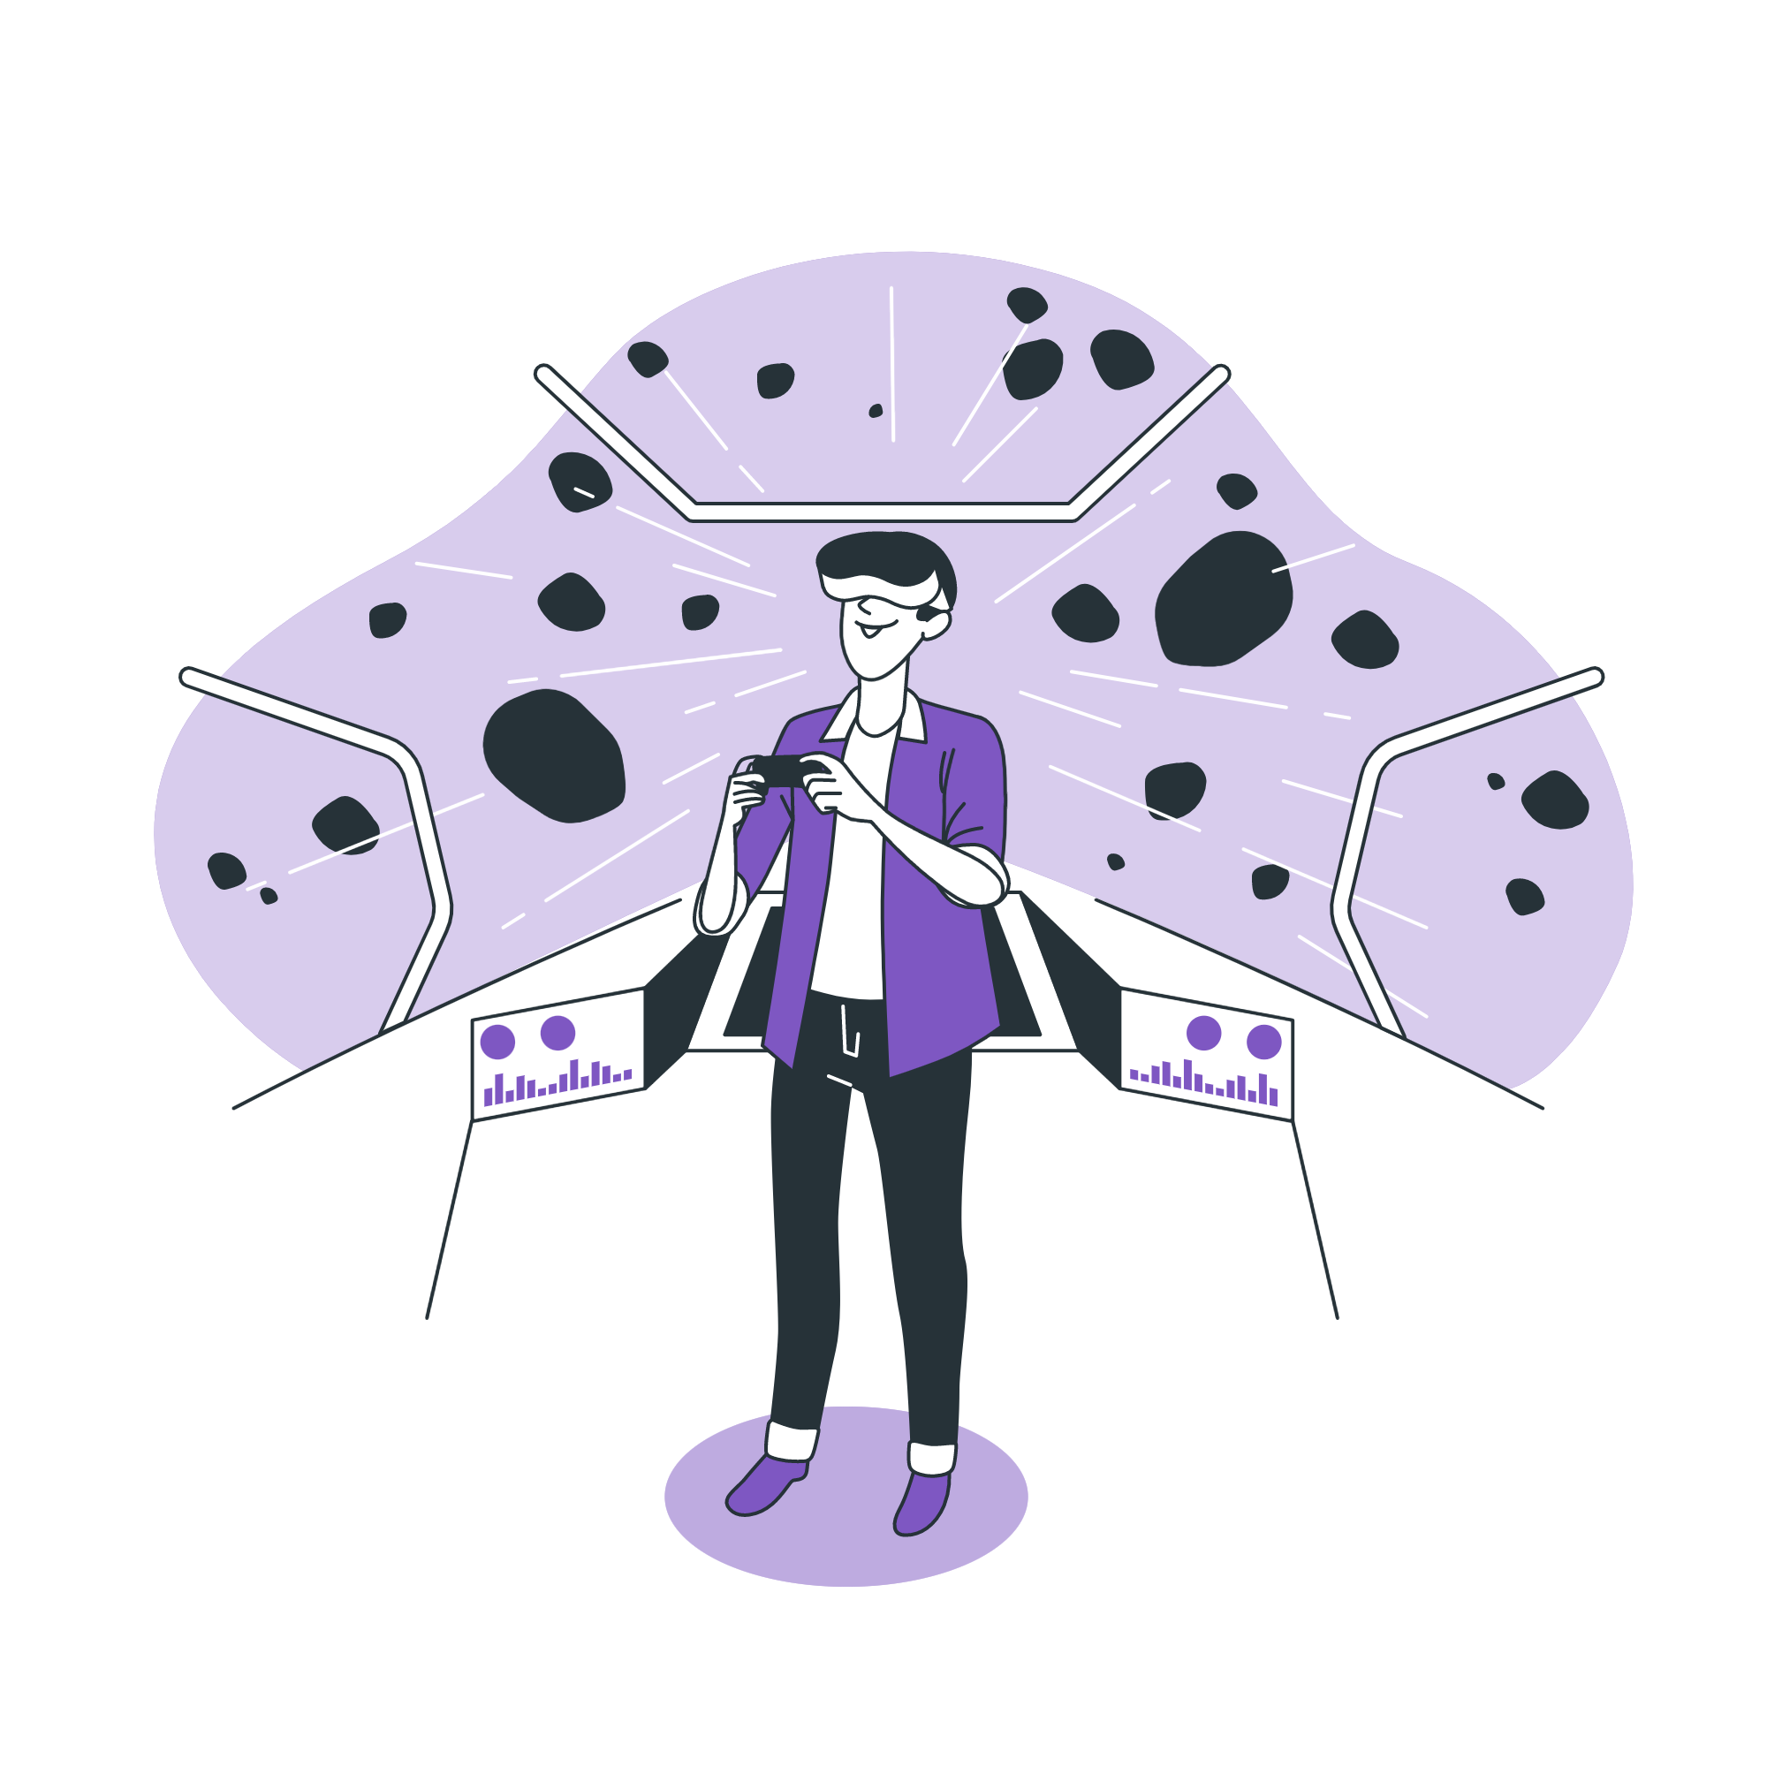
Future Plans
Integration of speech recognition in rooms and broadcasting them after filtering
Multiplayer avatar visibility
Creating a VR Headset with the HUD and preloading it with basic protocols of Vershield
Making a secure marketplace with decentralised asset storing

