Slide 1
Artificial Intelligence
Workshop

Slide 2
Introduction
Artificial Intelligence
Machine Learning vs Deep Learning
Neural Networks
Python
What is TensorFlow and how is it used in Machine Learning?
Google Colab

Slide 3
Types of ML Problems
Supervised Learning
Regression
Classification
Unsupervised Learning
Clustering
Association rule learning
Ranking

Slide 4
Layers
Input layer
Hidden Layer
Output Layer

Slide 5
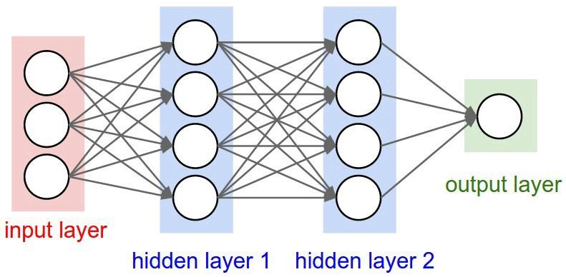

Slide 6
Linear Regression
Training and Testing
Loss
Hands-On(Celsius to Fahrenheit)

Slide 7
Hands-On: Celsius to Fahrenheit
tiny.cc/tk-ai1

Slide 8
Classification
Binary Classification
Multi-class classification

Slide 9
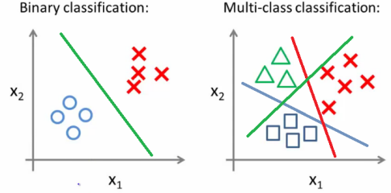

Slide 10
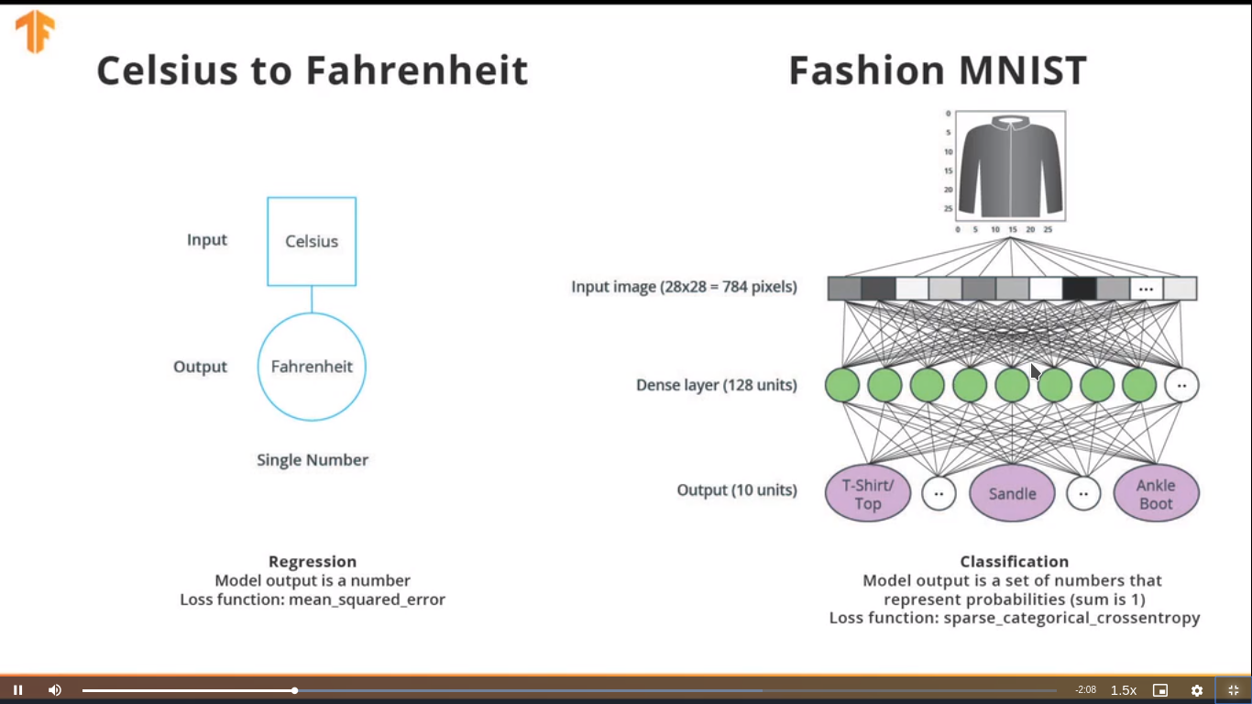

Slide 11
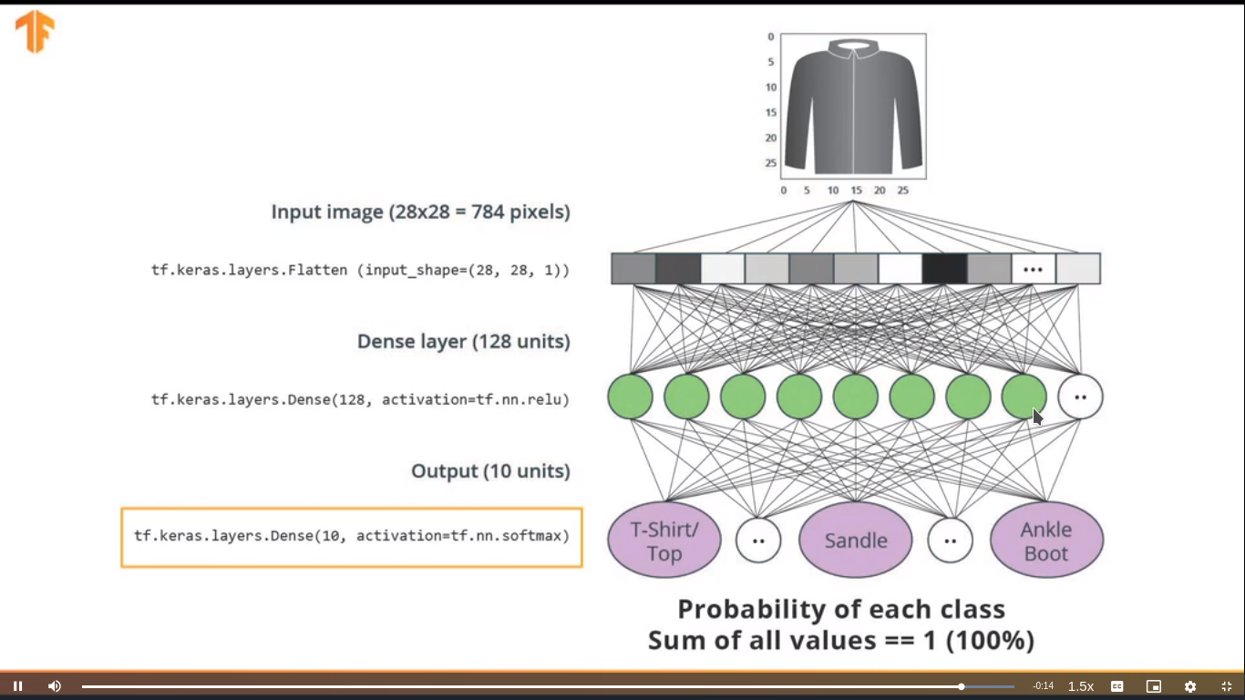

Slide 12
Hands-On: Classifying Images of Clothing
tiny.cc/tk-ai2

Slide 14
Completed Notebooks
tiny.cc/tk-ai3

Slide 15
Thank You

