Slide 1
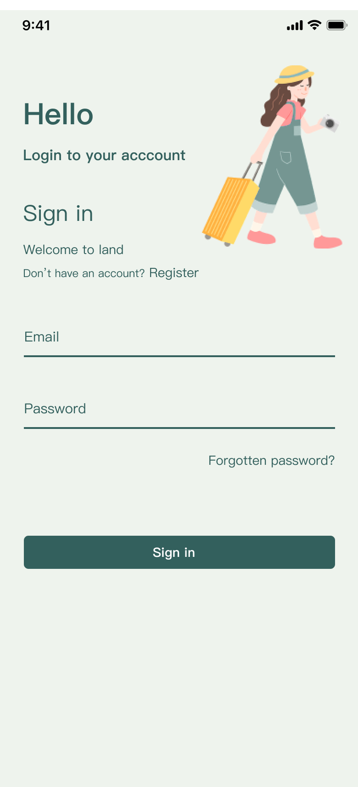

WeatherGuardian
Predicting weather changes for user safety and comfort
Description About Apps
Weather Guardian App is a comprehensive weather application that provides live weather data, weather warnings, and trip planning information to help users stay safe and comfortable during their journeys.
Install Now
casa0015-mobile-assessment
Yuxi Zheng

Slide 2
WeatherGuardian
Current Function Point:
User login registration function
Display of current city weather data
Provide real-time map function including temperature heat map
Search for weather conditions in other areas
Provide extreme weather warning notifications
Trip planning page, where users can select the departure location, destination, travel dates and number of days
Further functional points for the future:
Automatically retrieves and displays weather data for departure and destination based on user input
Automatically generated trip details page, including each day's itinerary, including weather conditions, transport advice and suggestions for places to visit
How Does This
App Work?

Slide 3
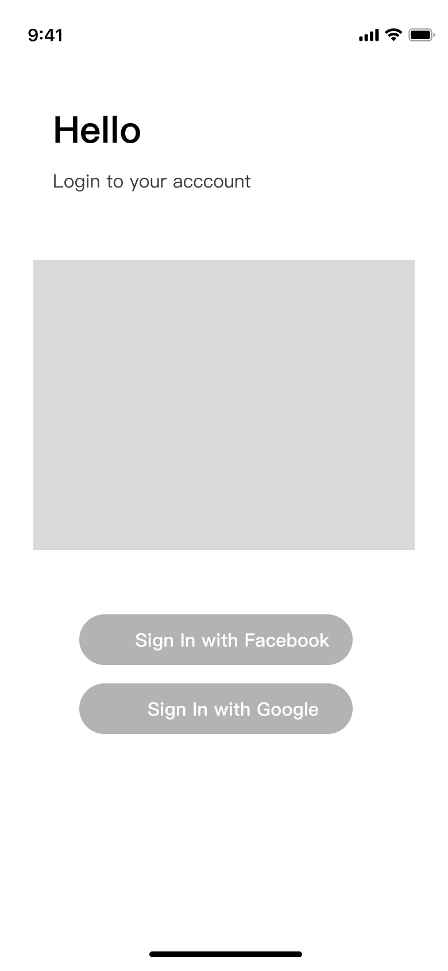
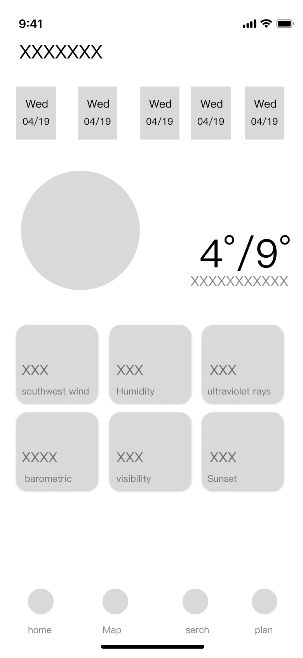
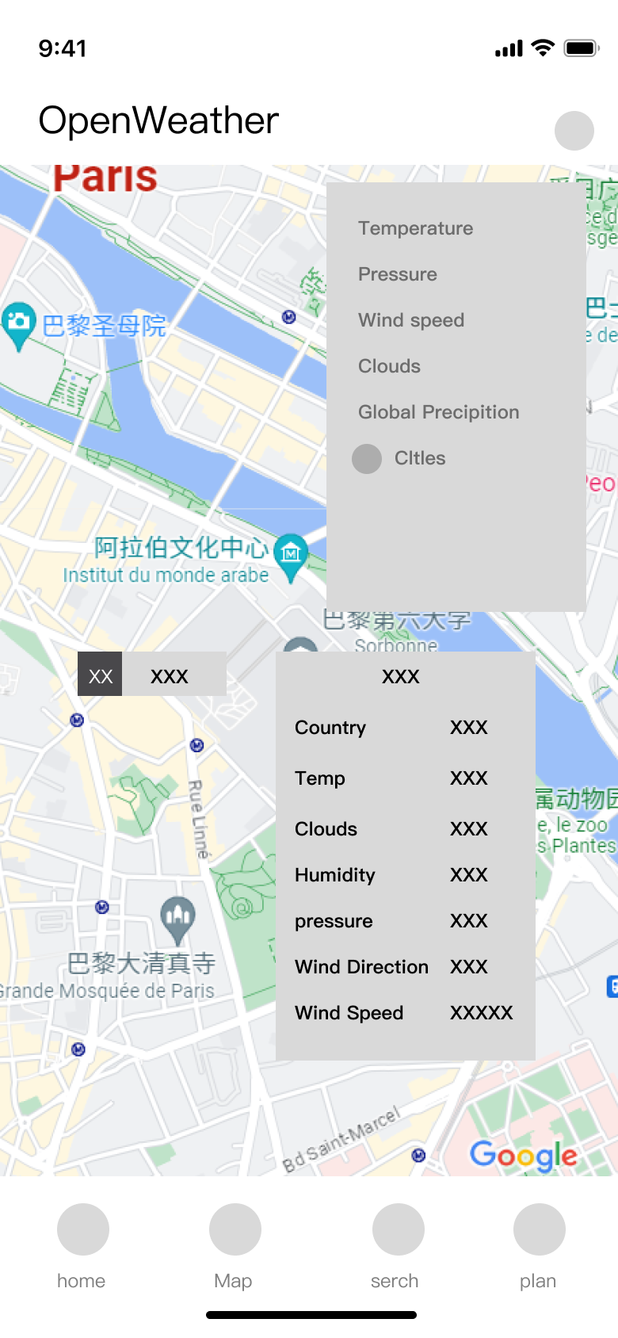
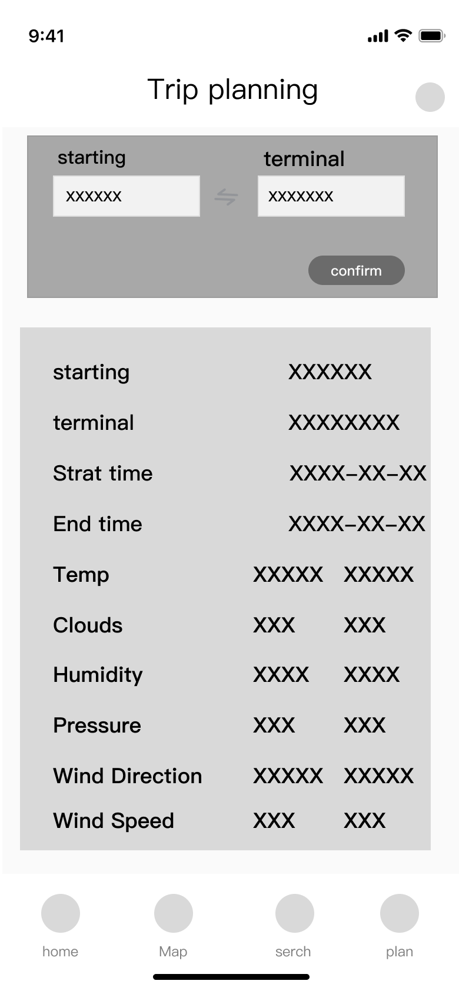
WeatherGuardian
Wireframe Design

Slide 4
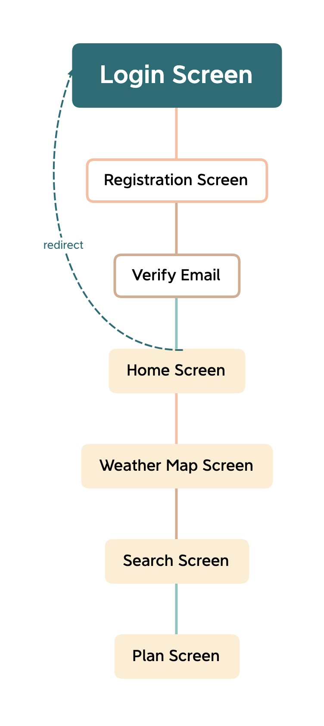

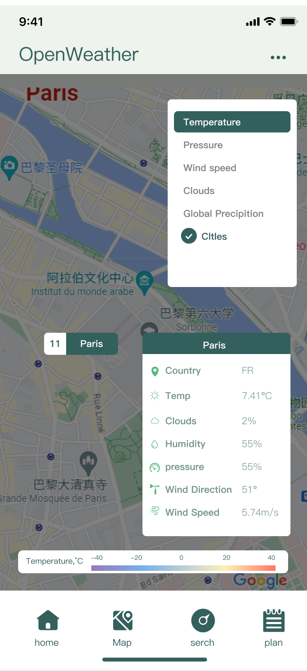
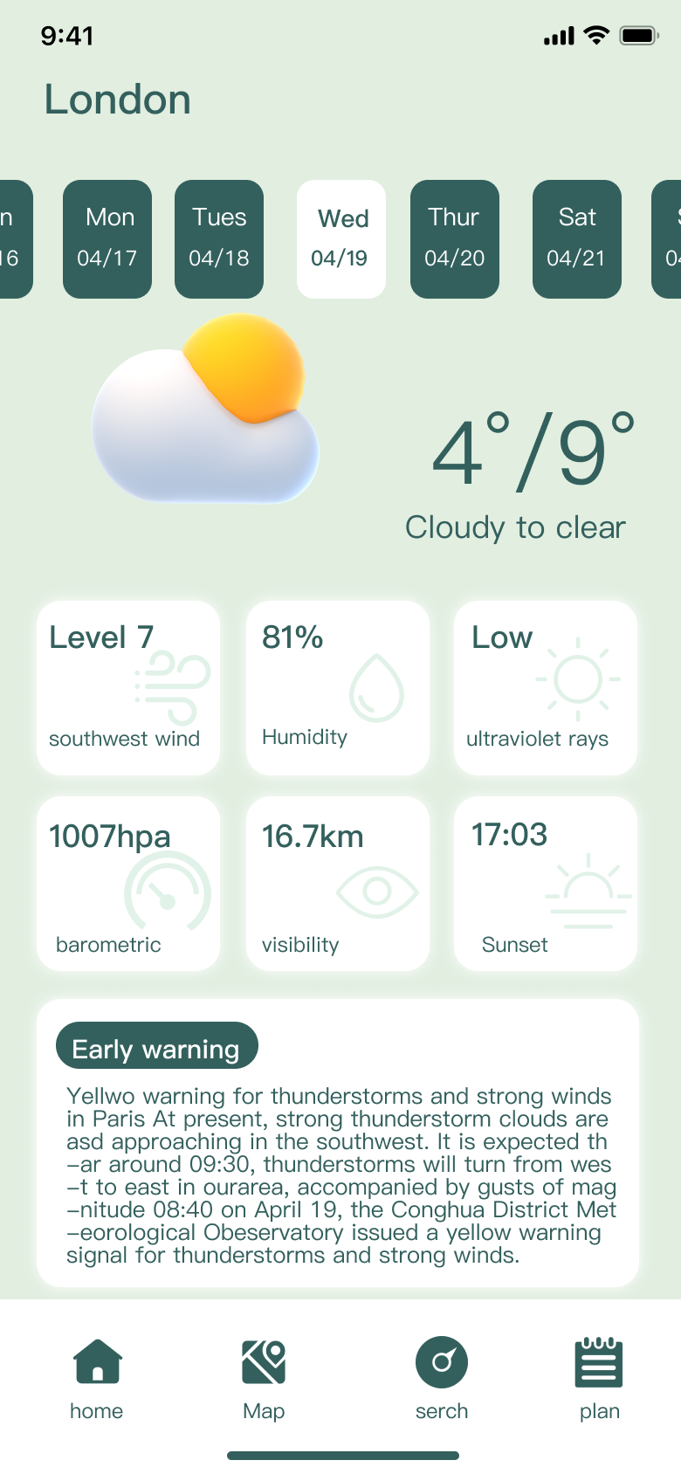
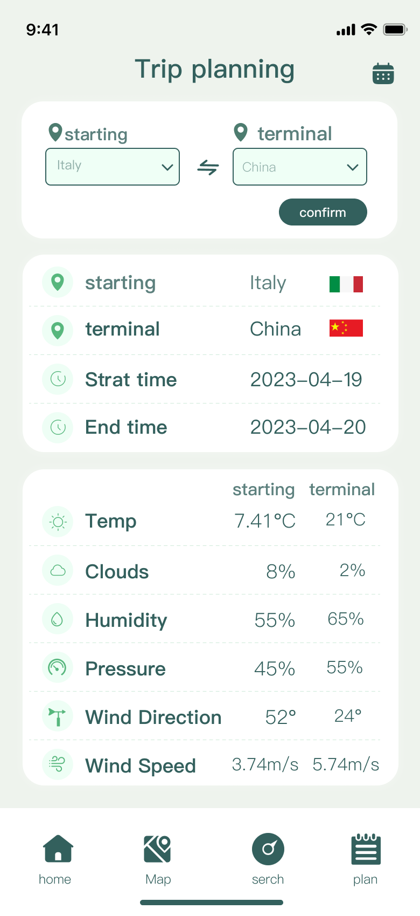

WeatherGuardian
User
Interface
Design
&
Hierarchy
And
Navigation

Slide 5
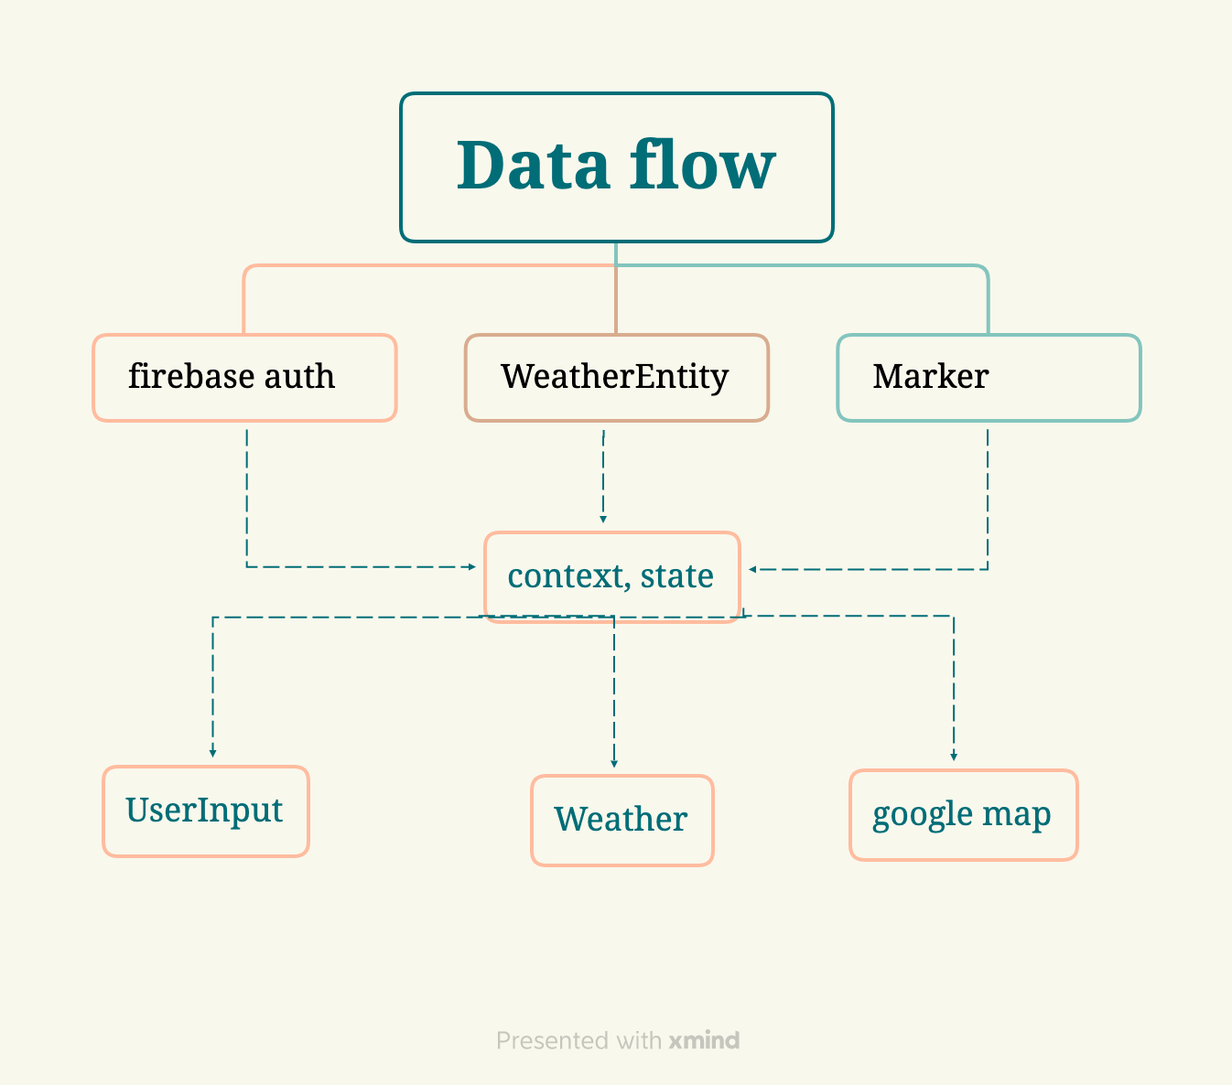
WeatherGuardian
Data Flow
1
Firebase Authentication
Firebase Authentication is a feature of Firebase that provides an easy way to authenticate users. In Flutter, you can use the Firebase Authentication plugin to implement user login. To use the Firebase Authentication plugin you need to import it in the Dart code.

Slide 6
WeatherGuardian
2
Open Weather ApI
OpenWeather is an API that provides weather data and can be used to obtain weather information from around the world. Flutter can use the OpenWeather API via HTTP requests. Here are the steps to use the OpenWeather API: 1. Register on the OpenWeather website and obtain an API key. 2. Add the http dependency to the Flutter project. 3. Add a Dart file to the Flutter project for handling API requests and responses. 4. Use the http package to send the API request and handle the response.
Data Flow

Slide 7
WeatherGuardian
3
Gogoole maps ApI
In Flutter, you can use the google_maps_flutter plugin to integrate Google Maps. The plugin provides a Map class that you can use to display the map and customise it with various options and controls. To implement search functionality on Google Maps you need to use the Places API provided by the Google Maps API. the Places API allows you to search for locations, get details and display them on the map. You can call the Places API using the google_maps_web service plugin, which provides a PlacesService class that you can use to call the Places API and get results.
Data Flow

Slide 8
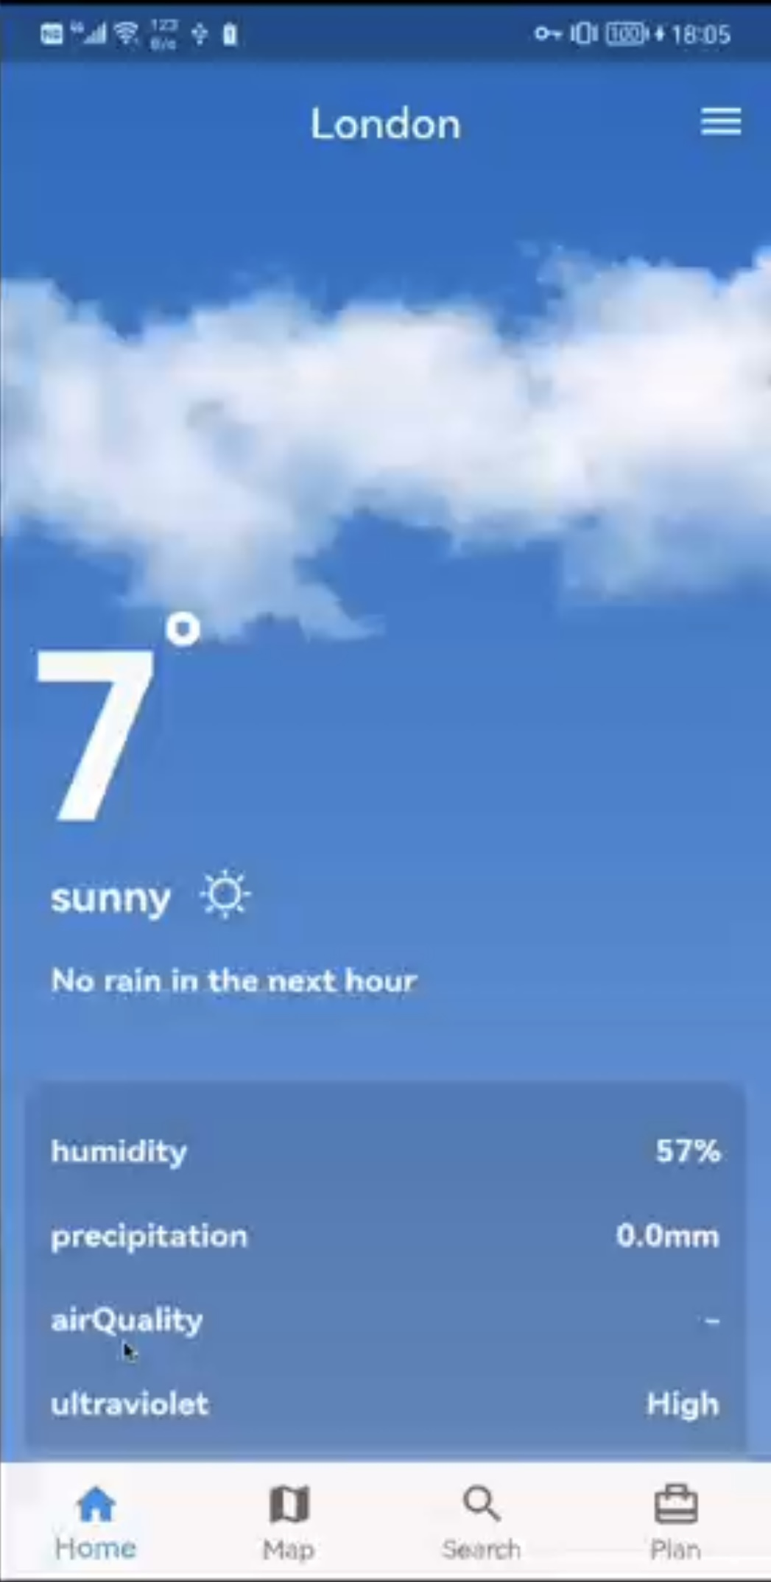
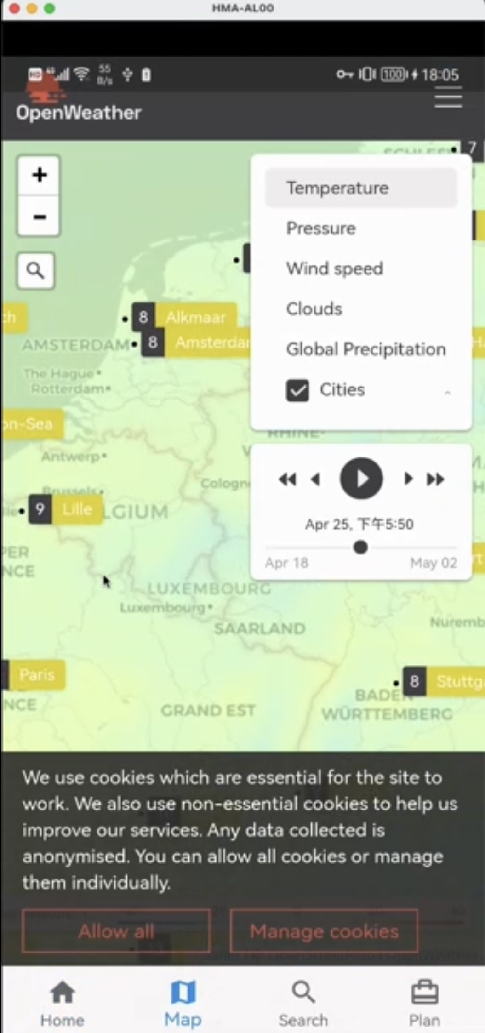
WeatherGuardian
Mobile Apps
Thank You
For Your Listening

