Slide 1
E-Commerce Portal
SUBMITTED BY:
Aavash Ganesh
Reg No: 62-622-25-2018
February 2021

Slide 2
CONTENT
TOPICS
SLIDE NO.
1. INTRODUCTION
1
2. PROBLEM ANALYSIS
2
3. SYSTEM OBJECTIVES
3
4.METHODOLOGY
4
5. EXPECTED OUTCOMES
11

Slide 3








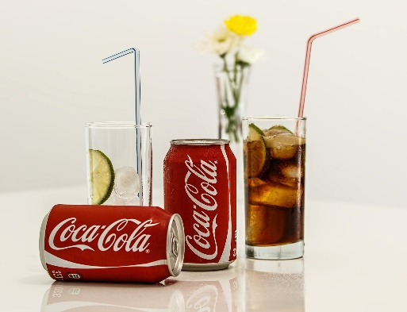
INTRODUCTION
‘theLiquors’
Web-Based Software
GET DELIVER
PAY
BUY
1

Slide 4






PROBLEM STATEMENT
High Delivery Charge
Difficulty to find the desire product
Time Consuming
Low Quality Delivery of Product
2

Slide 5


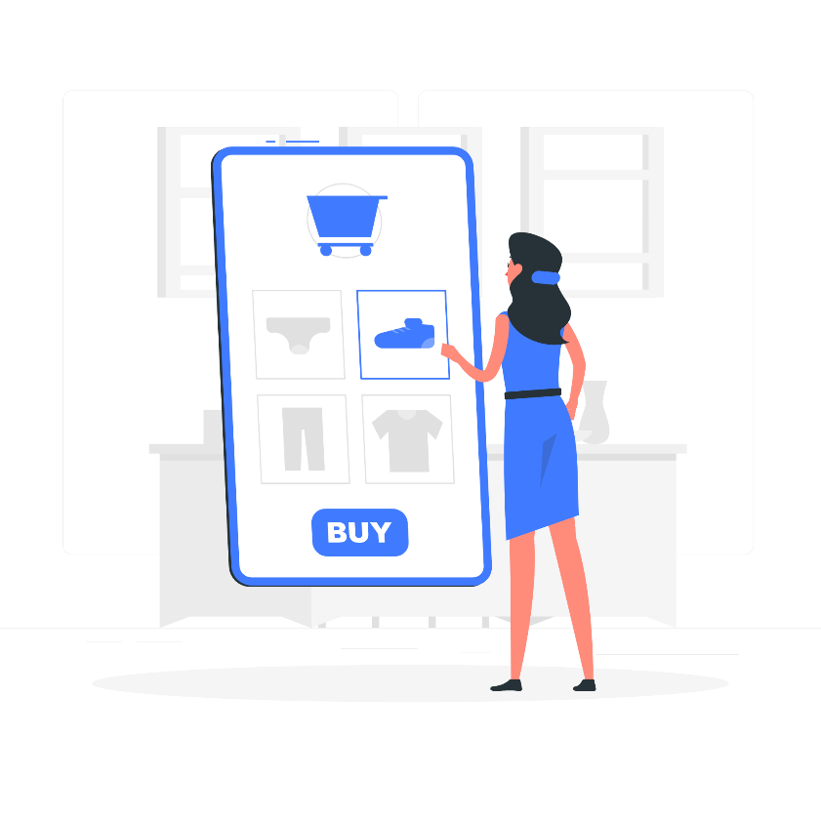
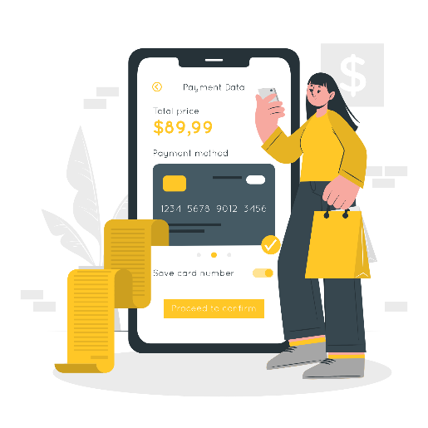
SYSTEM OBJECTIVES
uplift the way of conducting commerce transaction through online
Providing multiple product option and recommendation as per taste
3

Slide 6





METHODOLOGY
STUDY OF EXISTING SYSTEM
4

Slide 7

REQUIREMENT ANALYSIS
Change Password
Account Creation
View Users
Manage Product
Place Order
FUNCTIONAL REQUIREMENT
Search/View Product
Pay Online
5

Slide 8
Security
Easy-Access
NON-FUNCTIONAL REQUIREMENT
User-friendly
Maintainability
6

Slide 9




FEASIBILITY ANALYSIS
Technical Feasibility
Operational Feasibility
Economic Feasibility
Time Feasibility
7

Slide 10
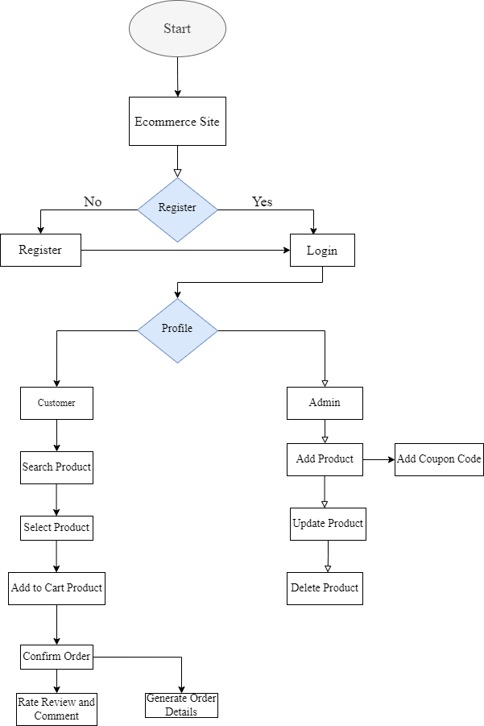
HIGH LEVEL DESIGN
8

Slide 11
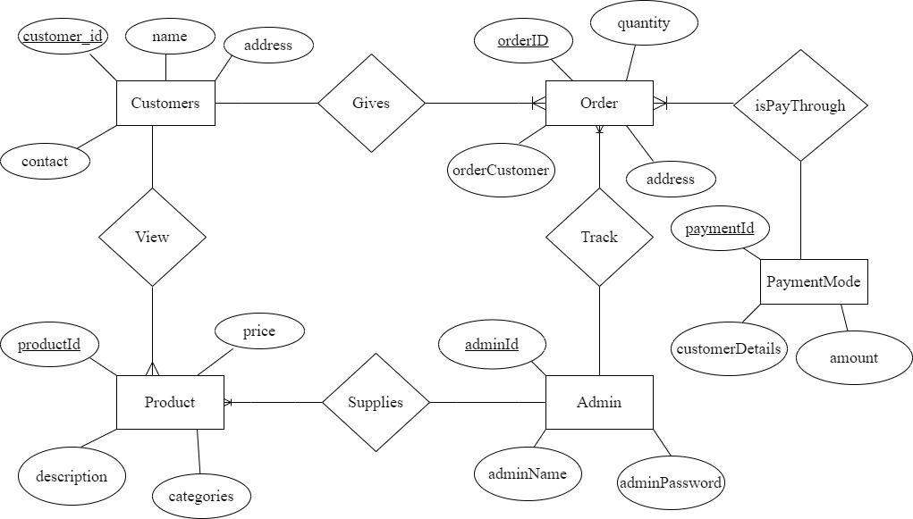
E-R DIAGRAM
9

Slide 12




ALGORITHM
Cold Coffee – 5 star
Himalayan Java Latte
Boba Tea – 5 star
Cold Coffee – 5 star
Strawbery Milk Shake
10

Slide 13

EXPECTED OUTCOMES
Recommend Product
Search/View Product
Functional and Non-functional requirement
Order Product
Manage Product, View users and tracks order
Pay Online
11

Slide 14



QUESTIONING TIME

Slide 15


