Slide 1

HR Data Analytics
Project Capstone
By
455722 Pearly Tantra
455723 Yamini Kuntal
2024

Slide 2





CONTENT
Introduction
Business
Significance
Project Overview
Analytics Overview
Tools –
Dashboard
2023

Slide 3

INTRODUCTION
HR is increasingly recognized as a critical asset, to understand and manage employee turnover.
HR Analytics Dashboard will utilize a comprehensive dataset to analyze employee attrition across department.
This tool will provide insights into the factors influencing employee resignation.
2024

Slide 4



BUSINESS SIGNIFICANCE
Decision Making
Understanding factors of employee retentions to provide actionable insights
Cost Reduction
Organization can reduce recruitment and training costs associated with replacing employees.
01
02
03
Employee Satisfaction
Leading to higher employee satisfaction and productivity
04
Strategic Workforce
Allowing for better workforce planning and talent management.
05
Competitive Advantage
Contributing to the organization's overall
success and stability
2024

Slide 5






Dataset :
IBM HR Analytics
Collaborative:
Leveraging GIT
Dashboard :
Using PowerBI
PROJECT
OVERVIEW
Analytics :
Correlation Matrix & Logistic Regression
ETL Process :
Cleaning data with Python
2024

Slide 6
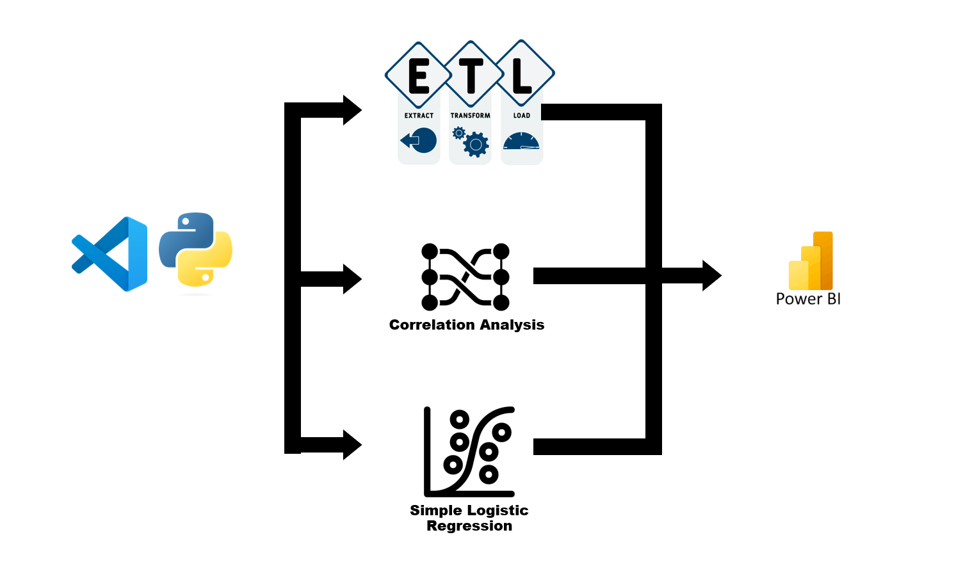
ANALYTICS
OVERVIEW
2024

Slide 7
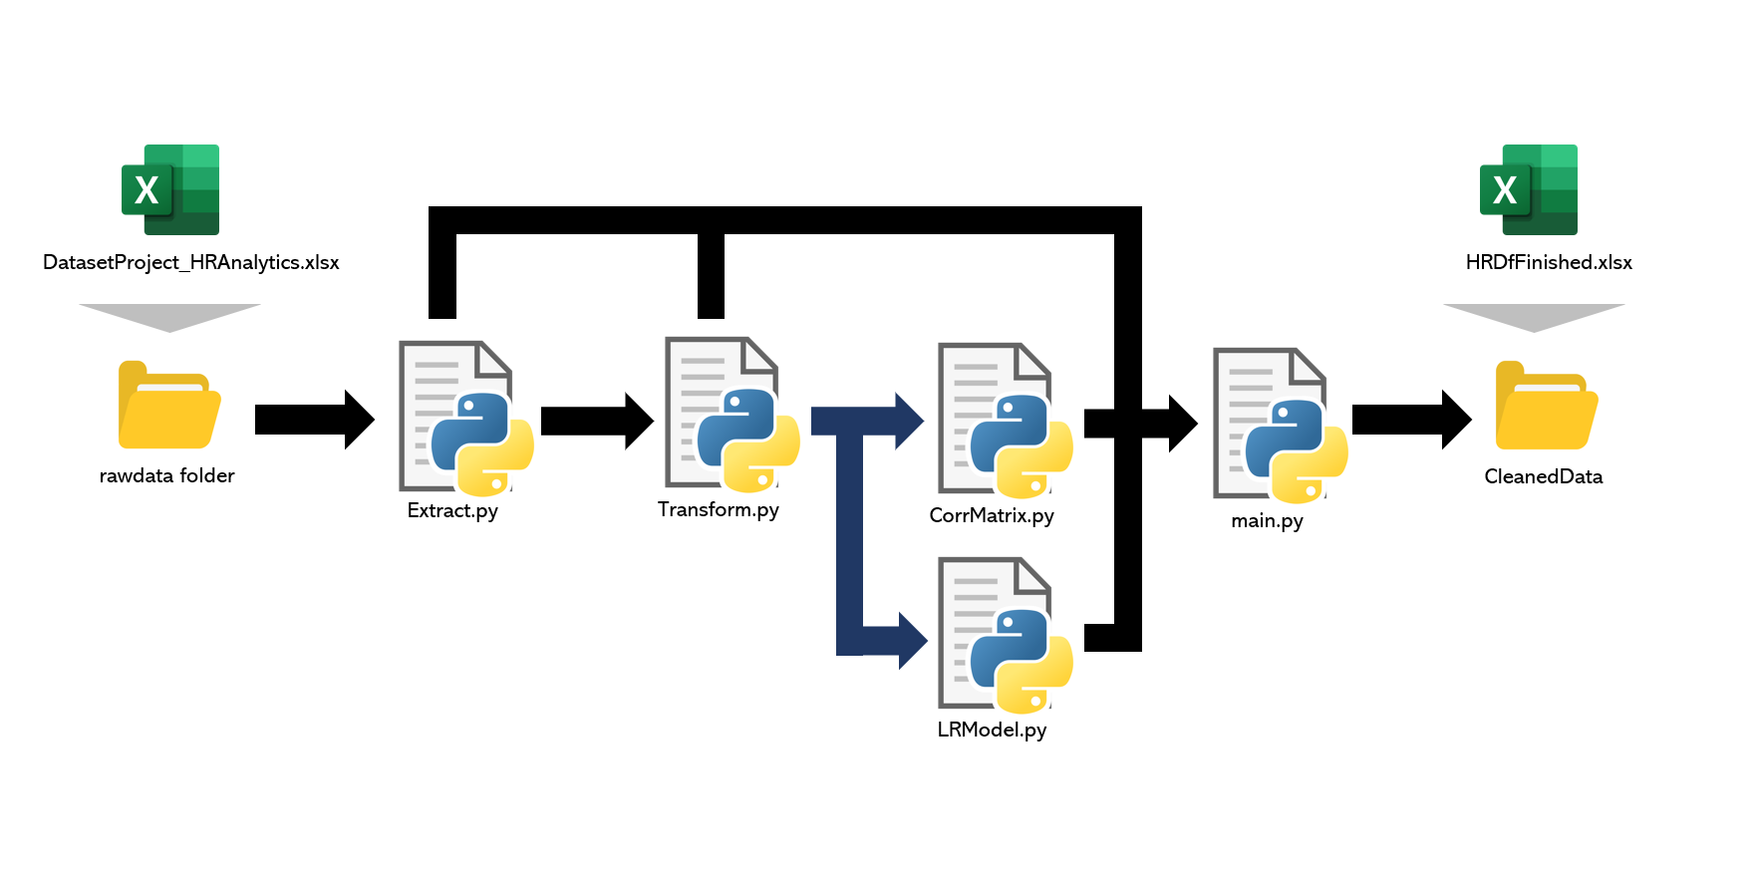
ANALYTICS
OVERVIEW
2024

Slide 8
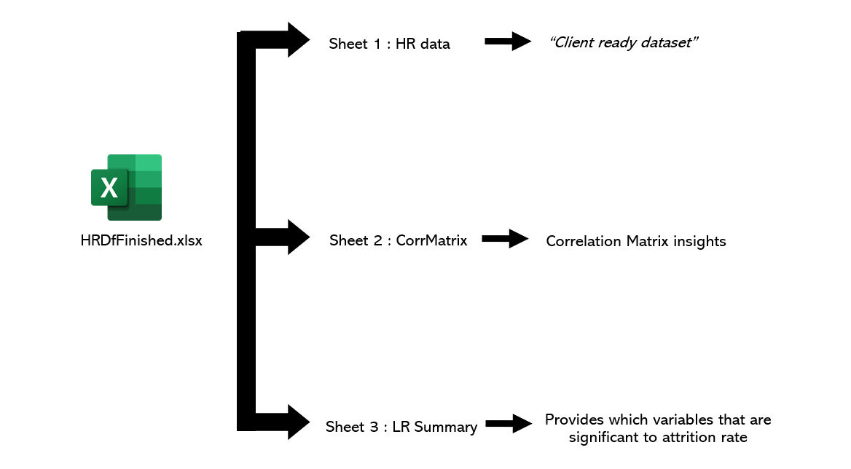
ANALYTICS
OVERVIEW
2024

Slide 9
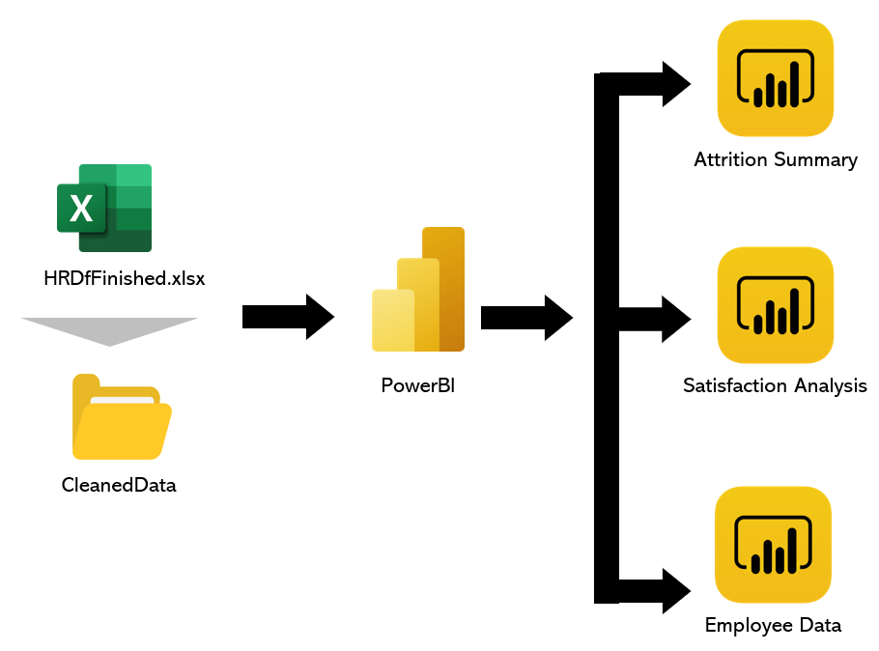
ANALYTICS
OVERVIEW
2024

Slide 10

DASHBOARD
OVERVIEW
2024

Slide 11
LIMITATION & POTENTIAL
IMPROVEMENT
2024

Slide 12
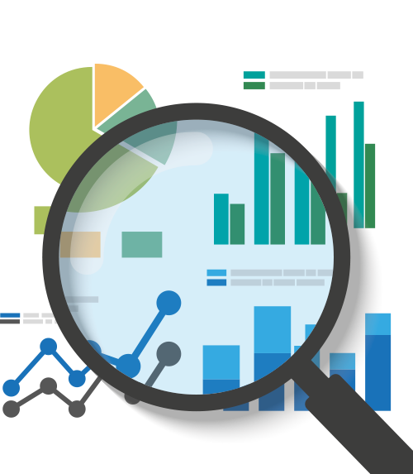
THANK YOU
2024

