Slide 1
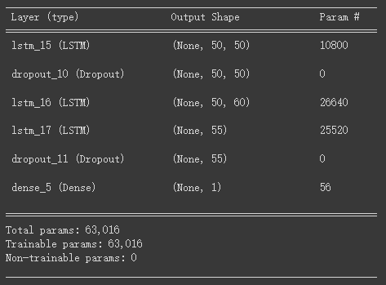
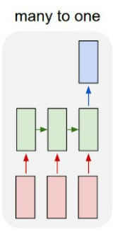
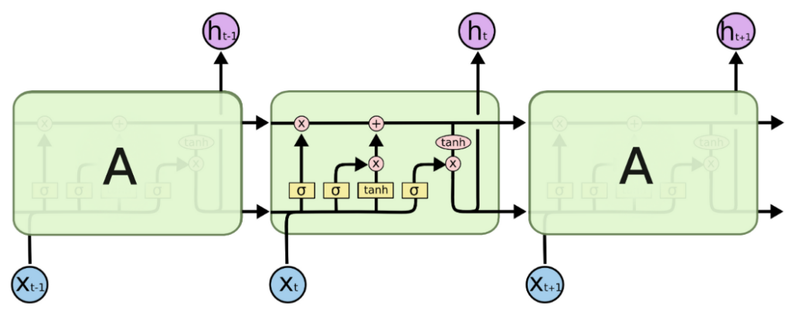
Method Description
We use LSTM as deep learning based method
What's LSTM model(optional topic)
The LSTM model structure

Slide 2
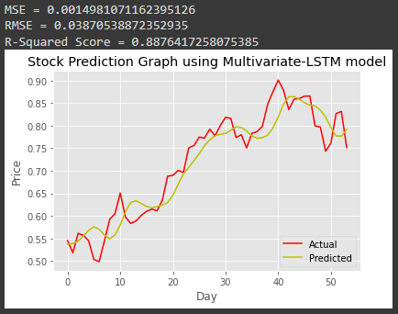
Result
Data for Final Model Building
TrainingData: 2010.1.4 ~ 2019.12.31
Shape: (2516, 3)
ValiatingData: 2020.1.1 ~ 2020.12.31
Shape: (377, 3)
TestingData: 2021.7.1 ~ 2021.11.26
Shape: (104, 3)
Timestep | Hidden_Layers | Learning_Rate | Batch_Size | epoch | Loss | Activation | Optimizer
50 | 60,55 | 0.001 | 64 | 100 | mean_squared_error | selu | Adam

