Slide 1
 | 順序 | 改變 | 重複
List | 1 | 1 | 1
Tuple | 1 | 0 | 1
dict | 0 | 1 | 0
set | 0 | 1 | 0

Slide 2
60b : 0 0 1 1 1 1 0 0
X 128 64 32 16 8 4 2 1
------------------------------------------------------------------------
二進位: 0 + 0 + 32 + 16 + 8 + 4 + 0 + 0 = 60
13b : 0 0 0 0 1 1 0 1
X 128 64 32 16 8 4 2 1
------------------------------------------------------------------------
二進位 : 0 + 0 + 0 + 0 + 8 + 4 + 0 + 1 = 13
60 & 13 : 0 0 0 0 1 1 0 0
0 + 0 + 0 + 0 + 8 + 4 + 0 + 0 = 12

Slide 3
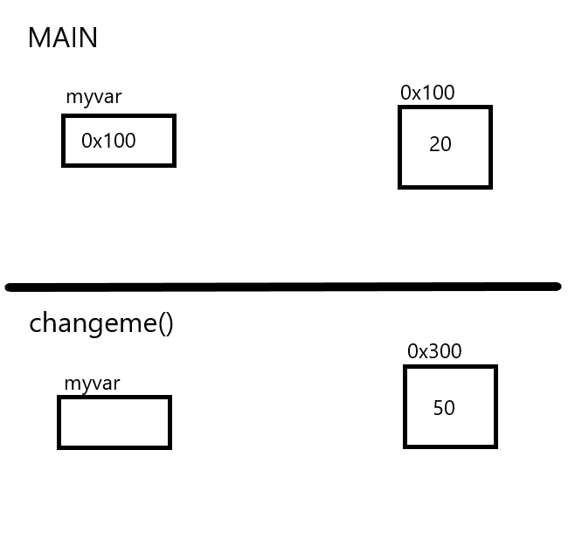
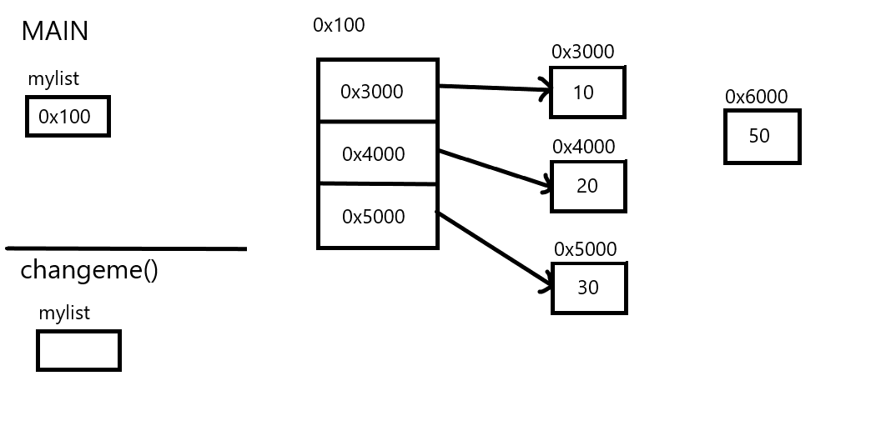

variable變數
list
串列
Call by value
Call by value
0x6000
def
def
0x100
0x300

