Slide 1
Employee Productivity & Work-Life Balance
Presented By: S-Rankers

Slide 2





Group Members
Ibrar Ahmad
FA22-BCS-101
Aqib Shehzad
FA22-BCS-118
Abdul Wasay
FA22-BCS-127
Kashif Ali
FA22-BCS-139
Junaid Ahmad
FA22-BCS-154

Slide 3
TABLE OF CONTENTS
1
2
3
4
5
6
Problem Statement
Datasets Overview
Univariate Charts
Bivariate Charts
Multivariate Charts
Conclusion & References

Slide 4
01
PROBLEM STATEMENT
By Ibrar Ahmad

Slide 5
Problem Statement
Modern employees face challenges balancing long working hours, sleep, stress, and remote work.
These factors directly affect job satisfaction, mental health, and overall productivity.
Companies struggle to measure and optimize work-life balance while maintaining performance.
The goal is to analyze how working hours, job satisfaction, and remote work impact productivity and well-being.

Slide 6
02
Datasets Overview
By Aqib Shehzad

Slide 7
Datasets Overview
1. Human Resource Dataset (1471 Rows):
Attributes: Age, MonthlyIncome, JobSatisfaction, WorkLifeBalance, OverTime.
2. Impact of Remote Work on Mental Health Dataset (5000 Rows):
Attributes: Work_Location, Hours_Worked_Per_Week, Stress_Level, Sleep_Quality, Work_Life_Balance_Rating
3. Remote Work Productivity Dataset (1000 Rows):
Attributes: Employment_Type, Hours_Worked_Per_Week, Productivity_Score, Well_Being_Score

Slide 8
03
Univariate Charts
By Abdul Wasay

Slide 9
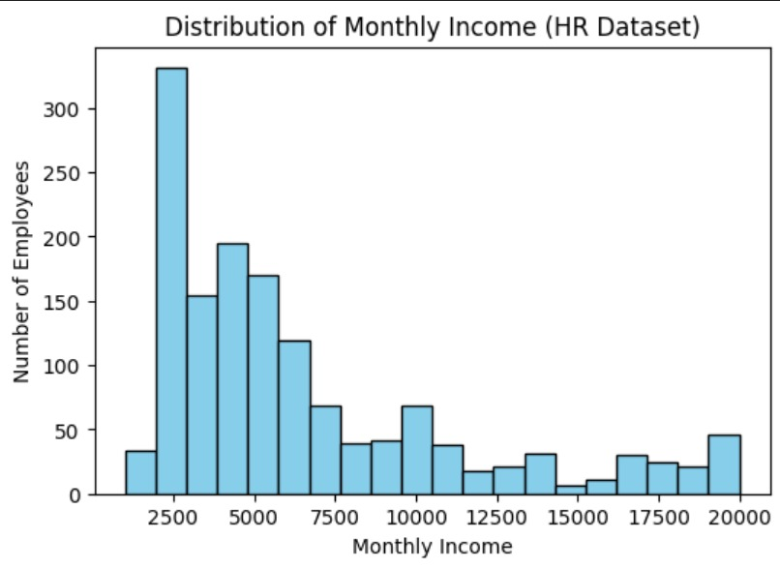
Univariate Charts
1. Histogram

Slide 10
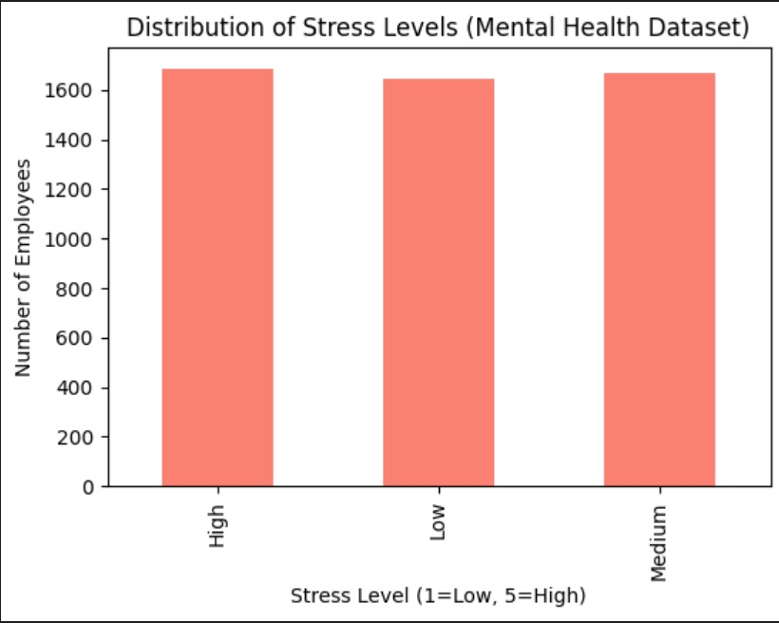
Univariate Charts
2. Bar Chart

Slide 11
04
Bivariate Charts
By Kashif Ali

Slide 12
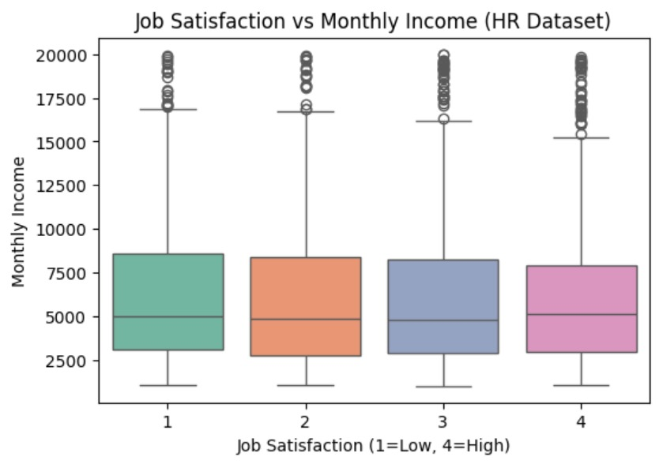
Bivariate Charts
1. Box Plot

Slide 13
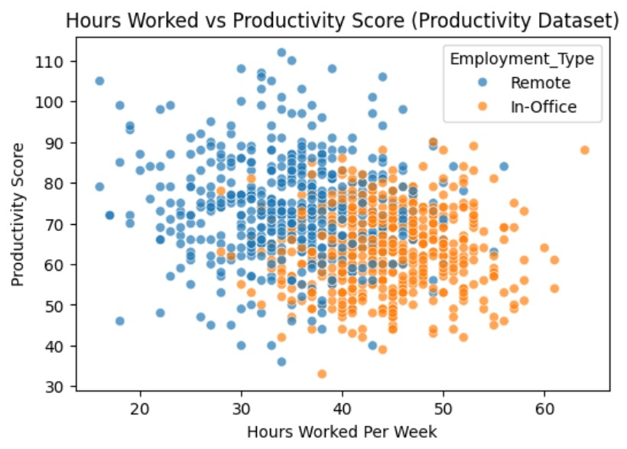
Bivariate Charts
2. Scatter Plot

Slide 14
05
Multivariate Charts
By Junaid Ahmad

Slide 15
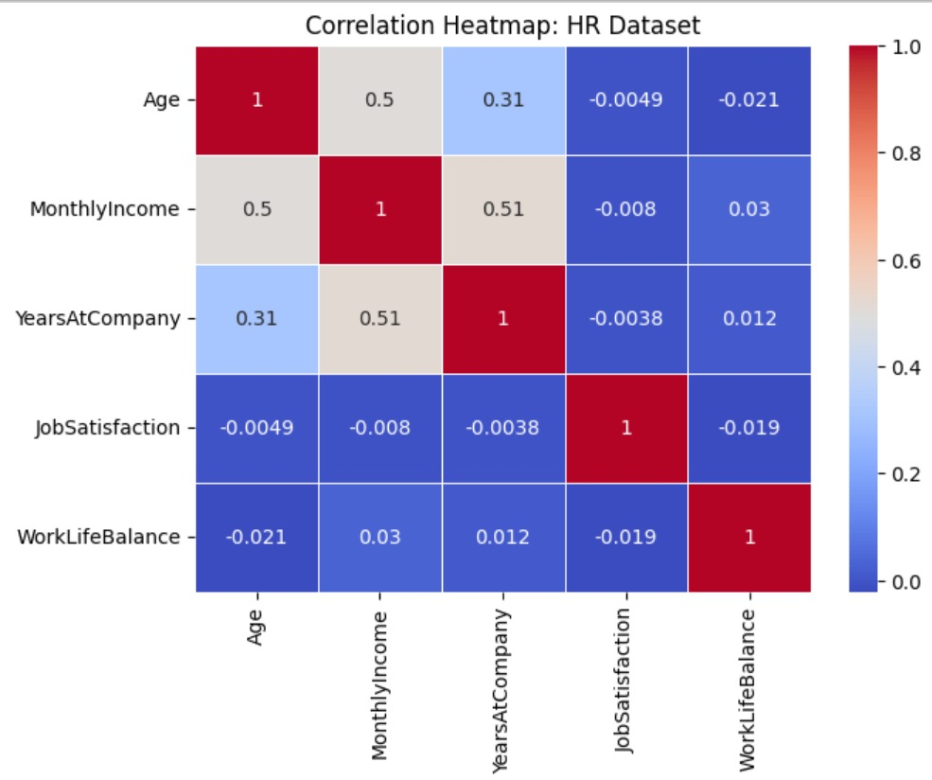
Multivariate Charts
1. HeatMap Chart

Slide 16
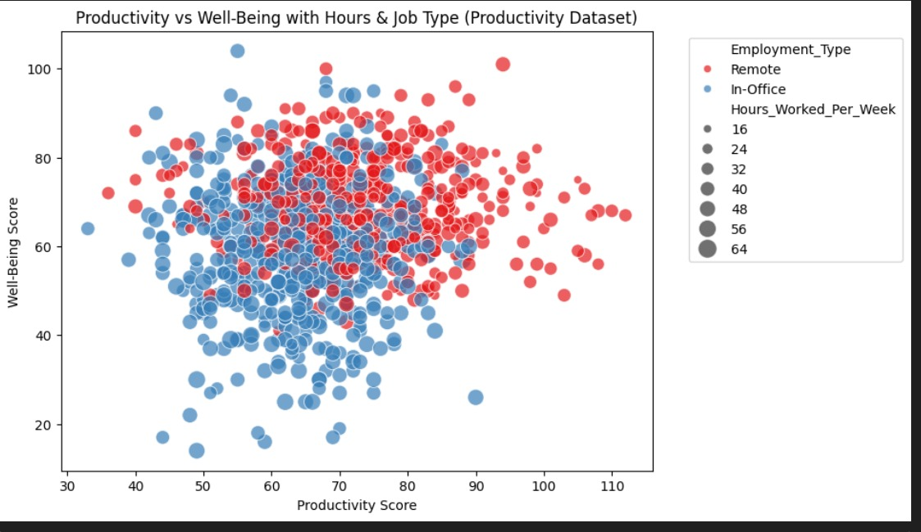
Multivariate Charts
2. Scatter Plot

Slide 17
06
Conclusion & References
By Ibrar Ahmad

Slide 18
Conclusion
Longer working hours are linked to lower productivity and reduced well-being.
Good work-life balance is associated with higher job satisfaction and performance.
Remote work arrangements show slightly higher well-being scores compared to on-site roles.
Employee well-being and productivity are influenced by a combination of work hours, sleep, and work-life balance.

Slide 19
References
1. Human Resource Dataset:
https://data.mendeley.com/datasets/smypp8574h/1
2. Impact of Remote Work on Mental Health Dataset:
https://www.kaggle.com/datasets/iramshahzadi9/remote-work-and-mental-health
3. Remote Work Productivity Dataset:
https://www.kaggle.com/datasets/mrsimple07/remote-work-productivity

Slide 20
THANKOOO!

