Slide 1
Python : Quick Start

Slide 2
Agenda
Why python : Scope
What is python
Setup python
Running python program
Python basics
Useful Packages
Important Links and Resources

Slide 3
Why python : Scope
Easy to Read & Easy to Learn : Beginner Friendly
Very productive or small as well as big projects
Big libraries available in every area
Java | Python
public class HelloWorld { public static void main (String[] args) { System.out.println(”Hello, world!”); } } | print "Hello, world!“ # Python version 2. print("Hello, world!") # Python version 3.

Slide 4
What Python will let you do
Automated testing frameworks : Robot
System Administration : python scripts
Web Application Development : Django
Data Analysis : Pandas
Computer Vision : OpenCV, SimpleCV
Internet Of Things : IBM watson api
Game Development : PyGame, Pyganim
Machine Learning : Tensorflow, Scikit-learn
Data Mining and NLP : Scrapy, NLTK

Slide 5
Who uses python today…
Python is being applied in real revenue-generating products by real companies. For instance:
Google makes extensive use of Python in its web search system, and employs Python’s creator
Intel, Cisco, Hewlett-Packard, Seagate, Qualcomm, and IBM use Python for hardware testing.
ESRI uses Python as an end-user customization tool for its popular GIS mapping products.
The YouTube video sharing service is largely written in Python
Quora is using python based web framework

Slide 6
What is python
Python is a general purpose programming language that is often applied in scripting roles.
So, Python is programming language as well as scripting language.
Python is also called as Interpreted language
Python is object-oriented
Structure supports such concepts as polymorphism, operation overloading, and multiple inheritance.
Indentation
Indentation is one of the great future in Python.
It's free (open source)
Downloading and installing Python is free and easy
Source code is easily accessible

Slide 7
What is python…
It's mixable
- Python can be linked to components written in other languages easily
- Linking to fast, compiled code is useful to computationally intensive problems
- - Python/C integration is quite common
It's easy to use
- No intermediate compile and link steps as in C/ C++
- Python programs are compiled automatically to an intermediate form called bytecode, which the interpreter then reads
It's easy to learn
- Structure and syntax are pretty intuitive and easy to grasp

Slide 8
What is python…
It's powerful
- Dynamic typing
- Built-in types and tools
- Library utilities
- Third party utilities (e.g. Numeric, NumPy, SciPy)
- Automatic memory management
It's portable
- Python runs virtually every major platform used today
- As long as you have a compatible Python interpreter installed, Python programs will run in exactly the same manner, irrespective of platform.

Slide 9
Difference between Scripting and Programing Lang.
Program
Scripting
a program is executed (i.e. the source is first compiled, and the result of that compilation is expected)
A "program" in general, is a sequence of instructions written so that a computer can perform certain task.
a script is interpreted
A "script" is code written in a scripting language. A scripting language is nothing but a type of programming language in which we can write code to control another software application.

Slide 10
Setup python
Python is pre-installed on most Unix systems, including Linux and MAC OS X
Try: python in terminal
For Windows : install the Python 2.7.* or 3.* Binaries from python.org
Add the Python 2.7 Directory to your System Path Environment Variable
use install pip to manage python packages
IDE for Python –
Pycharm
Pydev plugin for eclipse
Xcode
Sublime
https://wiki.python.org/moin/IntegratedDevelopmentEnvironments
Morgan Environment –
Putty - module load python/core [Unix environment]
Install python binaries using http://myapps.ms.com/
Install Pycharm IDE

Slide 11
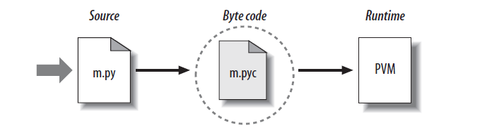
Running Python program
Python’s traditional runtime execution model: source code you type is translated to byte code, which is then run by the Python Virtual Machine. Your code is automatically compiled, but then it is interpreted.
Source code extension is .py
Byte code extension is .pyc (compiled python code)

Slide 12
Running Python program…
How to call up a Python interpreter will vary a bit depending on your platform, but in a system with a terminal interface, all you need to do is type “python” (without the quotation marks) into your command line.
python script.py
# This will simply execute the script and return to the terminal afterwards
$ python -i script.py
# The -i flag keeps the interpreter open after the script is finished running
$ python
>>> execfile('script.py')
Python evaluates each statement one-by-one

Slide 13
The Python Interpreter
Python is an interpreted language
The interpreter provides an interactive environment to play with the language
Results of expressions are printed on the screen
>>> 3 + 7
10
>>> 3 < 15
True
>>> 'print me'
'print me'
>>> print 'print me'
print me
>>>

Slide 14
Python Basics
Names & Assignment
Data Types
Sequences types: Lists, Tuples, and Strings
Comment
Control Flow
Functions
Data type is a property of the object and not of the variable

Slide 15
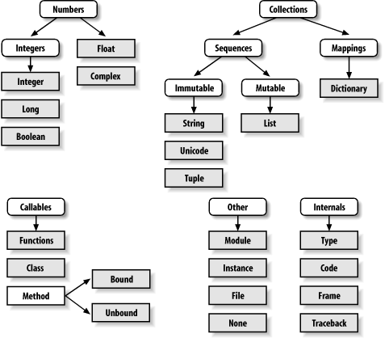

Slide 16
Data Types
Integers: 2323, 3234L
Floating Point: 32.3, 3.1E2
Complex: 3 + 2j, 1j
Lists: l = [ 1,2,3]
Tuples: t = (1,2,3)
Dictionaries: d = {‘hello’ : ‘there’, 2 : 15}

Slide 17
Boolean Expressions
Compound boolean expressions short circuit
and and or return one of the elements in the expression
Note that when None is returned the interpreter does not print anything
>>> True and False
False
>>> False or True
True
>>> 7 and 14
14
>>> None and 2
>>> None or 2
2

Slide 18
String
Substrings and Methods
len(String) – returns the number of characters in the String
str(Object) – returns a String representation of the Object
>>> s = '012345'
>>> s[3]
'3'
>>> s[1:4]
'123'
>>> s[2:]
'2345'
>>> s[:4]
'0123'
>>> s[-2]
'4'
>>> len(x)
6
>>> str(10.3)
'10.3'

Slide 19
String Literals
Strings are immutable
There is no char type like in C++ or Java
+ is overloaded to do concatenation
>>> x = 'hello'
>>> x = x + ' there'
>>> x
'hello there'

Slide 20
String Literals: Many Kinds
Can use single or double quotes, and three double quotes for a multi-line string
>>> 'I am a string'
'I am a string'
>>> "So am I!"
'So am I!'
>>> s = """And me too!
though I am much longer
than the others :)"""
'And me too!\nthough I am much longer\nthan the others :)‘
>>> print s
And me too!
though I am much longer
than the others :)‘

Slide 21
String Formatting
Similar to C’s printf
<formatted string> % <elements to insert>
Can usually just use %s for everything, it will convert the object to its String representation.
>>> "One, %d, three" % 2
'One, 2, three'
>>> "%d, two, %s" % (1,3)
'1, two, 3'
>>> "%s two %s" % (1, 'three')
'1 two three'
>>>

Slide 22
Lists
Lists
Ordered collection of data
Data can be of different types
Lists are mutable
Issues with shared references and mutability
Same subset operations as Strings
>>> x = [1,'hello', (3 + 2j)]
>>> x
[1, 'hello', (3+2j)]
>>> x[2]
(3+2j)
>>> x[0:2]
[1, 'hello']

Slide 23
Lists: Modifying Content
x[i] = a reassigns the ith element to the value a
Since x and y point to the same list object, both are changed
The method append also modifies the list
>>> x = [1,2,3]
>>> y = x
>>> x[1] = 15
>>> x
[1, 15, 3]
>>> y
[1, 15, 3]
>>> x.append(12)
>>> y
[1, 15, 3, 12]

Slide 24
Lists: Modifying Contents
>>> x = [1,2,3]
>>> y = x
>>> z = x.append(12)
>>> z == None
True
>>> y
[1, 2, 3, 12]
>>> x = x + [9,10]
>>> x
[1, 2, 3, 12, 9, 10]
>>> y
[1, 2, 3, 12]
>>>
The method append modifies the list and returns None
List addition (+) returns a new list

Slide 25
Tuples
Tuples
Tuples are immutable versions of lists
One strange point is the format to make a tuple with one element:
‘,’ is needed to differentiate from the mathematical expression (2)
>>> x = (1,2,3)
>>> x[1:]
(2, 3)
>>> y = (2,)
>>> y
(2,)
>>>

Slide 26
Dictionaries
Dictionaries
A set of key-value pairs
Dictionaries are mutable
>>> d = {1 : 'hello', 'two' : 42, 'blah' : [1,2,3]}
>>> d
{1: 'hello', 'two': 42, 'blah': [1, 2, 3]}
>>> d['blah']
[1, 2, 3]

Slide 27
Dictionaries: Add/Modify
Entries can be changed by assigning to that entry
>>> d
{1: 'hello', 'two': 42, 'blah': [1, 2, 3]}
>>> d['two'] = 99
>>> d
{1: 'hello', 'two': 99, 'blah': [1, 2, 3]}
Assigning to a key that does not exist adds an entry
>>> d[7] = 'new entry'
>>> d
{1: 'hello', 7: 'new entry', 'two': 99, 'blah': [1, 2, 3]}

Slide 28
Dictionaries: Deleting Elements
The del method deletes an element from a dictionary
>>> d
{1: 'hello', 2: 'there', 10: 'world'}
>>> del(d[2])
>>> d
{1: 'hello', 10: 'world'}

Slide 29
Input
The raw_input(string) method returns a line of user input as a string
The parameter is used as a prompt
The string can be converted by using the conversion methods int(string), float(string), etc.

Slide 30
If Statements
import math
x = 30
if x <= 15 :
y = x + 15
elif x <= 30 :
y = x + 30
else :
y = x
print ‘y = ‘,
print math.sin(y)
>>> import ifstatement
y = 0.999911860107
>>>
In interpreter
In file ifstatement.py

Slide 31
While Loops
>>> import whileloop
1
2
3
4
5
6
7
8
9
>>>
x = 1
while x < 10 :
print x
x = x + 1
In whileloop.py
In interpreter

Slide 32
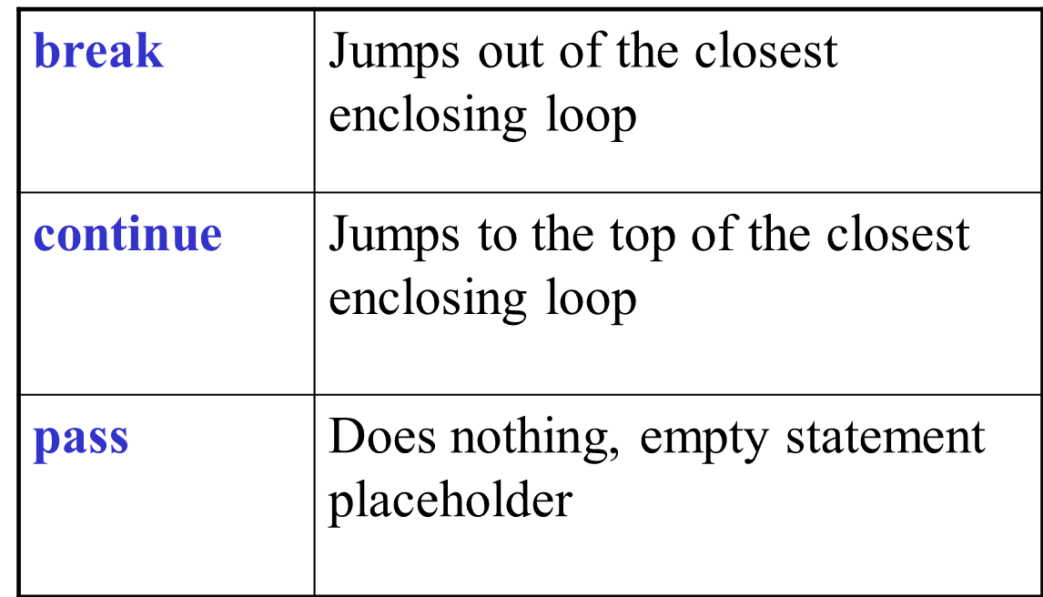
Loop Control Statements

Slide 33
The Loop Else Clause
The optional else clause runs only if the loop exits normally (not by break)
x = 1
while x < 3 :
print x
x = x + 1
else:
print 'hello'
~: python whileelse.py
1
2
hello
Run from the command line
In whileelse.py

Slide 34
For Loops
For loops also may have the optional else clause
for x in range(5):
print x
break
else :
print 'i got here'
~: python elseforloop.py
1
elseforloop.py

Slide 35
Function Basics
def foo (x) :
def bar(y) :
return x + y
return bar
# main
f = foo(3)
print f
print f(2)
def max(x,y) :
if x < y :
return x
else :
return y
>>> import functionbasics
>>> max(3,5)
5
>>> max('hello', 'there')
'there'
>>> max(3, 'hello')
'hello'
functionbasics.py

Slide 36
Functions are first class objects
Can be assigned to a variable
Can be passed as a parameter
Can be returned from a function
Functions are treated like any other variable in Python, the def statement simply assigns a function to a variable

Slide 37
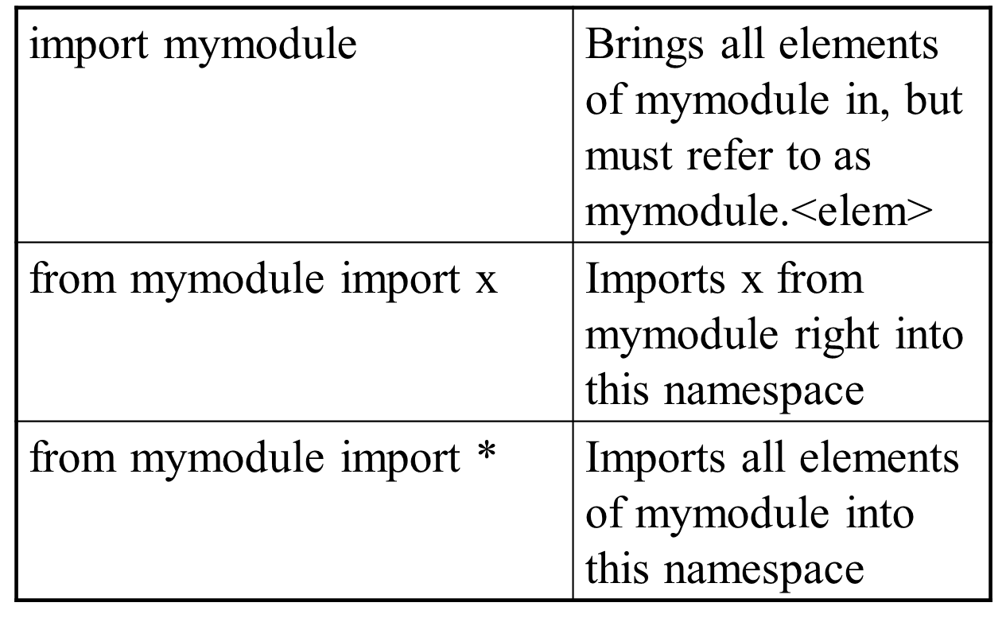
Modules: Imports

Slide 38
Important Links and Resources :

Slide 39
Differences between program and scripting language
Python 2 or 3?
For beginners there is no real difference
between Python 2 & 3. The basics are the
same (except for print)
REPL
Read, Eval, Print, Loop
$ python
>>> 2 + 2 # read, eval
4 # print
>>> # repeat (loop)
(unix) script
Make file hello with
#!/usr/bin/env python
print "hello world"
Run with:
chmod +x hello
./hello
Objects
Everything in Python is an object that has:
● an identity (id)
● a value (mutable or immutable)
id
>>> a = 4
>>> id(a)
6406896

Slide 40
Value
●Mutable:When you alter the item, the
id is still the same. Dictionary, List
● Immutable:String, Integer, Tuple
Mutable
>>> b = []
>>> id(b)
140675605442000
>>> b.append(3)
>>> b
[3]
>>> id(b)
140675605442000 # SAME!
Immutable
>>> a = 4
>>> id(a)
6406896
>>> a = a + 1
>>> id(a)
6406872 # DIFFERENT!

Slide 41
Variables
a = 4 # Integer
b = 5.6 # Float
c = "hello" # String
a = "4" # rebound to String
import sys
>>> sys.maxint
9223372036854775807
>>> sys.maxint + 1
9223372036854775808L
Careful with integer division
>>> 3/4
0
>>> 3/4.
0.75
(In Python 3 // is integer division
operator)
String escaping
Escape with \
>>> print 'He said, "I\'m sorry"'
He said, "I'm sorry"
>>> print '''He said, "I'm sorry"'''
He said, "I'm sorry"
>>> print """He said, "I'm sorry\""""
He said, "I'm sorry"

Slide 42
String formatting
c-like
>>> "%s %s" %('hello', 'world')
'hello world'
PEP 3101 style
>>> "{0} {1}".format('hello', 'world')
'hello world'
dunder methods
dunder (double under) or "special/magic"
methods determine what will happen
when + (__add__) or / (__div__) is
called.

Slide 43
comments
Comments follow a #
No multi-line comments

Slide 44
No Braces
Python uses indentation instead of braces to determine the scope of expressions
All lines must be indented the same amount to be part of the scope (or indented more if part of an inner scope)
This forces the programmer to use proper indentation since the indenting is part of the program!

Slide 45
To understand the code (Continued….)
Whitespace is meaningful in Python, especially indentation and placement of newlines
• Use a newline to end a line of code
Use \ when must go to next line prematurely
• No braces {} to mark blocks of code, use consistent indentation instead
• First line with less indentation is outside of the block
• First line with more indentation starts a nested block
• Colons start of a new block in many constructs,
e.g. function definitions, then clauses

Slide 46
To understand the code (Continued….)
• Start comments with #, rest of line is ignored
• Can include a “documentation string” as the first line of a new function or class you define
• Development environments, debugger, and other tools use it: it’s good style to include one
def fact(n):
“““fact(n) assumes n is a positive
integer and returns facorial of n.”””
assert(n>0)
return 1 if n==1 else n*fact(n-1)

Slide 47
To understand the code (Continued….)
• Binding a variable in Python means setting a name to hold a reference to some object
• Assignment creates references, not copies
• Names in Python don’t have an intrinsic type, objects have types
Python determines type of the reference automatically based on what data is assigned to it
• You create a name the first time it appears on the left side of an assignment expression:
x = 3
• A reference is deleted via garbage collection after any names bound to it have passed out of scope
• Python uses reference semantics (more later)

Slide 48
Assignment
• You can assign to multiple names at the
same time
>>> x, y = 2, 3
>>> x
2
>>> y
3
• This makes it easy to swap values
>>> x, y = y, x
• Assignments can be chained
>>> a = b = x = 2

Slide 49
Sequence types
• Sequences are containers that hold objects
• Finite, ordered, indexed by integers
• Tuple
• An immutable ordered sequence of items
• Items can be of mixed types, including collection types
• Strings
• An immutable ordered sequence of chars
• Conceptually very much like a tuple
• List
• A Mutable ordered sequence of items of mixed types

Slide 50
Positive and negative indices
>>> t = (23, ‘abc’, 4.56, (2,3), ‘def’)
Positive index: count from the left, starting with 0
>>> t[1]
‘abc’
Negative index: count from right, starting with –1
>>> t[-3]
4.56

Slide 51
Strings
A string is a sequence of characters
A string literal uses quotes ‘Hello’ or “Hello”
For strings, + means “concatenate”
When a string contains numbers, it is still a string
We can convert numbers in a string into a number using int()

Slide 52
Strings (Continued….)
We can get at any single character in a string using an index specified in square brackets
The index value must be an integer and starts at zero
The index value can be an expression that is computed
You will get a python error if you attempt to index beyond the end of a string.
There is a built-in function len that gives us the length of a string

Slide 53
Slicing
Sometimes you may find it necessary to extract a portion of a string from another string.
You can use “slicing” notation in Python to extract a span of characters from a string into a new string. We call this new String a "substring".
The syntax for this notation is as follows: substring = bigstring[start:end:step]
For example:
full_name =“Anand Raval”
first_name = full_name[0:5]
print (first_name)
>> Anand

Slide 54
Slicing (Continued….)
word = "Superman sings in the shower.“
print (word[0:8]) # Superman
print (word[9:14]) # sings
print (word[:5]) # Super
print (word[9:]) # sings in the shower.
print (word[-7:]) # shower.
print (word[0:len(word):3]) # Seasgit or

Slide 55
‘in’ operator
• Boolean test whether a value is inside a container:
>>> t = [1, 2, 4, 5]
>>> 3 in t
False
>>> 4 in t
True
>>> 4 not in t
False
• For strings, tests for substrings
>>> a = 'abcde'
>>> 'c' in a
True
>>> 'cd' in a
True
>>> 'ac' in a
False
• Be careful: the in keyword is also used in the syntax
of for loops and list comprehensions

Slide 56
Mutability Tuples vs List
Lists are mutable
>>> li = [‘abc’, 23, 4.34, 23]
>>> li[1] = 45
>>> li
[‘abc’, 45, 4.34, 23]
• We can change lists in place.
• Name li still points to the same memory
reference when we’re done.
Tuples are immutable
>>> t = (23, ‘abc’, 4.56, (2,3), ‘def’)
>>> t[2] = 3.14
Traceback (most recent call last):
File "<pyshell#75>", line 1, in -topleveltu[
2] = 3.14
TypeError: object doesn't support item assignment
• You can’t change a tuple.
• You can make a fresh tuple and assign its
reference to a previously used name.
>>> t = (23, ‘abc’, 3.14, (2,3), ‘def’)
• The immutability of tuples means they’re faster
than lists

Slide 57
Operations on list only
>>> li = [1, 11, 3, 4, 5]
>>> li.append(‘a’) # Note the method syntax
>>> li
[1, 11, 3, 4, 5, ‘a’]
>>> li.insert(2, ‘i’)
>>>li
[1, 11, ‘i’, 3, 4, 5, ‘a’]
• Lists have many methods, including index,
count, remove, reverse, sort
>>> li = [‘a’, ‘b’, ‘c’, ‘d’]
>>> li.index(‘b’) #
1
>>> li.count(‘b’) # number of occurrences
1
>>> li.remove(‘b’) #
>>> li
[‘a’, ‘c’, ‘d’]
>>> li = [5, 2, 6, 8]
>>> li.reverse() # reverse the list *in place*
>>> li
[8, 6, 2, 5]
>>> li.sort() # sort the list *in place*
>>> li
[2, 5, 6, 8]
>>> li.sort(some_function)
# sort in place using user-defined comparison

Slide 58
Tuple details
• The comma is the tuple creation operator, not parens
>>> 1,
(1,)
• Python shows parens for clarity (best practice)
>>> (1,)
(1,)
• Don't forget the comma!
>>> (1)
1
• Trailing comma only required for singletons others
• Empty tuples have a special syntactic form
>>> ()
()
>>> tuple()
()

Slide 59
Dictionary
>>> empty = {}
>>> empty
{}
>>> food = {“Pizza" : "yes", “Sandwitch" : "yes", “Burger" : "no" }
>>> food
{'egg': 'yes', 'ham': 'yes', 'spam': 'no'}
>>> food[“Burger"] = "yes"
>>> food
{'egg': 'yes', 'ham': 'yes', 'spam': 'yes'}
>>>
Tuple as keys are okay, as you can see in the following example:
>>> dic = { (1,2,3):"abc", 3.1415:"abc"}
>>> dic
{3.1415: 'abc', (1, 2, 3): 'abc'}

Slide 60
List from Dictionary
It's possible to create lists from dictionaries by using the methods items(), keys() and values().
As the name implies the method keys() creates a list, which consists solely of the keys of the dictionary.
values() produces a list consisting of the values.
items() can be used to create a list consisting of 2-tuples of (key,value)-pairs:
>>> w={"house":"Haus","cat":"Katze","red":"rot"}
>>> w.items()
[('house', 'Haus'), ('red', 'rot'), ('cat', 'Katze')]
>>> w.keys()
['house', 'red', 'cat']
>>> w.values()
['Haus', 'rot', 'Katze']

Slide 61
Exception handling
import sys try: fh = open('exceptionn.txt') line = fh.readline() except IOError as e: print(e) #raise except: print(sys.exc_info())
import sys try: FH = open('exception.txt') line = FH.readline() except: print (sys.exc_info()) else: print ("Content of the file: " + line) finally: print ("This will be executed every time")

