Slide 1
Python : Quick Start

Slide 2
Agenda
Why python : Scope
What is python
Setup python
Running python program
Python basics
Useful Examples
Important Links and Resources

Slide 3
Why python : Scope
Easy to Read & Easy to Learn : Beginner Friendly
Very productive or small as well as big projects
Big libraries available in every area
Java | Python
public class HelloWorld { public static void main (String[] args) { System.out.println(”Hello, world!”); } } | print "Hello, world!“ # Python version 2. print("Hello, world!") # Python version 3.

Slide 4
What Python will let you do
Automated testing frameworks : Robot
System Administration : python scripts
Web Application Development : Django
Data Analysis : Pandas
Computer Vision : OpenCV, SimpleCV
Internet Of Things : IBM watson api
Game Development : PyGame, Pyganim
Machine Learning : Tensorflow, Scikit-learn
Data Mining and NLP : Scrapy, NLTK

Slide 5
Who uses python today…
Python is being applied in real revenue-generating products by real companies. For instance:
Google makes extensive use of Python in its web search system, and employs Python’s creator
Intel, Cisco, Hewlett-Packard, Seagate, Qualcomm, and IBM use Python for hardware testing.
ESRI uses Python as an end-user customization tool for its popular GIS mapping products.
The YouTube video sharing service is largely written in Python
Quora is using python based web framework

Slide 6
What is python
Python is a general purpose programming language that is often applied in scripting roles.
So, Python is programming language as well as scripting language. Python is also called as Interpreted language.
The interpreter provides an interactive environment to play with the language
Python is object-oriented
Structure supports such concepts as polymorphism, operation overloading, and multiple inheritance.
Indentation
Indentation is one of the great future in Python.
It's free (open source)
Downloading and installing Python is free and easy
Source code is easily accessible

Slide 7
What is python…
It's mixable
- Python can be linked to components written in other languages easily
- Linking to fast, compiled code is useful to computationally intensive problems
- Python/C integration is quite common
It's easy to use
- No intermediate compile and link steps as in C/ C++
- Python programs are compiled automatically to an intermediate form called bytecode, which the interpreter then reads
It's easy to learn
- Structure and syntax are pretty intuitive and easy to grasp

Slide 8
What is python…
It's powerful
- Dynamic typing
- Built-in types and tools
- Library utilities
- Third party utilities (e.g. Numeric, NumPy, SciPy)
- Automatic memory management
It's portable
- Python runs virtually every major platform used today
- As long as you have a compatible Python interpreter installed, Python programs will run in exactly the same manner, irrespective of platform.

Slide 9
Difference between Scripting and Programing Lang.
Program
Scripting
a program is executed (i.e. the source is first compiled, and the result of that compilation is expected)
A "program" in general, is a sequence of instructions written so that a computer can perform certain task.
a script is interpreted
A "script" is code written in a scripting language. A scripting language is nothing but a type of programming language in which we can write code to control another software application.

Slide 10
Python 2 or 3?
For beginners there is no real difference between Python 2 & 3. The basics are the (except for print)
Python 2 :
print 'Hello, World!'
print('Hello, World!')
Python 3:
print('Hello, World!')
http://www.geeksforgeeks.org/important-differences-between-python-2-x-and-python-3-x-with-examples/
https://docs.python.org/3.0/whatsnew/3.0.html
Python 2 :
print 4/3
Python 3:
print4/3

Slide 11
Setup python
Unix - Python is pre-installed on most Unix systems, including Linux and MAC OS X
Try: python in terminal $ python >>> import this
For Windows : install the Python 2.7.* or 3.* Binaries from python.org
Add the Python 2.7 Directory to your System Path Environment Variable
use install pip to manage python packages
IDE for Python –
Pycharm
Pydev plugin for eclipse
Xcode
Sublime
https://wiki.python.org/moin/IntegratedDevelopmentEnvironments
Morgan Environment –
Putty - module load python/core [Unix environment]
Install python binaries using http://myapps.ms.com/
Install Pycharm IDE

Slide 12
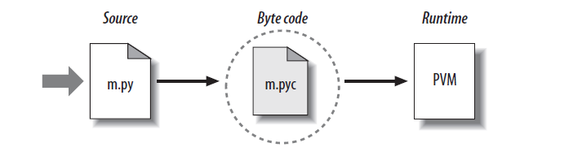
Running Python program
Python’s traditional runtime execution model: source code you type is translated to byte code, which is then run by the Python Virtual Machine. Your code is automatically compiled, but then it is interpreted.
Source code extension is .py
Byte code extension is .pyc (compiled python code)

Slide 13
Running Python program…
How to call up a Python interpreter will vary a bit depending on your platform, but in a system with a terminal interface, all you need to do is type “python” (without the quotation marks) into your command line.
Script execution-
Unix Env. –
Make file hello
#!/usr/bin/env python
print "hello world"
Run with:
chmod +x hello
./hello

Slide 14
Running Python program…
python script.py
# This will simply execute the script and return to the terminal afterwards
$ python –i -v script.py
# The -i flag keeps the interpreter open after the script is finished running
$ python
>>> execfile('script.py')

Slide 15
Running Python program…
Two ways to launch the interpreter:
–Run IDLE the interpreter is called the “Python shell”
–Type python at the operating system command line
The interpreter is a loop that does:
–Read an expression
–Evaluate the expression
–Print the result
(Jargon: An interpreter is also called a “read-eval-print loop”, or a REPL)
$ python
>>> 2 + 2 # read, eval
# print
>>> # repeat (loop)

Slide 16
Python Basics
Modules
Variable Names & Assignment
Data Types
Sequences types: Lists, Tuples, and Strings
Control Flow
Functions and classes

Slide 17
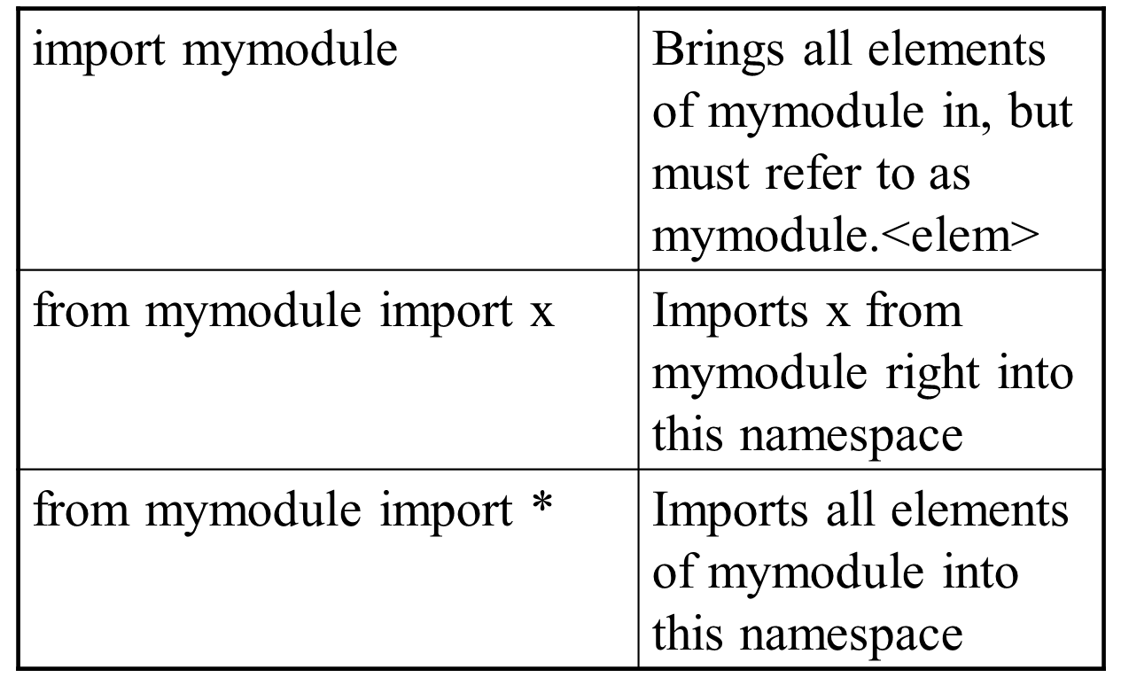
Modules

Slide 18
Naming and Assignment
Naming –
Case sensitive
don't start with numbers
[a-zA-Z_] + [a-zA-Z0-9_]*
See PEP 8
PEP Python Enhancement Proposal (similar to Python Enhancement Proposal (similar to JSR in Java)
Assignments – creates references, not copies
count = 232
a=b=c = 1
a,b,c = 1,2.3,”klsd”
x, y = y, x

Slide 19
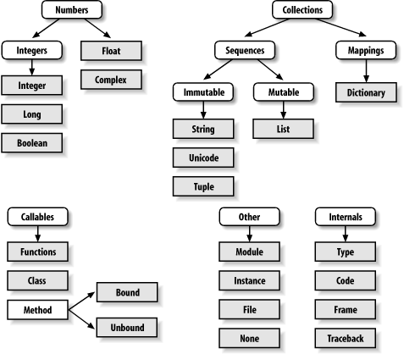
Datatypes

Slide 20
Data Types…
Integer: 2323
Long: 3234L for python 2.x
Floating Point: 32.3, 3.1E2
Complex: 3 + 2j, 1j
Boolean: True or False
Python 3.x
import sys
>>> sys.maxint
9223372036854775807
>>> sys.maxint + 1
9223372036854775808L

Slide 21
Sequence Data Types…
List : [1,’str’,3.2]
Tuple: (1,’str’,3.2,3433)
Dictionary: {1:’val’,2:’val’,3.43:’sdf’}
String: ’string1’ or ’’string2” or ’’’String3
span to multi line’’’
Type() – return the type of object
Dir() – return a list of valid attributes for that object
Id() – return the id associated with object
callable() – return Boolean according to object argument appears callable or not

Slide 22
Mutable and Immutable
Mutable : When you alter the item, the id is still the same. Dictionary, List is still the same.
Immutable : String, Integer, Tuple
Everything in Python is an object that has an identity (id) a value (mutable or immutable)
>>> a = 3
>>> b = 3
>>> id(b)
1509709584
>>> id(a)
1509709584
>>> a = 4
>>> id(a)
1509709600
>>> id(b)
1509709584

Slide 23
Comments
Single Line comment –
#single line comment
No multi line comment in python but we can use docstring
’’’multi line comment
using triple’’’
#prepended comment
class weather():
’’’ Act as a doc string contain ifo of class weather’’’
def getStatus_code(self, url):
result = requests.get(url)
return result.status_code

Slide 24
List
Most basic data structure Ordered collection of data
Values between square brackets
Data can be of different types
Maintain insertion order
Lists are mutable
>>>list = [1,2,4,’str’]
>>>print(list) or print(list[2]) or print(list[2:]) or print(list[-1])
>>>list[3] = ‘another string’
>>>del list[2]
>>>len(list)
>>>dir([])
>>>cmp(list1, list2)
>>> x = [1,2,3]
>>> y = x
>>> z = x.append(12)
>>> z == None
True
>>> y
[1, 2, 3, 12]
>>> x = x + [9,10]
>>> x
[1, 2, 3, 12, 9, 10]
>>> y
[1, 2, 3, 12]
>>>
>>> x = [1,'hello', (3 + 2j)]
>>> x
[1, 'hello', (3+2j)]
>>> x[2]
(3+2j)

Slide 25
Tuple
A tuple is a sequence of immutable Python objects
Just like lists but Tuples are immutable
Maintain insertion order
>>>tuple= (1,2,4,’str’) or tuple = (4,) or tuple = ()
>>>print(tuple) or print(tuple[2]) or print(tuple[2:]) or print(tuple[-1])
>>>len(tuple)
>>>del tuple
>>>dir(())
>>> 3 in (1, 2, 3)
>>>cmp(tuple1, tuple2)
>>> x = (1,2,3)
>>> x[1:]
(2, 3)
>>> y = (2,)
>>> y
(2,)
>>>

Slide 26
Dictionary
A Dictionary is a sequence of key and value pair
Key must be immutable type
Do not maintain insertion order but we can use → dict = collection.OrderedDict()
>>>dict= {} or dict = {‘key1’:’val1’, ‘key2’:’val2’, 2:34}
>>>print(dict) or print(dict[key])
>>>dict[‘key] = values
>>>del dict
>>>dict.clear()
>>>dict.items()
>>>len(dict)
>>>dir({})
>>>cmp(dict1, dict2)
>>> d
{1: 'hello', 'two': 42, 'blah': [1, 2, 3]}
>>> d['two'] = 99
>>> d
{1: 'hello', 'two': 99, 'blah': [1, 2, 3]}
>>> d[7] = 'new entry'
>>> d
{1: 'hello', 7: 'new entry', 'two': 99, 'blah': [1, 2, 3]}

Slide 27
String
>>> len(x)
6
>>> str(10.3)
'10.3'
String Data type are most popular in python
Strings are immutable
+ is overloaded to do concatenation
There is no char type like other programming language
Similar to C’s printf
>>>print ("My name is %s and weight is %d kg!" % ('Zara', 21))
>>>"{1} {0}".format('hello', 'world')
>>> s = '012345'
>>> s[3]
'3'
>>> s[1:4]
'123'
>>> s[2:]
'2345'
>>> s[:4]
'0123'
>>> s[-2]
'4'
>>> x = 'hello'
>>> x = x + ' there'
>>> x
'hello there'

Slide 28
Control Flow and Loops
If While For
import math
x = 30
if x <= 15 :
y = x + 15
elif x <= 30 :
y = x + 30
else :
y = x
print ‘y = ‘,
print math.sin(y)
var = 1
while var < 4 :
num = int(input("Enter No.:"))
print ("entered: ", num)
var+=1
for x in range(5):
print x
fruits = ['banana', 'apple']
for fruit in fruits
print ('Current fruit :', fruit)

Slide 29
Iterator
list = [1,2,3,4,5]
it = iter(list) # an iterator object
print (next(it)) #prints next available element
for x in it:
print (x, end=" ")
while True:
try:
print (next(it))
except StopIteration:
sys.exit() #you have to import sys module for this

Slide 30
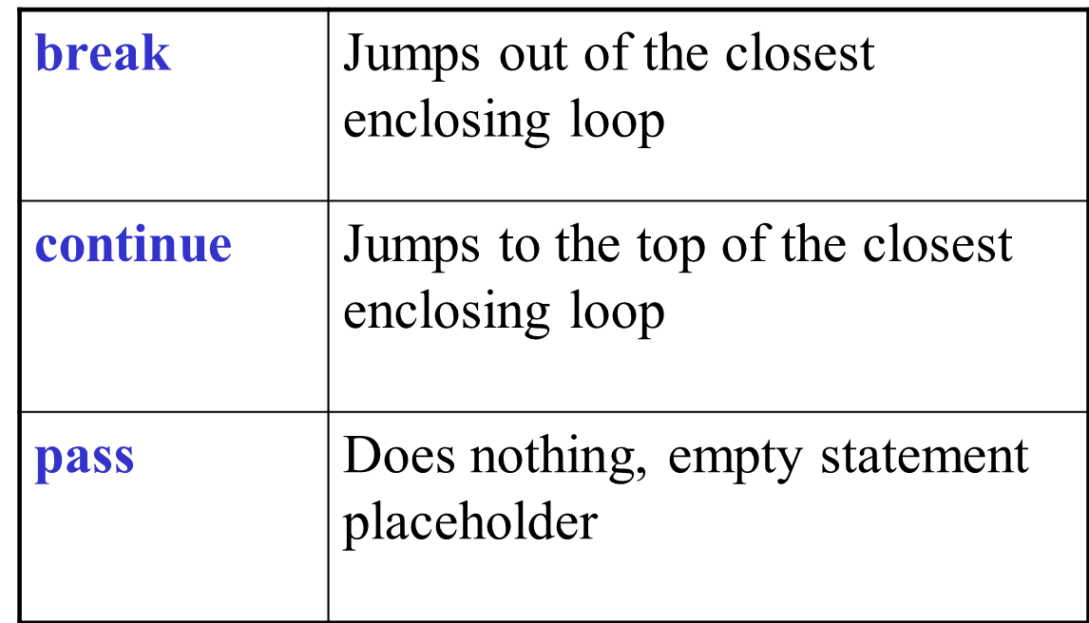
Loop Control Statements

Slide 31
Function
Function Call Function Definition Nested Function
>>> import functionbasics
>>> max(3,5)
5
>>> max('hello', 'there')
'there'
>>> max(3, 'hello')
'hello‘
def max(x,y) :
’’’ Doc String’’’
if x < y :
return x
else :
return y
def foo (x) :
def bar(y) :
return x + y
return bar
# main
f = foo(3)
print f
print f(2)

Slide 32
Class
Python has been an object-oriented language since the time it existed.
class Employee:
‘Doc string for Employee'
empCount = 0
def __init__(self, name, salary): # what is self and __init__
self.name = name
self.salary = salary
Employee.empCount += 1
def displayCount(self):
print "Total Employee %d" % Employee.empCount
def displayEmployee(self):
print "Name : ", self.name, ", Salary: ", self.salary
obj = Employee()
obj.displayCount()

Slide 33
Exception handling
import sys try: fh = open('exceptionn.txt') line = fh.readline() except IOError as e: print(e) #raise except: print(sys.exc_info())
import sys try: FH = open('exception.txt') line = FH.reaQdline() except: print (sys.exc_info()) else: print ("Content of the file: " + line) finally: print ("This will be executed every time")

Slide 34
Example
# Python program to check if the input number is prime or not
num = 407
# take input from the user
# num = int(input("Enter a number: "))
# prime numbers are greater than 1
if num > 1:
# check for factors
for i in range(2,num):
if (num % i) == 0:
print(num,"is not a prime number")
print(i,"times",num//i,"is",num)
break
else:
print(num,"is a prime number")
# if input number is less than or equal to 1, it is not prime
else:
print(num,"is not a prime number")

Slide 35
Important Links and Resources
https://docs.python.org/3.0/index.html
Lynda
Ievolve

