Slide 1
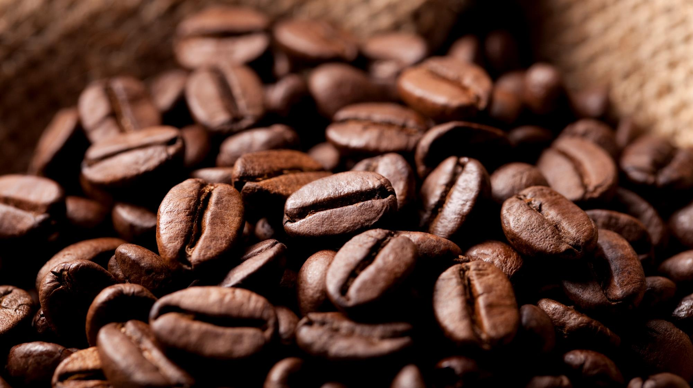
SUBSTITUTE GOODS
Market Goods

Slide 2

GOODS
GOODS INCLUDE ALL THOSE THINGS WHICH ARE PHURCHASED FOR THE PURPOSE OF RESALE
(WHICH ARE MEAN TO BE SALE)

Slide 3
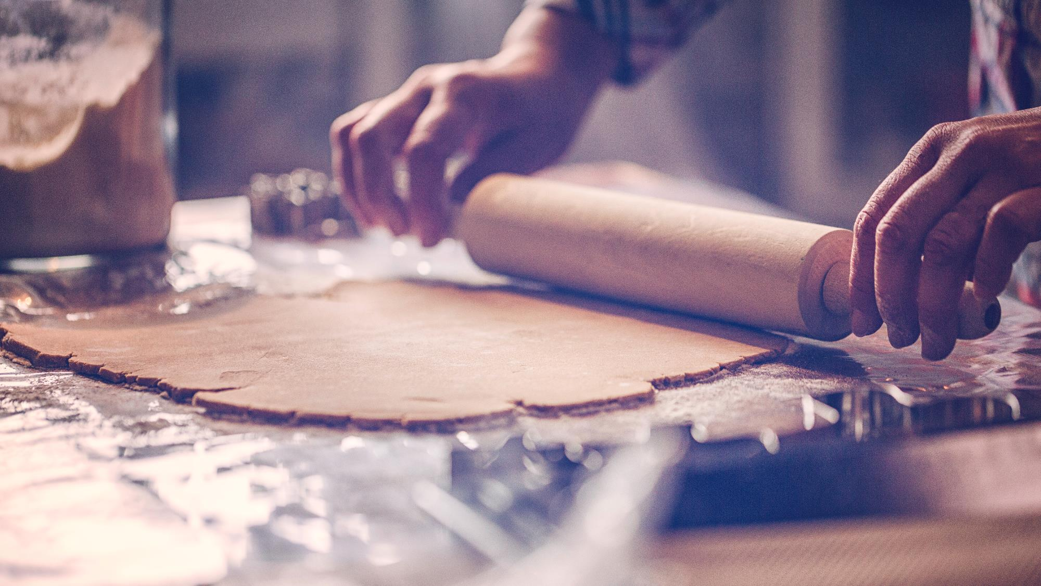

TYPES OF GOODS
SUSTITUTE
GOODS
COMPLEMENTARY
GOODS
NORMAL GOODS
INFERIOR GOODS
RELATED
GOODS

Slide 4

RELATED GOODS
GOODS WHICH ARE RELATED TO EACH OTHER

Slide 5
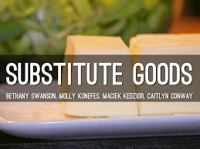
SUBSTITUTE GOODS
SUSTITUTE GOODS ARE THOSE GOODS WHICH CAN BE UESD IN PLACE OF
ONE ANOTHER FOR SATISFACTION OF A PARTICULAR WANT

Slide 6
EXAMPLES OF SUBSTITUTE GOODS
FOR EXAMPLE –
COMMODITY FIRST - TEA
COMMODITY SECOND – COFFEE
The price of a commodity first (Tea) increases then
The Demand for commodity second (Coffee) will rise as coffee
Because the price of commodity is cheaper now

Slide 7
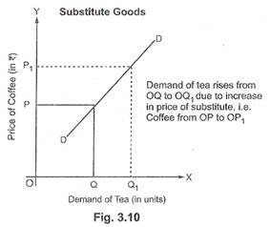
Graphical representation

Slide 8

Thank you
SUMIT KUMAR MEENA (XI D)
AJAI SAM (XI C)
ANSH GUPTA (XI C)
No. of Member - THREE

