Slide 1


THE EXTREME PROGRAMMING MODEL

Slide 2
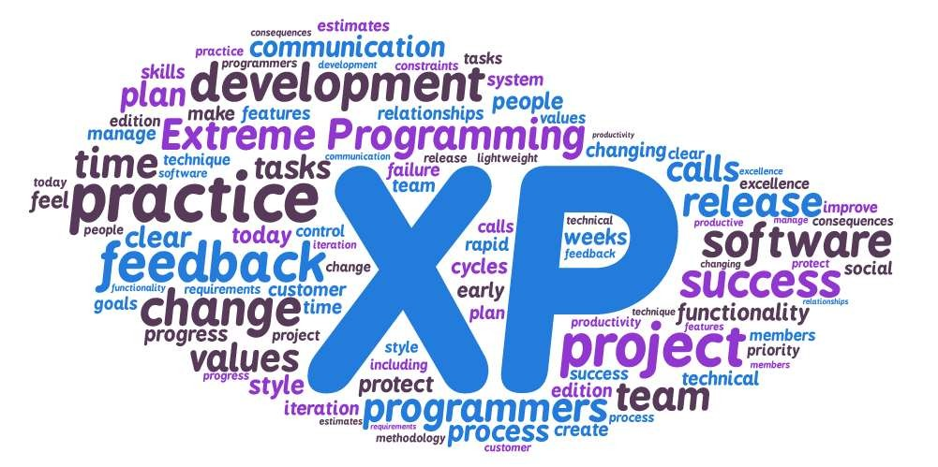
CONTENT
Overview
Details
Advantages
Disadvantages
Interesting
Reflection
Review
Summary

Slide 3

1. Overview

Slide 4
Overview
The “Extreme Programming (XP) Model” is a model that represents one method as to how software can be developed.

Slide 5
Timeline of Methodologies
1950s
Code & Fix
1960s
Design-Code-Test-Maintain
1970s
Waterfall Model
1980s
Spiral Model
1990s
Rapid Application Development, V Model
2000s
Agile Methods
6

Slide 6
Timeline of Methodologies
1950s
Code & Fix
1960s
Design-Code-Test-Maintain
1970s
Waterfall Model
1980s
Spiral Model
1990s
Rapid Application Development, V Model
2000s
Agile Methods
7

Slide 7
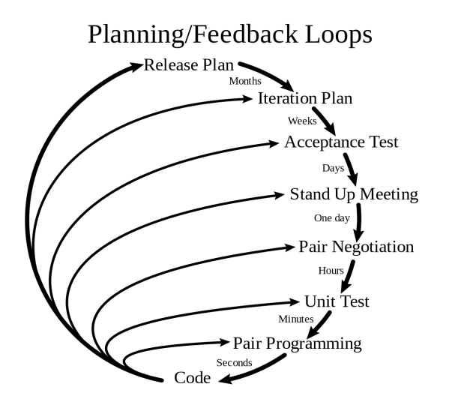
Overview
8

Slide 8
Overview
Extreme Programming (XP) was created by Kent Beck during his work on the C3 project.
Beck became the C3 project leader in 1996 and began to refine the development methodology used in the project
He wrote a book on the methodology, published in October 1999, called Extreme Programming Explained.
9

Slide 9

Kent Beck
Born in 1961.
an American software engineer and the creator of Extreme Programming
was one of the 17 original signatories of the Agile Manifesto
the leading proponent of Test-Driven Development

Slide 10
2. Details

Slide 11
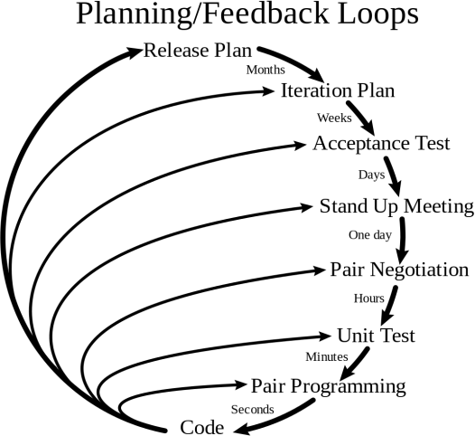
Extreme Programming (XP)

Slide 12
Extreme Programming (XP)
The key assumption of XP is:

Slide 13
Extreme Programming (XP)
The key assumption of XP is:
Embrace Change

Slide 14
Extreme Programming (XP)
Start with the Planning Game:
The game is a meeting that occurs once per iteration, typically once a week. The planning process is divided into two parts:
Release Planning: This is focused on determining what requirements are included in which near-term releases, and when they should be delivered. The customers and developers are both part of this.
Iteration Planning: This plans the activities and tasks of the
developers. In this process the customer is not involved.

Slide 15
Extreme Programming (XP)
This is done by:
Emphasis on continuous feedback from the customer
Short iterations
Design and redesign
Coding and testing frequently
Eliminating defects early, thus reducing costs
Keeping the customer involved throughout the development
Delivering working product to the customer

Slide 16
Extreme Programming (XP)
Management-Practices
On-Site Customer: A central customer contact must always be accessible in order to clarify requirements and questions directly.
Planning Game: Projects, in accordance with XP, run iteratively (repeatedly) and incrementally (gradually build on each other). The contents of the next step are planned before each iteration. All project members (incl. the customer) participate.
Short Releases: New deliveries should be made at short intervals. Consequently, customers receive the required functions quicker and can therefore give feedback on the development quicker.

Slide 17
12 Practices of XP

Slide 18
Extreme Programming (XP)
Management-Practices
On-Site Customer: A central customer contact must always be accessible in order to clarify requirements and questions directly.
Planning Game: Projects, in accordance with XP, run iteratively (repeatedly) and incrementally (gradually build on each other). The contents of the next step are planned before each iteration. All project members (incl. the customer) participate.
Short Releases: New deliveries should be made at short intervals. Consequently, customers receive the required functions quicker and can therefore give feedback on the development quicker.

Slide 19
Extreme Programming (XP)
Team-Practices
Metaphor: Only a few clear metaphors should describe the system being developed so that the nitty-gritty of the system is clear to all of the project members.
Collective Ownership: The whole team is responsible for the system, not individuals. Each developer must have access to all lines of code so that each developer is able to take over the task of another developer.
Continuous Integration: All changes to the system are integrated promptly so that not too many dependencies between changes occur.
Coding Standards: Regarding the common responsibility for the code, there should be a given common standard for writing the code.
Sustainable Pace: XP builds on the creativity of the individual project members. This creativity cannot be achieved if the project team constantly works overtime. Overtime is to be avoided.

Slide 20
Extreme Programming (XP)
Programming-Practices
Testing: All developments must be tested.
Simple Design: The system should be designed as simply as possible so that it is easier to understand, modify and test.
Refactoring: As soon as it becomes necessary to alter the structure of the system, it should be implemented.
Pair Programming: There are always two developers sitting in front of a computer in order to increase the quality and transfer the knowledge better.

Slide 21
Extreme Programming (XP)
Project are broken down into 1-2 week iterations.
If changes occur in the middle of an iteration, the team are capable of reacting to them, as long as the team hasn’t started work on a particular feature.
Extreme Programming teams work in a strict priority order. Features to be developed are prioritized by the customer.

Slide 22
Extreme Programming (XP)
Design
Writing unit tests before programming and keeping all of the tests running at all times. The unit tests are automated and eliminates defects early, thus reducing the costs.
Starting with a simple design just enough to code the features at hand and redesigning when required.

Slide 23
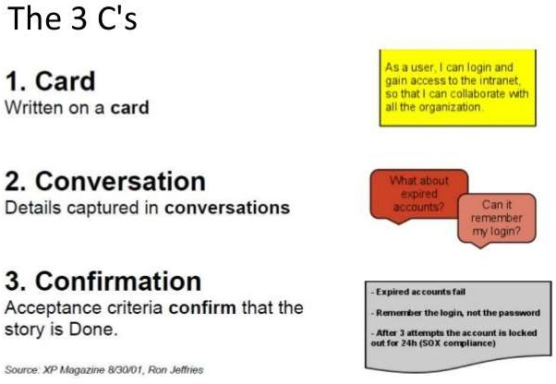
Extreme Programming (XP)
Design: User Stories

Slide 24
Extreme Programming (XP)
Development
Programming in pairs (called pair programming), with two programmers at one screen, taking turns to use the keyboard. While one of them is at the keyboard, the other constantly reviews and provides inputs.
Integrating and testing the whole system several times a day.

Slide 25

Extreme Programming (XP)
Pair Programming
two programmers work together at one workstation.
One, the driver, writes code while the other, the observer or navigator, reviews each line of code as it is typed in.
The two programmers switch roles frequently.

Slide 26
Extreme Programming (XP)
Pair Programming
While reviewing, the observer also considers the "strategic" direction of the work, coming up with ideas for improvements and likely future problems to address.
This frees the driver to focus all of their attention on the "tactical" aspects of completing the current task, using the observer as a safety net and guide.

Slide 27
Extreme Programming (XP)
Pair Programming
Pair programming increases the man-hours required to deliver code compared to programmers working individually from up to between 15% and 100%.
However, the resulting code has about 15% fewer defects.

Slide 28
Extreme Programming (XP)
Production
Putting a minimal working system into the production quickly and upgrading it whenever required.
Keeping the customer involved all the time and obtaining constant feedback.

Slide 29
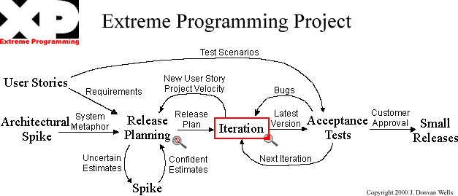
Extreme Programming (XP)

Slide 30
3. Advantages

Slide 31
Advantages
Large project are divided into manageable amounts

Slide 32
Advantages
Reduced costs and time required for project realization.

Slide 33
Advantages
Extreme Programming teams save lots of money because they don’t use too much documentation.

Slide 34
Advantages
Simplicity is another advantage of Extreme Programming projects.

Slide 35
Advantages
XP is reduces the risks related to programming. Normally programming depends a lot on individuals key team members. In XP, Using module structure, and pair programing XP spreads the risk and mitigate the dependence on individuals

Slide 36
Advantages
In software simplicity always brings quality and contributes the robustness. By bringing simplicity, XP manages to create faster software with less defects.
Test driven development at the coding stage and the customer UAT validation leads to successful development completion.

Slide 37
4. Disadvantages

Slide 38
Disadvantages
Extreme Programming is focused on the code rather than on design.

Slide 39
Disadvantages
XP requires a detailed planning from the start due to changing costs & scope

Slide 40
Disadvantages
XP doesn't measure/plan Quality Assurance of coding.

Slide 41
Disadvantages
To convince developers to accept this tough practice is not always easy. It requires more discipline in the team and devotion of your customers. Project management might experience difficulties related with
the practice that changes during the life cycle.

Slide 42
Disadvantages
XP is practiced with pair programming which might usually lead to too much duplication of codes and data.

Slide 43
5. Interesting

Slide 44
Interesting
XP engineering practices include things like test-driven development, automated testing, pair programming, simple design, and refactoring.

Slide 45
Interesting
XP says that the only truly important product of the system development process is code.

Slide 46
Interesting
Coding can also help to communicate thoughts about programming problems. A programmer dealing with a complex programming problem, or finding it hard to explain the solution to fellow programmers, might code it in a simplified manner and use the code to demonstrate what she means.

Slide 47
Interesting
System-wide integration testing is encouraged, initially, as a weekly activity, for early detection of incompatible interfaces, to reconnect before the separate sections diverged widely from coherent functionality.

Slide 48
Interesting
Listening is a key element of XP, programmers must listen to what the customers need the system to do, what "business logic" is needed.

Slide 49
Interesting
XP is still evolving, assimilating more lessons from experiences in the field. In the second edition of Extreme Programming Explained, five years after the first edition, Beck added more values and practices and differentiated between primary and corollary practices.

Slide 50
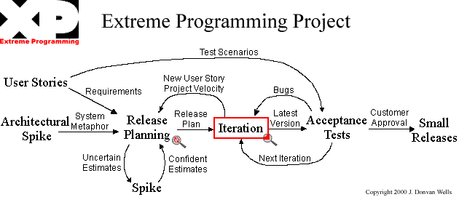
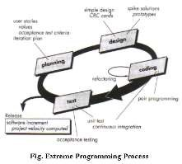
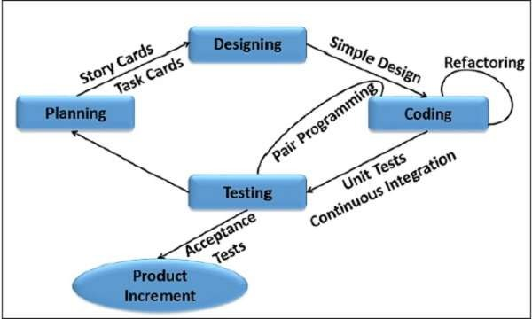
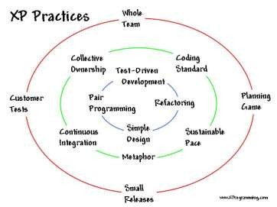
Interesting
There are other versions of the Model:

Slide 51
6. Reflections

Slide 52
Reflections
XP is very useful when we have:
Dynamically changing software requirements
Risks caused by fixed time projects using new technology
Small, co-located extended development team
The technology you are using allows for automated unit and functional tests

Slide 53
Reflections
XP sees communication as a vital aspect of development, and most people agree that face to face conversation is the best form of communication, so XP suggests that the team sit together in the same space without barriers to communication, such as cubicle walls.

Slide 54
Reflections
XP tells you to build in some slack, the idea behind slack is to add some low priority tasks or stories in your weekly and quarterly cycles that can be dropped if the team gets behind on more important tasks or stories.

Slide 55
Reflections
XP focuses on practice excellence. The method prescribes a small number of absolutely essential practices and encourages teams to perform those practices as good as they possibly can, almost to the extreme.

Slide 56
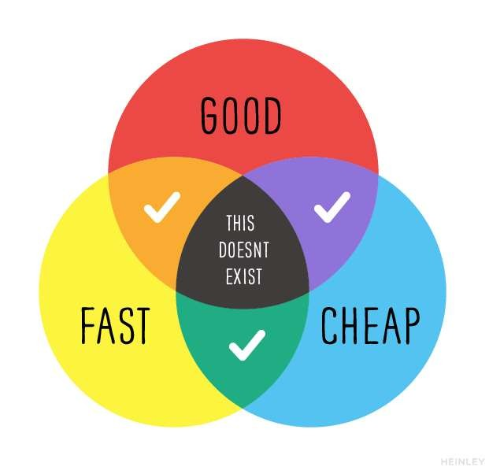
Reflections

Slide 57
7. Review

Slide 58
Review
What did we learn?

Slide 59
8. Summary

Slide 60
Summary

Slide 61


Slide 62
Reference
Beck, K. (1999) “Extreme Programming Explained: Embrace Change”. Addison-Wesley, ISBN 978-0321278654.

