Slide 1
KANBAN SYSTEMS

Slide 2
Push and Pull method of Work
Flow
Push Method: A method in which production of the item
begins in advance of customer needs.
Example: A buffet where food is prepared in advance.
Pull Method: A method in which customer demand activates
production of the service or item.
Example: A restaurant where food is only prepared when
orders are placed.
Lean systems use the pull method of
work flow.

Slide 3
KANBAN
Kanban means “card” or “visible record” in Japanese & refers to cards used to control the flow of production through a factory.
KANBAN is a PULL System .

Slide 4
General Operating Rules:
1. Each container must have a card.
2. The assembly line always withdraws materials from fabrication (pull system).
3. Containers of parts must never be removed from a storage area without a kanban being posted on the receiving post.
4. The containers should always contain the same number of good parts. The use of nonstandard containers or irregularly filled containers disrupts the production flow of the assembly line.
5. Only nondefective parts should be passed along.
6. Total production should not exceed the total amount authorized on the kanbans in the system.

Slide 5
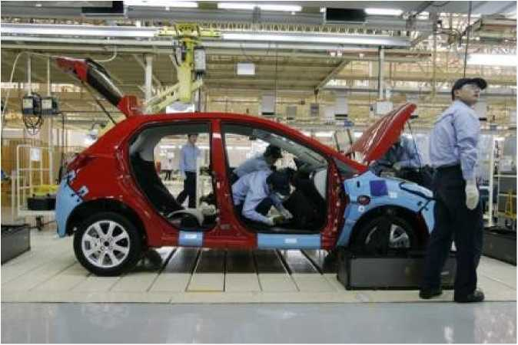
#5 - Kanban cards limit excess
work in progress
• #45 - Kanban literally means “visual card,” “signboard,” or “billboard.”
• Toyota originally used Kanban cards to limit the amount of inventory tied up in “work in progress” on a manufacturing floor
• Not only is excess inventory waste, time spent producing it is time that could be expended elsewhere
• Kanban cards act as a form of “currency” representing how WIP is allowed in a system.
5

Slide 6
“Pull” system to avoid overproduction
Milk example - weekly batch or daily purchase?
Next purchase triggered when you start using the only bottle of milk you nave.
Not an example of zero-inventory, but still a pull system.
Because of demand uncertainty and lead-times, in many cases inventory is necessary to allow for smooth production.
Hence TPS follows the supermarket model or keeping a small amount in stock. As soon as customers take products away, they are replenished.
Each demand instance triggers a part being pulled from upstream.
The triggering mechanism is called “Kanban” which means cards, signboard or a poster.
6

Slide 7
Kanban system
• At T oyota, empty bin (a kanban) is send upstream after a demand instance.
• It is a signal to refill it with a specific number of parts or send back a card with detailed information about the part location.
• Even today, one can see Kanban cards and bins moving on the shop-floor.
• Instead of using sophisticated computer scheduling techniques, this is a simple, effective and visual system of managing and ensuring the product flow and JIT production system.
7

Slide 8
Kanban system
• Gas tank example.
• Toyota philosophy about kanban:
“Kanban is an organized system of inventory buffers and as per TPS (Toyota Production System ), inventory is waste, whether it is in pull system or push system. So kanban is something you strive to get rid of.”
• Toyota uses kanban to force process improvements.
8

Slide 9
Kanban Flow
^Kanban Rule: No Kanban card, no production or movement of material
^Can accommodate 10%-20% of changes in planned production
^Can easily extend to suppliers (supplier Kanban)

Slide 10

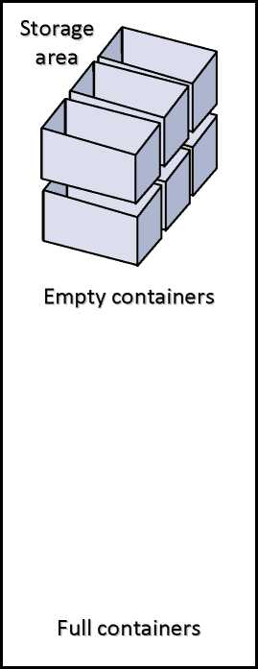
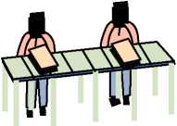
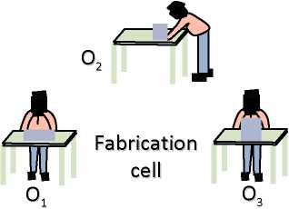
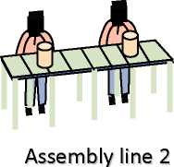

The Single-Card
Kanban System
Kanban card for product 1 Kanban card for product 2
Receiving post
Assembly line 1

Slide 11
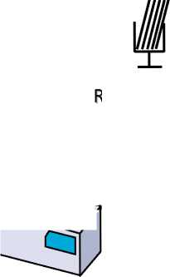
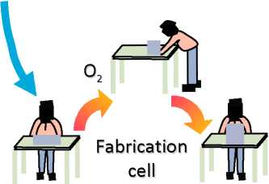
4^
Kanban card for product 1 Kanban card for product 2
deceiving post
V, J-
o₂

Slide 12
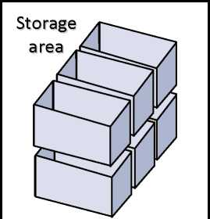
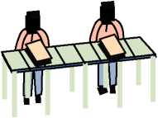
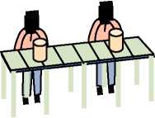
The Single-Card
Kanban System
Empty containers
Assembly line 1
Assembly line 2
Full containers

Slide 13

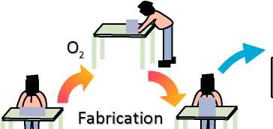
Kanban card for product 1 Kanban card for
Receiving post product 2

Slide 14
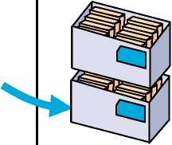
The Single-Card
Kanban System
Empty containers
Assembly line 1
Assembly line 2
Full containers

Slide 15


Kanban card for product 1 Kanban card for product 2
Receiving post

Slide 16
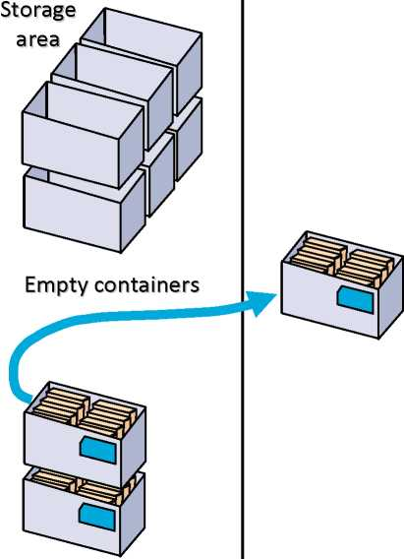
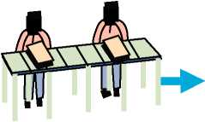

The Single-Card
Kanban System
Assembly line 1
Assembly line 2
Full containers

Slide 17
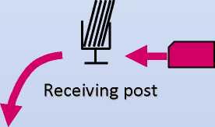
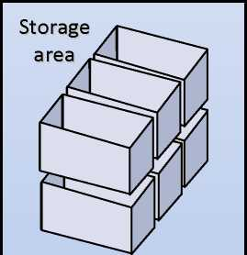
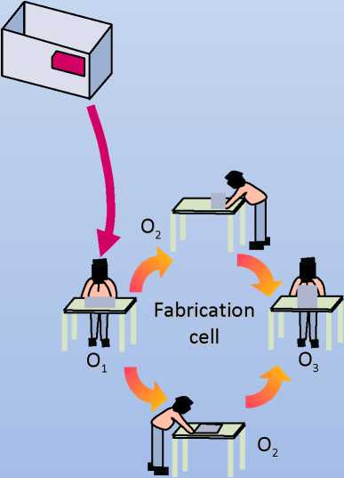
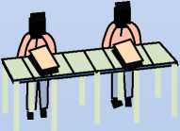
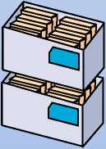
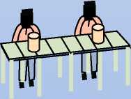
The Single-Card
Kanban System
Kanban card for product 1 Kanban card for product 2
Empty containers
Assembly line 1
Assembly line 2
Full containers

Slide 18
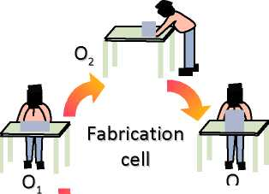
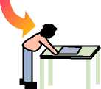
Kanban card for product 1 Kanban card for product 2
Receiving post
* V

Slide 19
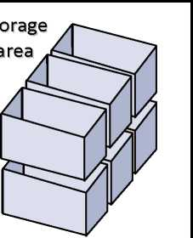
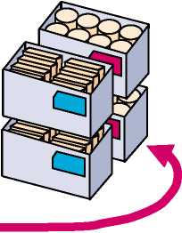
e Single-Card
inban System
Empty containers
Assembly line 1
Assembly line 2
Full containers

Slide 20

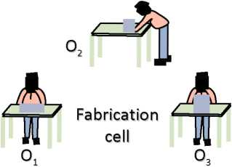
Kanban card for product 1 Kanban card for product 2
Receiving post

Slide 21
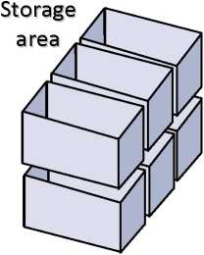
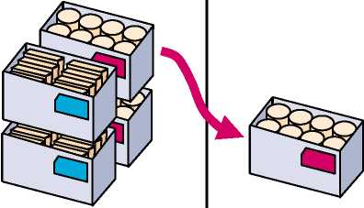
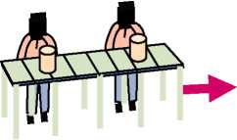
The Single-Card
Kanban System
Empty containers
Assembly line 1
Assembly line 2
Full containers

Slide 22
A TYPICAL KANBAN CARD
KANBAN CARD
PART VISUAL | INSERT PHOTO HERE
PART NO
PART DESCRIPTION
PRODUCTION LINE
WORK STATION NO
LINE SIDE RACK NO
LINE SIDE LOAD QTY
REPLINSHMENT TRIGGER QTY
REPLINSHMENT FROM LOCATION
REPLINSHMENT QTY
We can also modify this Kanban card to suit our requirement the best .
This card acts like a visual control to replenish the required quantity .

Slide 23
Thank you so much for viewing ...
Let me know your feedbacks at : industrialenggconsultancy@gmail.com

