Slide 1
What is Test Driven Development (TDD)?
TDD can be defined as a programming practice that instructs developers to write new code only if an automated test has failed. This avoids duplication of code. TDD means “Test Driven Development”. The primary goal of TDD is to make the code clearer, simple and bug-free.
Test-Driven Development starts with designing and developing tests for every small functionality of an application. In TDD approach, first, the test is developed which specifies and validates what the code will do.

Slide 2
The simple concept of TDD is to write and correct the failed tests before writing new code (before development). This helps to avoid duplication of code as we write a small amount of code at a time in order to pass tests. (Tests are nothing but requirement conditions that we need to test to fulfill them).
Test-Driven development is a process of developing and running automated test before actual development of the application. Hence, TDD sometimes also called as Test First Development.

Slide 3
How to perform TDD Test
Following steps define how to perform TDD test,
Add a test.
Run all tests and see if any new test fails.
Write some code.
Run tests and Refactor code.
Repeat.

Slide 4
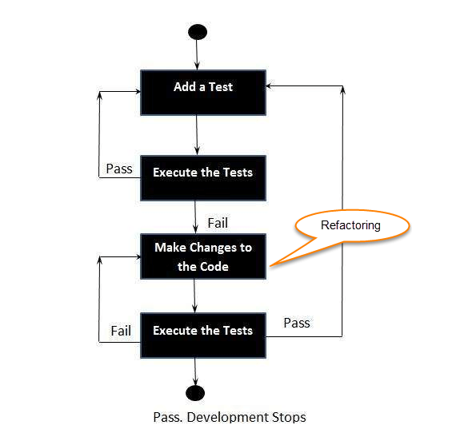

Slide 5
TDD cycle defines
Write a test
Make it run.
Change the code to make it right i.e. Refactor.
Repeat process.
Some clarifications about TDD:
TDD is neither about "Testing" nor about "Design".
TDD does not mean "write some of the tests, then build a system that passes the tests.
TDD does not mean "do lots of Testing."

Slide 6
TDD Vs. Traditional Testing
TDD approach is primarily a specification technique. It ensures that your source code is thoroughly tested at confirmatory level.
With traditional testing, a successful test finds one or more defects. It is same as TDD. When a test fails, you have made progress because you know that you need to resolve the problem.
TDD ensures that your system actually meets requirements defined for it. It helps to build your confidence about your system.

Slide 7
In TDD more focus is on production code that verifies whether testing will work properly. In traditional testing, more focus is on test case design. Whether the test will show the proper/improper execution of the application in order to fulfill requirements.
In TDD, you achieve 100% coverage test. Every single line of code is tested, unlike traditional testing.
The combination of both traditional testing and TDD leads to the importance of testing the system rather than perfection of the system.
In Agile Modeling (AM), you should "test with a purpose". You should know why you are testing something and what level its need to be tested.

Slide 8
What is acceptance TDD and Developer TDD
There are two levels of TDD
Acceptance TDD (ATDD): With ATDD you write a single acceptance test. This test fulfills the requirement of the specification or satisfies the behavior of the system. After that write just enough production/functionality code to fulfill that acceptance test. Acceptance test focuses on the overall behavior of the system. ATDD also was known as Behavioral Driven Development (BDD).
Developer TDD: With Developer TDD you write single developer test i.e. unit test and then just enough production code to fulfill that test. The unit test focuses on every small functionality of the system. Developer TDD is simply called as TDD.The main goal of ATDD and TDD is to specify detailed, executable requirements for your solution on a just in time (JIT) basis. JIT means taking only those requirements in consideration that are needed in the system. So increase efficiency.

Slide 9
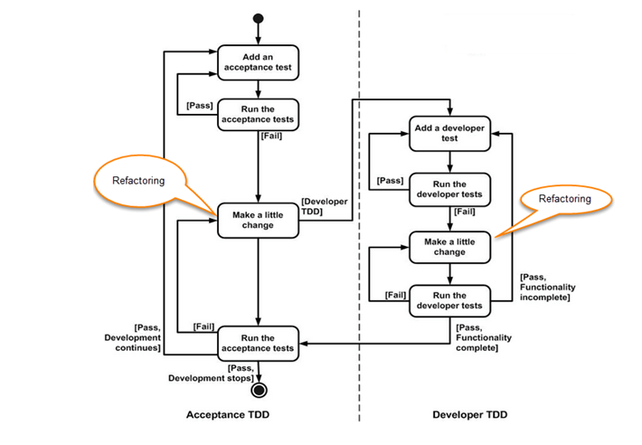

Slide 10
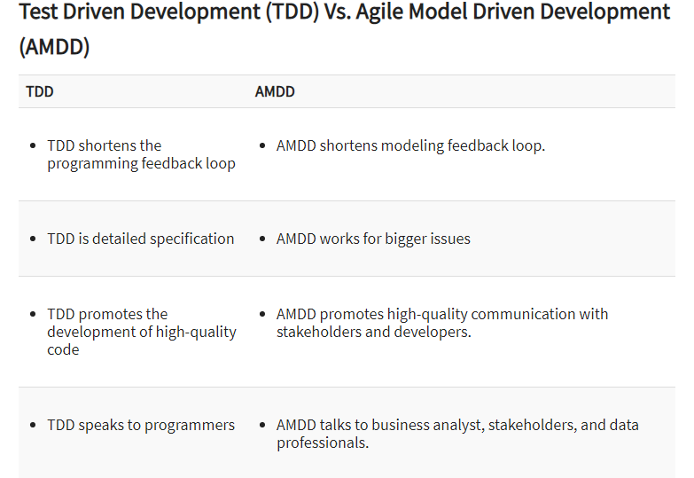

Slide 11
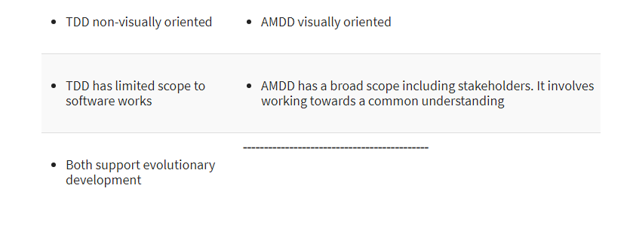

Slide 12
Example of TDD
Here in this example, we will define a class password. For this class, we will try to satisfy following conditions.
A condition for Password acceptance:
The password should be between 5 to 10 characters.
First, we write the code that fulfills all the above requirements.

Slide 13
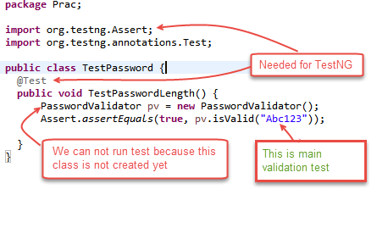

Slide 14
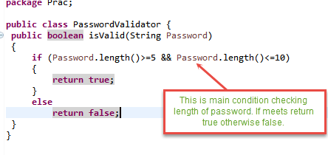
Scenario 1: To run the test, we create class PasswordValidator ();

Slide 15
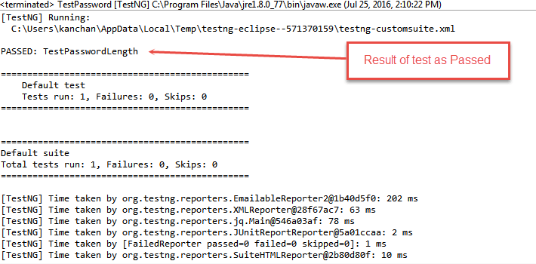
We will run above class TestPassword (); Output is PASSED as shown below; Output:

Slide 16
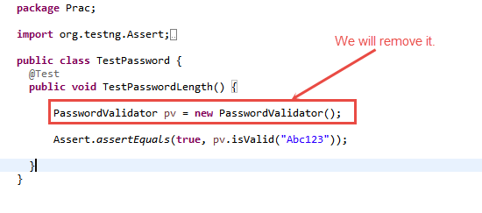
Scenario 2: Here we can see in method TestPasswordLength () there is no need of creating an instance of class PasswordValidator. Instance means creating an object of class to refer the members (variables/methods) of that class.

Slide 17
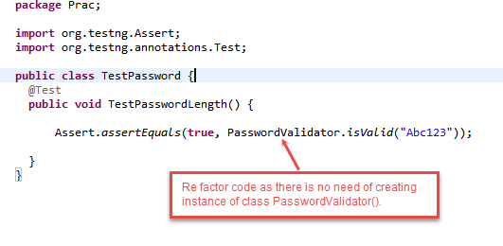
We will remove class PasswordValidator pv = new PasswordValidator () from the code. We can call the isValid () method directly by PasswordValidator. IsValid ("Abc123"). (See image below) So we Refactor (change code) as below:

Slide 18
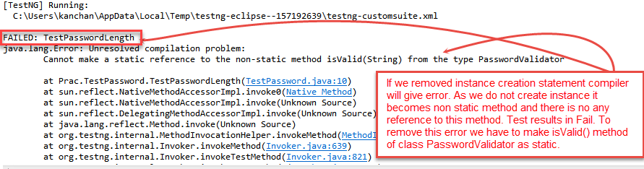
Scenario 3: After refactoring the output shows failed status (see image below) this is because we have removed the instance. So there is no reference to non –static method isValid ().

Slide 19
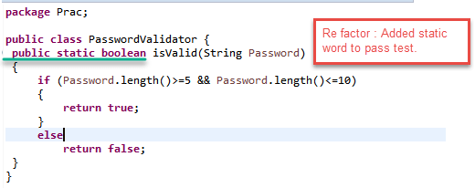
So we need to change this method by adding "static" word before Boolean as public static boolean isValid (String password). Refactoring Class PasswordValidator () to remove above error to pass the test.

Slide 20
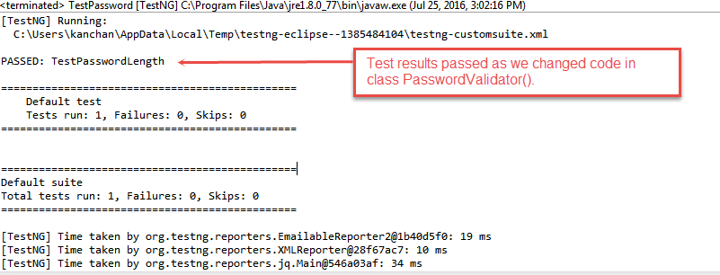
After making changes to class PassValidator () if we run the test then the output will be PASSED as shown below.

Slide 21
Advantages of TDD
Early bug notification.Developers test their code but in the database world, this often consists of manual tests or one-off scripts. Using TDD you build up, over time, a suite of automated tests that you and any other developer can rerun at will.
Better Designed, cleaner and more extensible code.
It helps to understand how the code will be used and how it interacts with other modules.
It results in better design decision and more maintainable code.
TDD allows writing smaller code having single responsibility rather than monolithic procedures with multiple responsibilities. This makes the code simpler to understand.
TDD also forces to write only production code to pass tests based on user requirements.
Confidence to Refactor
If you refactor code, there can be possibilities of breaks in the code. So having a set of automated tests you can fix those breaks before release. Proper warning will be given if breaks found when automated tests are used.
Using TDD, should results in faster, more extensible code with fewer bugs that can be updated with minimal risks.
Good for teamworkIn the absence of any team member, other team members can easily pick up and work on the code. It also aids knowledge sharing, thereby making the team more effective overall.
Good for DevelopersThough developers have to spend more time in writing TDD test cases, it takes a lot less time for debugging and developing new features. You will write cleaner, less complicated code.

Slide 22
Summary:
Test-driven development is a process of modifying the code in order to pass a test designed previously.
It more emphasis on production code rather than test case design.
In Software Engineering, It is sometimes known as "Test First Development."
TDD includes refactoring a code i.e. changing/adding some amount of code to the existing code without affecting the behavior of the code.
TDD when used, the code becomes clearer and simple to understand.

