Slide 1

Cloud Deployment Models

Slide 2
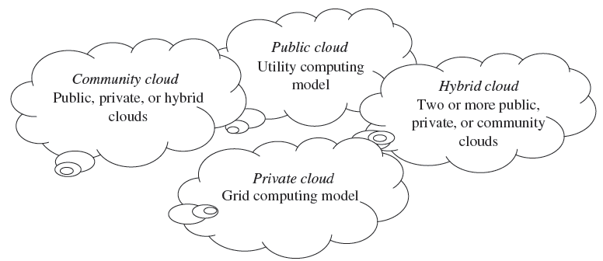
Cloud Deployment Models
Deployment models define the type of access to the cloud, i.e., how the cloud is located?
The cloud model is invented with four deployment models—public cloud, private cloud, hybrid cloud, and community cloud.)

Slide 3
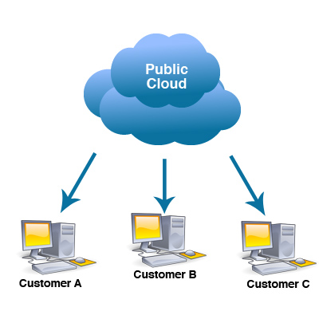
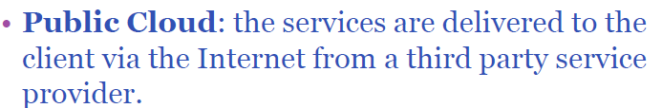
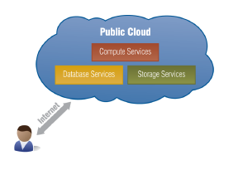
Public cloud
A Public cloud is basically the internet. Service providers use the internet to make resources, such as applications and storage, available to the general public, or on a ‘public cloud.
The public cloud is the first deployment model. In this model, users have many options to opt for and decide on any service provider as per requirement.
Some of the examples of those companies which provide public cloud facilities are: IBM, Google, Amazon, Microsoft etc. This cloud service is open for use.

Slide 4
Public Cloud
The advantages of Public cloud are:
Flexible
Reliable
High Scalable
Low cost
Place independence
Disadvantages are:
Less Secured
Poor Customizable: Not able to be modified

Slide 5
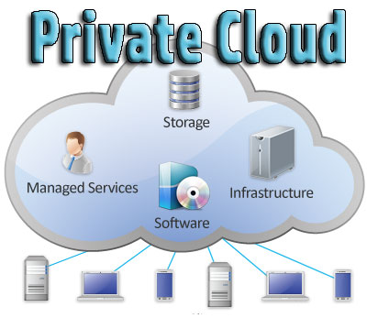
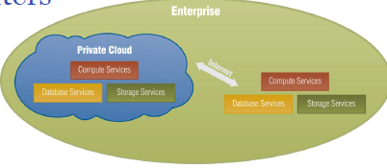
Private Cloud
Private Cloud also termed as ‘Internal Cloud‘; which allows the accessibility of systems and services within a specific boundary or organization.
The cloud platform is implemented on a cloud-based secure environment that is guarded by advanced firewalls under the surveillance of IT department that belongs to a particular organization.
Private clouds permit only authorized users, providing the organizations a greater control over data and its security.
Private Cloud are data centre architectures owned by a single company that provides flexibility, scalability, provisioning, automation and monitoring.

Slide 6
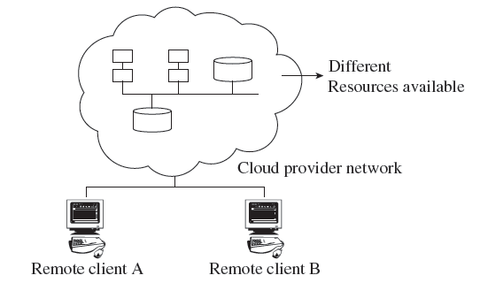
Private Clouds
The private cloud offers several advantages of an open cloud computing setting that comprises its service support and flexibility.
Private clouds allow infrastructure to be accessed only by the members of the organization and granted by third parties.
Examples of private cloud include Eucalyptus
cloud computing infrastructure with Ubuntu
Server, Elastra private-cloud, Vmware,
Microsoft, etc.

Slide 7
Private Cloud
The advantages of using private cloud are:
Highly private and secured: Private cloud resource sharing is highly secured.
Control Oriented: Private clouds provide more control over its resources than public cloud as it can be accessed within the organization’s boundary.
The Private cloud has the following disadvantages:
Poor scalability: Private type of clouds is scaled within internal limited hosted resources.
Costly: As it provides secured and more features, so it’s costlier than public cloud.
Pricing: is inflexible; i.e. purchasing a new hardware for up-gradation is more costly.
Restriction: It can be access locally within an organization and is difficult to expose globally.

Slide 8
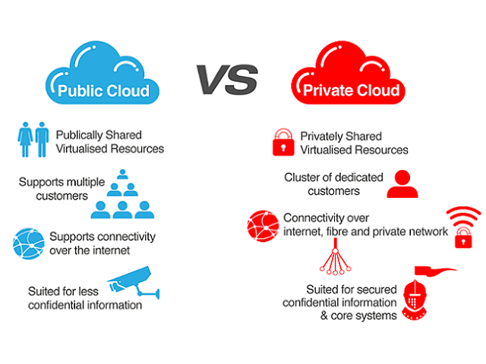

Slide 9
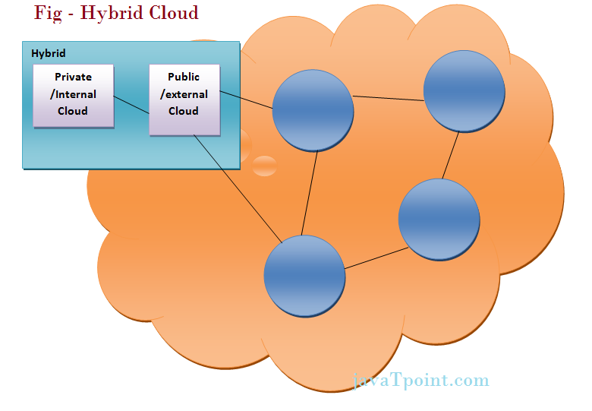
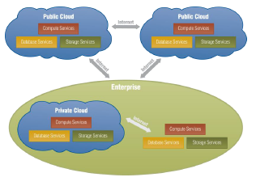
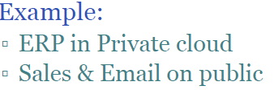
Hybrid Cloud
The Hybrid cloud is the mixture of public and private cloud. Non-critical activities are performed by public cloud while critical activities are performed by private cloud.
i.e. it can be a combination of two or more cloud servers, i.e. private, public or community combined as one architecture, but remain individual entities. Non-critical tasks such as development and test work-loads can be done using public cloud whereas critical tasks that are sensitive such as organization data handling are done using private cloud

Slide 10
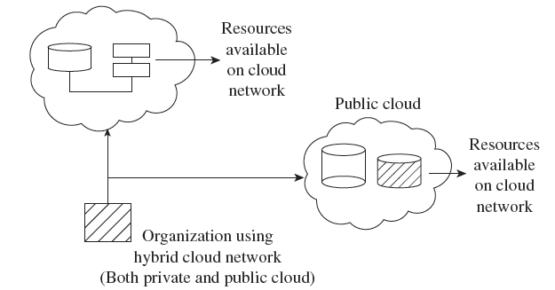
Hybrid Clouds
The hybrid cloud is a combination of a private and public cloud which is
mutually dependent on one another.
In this model, cloud users are supplied with information on the public cloud, in spite of the reality that the cloud supplier
has to maintain the company-significant
services and information in a few
instructions.

Slide 11
Hybrid Cloud
Advantages of Hybrid Cloud Computing are:
Flexible
Secure
Cost Effective
Rich Scalable
Disadvantages of Hybrid Cloud are:
Complex networking problem
Organization’s security Compliance

Slide 12
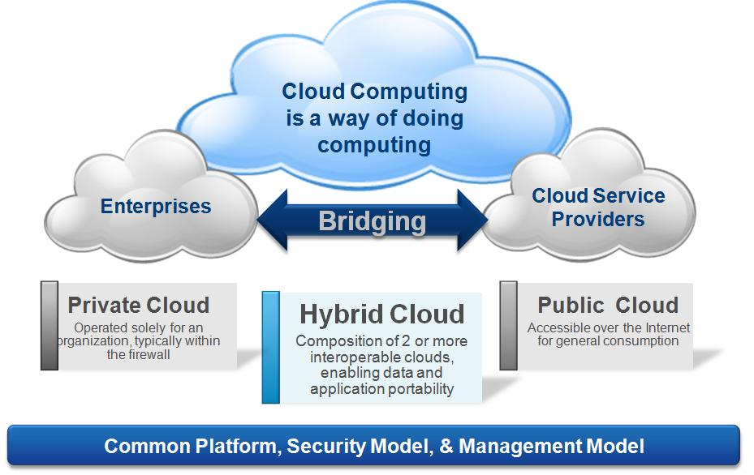

Slide 13
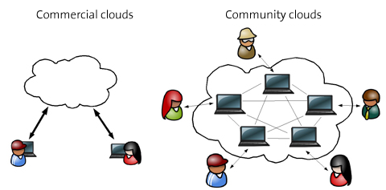
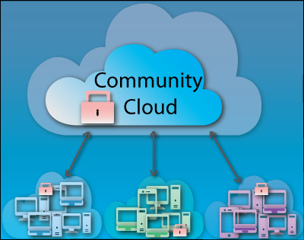
Community Cloud
Community Cloud is type of cloud computing in which setup of cloud is shared manually among different organizations that belong to the same community or area.
Example of such community is where organizations/firms are there along with the financial institutions/banks.
A multi-tenant setup developed using cloud among different organizations that belong to a particular community or group having similar computing concern.
For joint business organizations, ventures, research organizations and tenders community cloud is the appropriate solution.

Slide 14
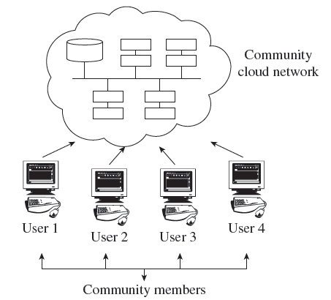
Community Clouds
A community cloud falls between public and private clouds category.
The drawback related to a community cloud is that of having costs higher than a public cloud.
Examples of community cloud include
Google’s ‘Gov Cloud’, NASA Nebula cloud,
etc.

Slide 15
Pros and cons of each architecture
IBM ICE (Innovation Centre for Education)
Benefits • Risks
Private cloud:
Fewer security concerns
IT organization retains control over data center
Private cloud:
High investment hurdle in private cloud implementation
New operational processes are required
Public cloud:
Low investment
Good test/development environment for applications
Public cloud:
Security concerns
IT organization may react negatively to loss of control over data-center function
Hybrid cloud:
Operational flexibility
Scalability
Hybrid cloud:
Hybrid clouds are still being developed
Control of security between private and public clouds

Slide 16
Deployment Models
PUBLIC CLOUD
The public cloud allows systems and services to be easily accessible to the general public. Public cloud may be less secure because of its openness.
PRIVATE CLOUD
The private cloud allows systems and services to be accessible within an organization. It is more secured because of its private nature.
COMMUNITY CLOUD
The community cloud allows systems and services to be accessible by a group of organizations.
HYBRID CLOUD
The hybrid cloud is a mixture of public and private cloud, in which the critical activities are performed using private cloud while the non-critical activities are performed using public cloud.

Slide 17
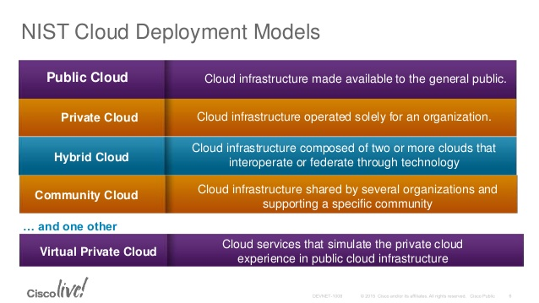

Slide 18
Alternative Deployment Models
Linthicum Model
Storage as a Service
Database as a Service
Information as a Service
Process as a Service
Application as a Service
Platform as a Service
Integration as a Service
Security as a Service
Management as a Service
Testing as a Service
Jericho Cloud Cube Model
Internal or external
Proprietary or open
Perimeterized or de-perimeterized architectures
Outsourced or insourced

Slide 19
Service Models
Cloud computing is based on service models.
These are categorized into following service models which are -
Infrastructure-as–a-Service (IaaS)
Platform-as-a-Service (PaaS)
Software-as-a-Service (SaaS)
Anything-as-a-Service (XaaS) is also a service model, which includes
Network-as-a-Service
Business-as-a-Service
Identity-as-a-Service
Database-as-a-Service
Strategy-as-a-Service

Slide 20
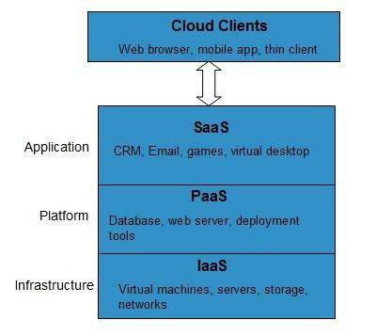
Service model
IaaS provides access to fundamental resources such as physical machines, virtual machines, virtual storage, etc.
Interrelated e.g.: particular store in a mall., server.
PaaS provides the runtime environment for applications, development and deployment tools, etc.
Interrelated e.g.: Laundry Machine services, java platform.
SaaS model allows to use software applications as a service to end-users.
Interrelated e.g.: Services in restaurant., Google sheet, Google doc, Google slide.

Slide 21
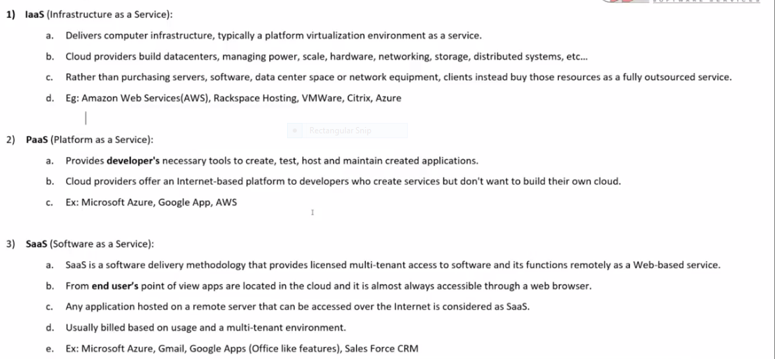

Slide 22
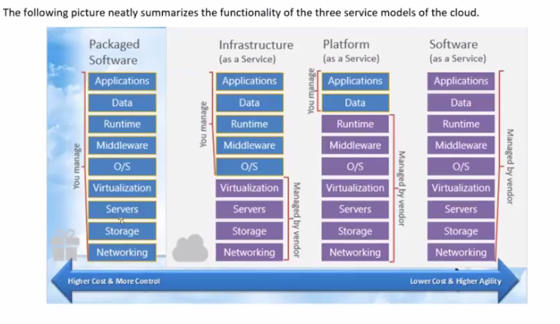

Slide 23
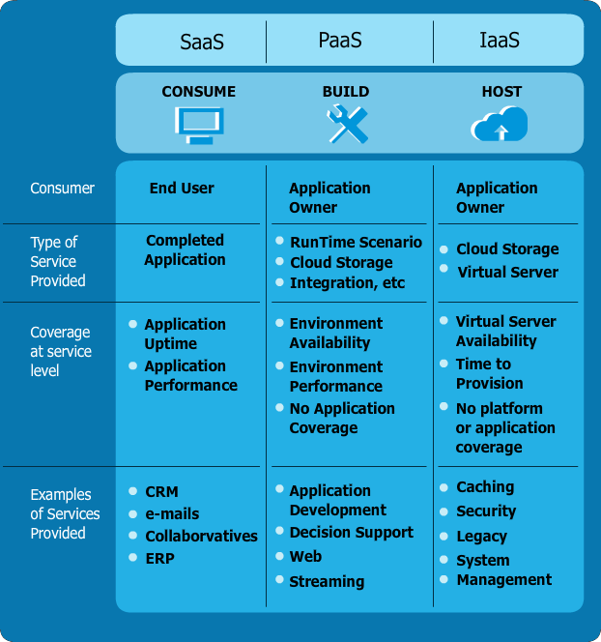
Cloud Delivery Models
→ Software as a Service (SaaS):
» The application is hosted centrally
» Software testing takes place at a faster rate
» Reduction in IT operational costs
» No need to install new software to release updates
→ Platform as a Service (PaaS):
» Facilitation of hosting capabilities
» Designing and developing the application
» Integrating web services and databases
» Providing security, scalability and storage
→ Infrastructure as a Service (IaaS):
» Virtualization of Desktop
» Internet availability
» Use of billing model
» Computerized administrative tasks

Slide 24
What does Pay-as-you-go Mean?
Service Model | Typical Unit of Measure | Typical values
SaaS | Per user per month, Per location per month, etc. | No norm. The vendor is free to set his pricing and the unit of measure!
PaaS | Per GB per month for DBs, Per connection per month for integration layer, Data Transfer In/Out | 10 USD/GB-month
IaaS | Instance-hours per month, Data Transfer in/Out, GB per month for storage | 10 cents/hour 10 cents/GB – in, 15 cents/GB-out 10 cents/GB-month

Slide 25
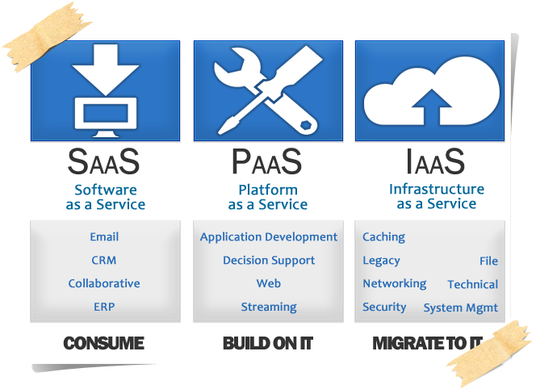

Slide 26





Cloud Introduction: The NIST Model
Broad Network Access
Rapid Elasticity
Measured Service
/Pay as you go
On Demand self- service
Attributes
Resource Pooling
Software as a Service (SaaS)
CRM, Email, Social Collaboration, Payment and Reconciliation
Platform as a Service (PaaS)
Middleware, Database,
Build/Dev/Test
Infrastructure as a Service (IaaS) Compute, Storage, Network, Desktop
Anything as a Service (XaaS)
Service
Models
Public Cloud (multi- tenant)
Private Cloud (single-tenant)
Community (Special purpose/group)
Deployment Models
Hybrid
http://csrc.nist.gov/publications/nistpubs/800-145/SP800-145.pdf

Slide 27
NIST Model
On Demand Self Service: Cloud Computing allows the users to use web services and resources on demand. One can logon to a website at any time and use them.
Broad Network Access: Since cloud computing is completely web based, it can be accessed from anywhere and at any time.
Resource Pooling: Cloud computing allows multiple tenants to share a pool of resources. One can share single physical instance of hardware, database and basic infrastructure.
Rapid Elasticity: It is very easy to scale the resources vertically or horizontally at any time. Scaling of resources means the ability of resources to deal with increasing or decreasing demand.
The resources being used by customers at any given point of time are automatically monitored.
Measured Service: In this service cloud provider controls and monitors all the aspects of cloud service. Resource optimization, billing, and capacity planning etc. depend on it.

Slide 28
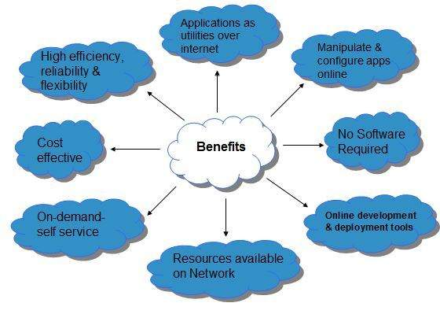
Benefits of Cloud Computing

Slide 29
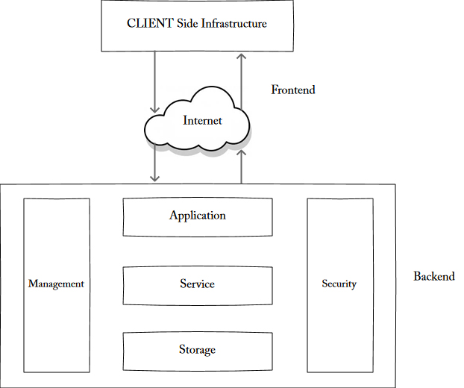
Cloud Architecture layers- Exploring Cloud stack
The broad divisions of cloud architecture are:
Front-end
Back-end
Each of the ends is connected through a network, usually Internet.
The front end refers to the client part of cloud computing system. It consists of interfaces and applications that are required to access the cloud computing platforms, Example - Web Browser.
The back End refers to the cloud itself. It consists of all the resources required to provide cloud computing services. It comprises of huge data storage, virtual machines, security mechanism, services, deployment models, servers, etc.

Slide 30
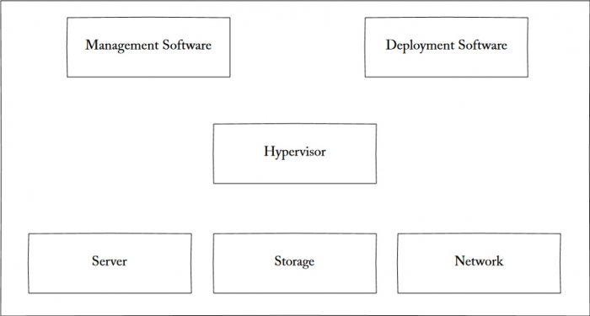
Cloud infrastructure: components
Cloud infrastructure consists of servers, storage devices, network, cloud management software, deployment software, and platform virtualization
Management Software: It helps to maintain and configure the infrastructure.
Deployment Software: It helps to deploy and integrate the application on the cloud.
Network: It allows to connect cloud services over the Internet Server
The server helps to compute the resource sharing and offers other services
Storage: Cloud keeps multiple replicas of storage. If one of the storage resources fails, then it can be extracted from another one, which makes cloud computing more reliable.

Slide 31
Composability
cloud computing describes some new capabilities that are architected into an application stack and are responsible for the programmability, scalability, and virtualization of resources. One property that differentiates cloud computing is referred to as composability.
Applications built in the cloud often have the property of being built from a collection of components, a feature referred to as composability.
Benefits from a composable system that a user does—these things, among others:
Easier to assemble systems
Cheaper system development
More reliable operation
A larger pool of qualified developers
A logical design methodology

Slide 32
Platform-as-a-Service
It offers the runtime environment for applications. It also offers development and deployment tools required to develop applications. PaaS has a feature of point-and-click tools that enables non-developers to create web applications.
App Engine of Google and Force.com are examples of PaaS offering vendors. Developer may log on to these websites and use the built-in API to create web-based applications.
But the disadvantage of using PaaS is that, the developer locks-in with a particular vendor. For example, an application written in Python against API of Google, and using App Engine of Google is likely to work only in that environment.
Benefits
Lower administrative overhead: Customer need not bother about the administration because it is the responsibility of cloud provider.
Lower total cost of ownership: Customer need not purchase expensive hardware, servers, power, and data storage.
Scalable solutions: It is very easy to scale the resources up or down automatically, based on their demand.
More current system software: It is the responsibility of the cloud provider to maintain software versions and patch installations.

Slide 33
Disadvantages of PaaS
Vendor Migration: Migration from one PaaS vendors' application to another PaaS vendor will create some problem.
Data-Privacy: Privacy of data can get hamper if it is not hold within the boundary of the company or organization.
Mix-up Complexity: It may happen that some of the applications developed are local while others are from cloud; which may increase the complexity.

Slide 34
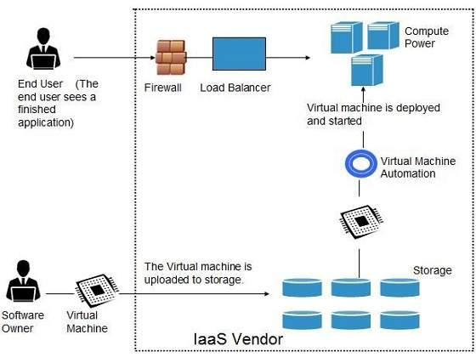
Infrastructure-as-a-Service
Infrastructure-as-a-Service provides access to fundamental resources such as physical machines, virtual machines, virtual storage, etc. Apart from these resources, the IaaS also offers:
Virtual machine disk storage
Virtual local area network (VLANs)
Load balancers
IP addresses
Software bundles
All of the above resources are made available to end user via server virtualization.

Slide 35
Advantages of IaaS are:
Dynamic: Users can dynamically opt & configure devices such as: CPU, storage drive etc.
Easy Access: Users can easily access the vast cloud computing power.
Renting: Flexible and efficient while renting IT infrastructures.
Full control of computer resources along with portability.
Disadvantages of IaaS are as follows:
Internet connection is must.
IaaS depends on virtualization services.
This service restricts the user-privacy & customization.

Slide 36
IDaaS (Identity as a Service)
IDaaS (Identity as a Service) This provides management of employee or user's identity information as digital entity. It minimizes the problem of remembering every different username & password combination or disabling of account when an employee leaves the company.
Employees in a company require to login to system to perform various tasks. These systems may be based on local server or cloud based. the problems that an employee might face:
Remembering different username and password combinations for accessing multiple servers.
If an employee leaves the company, it is required to ensure that each account of that user is disabled. This increases workload on IT staff.
To solve above problems, a new technique emerged which is known as Identity-as–a-Service (IDaaS).

Slide 37
Identity refers to set of attributes associated with something to make it recognizable. All objects may have same attributes, but their identities cannot be the same. A unique identity is assigned through unique identification attribute.
There are several identity services that are deployed to validate services such as validating web sites, transactions, transaction participants, client, etc. Identity-as-a-Service may include the following
Single sign-on (SSO) is a session and user authentication service that permits a user to use one set of login credentials (e.g., name and password) to access multiple applications.
IDaaS may include:
Directory services
Registration information
Authentication services
Risk & event monitoring
Profile management
Sign-on services

