Slide 1

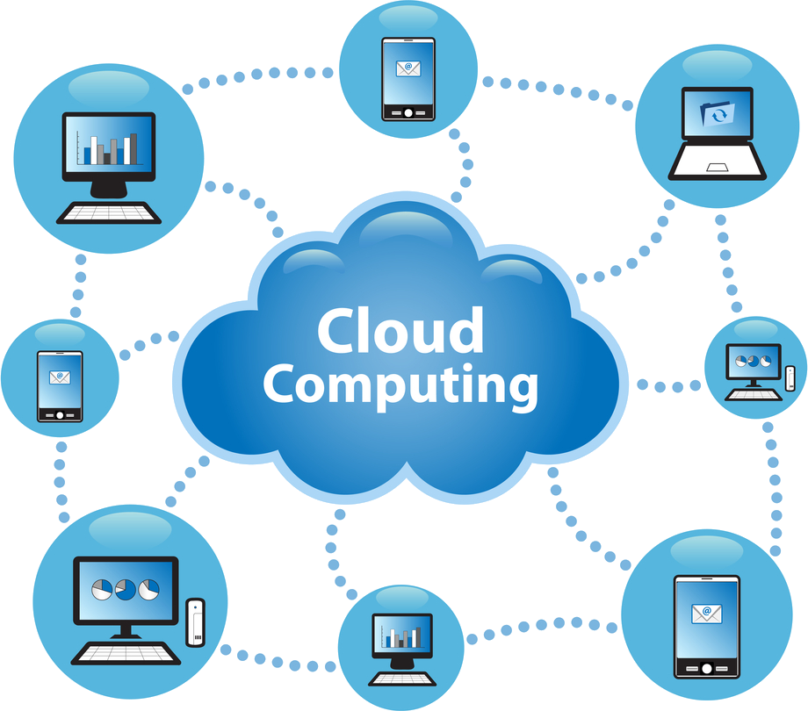
Course: Introduction to Virtualization and Cloud computing
Credits: 03
Dr. Sunil Gupta
Professor- SoCS

Slide 2
What should you expect from this course?
Understanding on Cloud Computing
Technology and to help them build their skills to develop large-scale industry standard applications using cloud platforms and tools
Covers concepts of cloud storage as well as how to ensure security in cloud.
Notes:
Exposure to Computer Systems and their components
Broad understanding of underlying principles on which these systems work
Their applications and related technologies

Slide 3
Course Outcomes
CO 1 Understanding of Cloud Computing, its benefits, trends, and issues.
CO 2 Infrastructure of Cloud computing.
CO 3 Understanding Services and Applications by its type.
CO 4 Cloud Capacity Planning and security in cloud computing.
CO 5 Moving Applications to the Cloud.
CO 6 Going through Cloud storage working and its creation
CO 7 How does communication happens with the cloud
CO 8 Concept of Mobile Cloud and using smartphones with cloud
CO 9 Workloads and services management in cloud
CO 10 Cloud migration and mobile web services working

Slide 4
Cloud computing jobs in high demand
Cloud Architect.: development and implementation of cloud based initiative.
Cloud Software Engineer: Design and development of distributed software module.
Cloud sales manager: Cloud Business
Cloud Engineer: for Technical Task in virtualized infrastructure
Cloud Services Developer: Build multiplatform customer.
Cloud System administrator: Maintain the system in cloud platform
Cloud system Engineer: Build the virtual system.
Cloud Network engineer: Maintenance and optimization of network.
Cloud Product Manager: Planning for cloud based offering.
Cloud Consultant: Conduct technical studies and evaluations.
Credentials: Knowledge of cloud based development

Slide 5
How do I create and activate a new AWS account?
Open the Amazon Web Services home page.
Choose Create an AWS Account.
choose Sign in to the Console
Enter your account information, and then choose Continue. Be sure that you enter your account information correctly, especially your email address. If you enter your email address incorrectly, you can't access your account
Choose Personal or Professional.
Enter your company or personal information.
Read and accept the AWS Customer Agreement.
Choose Create Account and Continue.
Add a payment method
Verify your phone number
Choose your country or region code from the list.
Enter a phone number where you can be reached in the next few minutes.
Enter the code displayed in the captcha and then submit.
In a few moments, an automated system contacts you.
Enter the PIN you receive, and then choose Continue.

Slide 6
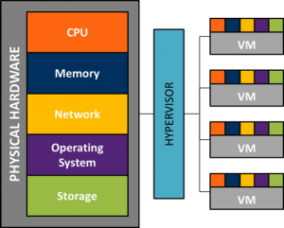
Concept of virtualization
Virtualization is the "creation of a virtual (rather than actual) version of something, such as a server, a desktop, a storage device, an operating system or network resources".
In other words, Virtualization is a technique, which allows to share a single physical instance of a resource or an application among multiple customers and organizations. It does by assigning a logical name to a physical storage and providing a pointer to that physical resource when demanded.

Slide 7
Learning Outcomes
At the end of the session you will be able to:
Comprehend virtualization
Explain need of compute virtualization
Understand virtual clusters
Apply various techniques used for computing virtualization
Describe various resource management tools
Describe application of virtual machine
Describe hypervisor taxonomy
Appreciate the concept of virtual machine
Explain data center virtualization

Slide 8
Concept of virtualization
Virtualization is the "creation of a virtual (rather than actual) version of something, such as a server, a desktop, a storage device, an operating system or network resources".
In other words, Virtualization is a technique, which allows to share a single physical instance of a resource or an application among multiple customers and organizations. It does by assigning a logical name to a physical storage and providing a pointer to that physical resource when demanded.

Slide 10
Introduction
Virtualization refers to a technology that is used to make physical
resources available as virtual resources.
Cloud computing technologies use a set of techniques to create virtual
servers, virtual storage, virtual networks, and perhaps virtual applications as
well.
Virtualization software is used to make a physical server like a virtual server.
Operating system-level virtualization can be achieved by installing
virtualization software on already installed operating systems.

Slide 11
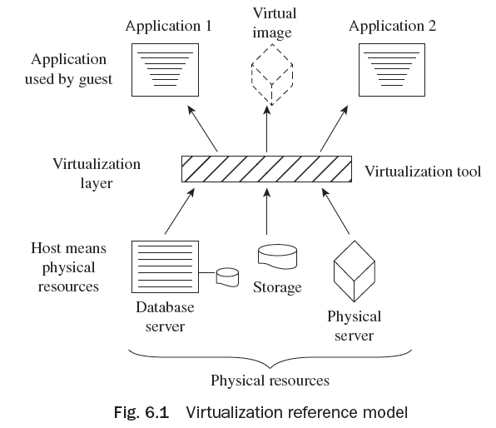
Virtualization Reference Model
The virtualization model consists of a host or physical resources in the first
layer, virtualization tool in the second layer,
and a guest in the third layer
(application as well as virtual image)
as shown in Fig. 6.1.

Slide 12
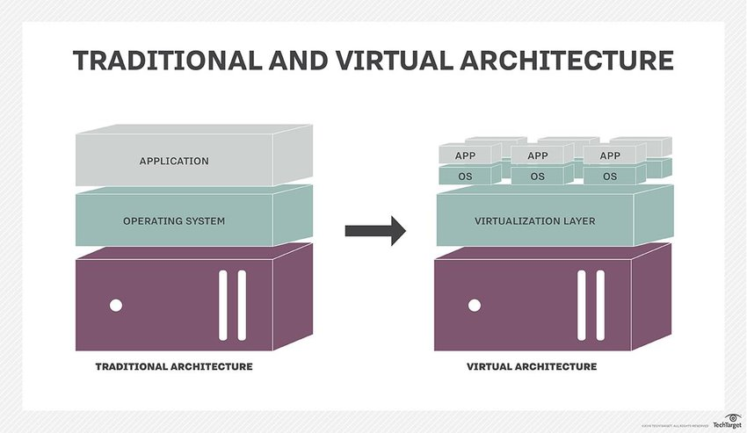
Traditional IT Infrastructure - Virtualization

Slide 16
Advantages of Virtualization
The advantages of virtualization include the following:
It allows any network-enabled device to access any network application over any network.
It maintains isolation of one workload from another application to enhance security in the environment.
Virtualization of an application allows users to be comfortable with different versions of the operating system.
It can support and allow application with multiple instances to run on various machines concurrently.
It optimizes the use of a single system.
It enhances the reliability or availability of an application through redundancy.

Slide 23
Server/Compute Virtualization
Server/Compute virtualization in cloud computing refers to making a virtual edition of a device or resource, such as a server, storage device, network, or an operating system where the structure splits the resources as one or more environments for execution.
The following are the advantages of server/compute virtualization:
1. Consistency
2. Energy efficiency
3. Enhanced disaster recovery
4. Cost savings
A virtual machine is a reasonable computing system like a physical machine which governs an application and operating system (OS). Some of the virtual components used in a virtual machine are as follows:

Slide 24
Server/Compute Virtualization
A virtual machine (VM) can be configured with the following virtual components:
Virtual central processing unit (vCPU)
Virtual random access memory (vRAM)
Virtual disk
Virtual network adaptor (vNIC)
Virtual DVD/CD-ROM and floppy drives
Virtual SCSI (Small Computer System Interface) controller
Virtual USB controllers
Virtual machine console

Slide 25
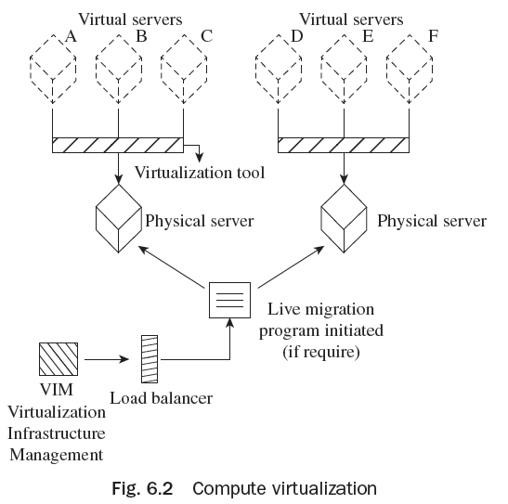
Server/Compute Virtualization

Slide 26
Area and technology based classification
Virtualization can be also be classified based on the technology or the area that is being virtualized
Server Virtualization
Network Virtualization
Storage Virtualization
Desktop Virtualization
Application Virtualization
Management Virtualization

Slide 27
Types of Virtualization
Virtualization is classified based on the extent of hardware emulation.
Full Emulation
Full/Native Virtualization
Para-Virtualization
OS Virtualization
Application Virtualization

Slide 28
Server/Compute Components
The logical components of a server/compute system comprise the following:
File system
Operating system
Volume manager
Device drivers

Slide 29
Need of Server/Compute Virtualization
Compute virtualization facilitates and permits various applications and operating systems to function on a physical machine.
This method considerably minimizes charge and enhanced consumption. Resource management is the allotment of a physical machine or clustered physical machines to VMs.
Every physical machine and group has a parent resource pool which provides the resources of that physical machine or group.
Each child resource pool possesses a few of the resources of their parents. A parent resource pool may include virtual machines, child resource pools, or both.

Slide 30
Need of Server/Compute Virtualization
Present CPUs are prepared with hyper-threading characteristics and multiple cores per CPU. A multicore CPU is an incorporated circuit with which two or more processing units have been connected for improved functioning and more effective, synchronized processing of multiple resources.
A hypervisor augments and supports the CPU resources by use of modern CPU aspects such as hyper-threading and multicore. It also helps in the following ways:
1. Server consolidation
2. Improved security
3. Increased hardware consumption
4. Hardware independence and support portability
5. Decreased provisioning timing

Slide 31
Virtual Clusters
There are common agreements for most applications or users, such as user-level or OS programming libraries.
The VMs (guest systems) and physical machines (host systems) may operate with different OSes.
The virtual environment design should be able to function quickly. In this case, deployment should be to build and allocate software stacks (i.e., applications, OS, and libraries) to a physical node within clusters as quick as possible and to instantly switch run time environments from one virtual cluster of user to another.
Live moving VMs permit one to deliver workloads from one node to other one.
One more advantage for clustering carried by virtualization is load-balancing applications in a virtual cluster.

Slide 32
Advantages of Server/Compute Virtualization
Compute virtualization offers the following advantages:
Server consolidation
Segregation
Encapsulation
Non-dependence on hardware
Reduction in cost

Slide 33
Techniques of Server/Compute Virtualization
The three methods which manage confidential commands to virtualize the CPU are:
Full Virtualization
Para Virtualization
Hardware Assisted Virtualization

Slide 34
Virtual Machine and Hardware Components
A VM is a rational compute system similar to a physical machine which operates an application and an OS.
An operating system which works within a virtual machine is known as a guest operating system.
Network file system (NFS) and virtual machine file system (VMFS) are the file systems sustained by the hypervisor.
The VMFS is a group of file systems augmented to preserve files of a virtual machine.
In a virtualization environment, if any of the physical servers does not work properly, virtual infrastructure management (VIM) is initiated to divert traffic to a new selected physical server.

Slide 35
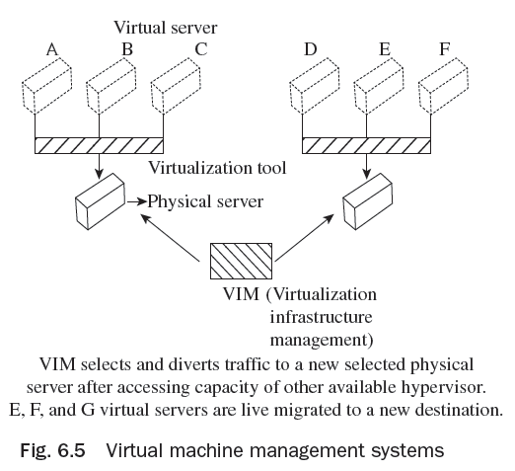
Virtual Machine and Hardware Components
In Fig. Virtual machine management systems, if E, F, and G virtual instances are not working, then live migration
of these E, F, and G into a new
destination will be carried out.

Slide 36
Hypervisor Taxonomy
A hypervisor, also known as a virtual machine manager, is a program that permits multiple operating systems to share one hardware host.
Hypervisor is compute virtualization software which facilitates manifold operating systems to operate on physical machines simultaneously.
The hypervisor is the main constituent of the data center consolidation.
Hypervisor has two main constituents—virtual machine monitor (VMM) and kernel.

Slide 37
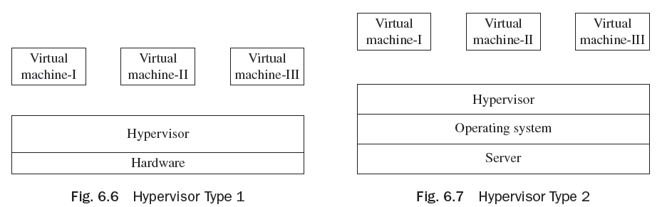
Hypervisor Taxonomy
Hypervisors are categorized into two types:
Type 1 (Bare-metal hypervisor)
Type 2 (Hosted hypervisor)

Slide 38
Resource Management and Tools
Cloud resource management needs versatile judgments and policies for multi-objective optimization.
The policies for cloud resource management associated with the three cloud delivery models, Software as a Service (SaaS), Platform as a Service (PaaS), and Infrastructure as a Service (IaaS) vary from each other.
In cloud computing, where alterations are common and spontaneous, centralized control is not believable to offer a persistent service and performance assurances.
Resource management policies frequently mutually target power utilization and performance.

Slide 39
Resource Management and Tools
Resource management is the allotment of a physical machine or clustered physical machines to virtual machines.
Unused memory allocated by a virtual machine to CPU can be accessed and used by other virtual machines without disturbing other resources.
Some virtual machines can enclose the same user data, administer the same guest operating system, or have the same applications.
A hypervisor recognizes surplus pages copied by their contents.
Virtual machines may securely alter the shared pages without disturbing other virtual machines which are sharing that memory.

Slide 40
Physical Machine to Virtual Machine (P2v) Conversion
A VM maintains a relationship between various virtual machines, and between a hypervisor and a VM in a grouped server environment.
Physical to VM exchange is a procedure via which a physical machine is transformed into a virtual machine. When transforming a physical machine, the ‘converter application’ (Converter) copies data on the hard disk of the source machine and shifts that data to the target virtual disk.
Advantages of P2V converters are:
1. Runs migration among heterogeneous hardware
2. Minimizes time required to set up a new virtual machine
3. Permits migration of machines to a new hardware without re-launching the
application or operating system

Slide 41
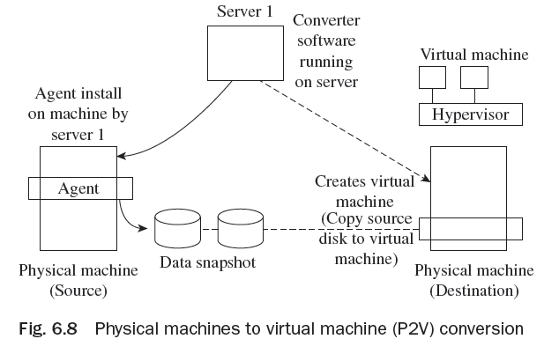
Physical Machine to Virtual Machine (P2v) Conversion
The P2V ‘converter application’ comprises three constituents—converter server, converter agent, and converter boot CD.
There are two means to shift from physical machine to virtual machine (VM). These are cold migration and hot
migration.

Slide 42
Types of Virtualization
Different types of virtualization are :
Data Center Virtualization
Server Virtualization
Storage Virtualization
Sensor Virtualization

Slide 43
Storage Area Network
Storage area network (SAN) refers to the LAN design for managing huge amounts of data transfer.
It uses interconnection technology for supporting data storage, retrieval, and replication. NAS works on TCP/IP, whereas SAN for disk blocks transformation works on low-level network protocols.
Storage area networks are actually designed for data management. It is a rapid storage device network and can be connected with servers.
SAN is helpful for transferring data from one storage device to another without disturbing other devices.
SAN also supports fast backup as CPU cycles of server are not involved in the backup process. At the time of recovery, SAN plays an important role.

Slide 44
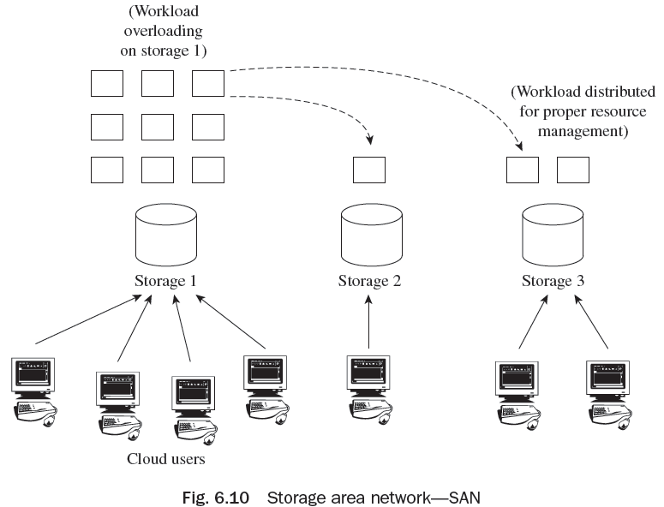
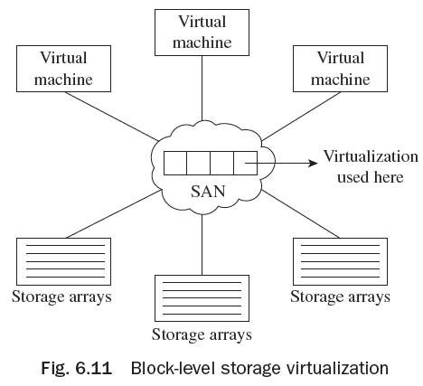
Storage Area Network

Slide 45
Network Attached Storage
Network-attached storage (NAS) is actually a dedicated file storage device for providing local area network nodes with file-based shared storage using a standard ethernet connection.
NAS has its own IP address and each NAS exists on the LAN as an independent network node.
Some examples of NAS devices include Seagate Central, Seagate Business Storage NAS, and 8-Bay Rackmounts. All NAS products provide a secure and centralized location for the files.
Accessing of NAS system storage data is easy—it can be accessed from anywhere, whether one is in own house, on another computer, or through mobile, Wi-fi technology, etc.

Slide 46
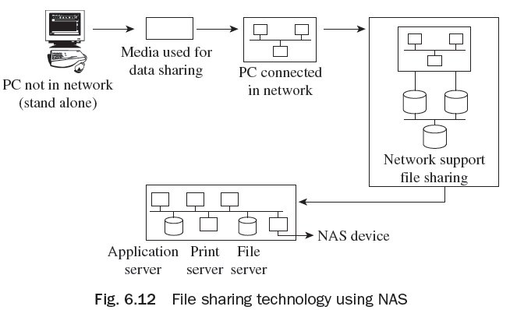
Network Attached Storage
NAS has the following benefits:
Broad access to information
Better efficiency
Better flexibility
Centralized storage
Simplified management
Scalability
High availability
Security

Slide 47
Network Attached Storage
NAS has the following components:
NAS head (CPU and memory)
Network interface cards (NICs) for providing connectivity
Operating system for handling NAS functionality
Network file system (NFS) and common Internet file system (CIFS) protocols for file sharing. NFS mainly supports UNIX-based operating environments, whereas CIFS is supported by Microsoft Windows-based operating environments. Supported file sharing protocols facilitate users to share files with different operating platforms.
Storage protocols to connect and manage physical disk resources
Storage array

Slide 48
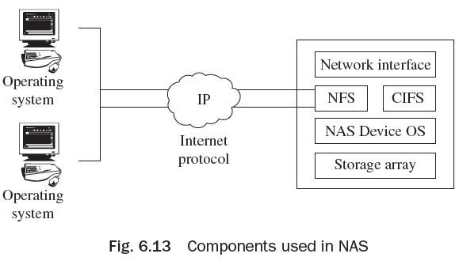
Network Attached Storage
Comparison between SAN and NAS:
Storage area network (SAN) supports networking, whereas network-attached storage (NAS) is a storage device, in a network.
Operating systems consider SAN as a disk, whereas a NAS device is a file server.
SAN supports block-level storage for servers, whereas NAS devices support file-level storage. For saving files such as word documents or MS Excel spreadsheets, NAS is generally used.

Slide 49
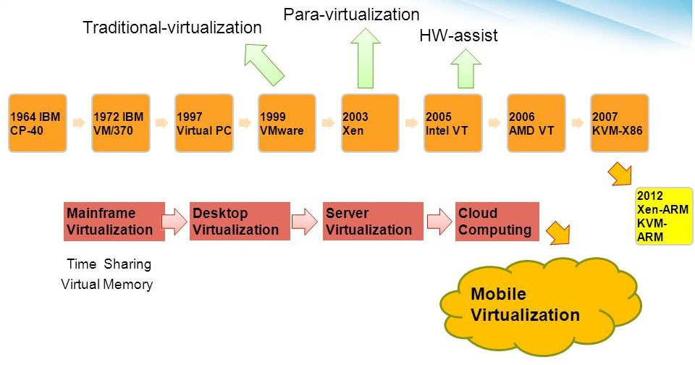
History of Virtualization
IBM ICE (Innovation Centre for Education)

Slide 50
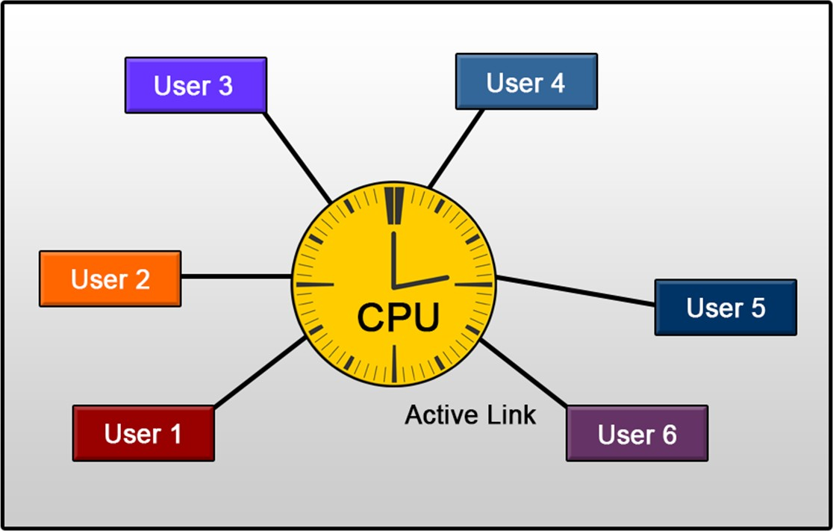
Time-sharing systems
IBM ICE (Innovation Centre for Education)

Slide 51
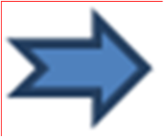
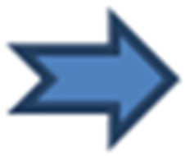
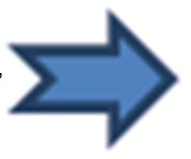
IBM Mainframe Virtualization
IBM ICE (Innovation Centre for Education)
The earliest pioneer of modern virtualization technology was IBM. IBM invented virtualization nearly 50 years ago.
CP-40
CP-67
S/360-67
S/370
In the late 1960s, IBM introduced the first successful virtual machine operating system, the CP-40 which was geared for the System/360 Mainframe. A revision of CP-40 was introduced by the name of CP-67 and was later implemented as S/360- 67 and finally as S/370.

Slide 52
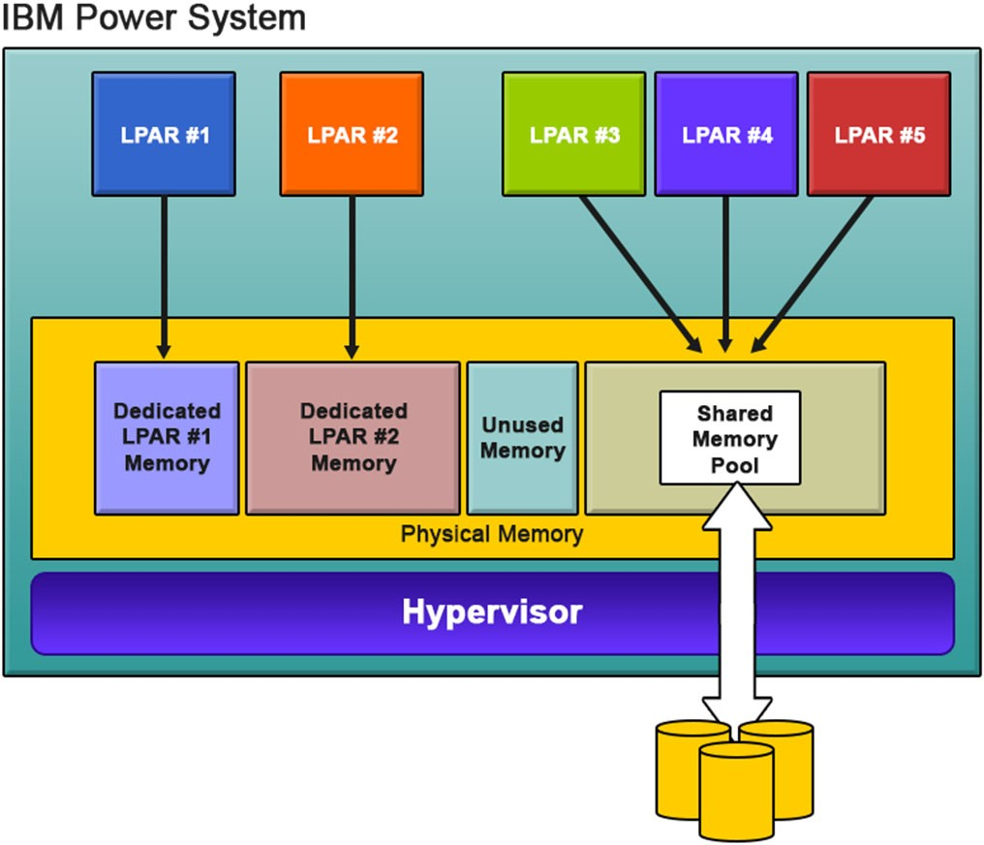
IBM PowerVM Virtualization
IBM ICE (Innovation Centre for Education)

Slide 53
Extending Virtualization to x86
IBM ICE (Innovation Centre for Education)
The virtualization on x86 Architecture was introduced in the year 1985.
In 1997, Connectix released the first version of “Virtual PC” for MAC platforms.
In 1998, VMware filed an US Patent 6,397,242 for virtualization techniques for x86 architecture and subsequently, a VMware Virtual Platform was introduced for IA32 architecture.
In 2000, FreeBSD introduced FreeBSD Jails for OS Virtualization.
In 2001, Connectix building on it initial success on Virtual PC launches the first version for Microsoft Windows.
Year 2003, marked the release of the first open source hypervisor for x86 machines called Xen Hypervisor. The company XenSource that developed the hypervisor was later acquired by Citrix. Citrix is currently one of the major virtualization solution provider in the x86 market.
In 2006/2007, Virtual Iron released Virtual- Iron, an x86 bare-metal hypervisor for enterprise customers. VirtualBox was also introduced as an open source alternative under the GPL license.

Slide 54
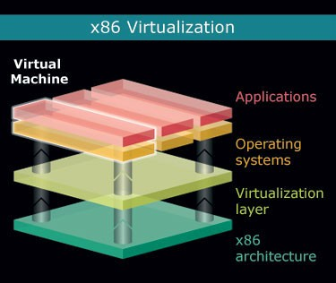
Hardware support for x86 Virtualization
IBM ICE (Innovation Centre for Education)
Source: https://www.desktop-virtualization.com

Slide 55
Impact of Virtualization
IBM ICE (Innovation Centre for Education)
The impact of virtualization can be classified under two major headings:
Cost
Manageability.

Slide 56
Cost Impact
IBM ICE (Innovation Centre for Education)
Security/Segregation of critical applications
Limited or No Monitoring
Ineffective Asset Management
Provisioning Turnaround

Slide 57
Thank You!

