Slide 1

Unit-3- Introduction to Cloud Computing

Slide 2
Unit-3 Lecture-1-2
Introduction to Cloud Computing

Slide 3
Learning Outcomes
At the end of the session you will be able to:
Define cloud computing
Describe need of cloud computing
Describe history of cloud computing
Explain historical evolution of cloud computing
Describe benefits of cloud computing
Understand limitations of cloud computing
Explain elastic computing
Differentiate various vendors of cloud computing
Distinguish traditional data center and cloud data center

Slide 4
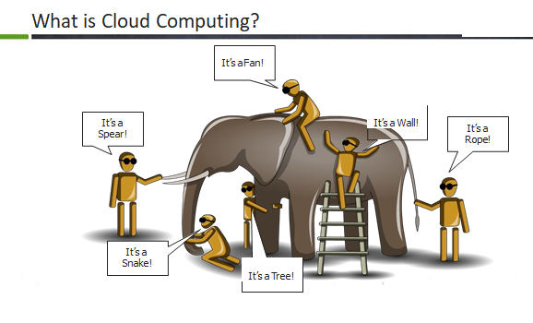

Slide 5
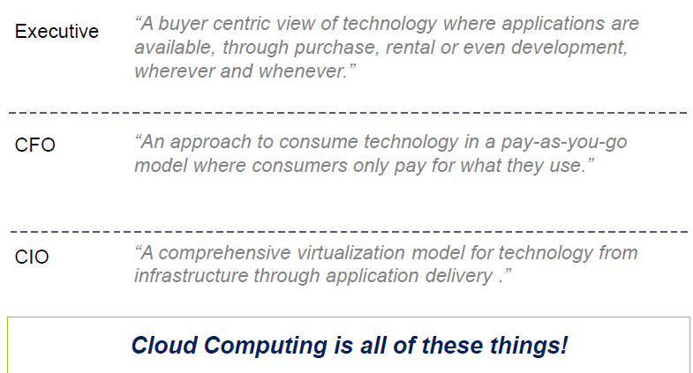
Cloud Computing View Points

Slide 6
Introduction
Cloud computing is a technology which utilizes the Internet and central isolated servers in order to sustain applications and data.
This technology permits much more proficient computing by consolidating bandwidth, processing, and storage memory.
Cloud offers robust memory administration, thus there is no necessity to sustain memory on a personal system.

Slide 7
Examples:
Cloud computing with an example -
Whenever you travel through a bus or train, you take a ticket for your destination and hold back to your seat till you reach your destination. Likewise other passengers also takes ticket and travel in the same bus with you and it hardly bothers you where they go. When your stop comes you get off the bus. Cloud computing is just like that bus, carrying data and information for different users and allows to use its service with minimal cost.
Landline Phone Vs. Smart Phone
Making of Websites
What is Cloud Computing?
It enable us to utilize high end resources so that we build great applications without worrying about infrastructure.
i.e you can create a application without worrying of hardware, software, security, backup.

Slide 8
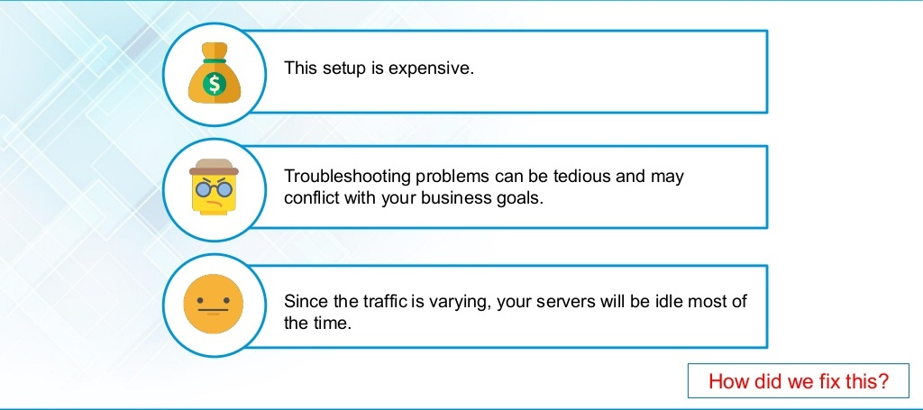
Before Cloud Computing: Disadvantage

Slide 9
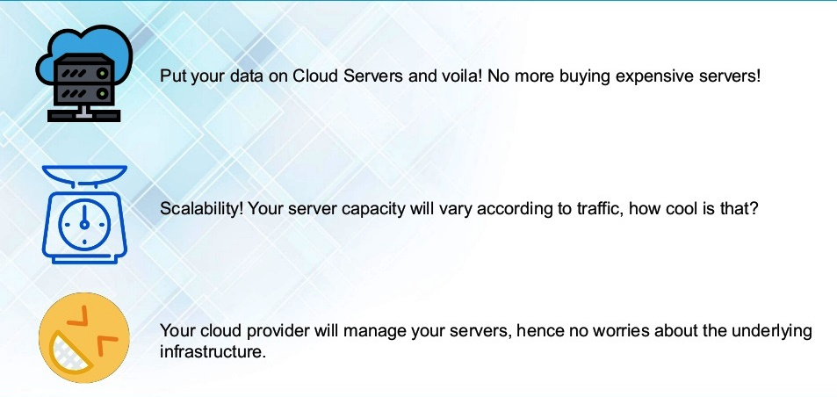
Solution

Slide 10
Definition's: Cloud Computing
What is Cloud?
The term Cloud refers to a Network or Internet.
In other words, we can say that Cloud is something, which is present at remote location. Cloud can provide services over public and private networks, i.e., WAN, LAN or VPN.
Applications such as Gmail, Yahoo Mail, web conferencing, customer relationship management (CRM) execute on cloud.
Cloud Computing provides us means by which we can access the applications as utilities over the internet. It allows us to create, configure, and customize the business applications online.
Definition:
Cloud Computing refers to manipulating, configuring, and accessing the hardware and software resources remotely. It offers online data storage, infrastructure, and application

Slide 11
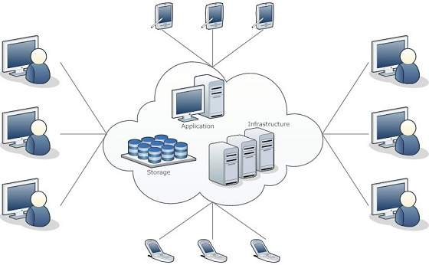
Cloud Introduction
→ According to Forrester, Cloud Computing is:
“A form of standardized IT-based capability — such as Internet- based services, software, or IT infrastructure — offered by a service provider that is accessible via Internet protocols from any computer, is always available and scales automatically to adjust to demand, is either pay-per-use or advertising-based, has Web- or programmatic-based control interfaces, and enables full customer self-service.”
Cloud computing offers platform independency, as the software is not required to be installed locally on the PC. Hence, the Cloud Computing is making our business applications mobile and collaborative.
Cloud computing is a technology that uses the internet and central remote servers to maintain data and applications.

Slide 12
Definition of Cloud Computing
The term ‘cloud’ is defined by NIST as follows:
“Cloud computing is a model for enabling ubiquitous, convenient, on-demand network access to a shared pool of configurable computing resources (e.g., networks, servers, storage, applications, and services) that can be rapidly provisioned and released with minimal management effort or service provider interaction. This cloud model is composed of five essential characteristics, three service models, and four deployment models.”
Cloud Computing can be defined as delivering computing power( CPU, RAM, Network Speeds, Storage OS software) a service over a network (usually on the internet) rather than physically having the computing resources at the customer location.
Example: AWS, Azure, Google Cloud

Slide 13
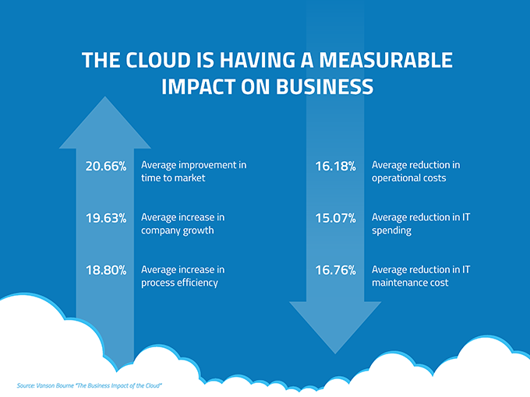
Why do we need cloud computing?
According to a study by the Cloud Security Alliance, 33% of organizations have a “full steam ahead” attitude toward cloud services and 86% of companies spend at least part of their IT budget on cloud services.
IT leaders at 79% of companies receive regular requests from end users each month to buy more cloud applications with file sharing and collaboration, communication, social media, and content sharing topping the list of the most-requested cloud services.

Slide 14
Why do we need cloud computing?
Fresh Software: Availability of software
Do more with less: cost saving. Yes, Cloud computing has made drastic change in the reduction of hardware and software cost and other server resources as well.
Always-on availability: Most cloud providers are extremely reliable in providing their services, with many maintaining 99.99% uptime.
Improved mobility: Data and applications are available to employees no matter where they are in the world. E.g. Facebook.
Huge amount of processing power: We can run all our workload data of applications and processes online over the internet remotely instead of using physical hardware and software.
Day to day issues related to server maintenance or installation of software/hardware: renewal of license, all those factors are undertaken via cloud computing service providers
Protects and recovers all crashed or loss data: so we don’t have to worry about crashed or loss of data, it gives you high security
Scaling: If User increased from 100 to 1000, so more flexible.

Slide 15
Advantages of Cloud Computing
Lower cost computer for users: In cloud, you don't require a high-powered (and accordingly high-priced) computer to run cloud computing's web based applications because applications run on cloud not on desktop PC or laptop.
Lower IT infrastructure cost: By using cloud computing, you need not to invest in larger numbers of more powerful servers, you also need not to require the IT staff for handling such powerful servers.
Fewer maintenance cost: The maintenance cost in cloud computing greatly reduces both hardware and software maintenance for organizations of all sizes.
Lower Software Cost: It reduces the software cost because you don't need to purchase separate software packages for each computer in the organization.
Instant software updates: Another software-related advantage in cloud computing is that users don't need to face with the choice between obsolete software and high upgrade costs. If the app is web-based, updates happen automatically and are available next time when the user logs in to the cloud.

Slide 16
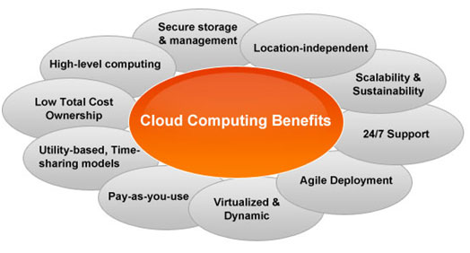
Advantages of Cloud Computing
Increased computing Power: The execution capacity of cloud servers are very high. It processes the application very fast.
Unlimited storage capacity: Cloud offers you a huge amount of storage capacity like 2000 GB or more than that if required.
Improved compatibility between Operating systems
Backup and recovery
Performance and Scalability
Increase data safety

Slide 17
Disadvantages of Cloud Computing
Require a constant Internet Connection: Cloud computing is impossible without Internet connection. To access any applications and documents you need a constant Internet connection.
Require High Speed Internet connection: Similarly, a low-speed Internet connection makes cloud computing painful at best and often impossible. Web based apps often require a lot of bandwidth to download, as need to download large documents.
Stored Data Might Not Be Secure: With cloud computing, all your data is stored in the cloud. That's all well and good, but how secure is the cloud? Can't unauthorized users gain access to your confidential data?

Slide 18
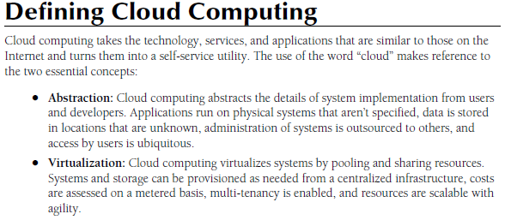
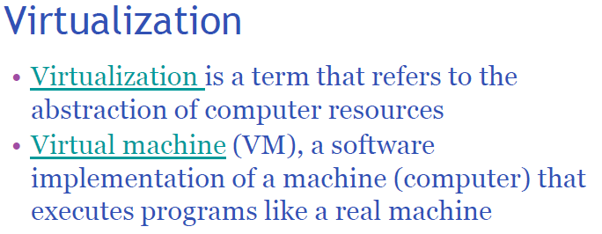
Defining cloud computing

Slide 19
How does cloud computing work
Assume that you are an executive at a very big corporation. Your particular responsibilities include to make sure that all of your employees have the right hardware and software they need to do their jobs. To buy computers for everyone is not enough. You also have to purchase software as well as software licenses and then provide these software's to your employees as they require. Whenever you hire a new employee, you need to buy more software or make sure your current software license allows another user. It is so stressful that you have to spend lots of money.
But, there may be an alternative for executive. So, instead of installing a suite of software for each computer, you just need to load one application. That application will allow the employees to log-in into a Web-based service which hosts all the programs for the user that is required for his/her job. Remote servers owned by another company and that will run everything from e-mail to word processing to complex data analysis programs. It is called cloud computing, and it could change the entire computer industry.

Slide 20
History of Cloud Computing
Before emerging the cloud computing, there was Client/Server computing which is basically a centralized storage in which all the software applications, all the data and all the controls are resided on the server side.
If a single user wants to access specific data or run a program, he/she need to connect to the server and then gain appropriate access, and then he/she can do his/her business.
Then after, distributed computing came into picture, where all the computers are networked together and share their resources when needed.
On the basis of above computing, there was emerged of cloud computing concepts that later implemented.

Slide 21
Overlapping of virtualization and cloud
Virtualization is only an enabler for Cloud. Virtualization provides the required infrastructure flexibility to cloud by virtualizing the resources which allows for easy provisioning and management of these resources across hardware pools
Virtualization is only one of the eight major building blocks of Cloud.
Virtualization is most relevant to IaaS (Infrastructure as a Service). However, PaaS (Platform as a Service) and SaaS (Software as a Service) could largely be achieved without virtualization. Increasingly, PaaS and SaaS units are being packaged as VMs for easy deployment.
The real difference between Cloud and Virtualization comes from the business aspects of Cloud and the Service management framework built into Cloud.

Slide 22
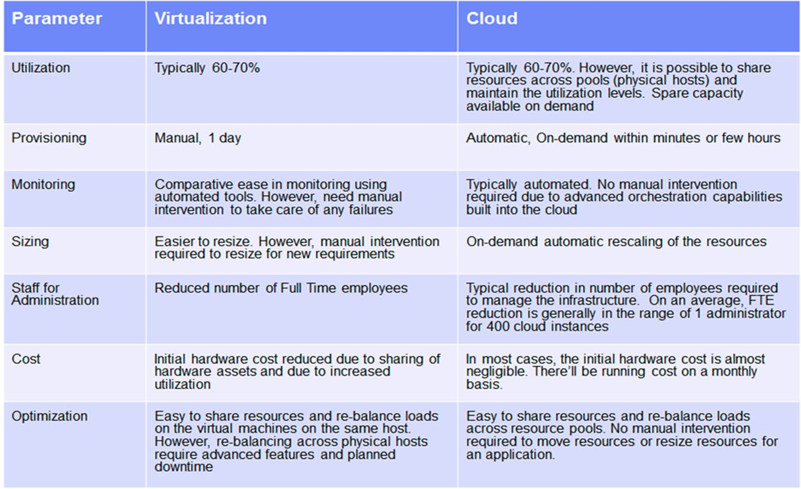
Areas and relative savings

Slide 23
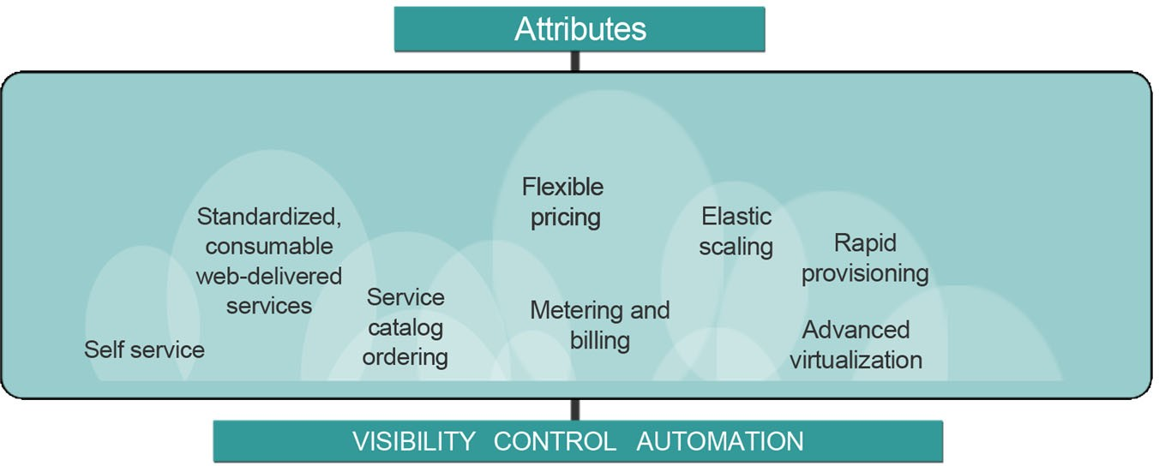
What is cloud computing?

Slide 24
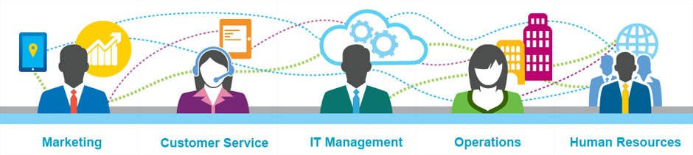
Cloud computing improves service management

Slide 25

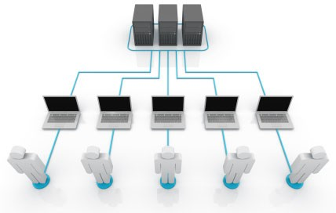
A service driven model
Cloud computing provides service delivery for consumer and business needs in a simplified way.
Hardware and platform-level resources are provided as services on an on-demand basis.

Slide 26
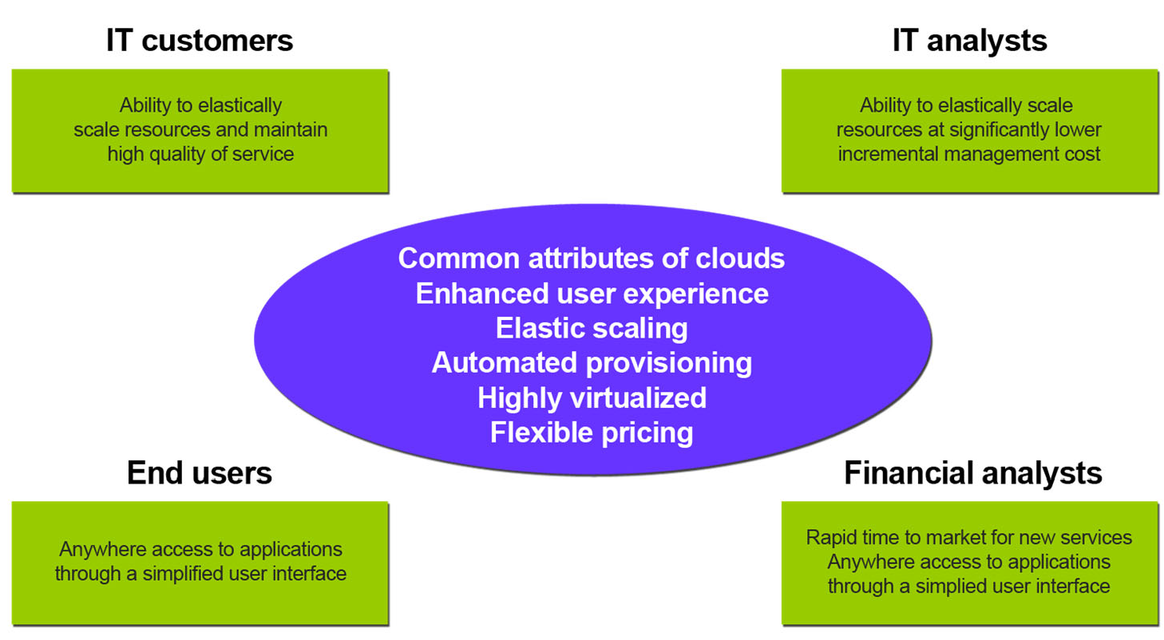
Advantages of cloud

Slide 27
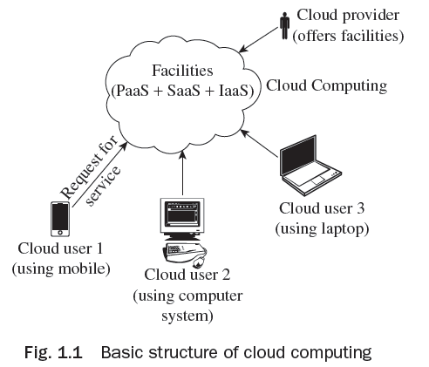
Basic Structure of Cloud Computing
The basic structure of cloud computing is
shown in Fig. 1.1. As given in the figure,
facilities and services are offered by cloud
providers in a cloud computing environment
and different users from various locations
and devices can request for specific services
that are offered.

Slide 28
Basic Structure of Cloud Computing
Some of the benefits of cloud computing are given here:
It improves parallelism and allocation of resources for fast accessing.
One may acquire software services, networked storage space, computer resources, and various other services at a single place.
An additional company hosts a set of applications, get software renewals (with no charge), and so on.
It improves monetary burden such as operational expenses, renewing charge, and capital expenses.

Slide 29
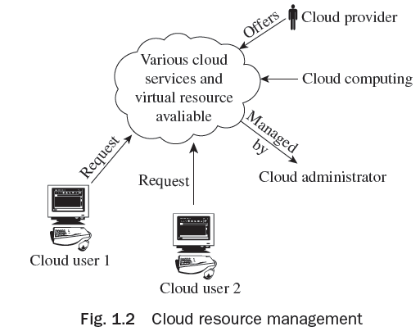
Cloud Resource Management

Slide 30
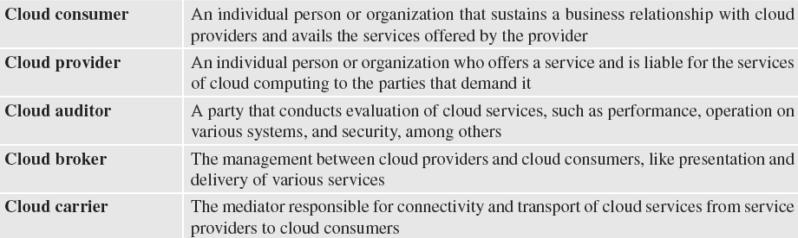
Terminology used in Cloud Computing

Slide 31
Need of Cloud Computing
Cloud computing is a new trend in computing due to its many benefits:
Reduced Costs
Scalability
Remote Access
Disaster Relief
Ease of Implementation
Skilled Vendors
Response Time
Easy to Customize
Virtual Provisioning
Fully Automated Storage Tiering—FAST

Slide 32
History of Cloud Computing
The historical evolution of Cloud Computing is as follows:
Client-Server Technology
Peer-to-Peer Approach
Distributed Computing
Evolution of Cloud Computing from Grid Computing
Autonomic Computing
Platform Virtualization
Service Oriented Architecture—SOA
Utility Computing
Web 2.0
Parallel Computing

Slide 33
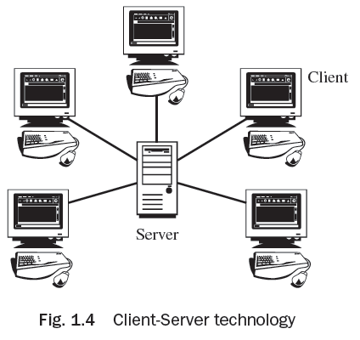
Client-Server Technology
Client-Server is the technology behind cloud computing. It is shown in Fig. 1.4. In this, multiple computers perform collectively to augment computing power.
The server is the prime regulator wherein software applications and data are kept for access.
The client is simply a tool which is associated with
the user for facilitation.
Due to inadequate processing power, IT employees
neither acquire instant access nor can two users
access similar data concurrently in client–server
technology.

Slide 34
Peer to Peer Approach
Peer-to-Peer (P2P) is a decentralized approach and it encompasses no principal server. It is a design in which every computer has equal responsibilities and facilities.
P2P facilitates straight swap of services and resources.
This kind of network is not simple to manage.

Slide 35
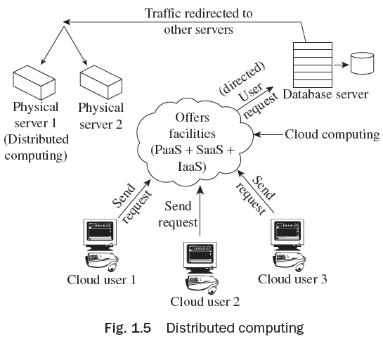
Distributed Computing
Distributed computing utilizes those idle resources that are not utilized for some reason or the other. Figure 1.5 shows distributed computing.

Slide 36
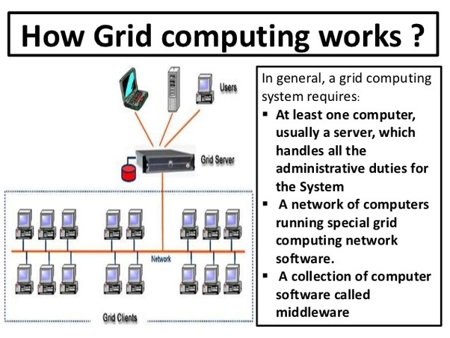

Slide 37
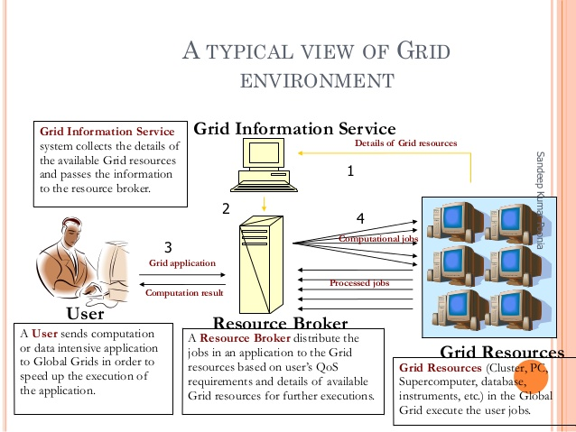

Slide 38
Grid Framework
Grids are a type of dispersed computing system, whereas a virtualized super computer is made from various networked.
Grids focus on two different but associated objectives—supplying isolated access to IT resources and building up processing control.
The grid is a technology which controls two factors—allocation and trust.
Grid computing is a versatile technology which has its base in e-science and has progressed from previous expansions in parallel and high-performance computing (HPC).

Slide 39
Grid Framework
The main resources that can be shared in a grid are:
1. Processing and computing power
2. Networked file and data storage systems
3. Bandwidth and communications
4. Application software
5. Tools used for scientific purpose

Slide 40
Grid Framework
The distinct definitions for grid and grid computing are:
Grid middleware is exclusive software that offers the essential functionality needed to facilitate sharing of various resources and setting up of virtual businesses. Grid middleware is exclusive software that is incorporated into the infrastructure of the concerned corporation. Grid middleware offers a unique virtualization and sharing layer which is positioned among the various infrastructures and the particular user applications using it.
Grid computing is fundamentally the installed Grid middleware or the computing permitted by grid middleware based on synchronized, safe, flexible resource sharing among a collection of resources, people, and organizations.

Slide 41
Grid Framework
Grid infrastructure refers to the union of grid middleware and hardware which converts single portions of data resources and hardware into an incorporated virtualized infrastructure that is displayed to the user as the only computer in spite of heterogeneity of the fundamental infrastructure.
Utility computing is a type of computing that provides customized applications of grid and computing as a service. It is based on pay-as-per-utilization business modules.

Slide 42
Grid Architecture
The grid design offers an outline of the grid constituents, describes the objective and operations of its constituents, and shows how the constituents interrelate with each other. Various layers of the grid architecture are:
Fabric layer
Connectivity layer
Resource layer
Collective layer
Application layer

Slide 43
Grid Architecture
The key functionalities of a grid middleware are as follows:
1. Integration and virtualization of various independent resources
2. Requirement of information concerning resources and their accessibility
3. Lively and flexible resource administration and allotment
4. Brokerage of resources based on open markets or corporation strategies
5. Safety comprising agreement and confirmation of users and accountability
6. Licenses administration
7. Expense and invoicing
8. Transport of non-insignificant ‘Quality of Service’

Slide 44
Challenges of Grid Computing
It is not enough to just change the prevailing spread IT infrastructure into a grid. In majority of instances, investments are required for making the existing applications to work on a grid infrastructure.
Lack of values for grid computing make resources’ findings for grid technology difficult and risky.
Grid computing is a versatile technology and the launching of grid computing in a corporation is characteristically a long-standing plan that needs time until the visibility of first results. The beginning of grid computing could need consistency of physical resources. Even if grids would essentially be capable to handle heterogeneity of resources that are accessible, advanced heterogeneity of resources might need advanced savings in terms of money and time and hence increase the downfall risk.

Slide 45
Cloud Computing Architecture
In cloud computing environment, physical resources are made available to cloud users with the help of virtualization software in the form of virtual resources.
Cloud computing architecture is not fixed as other computing architectures, but it is different on the basis of different jobs, resource distribution.

Slide 46
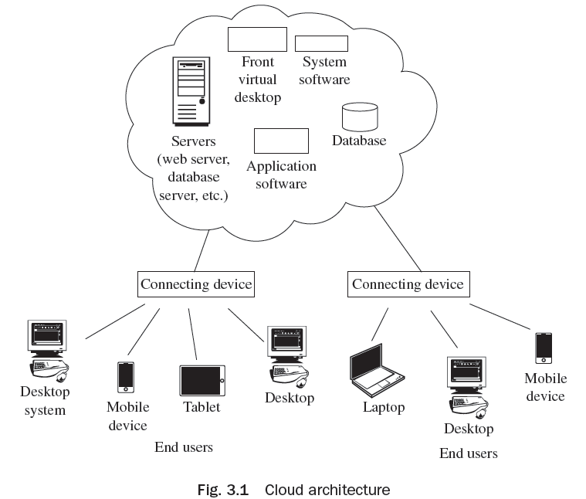
Cloud Computing Architecture
Basic cloud computing environment is shown in the Fig. 3.1 in which various services such as available servers, virtual desktop, system software, application software, database, etc. are available for cloud users. Users can avail the services using any device such as desktop system, laptop, mobile, tablet, etc.,

Slide 47
Cloud Computing Architecture
The Cloud Computing architecture is discussed based on different criteria:
On the Basis of Load Balancing
On the Basis of Disk Provisioning
On the Basis of Storage Management
On the Basis of Hypervisor Installed
On the Basis of Migration
On the Basis of Service Relocation
On the Basis of Cloud Balancing
On the Basis of Virtual Switches Load Balancing
On the Basis of Failure Detection and Recovery

Slide 48
Key Design Aspects of Cloud Architecture, Cloud Services and Cloud Applications
Cloud computing has various issues related to its architecture:
Issues at Design Level
Issues of Architectural of Cloud Computing
Platform Related Issues
Issues Related to the Implementation
Issues related to Business
Technical Issues

Slide 49
Similarities and Differences between Grid and Cloud Computing
Similarities:
Grid computing and cloud computing are scalable.
Grid and cloud computing offer service-level agreements (SLAs) for uptime accessibility of around 99 per cent. If the service slides below the definite uptime service level, the service credit for receiving data to the customer gets delayed.
Differences:
Cloud computing offers SaaS applications, whereas grid computing is used when the processing authority of service or an application is distributed across multiple systems.
With cloud computing, the corporation acquires feasibility and expense savings, whereas with grid computing the corporation acquires suppleness and authority.

Slide 50
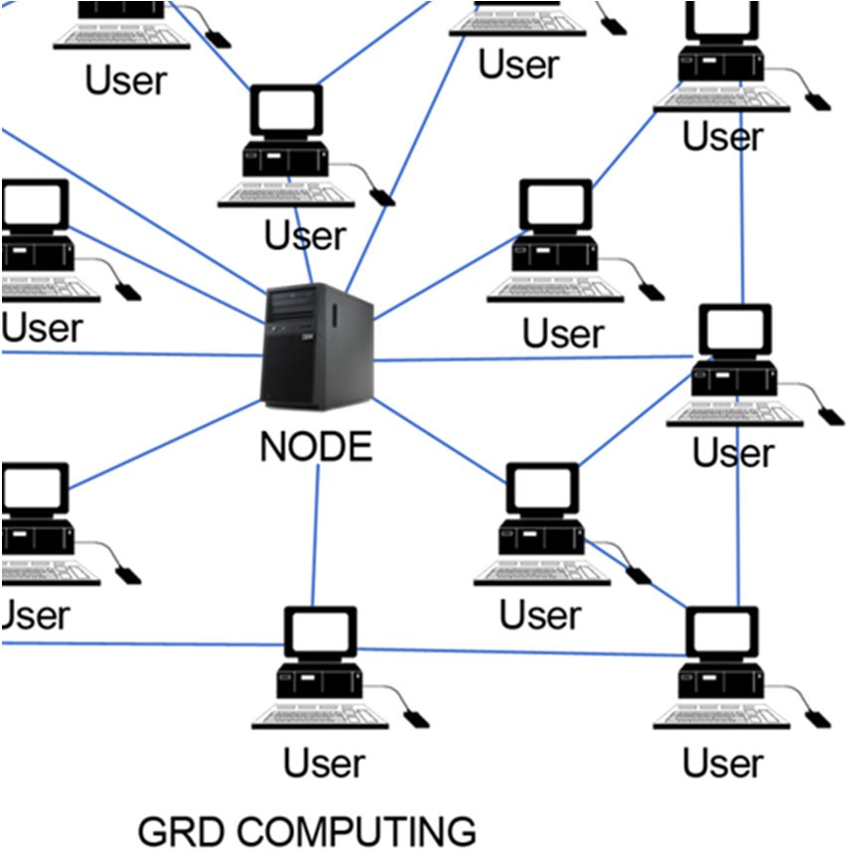
Grid computing
IBM ICE (Innovation Centre for Education)

Slide 51
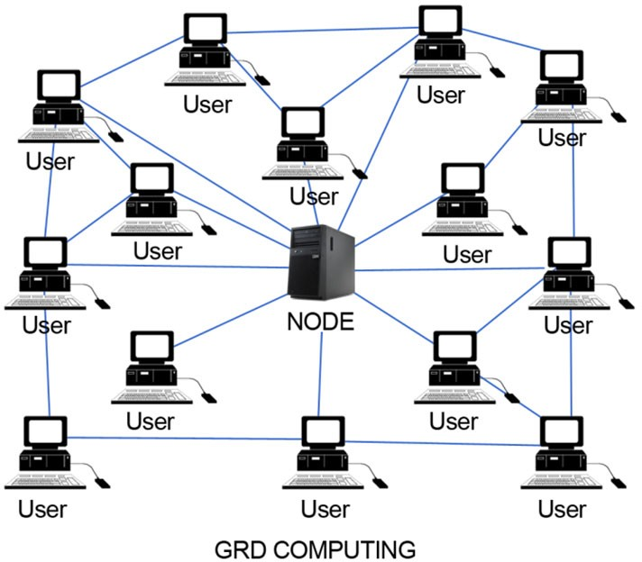

Cloud Vs Grid Computing
IBM ICE (Innovation Centre for Education)

Slide 52
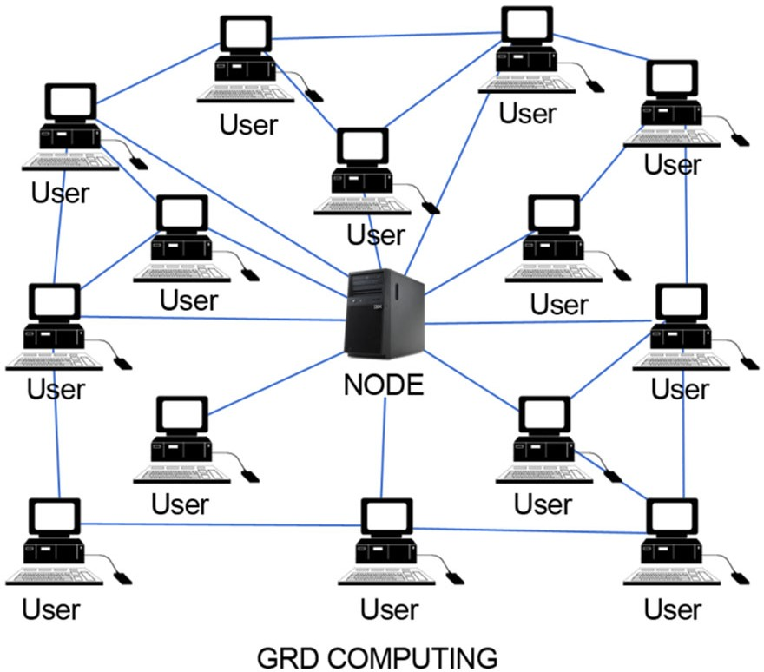
Relationship between grid and cloud computing
IBM ICE (Innovation Centre for Education)

Slide 53
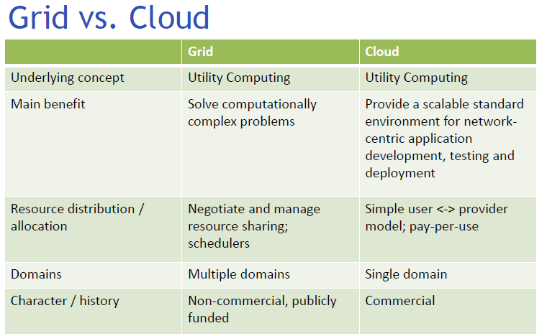

Slide 54
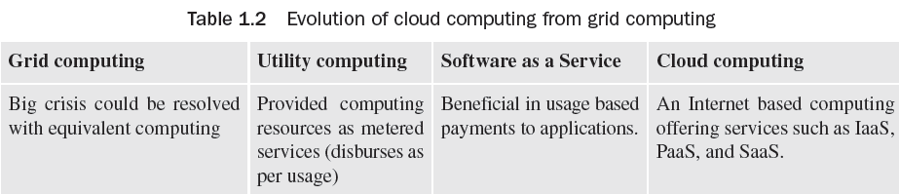
Evolution of Cloud Computing from Grid Computing

Slide 56
Web 2.0
Web 2.0 represents a change in technology in the world of the World Wide Web. It is usually designed to increase data security and customization of application as per the requirement with improved functionality.
The important features of Web 2.0 are as follows:
Easy to access
User interaction and participation
Rich customization features
Easy communication through video chatting, instant messaging facilities, etc.
User-friendly writing tools and applications
Data management and analysis
Multimedia supporting tools
Web application and hosting

Slide 57
Parallel Computing
Parallel computing simultaneously uses various computing resources for solving a computational problem.
It is based on the principle that a single large problem is divided into small parts and parallely runs different parts on different machines.
Parallel computing supports applications that require processing of a large problem in a sophisticated way. Some of the examples are Big data problem, Data mining, Search engines, Medical diagnosis, Virtual reality, Multimedia.

Slide 58
Services Provided by Cloud Computing
Electronic Faxing
Voice on Clouds
Commerce on Clouds
Distributed Hosting on Clouds
Accounting and Online Banking

Slide 59
News on Cloud Computing
A mobile phone can be used to access services related to news.
Google Apps or Gmail is capable of seeking information via e-mail, rapidly from any tool. We can talk and work with partners or consumers without any language barrier.
Distribution and editing of data with trouble-free collaboration using Google items Docs and Sites. TripIt is a private travel that assists in arranging tours. Data is gathered from consumers and colleagues by using Google types. There is joint work on a general venture.
Through Force.com, you may construct a scalable business application on the cloud platform.
Both Google’s cloud and salesforce.com computing platforms are employed to generate
business and web applications.
Using online patterns for presentations, spreadsheets, and records.
Functioning steady, safe, and quick Web apps.
Easily and firmly distributing video in apps through Youtube for Google apps.

Slide 60
Benefits of Cloud Computing
Cloud computing offers the following benefits:
Pay as per use
Reduced investment and proportional costs
Accessibility from anywhere
Increased scalability
Increased availability and reliability
Dynamic provisioning

Slide 61
Limitations of Cloud Computing
Some of the limitations of Cloud computing are:
Availability of Services
Data Lock-in
Data Segregation
Privilege Neglect
Scaling Resources
Data Location
Deletion of Data
Recovery and Backup
Offline Clouds
Unpredictable Performance

Slide 62
How to develop Cloud Computing
For the development of cloud infrastructure, the following are needed:
Understanding the prevailing conventional data center
Computing resources that will be virtualized
Installing service administration devices

Slide 63
Core Components of Traditional Data Centers
Application Program employed to carry out numerous computing functions. It may be an operating system, DBMS, and many more.
DBMS It is an administration system which offers the ability to save or get data from rationally prepared tables.
Compute Resources which work numerous applications using various elements.
Storage This is used to save data for often use.
Network It is the ability to communicate among systems. It assists us to share data and resources.

Slide 64
Vendors of Cloud Computing
Amazon Web Services—IaaS
Google—SaaS, PaaS
Microsoft Azure Service Platform—PaaS
Rackspace—Cloud Hosting
Salesforce.com—SaaS, PaaS

Slide 65
Elastic Computing
Elastic computing is the capability of a cloud service supplier to provision flexible computing strength when and where required.
In cloud computing, elasticity is described as the level to which a system is capable of adapting to workload variation by offering and taking back resources the autonomic way; at every point in time the accessible resources meet the present need.

Slide 66
Social Networking
Social networking may be done for business purposes, social purposes, or both.
Examples of social networking include LinkedIn, Facebook, etc..
A social networking website is an online podium which permits customers to build a public profile and interact with other users on the website.
Some social networking websites like LinkedIn are used for creating professional links, whereas sites such as Facebook are on both sides of the line (i.e., professional and private).

Slide 67
Enterprise Cloud Computing
Enterprise cloud computing is the process of using cloud computing for saving cost and for business innovation by getting extraordinary speed and agility, and improved collaboration among customers and business partners. Enterprise cloud computing is important because:
Cost of accessing data can be reduced to a great extent by linking it directly with the usage. Customers are charged on a pay-per-use basis.
Start-ups can test out new business ideas risk-free and at low cost, due to enormous scalability. Since there is no upfront capital expense involved, in case a new project takes off, it can be scaled up instantly, and vice versa.

Slide 68
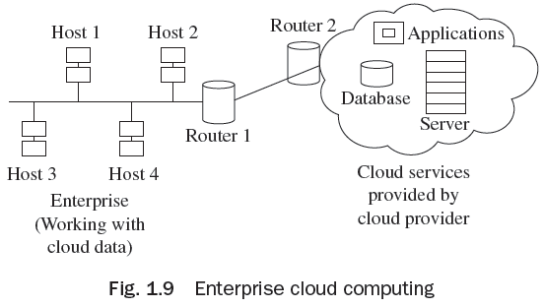
Enterprise Cloud Computing
Enterprise cloud computing allows a company to create a shared workspace in order to collaborate with its trading partners and work together as a ‘virtual enterprise network’. In this way, they can share the information and communication resources, without actually owning it all. This also helps in lowering costs. As shown in Fig. 1.9, an
enterprise with n numbers of hosts can connect
through cloud services and different types of
services supported by cloud network such as
database, servers, and various applications.

Slide 69
Cloud computing business value
Provides creative ways for companies to address how they utilize IT
Reduces capital expenses and operational costs
Makes IT applications and infrastructure dynamically available
Provides rapid service delivery
Provides ability to test new plans with little delay

Slide 70
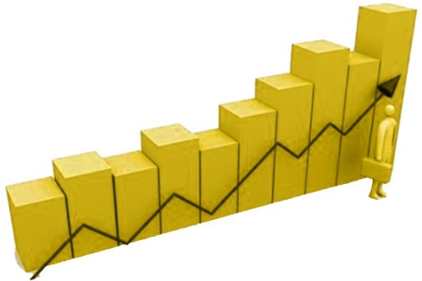
Business impact when using a cloud
IBM ICE (Innovation Centre for Education)
Companies are improving their overall IT quality
Substantial savings
Power, operations, hardware purchase
Avoids the cost impact associated with over-provisioning and under-provisioning
New opportunities
Investment to support a new product is noticeably reduced
Faster start-up
Time between approval of a project and the start of work is shorter

Slide 71
Cloud computing technological value
IBM ICE (Innovation Centre for Education)
Technological capabilities Value
Heritage of Grid Computing
Accelerate the deployment of new applications by serving computing resources for the enterprise’s core business
Resource capacity
Virtualized pool of resources
Gain flexibility to meet changes in computing resource demands
Automation
Self service provisioning
Potential inhibitors…
Strong network management and high bandwidth needed Performance of applications Compliance with regulations for data stored in the cloud
Scalability, agility
Multi-tenancy

Slide 72
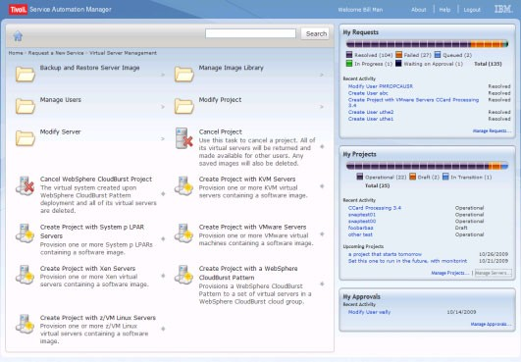
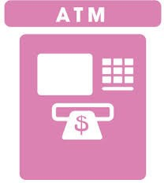
Cloud computing and end user
IBM ICE (Innovation Centre for Education)
self -service portal
Similar to banking ATMs and retail point of sale, cloud is driven by self service technology advancement.

Slide 73
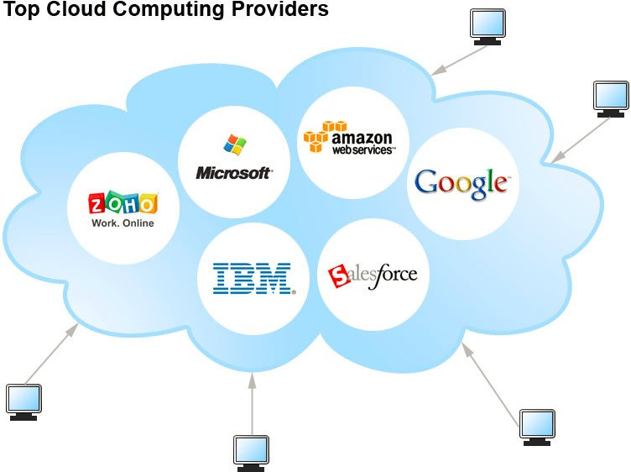
What does cloud computing change for the provider?
IBM ICE (Innovation Centre for Education)

Slide 74
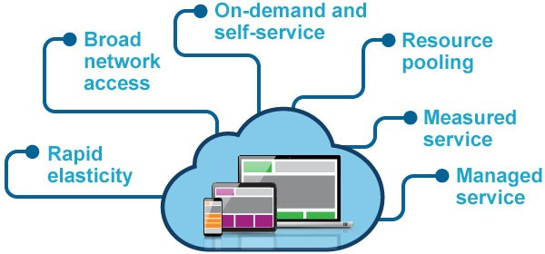
Pros and cons of a cloud model
IBM ICE (Innovation Centre for Education)
Pros:
Scalability
Cost
Flexibility
Agility
Elasticity
Cons:
Security
Lack of control
Standardization

Slide 75
Anatomy of a cloud
IBM ICE (Innovation Centre for Education)
A cloud is composed of eight major components.
Provisioning and Configuration Module
Monitoring and Optimization
Metering and Chargeback
IT Service Management
Orchestration
CMDB (Configuration Management Database)
Cloud Lifecycle Management Layer
Service Catalog

Slide 76
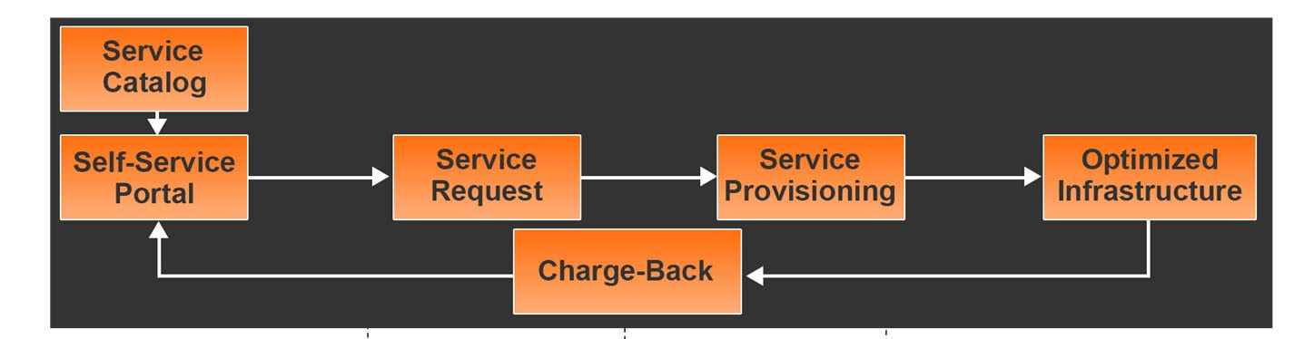
Cloud computing solution components
IBM ICE (Innovation Centre for Education)
User/IT self service
Improving customer satisfaction and
responsiveness
Capacity management Reservation with connection to platform configuration
Controlled anticipation Validated change requests with automated approval workflow process
Low or no touch deployment Drive down operational costs and manage thru full life-cycle
Deploy new systems faster Shorter leads times, quicker to market, agility, competitive advantage
Improve server and power utilization Cost avoidance on new hardware, energy and cooling costs
Standardized delivery models Utilize service catalog of standard components.
Consistency of configuration
Driving compliance, easier support and auditing,
consistent security.

Slide 77
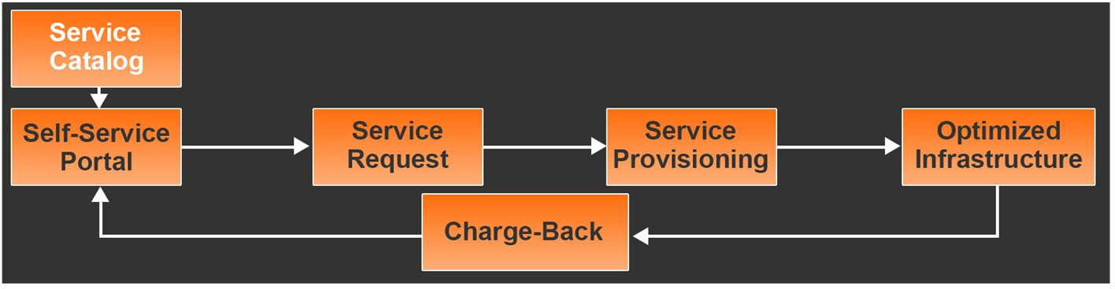
Service Catalog
IBM ICE (Innovation Centre for Education)

Slide 78
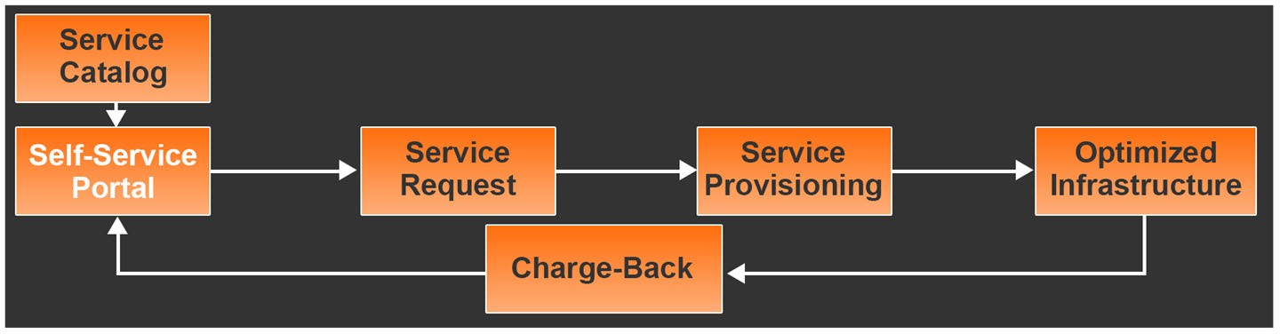
User self-service portal
IBM ICE (Innovation Centre for Education)

Slide 79
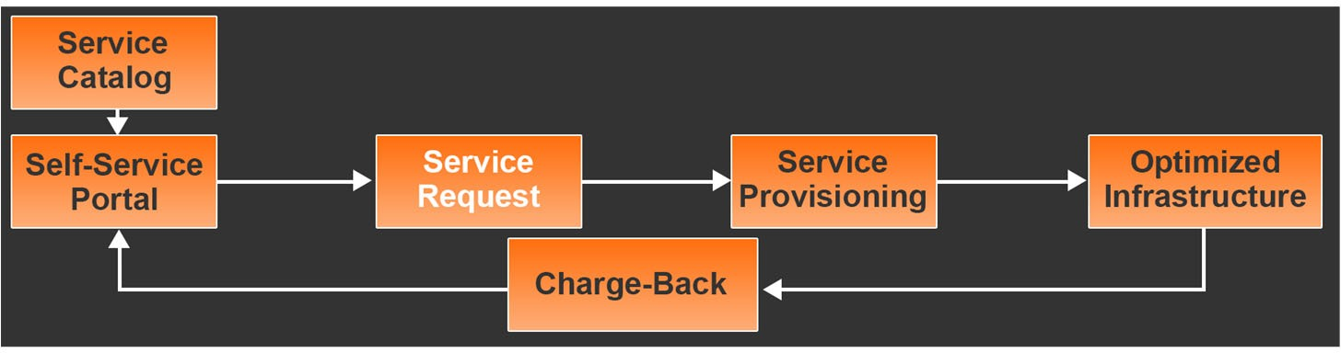
Service request management
IBM ICE (Innovation Centre for Education)

Slide 80
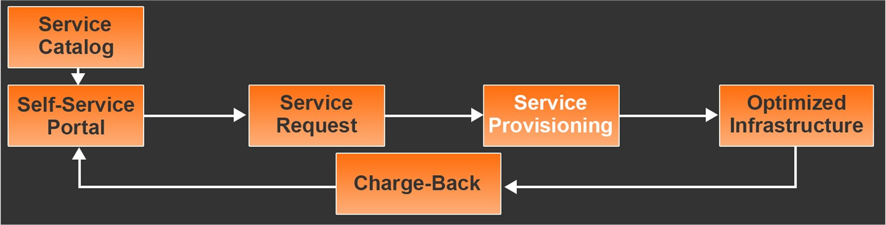
Provisioning
IBM ICE (Innovation Centre for Education)

Slide 81
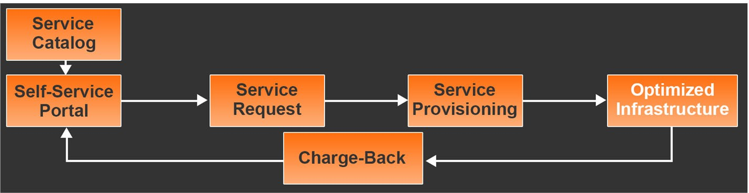
Optimized infrastructure
IBM ICE (Innovation Centre for Education)

Slide 82
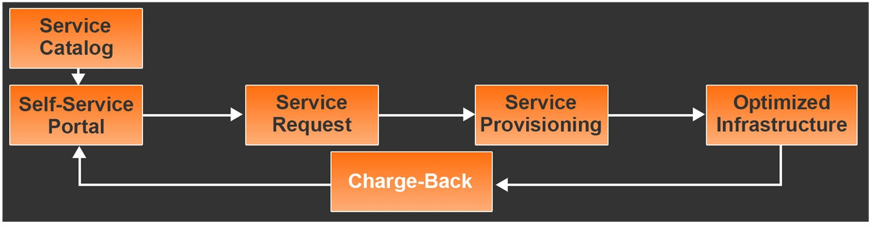
Chargeback
IBM ICE (Innovation Centre for Education)
Chargeback model agreement between cloud provider and cloud consumer

Slide 83

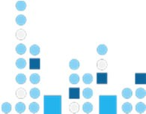

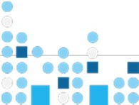
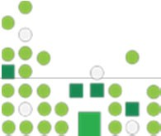
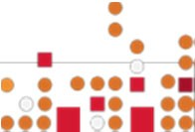





What is different about cloud computing?
IBM ICE (Innovation Centre for Education)
Without cloud computing
With cloud computing
Virtualized resources
Automated service management
Standardized services
Locat independent
Rapid scalability
Self-service
ion
Software
Hardware
Storage
Networking
Software
Hardware
Storage
Networking
Software
Hardware
Storage
Networking

Slide 84
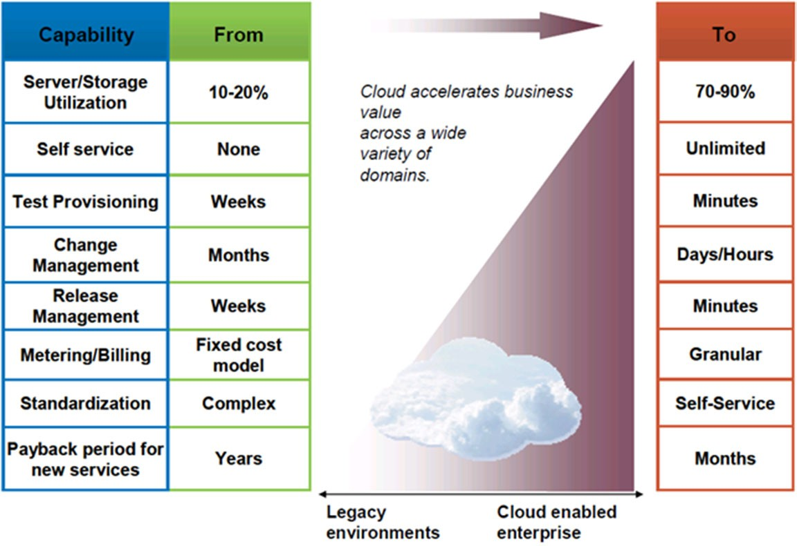
Benefits of cloud
IBM ICE (Innovation Centre for Education)

