Slide 1

Compiler front-end: lexical analysis, syntax analysis, semantic analysis
Tasks: understanding the source code, making sure the source code is
written correctly
Compiler back-end: Intermediate code generation/improvement, and Machine
code generation/improvement
Tasks: translating the program to a semantically the same program (in a different language).

Slide 2

Compiler Code Optimizations
Optimized code
Executes faster
Efficient memory usage
Yielding better performance.
Reduces the time and space complexity
Code size get reduced
Process of transforming a piece of code to make it more efficient without changing its output.

Slide 3

A Code optimizer sits between the front end and the code generator.
Works with intermediate code.
Can do control flow analysis.
Can do data flow analysis.
Does transformations to improve the intermediate code.

Slide 4
Control flow analysis
Control flow analysis
Control flow graph
Control flow graph
Graph showing the different possible paths of program flow.
CFG is constructed by dividing the code into basic blocks
Basic blocks
Basic blocks are sequences of intermediate code with a single entry and a single exit.
Control flow graphs show control flow among basic blocks.
Optimization is done on these basic blocks

Slide 5
A basic block begins in one of the following ways:
the entry point into the function.
the target of a branch (can be a label)
the instruction immediately following a branch or a return
A basic block ends in any of the following ways :
a jump statement
a conditional or unconditional branch
a return statement

Slide 6
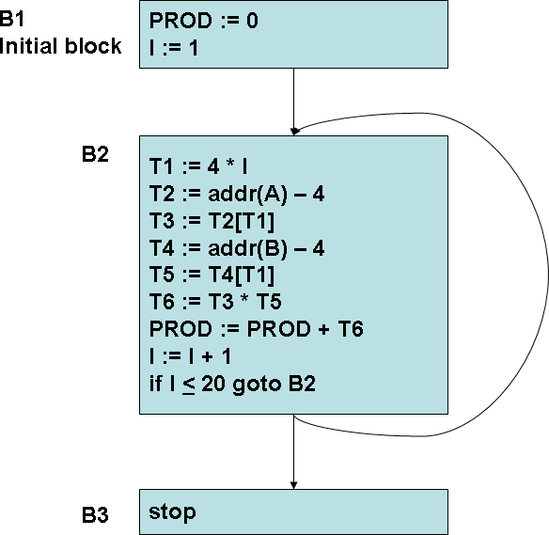

Slide 7
Classification of optimization
There are mainly 3 types of optimizations:
Local optimization
Apply to a basic block in isolation
Global optimization
Apply across basic blocks
peep-hole optimization
Apply across boundaries
Most compilers do (1), many do (2) and very few do (3)

Slide 8

Local optimization
Optimization performed within a basic block.
The simplest form of optimizations
Local optimization
No need to analyze the whole procedure body
– Just the basic blocks
The local optimization techniques include:
Global optimization
Peep-hole optimization
Constant Folding
Constant Propagation
Algebraic Simplification and Re-association
Operator Strength Reduction
Copy Propagation
Dead Code Elimination

Slide 9

Constant Folding
Evaluation of expressions at compile time whose operands
are known to be constants
Local optimization
If an expression such as 10 + 2 * 3 is encountered the compiler can compute the result at compile time as (16) and thus replace the expression with the value.
Global optimization
Peep-hole optimization
Conditional branch such as if a < b goto L1 else goto L2
where a and b are constants can be replaced by a goto L1 or
goto L2

Slide 10
Constant Propagation
If a variable is assigned a constant value, then subsequent
uses of that variable can be replaced by the constant.
Local optimization
For eg :
temp4 = 0; f0 = temp4; temp5 = 1; f1 = temp5; temp6 = 2; i = temp6;
Global optimization
f0 = 0;
f1 = 1;
i = 2;
Can be converted as
Peep-hole optimization

Slide 11
Algebraic Simplification and Re-association
Simplification use algebraic properties or operand- operator combinations.
Re-association refers to using properties such as associativity, commutativity and distributivity to rearrange an expression.
Local optimization
Global optimization
X + 0
0 + X
X * 1
1 * X
0 / X
X – 0
= X
= X
= X
= X
= 0
= X
Peep-hole optimization
e.g. :- b = 5 + a +10;
temp0 = 5;
temp1 = temp0+a; temp2 = temp1 + 10; b = temp2;
temp0 = 15; temp1 =a+temp0; b = temp1;
b && true = true b && false = false
code optimization
12

Slide 12
Operator Strength Reduction
Replaces an operator by a less expensive one.
e.g.:-
Local optimization
i * 2 = 2 * i = i + i
i / 2 = (int) (i * 0.5) 0 – i = - i
f * 2 = 2.0 * f = f + f
f/0.2 = f * 0.5
f – floating point number, i = integer
Global optimization
Peep-hole optimization

Slide 13
Copy Propagation
Similar to constant propagation, but generalized to non- constant values.
e.g.:-
Local optimization
temp2 = temp1;
temp3 = temp2 * temp1; temp4 = temp3;
temp5 = temp3 *temp2;
c = temp5 +temp4;
temp3 = temp1 * temp1; temp5 = temp3 * temp1; c = temp5 +temp3;
Global optimization
Peep-hole optimization

Slide 14
Dead Code Elimination
If an instruction’s result is never used, the instruction is considered “dead” and can be removed.
e.g.:-
Consider the statement temp1 = temp2 + temp3; and if temp1 is never used again then we can eliminate it.
Local optimization
Global optimization
Peep-hole optimization

Slide 15
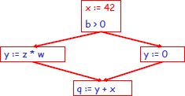
Global Optimization
Optimization across basic blocks
Data-flow analysis is done to perform optimization across basic blocks
Local optimization
Global optimization
Each basic block is a node in the flow graph of the program.
Peep-hole optimization
These optimizations can be extended to an entire control-
flow graph

Slide 16
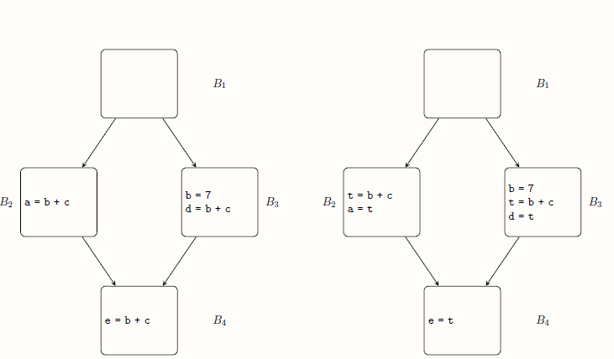
Code optimization between basic blocks
Local optimization
Global optimization Peep-hole optimization

Slide 17
How to implement common sub-expression elimination ?
An expression is defined at the point where it is assigned a value and killed when one of its operands is subsequently assigned a new value.
An expression is available at some point p in a flow graph if every path leading to p contains a prior definition of that expression which is not subsequently killed.
Local optimization
Global optimization
avail[B] = set of expressions available on entry to block B exit[B] = set of expressions available on exit from B killed[B] = set of expressions killed in B
defined[B] = set of expressions defined in B
Peep-hole optimization
exit[B] = avail[B] – killed[B] + defined[B]

Slide 18
Algorithm for global common sub-expression elimination
1. First, compute defined and killed sets for each basic block
2. Iteratively compute the avail and exit sets for each block by running the following algorithm until you hit a stable fixed point:
Local optimization
Identify each statement s of the form a = b op c in some block B such that b op c is available at the entry to B and neither b nor c is redefined in B prior to s.
Follow flow of control backwards in the graph passing back to but not through each block that defines b op c. the last computation of b op c in such a block reaches s.
After each computation d = b op c identified in step 2a, add statement t = d to that block where t is a new temp
Replace s by a = t
Global optimization
Peep-hole optimization

Slide 19
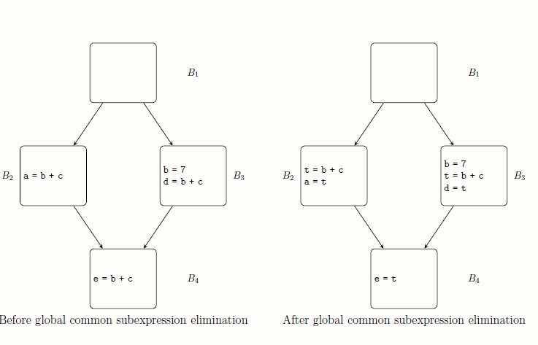
An example illustrating global common sub-expression elimination
Local optimization
Global optimization Peep-hole optimization

Slide 20
Peep-hole optimization
Optimization technique that operates on the target code considering few instructions at a time.
Local optimization
Do machine dependent improvements
Global optimization
Peeps into a single or sequence of two to three instructions and replaces it by most efficient alternatives.
Peep-hole optimization
Characteristics of peep-hole optimizations:
Redundant-instruction elimination
Flow-of-control optimizations
Algebraic simplifications
Use of machine idioms

Slide 21
Eliminating redundant loads and stores
e.g :
LD a , R1;
ST R1 , a;
Local optimization
First instruction load the value of a from register R1 to memory and second instruction stores the value of a into the register R1.
Redundant load and store can be eliminated.
Global optimization
Peep-hole optimization
Flow-of-control optimization
goto L1; L1 : goto L2
can be replaced by goto L2;
e.g :

Slide 22
Algebraic simplification and reduction in strength
e.g : x = x + 0; or x = x * 1; can be eliminated.
x2 can be replaced by x * x since the former calls an exponential routine
floating-point division by a constant can be replaced by multiplication by a constant.
Local optimization
Global optimization
Peep-hole optimization
Use of machine idioms
Make use of architectural techniques
e.g : some machines have auto-increment or auto- decrement addressing modes that helps the statement x = x +1 ; or x = x – 1; to execute faster.

