Slide 1
Chapter 10
3D Viewing Transformation

Slide 2
Contents
3D Viewing Pipeline
3D Viewing Transformation

Slide 3
3D Viewing Pipeline
Primitives
Object space
Modeling Transformation
World space
Viewing Transformation
Camera space
Hidden Surface Removal
Lighting & Shading
3D-Clipping
Projection
Normalized view space
Scan conversion, Hiding
Image space,
Device coordinates
Image

Slide 4
3D Viewing Pipeline
Procedures for displaying views of a 3-dimensional scene on an output device involve many aspects:
  Generate a 3D scene with objects generally defined with a set of surfaces forming a closed boundary around the object interior.
  Generate interior of 3D objects, if needed.
  Project object surfaces views onto the surface of a display device with 3D viewing pipeline.
  Identification of visible parts.
  Lighting effects and surface characteristics.

Slide 5
3D Viewing Pipeline
3D viewing pipeline – similar to taking a picture with a camera
  Construct and model the scene in world coordinates.
  Choose a viewing position corresponding to where we would place a camera, depending whether we want a front, back, top, bottom, or side of the scene, or inside of an object, or within group.
  Choose camera orientation.

Slide 6
3D Viewing Pipeline
  Convert the description of the scene to viewing coordinates, which includes the position and orientation of the projection plane, called the view plane, similar to a camera film plane.
  Convert and project the viewing coordinates into projection coordinates of the 2D clipping region selected – called the view volume and defined as a volume of space enclosed in clipping planes.
  Transform viewing-coordinates to normalized-coordinates (ex: between 0 and 1, or between -1 and 1), clipping off parts of the scene outside the view volume.
  Map normalized-coordinates to device-coordinates.

Slide 7
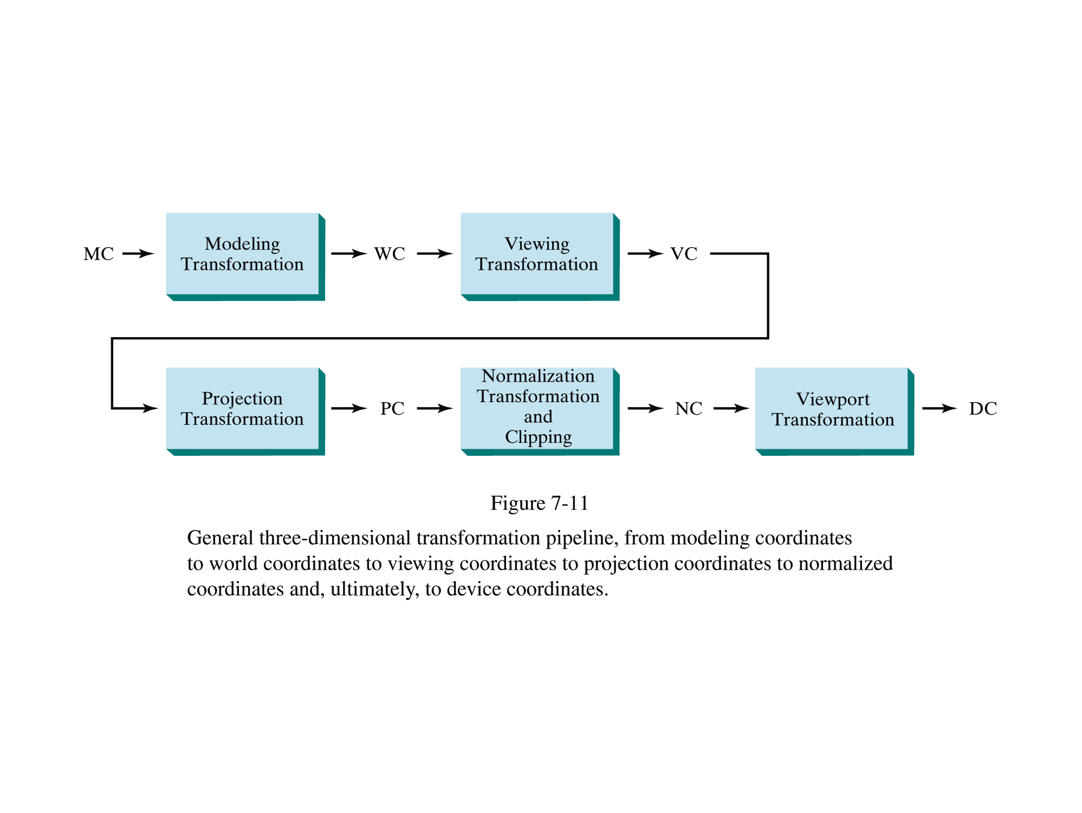
3D Viewing Pipeline
(from Donald Hearn and Pauline Baker)

Slide 8
3D Viewing Pipeline
Modeling Transformation: The transformations applied to the object (more precisely the data representing the objects in world coordinate system) prior to viewing are called modeling transformations. These include instance transformations such as:
  Translation
  Scaling
  Rotation

Slide 9
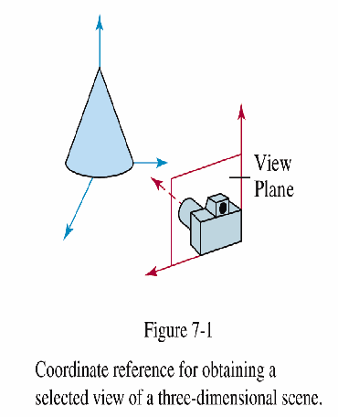
3D Viewing Pipeline
Viewing Transformation: These transformations are applied to the desired object to specify the observer viewing position and the position of the projection plane, which we think of in analogy with the camera film plane. It consists of defining view volume.

Slide 10
3D Viewing Pipeline
Projection Transformation: These performed to covert viewing coordinates description of the scene to coordinate positions on the output device.
  Parallel projection: parallel lines are transformed into parallel lines – can be orthogonal or oblique.
    Orthogonal projection: projection lines are perpendicular to the view plane.
    Oblique parallel projections: projection lines are all parallel and not perpendicular to the view plane.
      Cavalier projection: angle = 45 degrees
      Cabinet projection: angle = 63.4 degrees / tan (angle) = 2
  Perspective projection does not conserve parallel lines nor objects proportions.
    Frustum is the view volume between near and far clipping planes, and has the shape of a truncated pyramid.

Slide 11
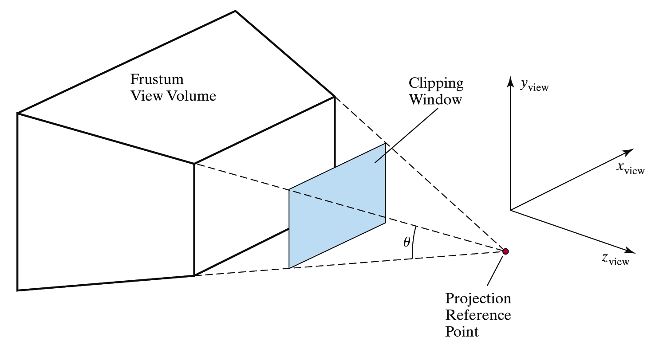
3D Viewing Pipeline

Slide 12
3D Viewing Pipeline
Normalization Transformation: The view volume is mapped to unit volume in the normalized projection coordinate system.
Workstation Transformation: Finally normalized projection coordinates are converted to device coordinates for display.

Slide 13
Contents
3D Viewing Pipeline
3D Viewing Transformation

Slide 14
3D Viewing Transformation
Viewing Transformation:
These transformations are applied to the desired object to specify the observer viewing position and the position of the projection plane, which we think of in analogy with the camera film plane. It consists of defining view volume.

Slide 15
3D Viewing Transformation
Viewing Transformation:
It perform following functions
Specification of Projection Plane (or view plane)
Build View Plane coordinate system
Conversion of World Coordinates to View Plane coordinates
Specification of View Volume

Slide 16
3D Viewing Transformation
Specification of Projection Plane (or view plane)
We specify the projection plane by
  A Reference Point R₀(x₀,y₀,z₀) in World Coordinates
  A unit normal vector N = n₁I+n₂J+n₃K again in WCS axis
From this information we can construct projections used in representing the required view with respect to View Point (Perspective Projections) or View Direction (Parallel Projections)

Slide 17
3D Viewing Transformation
Viewing Transformation:
It perform following functions
Specification of Projection Plane (or view plane)
Build View Plane coordinate system
Conversion of World Coordinates to View Plane coordinates
Specification of View Volume

Slide 18
3D Viewing Transformation
2. Build View Plane Coordinate System
We build such coordinate system by
  Assuming the Reference Point R₀(x₀,y₀,z₀) to be the origin
  Determine 3 mutually perpendicular axes.
To make 3 mutually perpendicular axes we need three mutually perpendicular UNIT vectors
Let us see how can we define these vectors…….

Slide 19
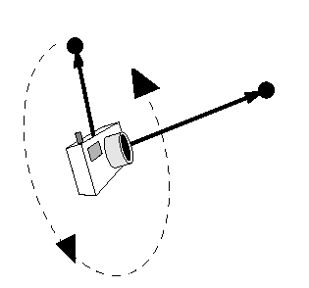
3D Viewing Transformation
First define the look vector that indicates the direction in which the camera is pointing. It’s the Normal N and defines the first axis of the view plane coordinate system.
Then choose the up vector that determines how the camera is rotated. For example, is the camera held vertically or horizontally. Its projection onto view plane determines another axis.
At last, the third vector is
found by the cross product
of above two.
Projection of up vector
Up vector
Look vector
Position

Slide 20
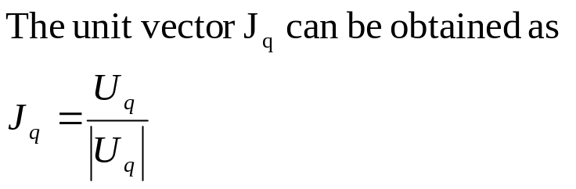
3D Viewing Transformation
Let us determine the coordinate axes
Let J_{q} defines direction of a positive q-axis of the view plane.
Given N as the unit normal vector and U as the UP vector, k.N is any vector parallel to N.
Let U_{q} be the projection of U, then by Δ law of vectors
U_{q} + k.N = U
Pre-multiplying by N
N.U_{q} + k.N.N = N.U
(why) 0 + k.1 = N.U ⇒ k = N.U
U_{q} = U – (N.U)
N
Y-axis
q axis
J_{q}
k.N
U
N
p axis
R₀
N
O
X-axis
Z-axis

Slide 21
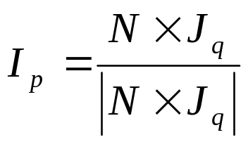
3D Viewing Transformation
Finally, the direction vector I_{p} defines direction of a positive p-axis of the view plane can be chosen so that it is ⊥ to both J_{q} and N. By convention the triad I_{p}, J_{q} and N will form LHCS.
N
Y-axis
q axis
J_{q}
k.N
U
N
p axis
R₀
N
O
X-axis
Z-axis

Slide 22
3D Viewing Transformation
Corollary:
If the view plane is the XY-plane, then I_{p} = I and J_{q} = J and the unit normal vector is N = -k.
The view plane coordinate system
Transformation can be obtained
by performing simple conversion
as follows:
x’ = x
T_{RL} = y’ = y
z’ = -z
Y-axis
-Z axis
● COP
O
X-axis
Z-axis

Slide 23
3D Viewing Transformation
Viewing Transformation:
It perform following functions
Specification of Projection Plane (or view plane)
Build View Plane coordinate system
Conversion of World Coordinates to View Plane coordinates
Specification of View Volume

Slide 24
3D Viewing Transformation
3. Conversion of World Coordinates to View Plane coordinates
Let [I,J,K] be the world coordinate system axes and the view plane system consists of coordinate axes determined by the triad of vectors [I_{p},J_{q},N] and origin as the reference point R₀.
Y-axis
Jq axis
Ip axis
N
O
R₀
X-axis
Z-axis

Slide 25
Exercise 4
We need to construct T_{wv} through the concatenation of matrices determined as follows:
Translate view plane origin R₀ to the world coordinate origin by using translation T_{v} where V = – x₀I – y₀J – z₀K
Align View plane Normal Vector N with –K using transformation A_{N,-K,}
  With this transformation I_{p} will become I_{p’} = A_{N,-K} I_{p}
Rotate I_{p’} by angle θ about z-axis so that it aligns with align I where θ is the angle between I_{p} and I_{p’} .
Now View Plane coordinate system become Right Handed coordinate system and perform the transformation T_{RL}.

Slide 26
3D Viewing Transformation
If P_{w} is the object point in the world coordinate system then corresponding View plane coordinate P_{v} can be found as :
Translate R₀ to origin ⇒ P¹ = T_{-R0}(P_{w})
Align Vector N with -K. ⇒ P² = A_{N,-K}(P¹)
Rotate I_{p’} by angle θ. ⇒ P³ = R_{θ,K} (P²)
Perform T_{RL}. ⇒ P_{v} = T_{RL} (P³)
Thus P_{v} = T_{RL} (P³)
= T_{RL} R_{θ,K} (P²)
= T_{RL} R_{θ,K} A_{N,-K}(P¹)
= T_{RL} R_{θ,K} A_{N,-K} T_{-R0}(P_{w})
Thus we form the matrix to be T_{wv}= T_{RL} R_{θ,K} A_{N,-K} T_{-R0}

Slide 27
3D Viewing Transformation
Viewing Transformation:
It perform following functions
Specification of Projection Plane (or view plane)
Build View Plane coordinate system
Conversion of World Coordinates to View Plane coordinates
Specification of View Volume

Slide 28
3D Viewing Transformation
4. Specification of View Volume
Projector
Jq axis
The view volume bounds the region in the world coordinate space that will be clipped and projected onto the view plane.
To define view volume that projects onto a specified rectangular window in view plane we first need to find the representation of View Plane point (p,q) into the world coordinate (x,y,z)
Y-axis
● P_{w}(x,y,z)
● P_{v}(p,q)
N
W
R₀
Ip axis
R
O
X-axis
Z-axis

Slide 29
3D Viewing Transformation
4. Specification of View Volume
Projector
Jq axis
Assume that if P_{v}(p,q) be the view port point then the corresponding world coordinate be P_{w}(x,y,z).
Let R and W be the position vectors of R₀ and P_{w} with respect to world coordinate system, respectively.
Further let V the position vector of P_{v} with respect to View plane coordinate system.
Thus W = R+V
Y-axis
● P_{w}(x,y,z)
● P_{v}(p,q)
N
W
R₀
Ip axis
R
O
X-axis
Z-axis

Slide 30
3D Viewing Transformation
W = R+V
where R = x₀I+y₀J+z₀K and
V = pI_{p}+qJ_{q}
If I_{p} = p₁I+p₂J+p₃K and
J_{q} = q₁I+q₂J+q₃K
Then
W = R+V
= (x₀I+y₀J+z₀K)+ pI_{p}+qJ_{q}
= (x₀I+y₀J+z₀K)+ p(p₁I+p₂J+p₃K) +q(q₁I+q₂J+q₃K)
= (x₀+ pp₁+qq₁)I+(y₀ + pp₂+qq₂)J+(z₀ + pp₃+qq₃)K
P_{w}↔ ( x₀+ pp₁+qq₁ , y₀ + pp₂+qq₂, z₀ + pp₃+qq₃ )
Projector
Jq axis
Y-axis
● P_{w}(x,y,z)
● P_{v}(p,q)
N
W
R₀
Ip axis
R
O
X-axis
Z-axis

Slide 31
3D Viewing Transformation
Now if the rectangular view plane window is defined from Lower Left corner as L(P_{min},Q_{min}) to Upper Right corner as R(P_{max},Q_{max}) then we have two types of view volumes depending upon the type of projection to be used as follows:
Infinite parallelepiped
  (Parallel Projection)
Semi Infinite Pyramid
  (Perspective Projection)
Jq axis
Y-axis
R
N
L
R₀
Ip axis
O
X-axis
Z-axis

Slide 32
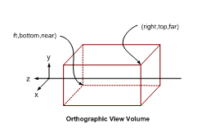
3D Viewing Transformation
Infinite Parallelepiped that can be bounded by Near and far planes for clipping

Slide 33
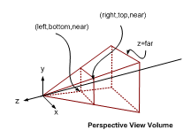
3D Viewing Transformation
Semi Infinite Pyramid that can be bounded by Near and far planes for clipping

Slide 34
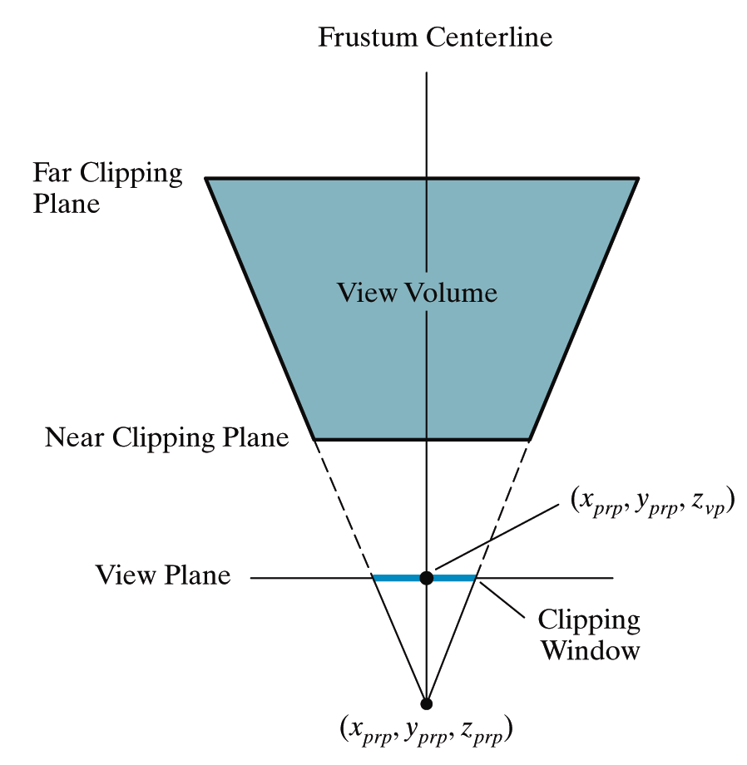
3D Viewing Transformation
Although a perspective projection is set up by specifying the position and size of the view plane and the position of the projection reference point called COP
However, this can be kind of awkward

Slide 35
3D Viewing Transformation
The field of view angle can be a more intuitive way to specify perspective projections
This is analogous to choosing a lense for a camera
Field of view

Slide 36
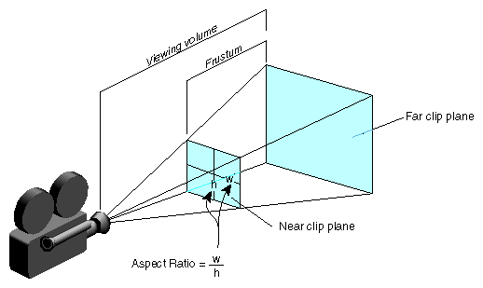
3D Viewing Transformation
We need one more thing to specify a perspective projections using the filed of view angle
The aspect ratio gives the ratio between the width sand height of the view plane

Slide 37
Any Question !

Slide 38
3D Viewing Pipeline
Primitives
Object space
Modeling Transformation
World space
Viewing Transformation
Camera space
Hidden Surface Removal
Lighting & Shading
3D-Clipping
Projection
Normalized view space
Scan conversion, Hiding
Image space,
Device coordinates
Image

