Slide 1
Chapter 12
Hidden Surface Removal

Slide 2
3D Viewing Pipeline
Primitives
Object space
Modeling Transformation
World space
Viewing Transformation
Camera space
Hidden Surface Removal
Lighting & Shading
3D-Clipping
Projection
Normalized view space
Scan conversion, Hiding
Image space,
Device coordinates
Image

Slide 3
Contents
Introduction
Methods

Slide 4

Introduction
Need for Hidden Surface Removal
We must determine what is visible within a scene from a chosen viewing position
For 3D worlds this is known as visible surface detection or hidden surface elimination

Slide 5
Introduction
Visible surface detection algorithms are broadly classified as:
  Object Space Methods: Compares objects and parts of objects to each other within the scene definition to determine which surfaces are visible
  Image Space Methods: Visibility is decided point-by-point at each pixel position on the projection plane
Image space methods are by far the more common

Slide 6
Methods
  Back face detection
  Depth-buffer method
  A-buffer method
  Scan-line method
  Depth Sort method
  Sub division method
  BSP Tree method
  Octree methods

Slide 7
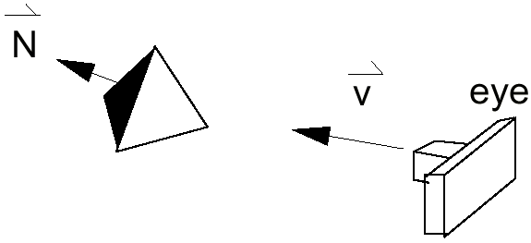
Back-Face Detection
The simplest thing we can do is find the faces on the backs of polyhedra and discard them

Slide 8
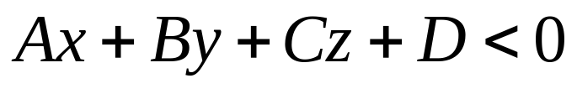
Back-Face Detection
We know from before that a point (x, y, z) is behind a polygon surface if:
where A, B, C & D are the plane parameters for the surface
When an inside point is along the line of sight to the surface, the polygon must be a back face.
It is also called culling.
This is an object space method.

Slide 9
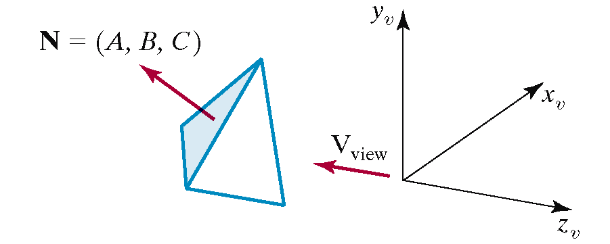
Back-Face Detection
We can simplify the test by considering a surface Normal N and Viewing vector V
A polygon is back face if V.N > 0

Slide 10
Back-Face Detection
Ensure we have a right handed system with the viewing direction along the negative z-axis ⇒ N.V = C.(– z_{v}), thus we need to consider only the sign of C.
Now we can simply say that if the z component of the polygon’s normal is less than zero (C<0) the surface cannot be seen.
If C = 0, our viewing direction is grazing that polygon.
Hence Back face means
C ≤ 0

Slide 11
Back-Face Detection
In general back-face detection can be expected to eliminate about half of the polygon surfaces in a scene from further visibility tests
More complicated surfaces
though scupper us!
We need better techniques
to handle these kind of
situations.

Slide 12
Methods
  Back face detection
  Depth-buffer method
  A-buffer method
  Scan-line method
  Depth Sort method
  Sub division method
  BSP Tree method
  Octree methods

Slide 13
Depth-Buffer Method
Often called the z-buffer method
It is a image space method to detect visible surfaces.
Compares surface depth values throughout a scene for each pixel position on the projection plane
Usually applied to scenes only containing polygons
As depth values can be computed easily, this tends to be very fast

Slide 14
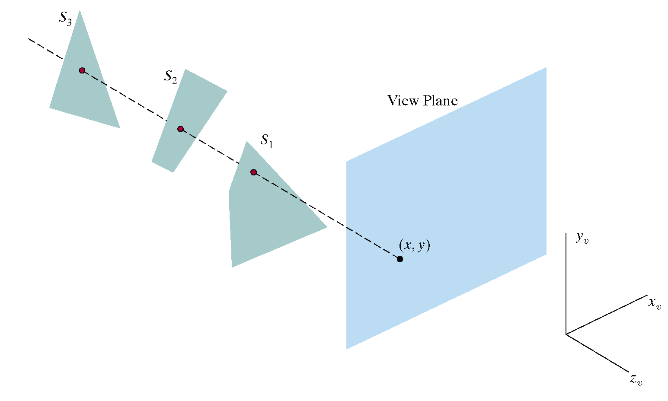
Depth-Buffer Method
Shorter the distance the visible is an object

Slide 15
Depth-Buffer Algorithm
The method can be implemented in normalized coordinates, so that the value of Z ranges from 0 at back clipping plane to Z_{max} (1 or the largest value you can store on your system )at front clipping plane.
The algorithm uses two buffer areas
  Depth Buffer: (Z-Buffer) to store depth value for each surface
  Refresh Bufer: (Frame Buffer) to store intensity value for each pixel.

Slide 16
Depth-Buffer Algorithm
Initialise the depth buffer and frame buffer so that for all buffer positions (x, y)
depthBuff(x, y) = 1.0
frameBuff(x, y) = bgColour
Process each polygon in a scene, one at a time
  2.1 For each projected (x, y) pixel position of a polygon, calculate the depth z (if not already known)
  2.2 If z < depthBuff(x, y), compute the surface colour at that position and set
  depthBuff(x, y) = z
  frameBuff(x, y) = surfColour(x, y)
After all surfaces are processed depthBuff and frameBuff will store correct values

Slide 17
Depth-Buffer Algorithm
Calculating Depth
top scan line
y scan line
y - 1 scan line
bottom scan line
x
x’

Slide 18
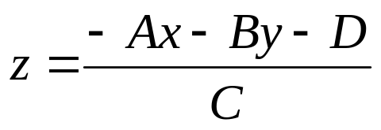
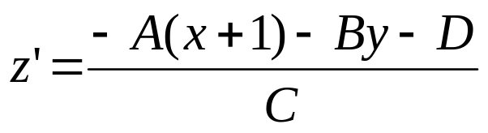
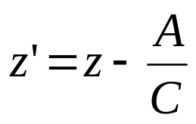
Depth-Buffer Algorithm
Calculating Depth
At any surface position the depth is calculated from the plane equation as:
Horizontally: For any scan line adjacent x positions differ by ±1, as do adjacent y positions

Slide 19
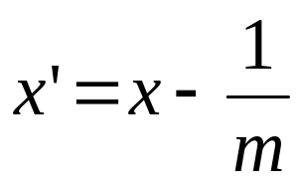
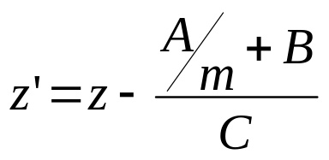
Depth-Buffer Algorithm
The depth-buffer algorithm proceeds by starting at the top vertex of the polygon. Then we recursively calculate the x-coordinate values down a left edge of the polygon
Vertically: The x value for the beginning position on each scan line with slope m can be calculated from the previous one as follows:
Depth values along the edge being considered are calculated using

Slide 20
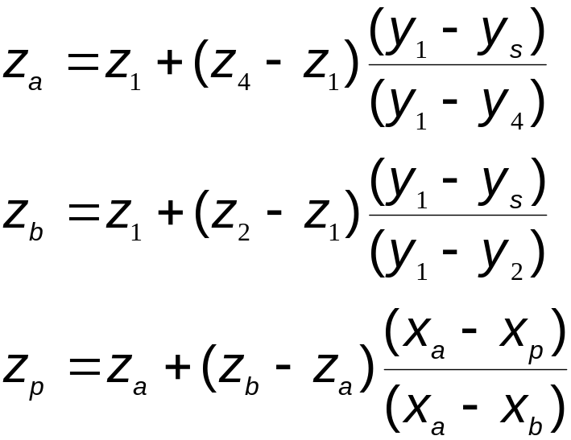
Depth-Buffer Algorithm
For Non Planar Surfaces Bilinear Interpolation of Depth Values
P₃
P₄
P₂
y_{s}
z_{a}
z_{p}
z_{b}
P₁

Slide 21
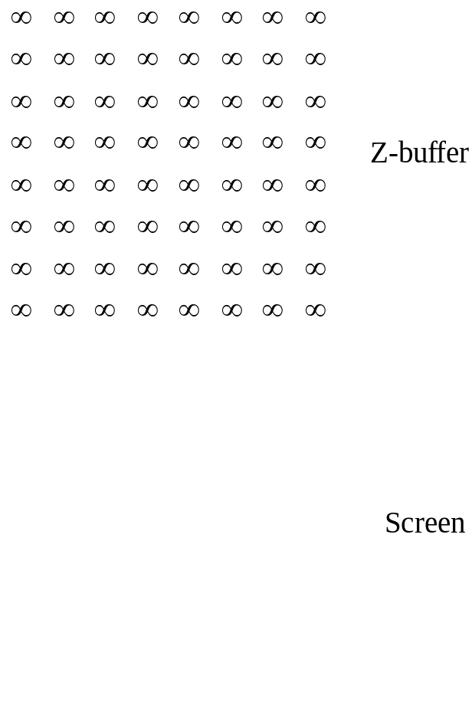
Depth-Buffer Algorithm

Slide 22
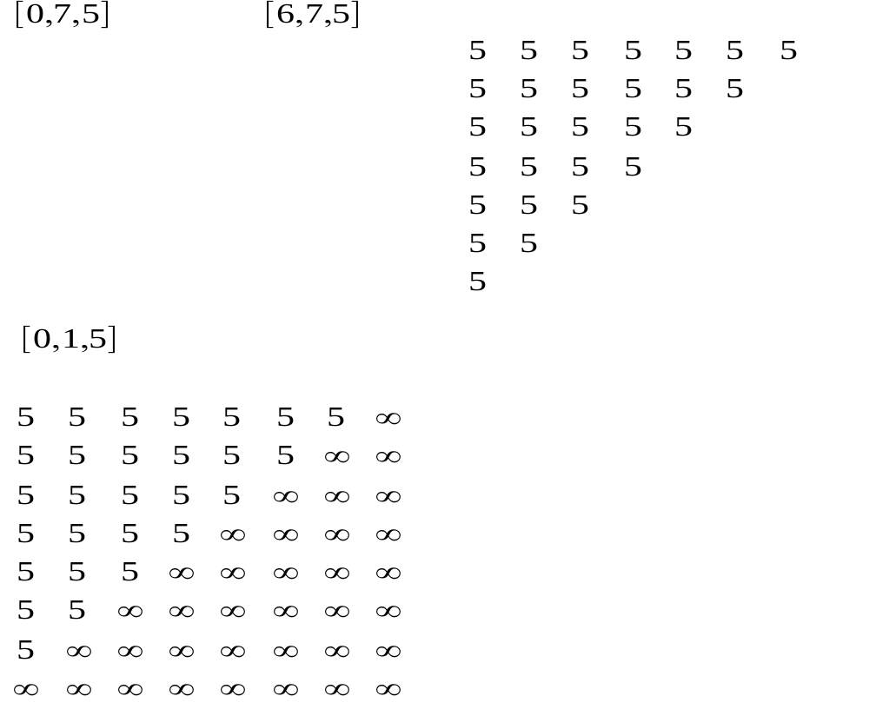
Depth-Buffer Algorithm

Slide 23
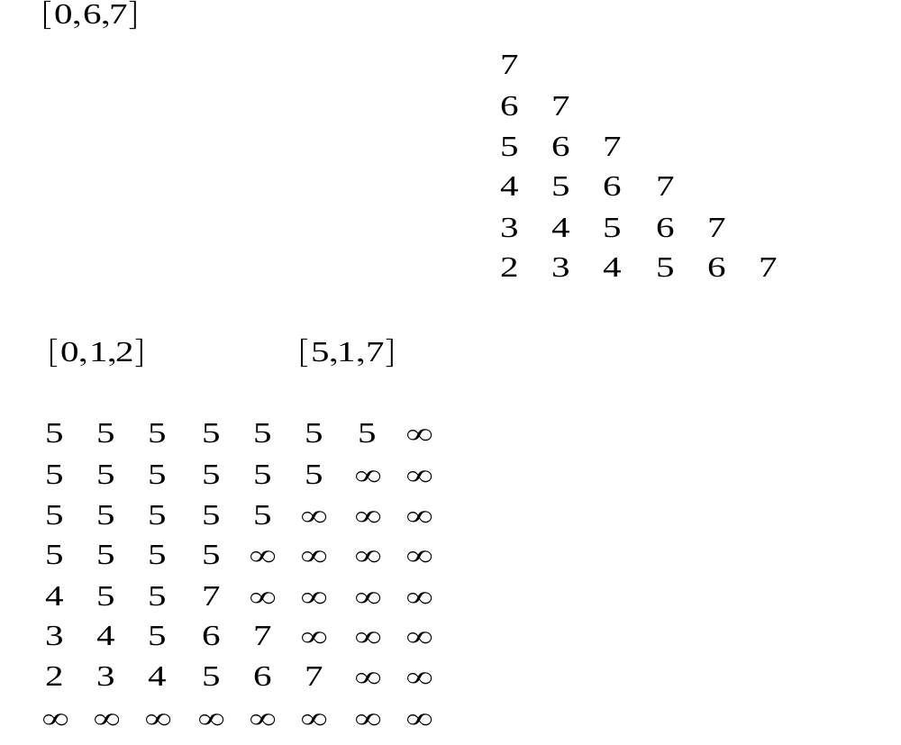
Depth-Buffer Algorithm

Slide 24
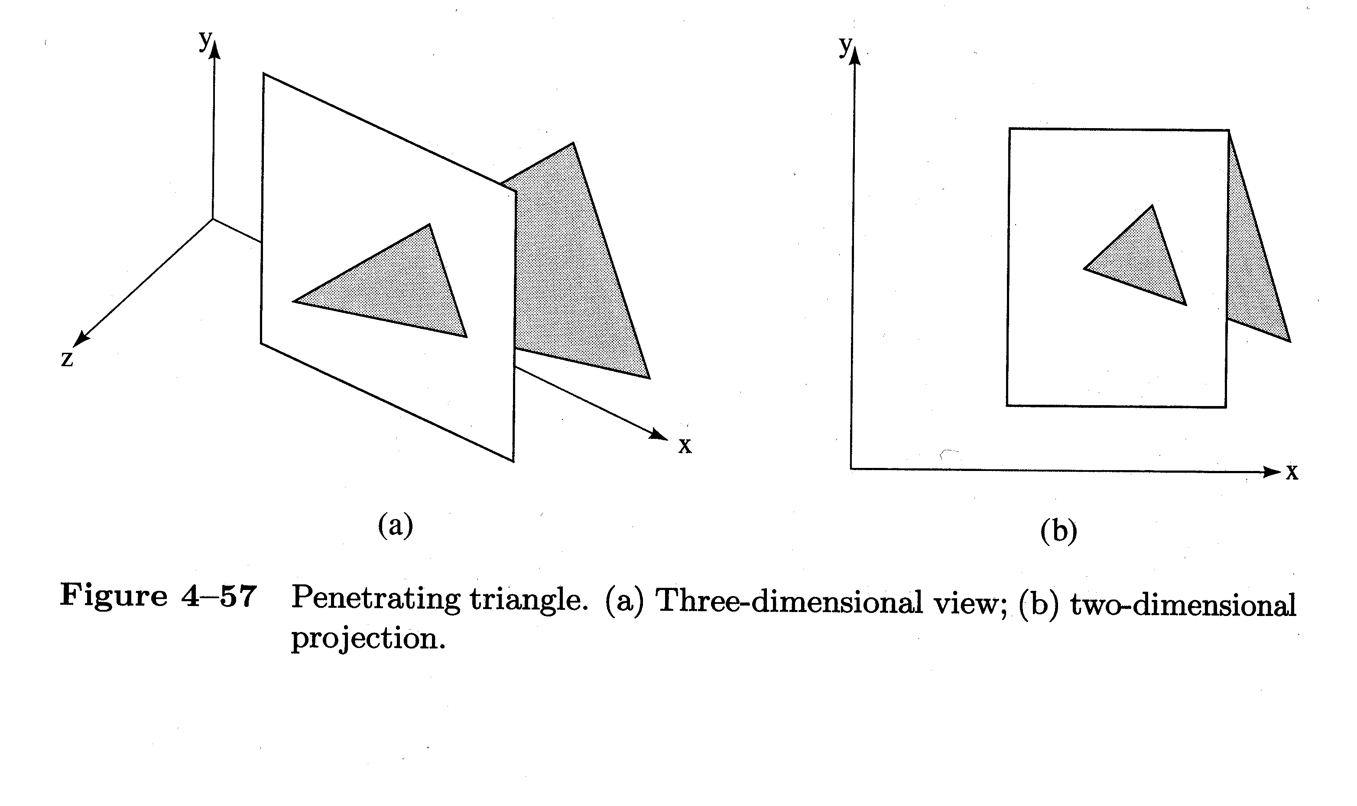
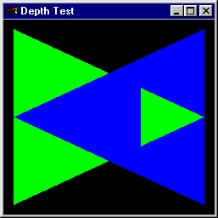
Depth-Buffer Algorithm
Non Trivial Example
  Rectangle: P1(10,5,10), P2(10,25,10), P3(25,25,10), P4(25,5,10)
  Triangle: P5(15,15,15), P6(25,25,5), P7(30,10,5)
  Frame Buffer: Background 0, Rectangle 1, Triangle 2
  Z-buffer: 32x32x4 bit planes

Slide 25
Depth-Buffer Algorithm
Advantages
  Simple!!!
  Easy to implement in hardware
  Polygons can be processed in arbitrary order
  Easily handles polygon interpenetration
  Enables deferred shading
    Rasterize shading parameters (e.g., surface normal) and only shade final visible fragments

Slide 26
Depth-Buffer Algorithm
Disadvantages
  Lots of memory (e.g. 1280x1024x32 bits)
    With 16 bits cannot discern millimeter differences in objects at 1 km distance
  Read-Modify-Write in inner loop requires fast memory
  Hard to do analytic antialiasing
    We don’t know which polygon to map pixel back to
  Shared edges are handled inconsistently
    Ordering dependent
  Hard to simulate translucent polygons
    We throw away color of polygons behind closest one

Slide 27
Methods
  Back face detection
  Depth-buffer method
  A-buffer method
  Scan-line method
  Depth Sort method
  Sub division method
  BSP Tree method
  Octree methods

Slide 28
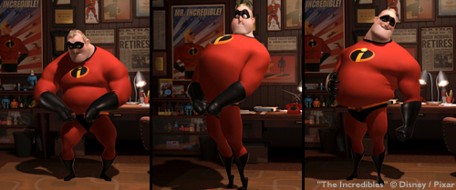
A-Buffer Method
The A-buffer method is an extension of the depth-buffer method
The A-buffer method is visibility detection method developed at Lucasfilm Studios for the rendering system REYES (Renders Everything You Ever Saw)

Slide 29
A-Buffer Method
The A-buffer expands on the depth buffer method to allow transparencies
The key data structure in the A-buffer is the accumulation buffer

Slide 30
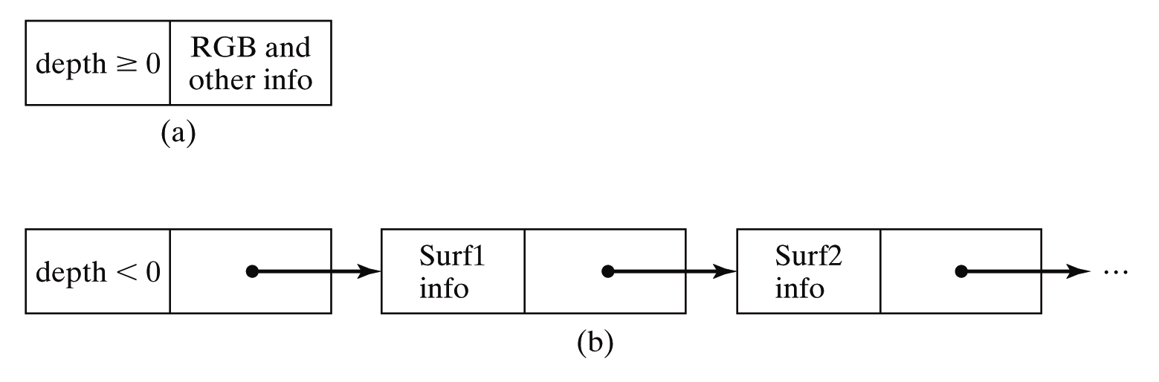
A-Buffer Method
If depth is >= 0, then the surface data field stores the depth of that pixel position as before
If depth < 0 then the data filed stores a pointer to a linked list of surface data

Slide 31
A-Buffer Method
Surface information in the A-buffer includes:
  RGB intensity components
  Opacity parameter
  Depth
  Percent of area coverage
  Surface identifier
  Other surface rendering parameters
The algorithm proceeds just like the depth buffer algorithm
The depth and opacity values are used to determine the final colour of a pixel

Slide 32
Methods
  Back face detection
  Depth-buffer method
  A-buffer method
  Scan-line method
  Depth Sort method
  Sub division method
  BSP Tree method
  Octree methods

Slide 33
Scan-Line Method
An image space method for identifying visible surfaces.
An extension of scan line polygon fill method
  Handle multiple surfaces simultaneously
  Maintain information about depth value
Computes and compares depth values along the various scan-lines for a scene
The algorithm exploits
  Scan-line coherency across multiple scan-lines
  Or span-coherence !
  Depth coherency
Also Known as Spanning Scan Line Algorithm

Slide 34
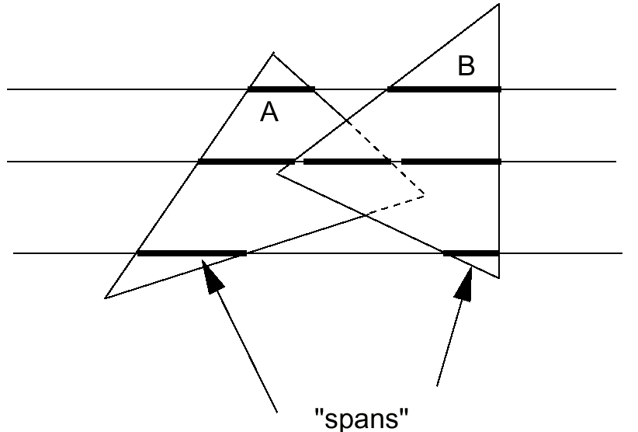
Scan-Line Method
Use no z-buffer
Each scan line is subdivided into several "spans"
Determine which polygon the current span belongs to
Shade the span using the current polygon’s color
Exploit "span coherence" :
For each span, only one visibility test needs to be done

Slide 35
Scan-Line Method
A scan line is subdivided into a sequence of spans
Each span can be "inside" or "outside" polygon areas
  "outside“: no pixels need to be drawn (background color)
  "inside“: can be inside one or multiple polygons
If a span is inside one polygon, the pixels in the span will be drawn with the color of that polygon
If a span is inside more than one polygon, then we need to compare the z values of those polygons at the scan line edge intersection point to determine the color of the pixel

Slide 36
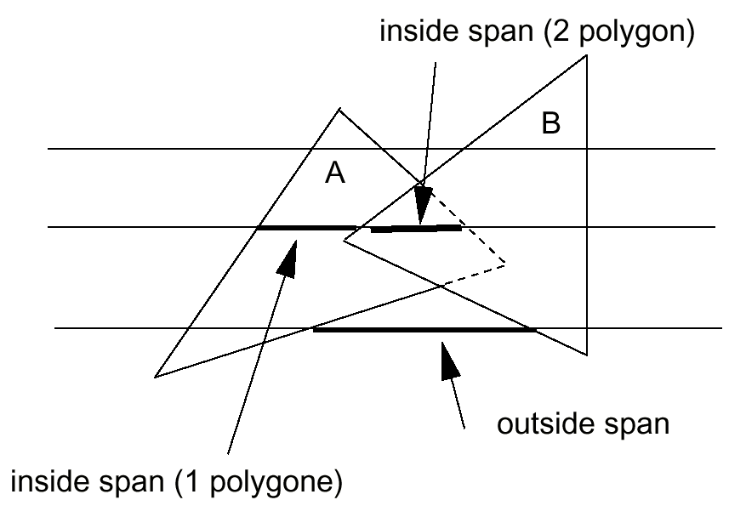
Scan-Line Method

Slide 37
Scan-Line Method
Determining a span is inside/outside (Single Polygon)
  When a scan line intersects an edge of a polygon
    for a 1st time, the span becomes "inside" of the polygon from that intersection point on
    for a 2nd time, the span becomes "outside“ of the polygon from that point on
  Use a "in/out" flag for each polygon to keep track of the current state
  Initially, the in/out flag is set to be "outside" (value = 0 for example). Invert the tag for “inside”.

Slide 38
Scan-Line Method
When there are multiple Polygons
  Each polygon will have its own in/out flag
  There can be more than one polygon having the in/out flags to be "in" at a given instance
  We want to keep track of how many polygons the scan line is currently in
  If there are more than one polygon "in", we need to perform z value comparison to determine the color of the scan line span

Slide 39
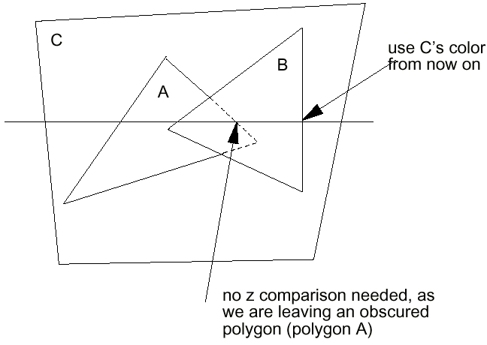
Scan-Line Method
Z- Value Comparison
  When the scan line is intersecting an edge and leaving a new polygon, we then use the color of the reminding polygon if there is now only 1 polygon "in". If there are still more than one polygon with "in" flag, we need to perform z comparison only when the scan line is leaving a non-obscured polygon

Slide 40
Scan-Line Method
Procedure
  Pixel positions across each scan-line are processed from left to right
  At the left intersection with a surface the surface flag is turned on
  At the right intersection point the flag is turned off
  We only need to perform depth calculations when more than one surface has its flag turned on at a certain scan-line position

Slide 41
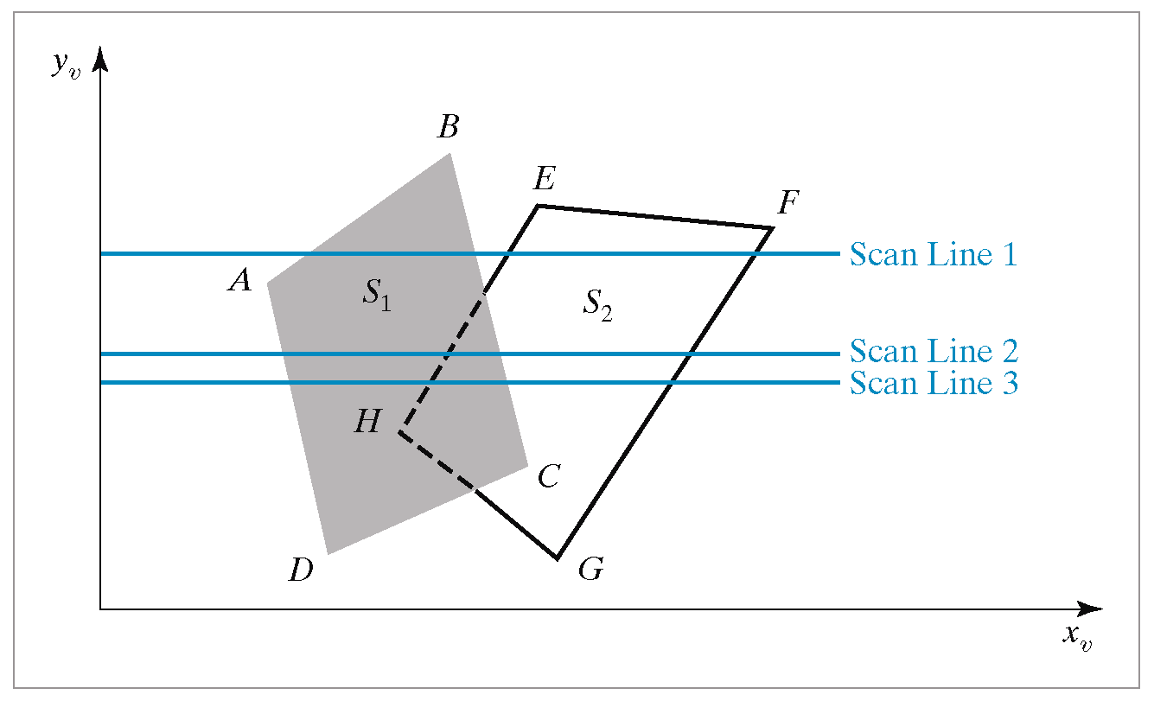
Scan-Line Method

Slide 42
Scan-Line Method
Data structures maintained are:
  The Edge Table
  The Polygon Table
  Active Edge List
  Active Polygon List

Slide 43
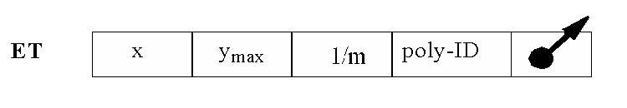
Scan-Line Method
The Edge Table contains:
  Coordinate end points of reach line in the scene
  The inverse slope of each line
  Pointers into the Polygon table to connect edges to surfaces
It is the same edge table that you have constructed in scan line polygon fill algorithm.

Slide 44
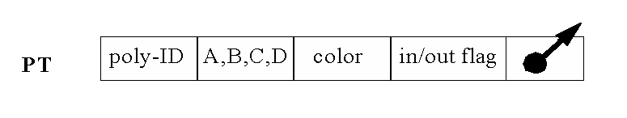
Scan-Line Method
The Polygon Tables contains:
  The plane coefficients
  Surface data
    Colour
    Surface material properties
    Maybe pointers into the edge table
  In/Out Flag to indicate whether a position along a scan-line is either inside or outside the surface

Slide 45
Scan-Line Method
The Active Edge List
  To facilitate the search for surfaces crossing a given scan-line an active list of edges is formed for each scan-line as it is processed
  The active list stores only those edges that cross the scan-line in order of increasing x
The Active Polygon List
  At each x scan value this list contain
    All polygons whose in/out flag is set.
    The number of polygons in the list

Slide 46
Scan-Line Method
The Algorithm
  Initialization phase
  Y-scan loop
  X-scan loop
I. Initialization
  Initialize the AEL to empty
  Initialize each screen pixel to background color
  Set y = first non empty cell value in the edge list.
Repeat step I and II until no further processing can be performed on AEL

Slide 47
Scan-Line Method
II. Y-Scan Loop: Update the AEL by merging into it the information contained in the cell Y of the edge list.
if AEL is null then exit
Else Sort the AEL in the order of increasing x
III. X-Scan Loop: Process from Left → Right, each edge of AEL, as follows
  Invert IN/OUT flag of polygons in polygon list which contain the edge.
  Update APL to contain only those polygons whose IN/OUT flag is set to IN.

Slide 48
Scan-Line Method
  Count the number of polygons in APL
    c.1 If number = 0 then show background colour
    c.2 If number = 1 then show the polygon colour from this edge to next edge.
    c.3 If number > 1 then determine the visibility of polygon by using depth calculations
  When the last active edge is processed update AEL as follows
    d.1 Remove those edges for which Ymax has reached.
    d.2 For each reaming edge x = x + 1/m
    d.3 Increment to next scan line y =y + 1
    Go to step II

Slide 49
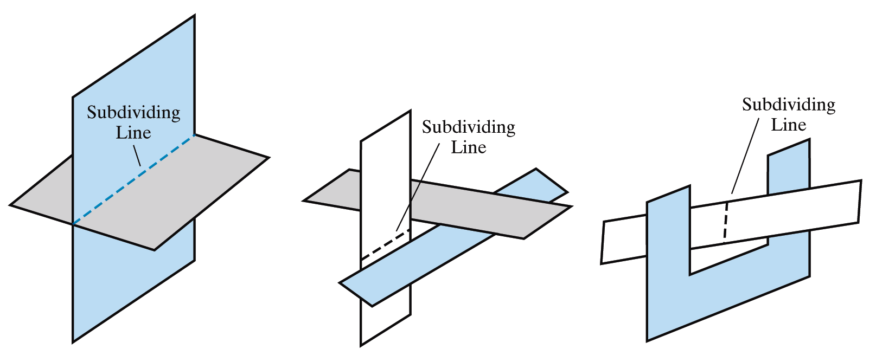
Scan-Line Method
Limitations:
  The scan-line method runs into trouble when surfaces cut through each other or otherwise cyclically overlap
  Such surfaces need to be divided

Slide 50
Methods
  Back face detection
  Depth-buffer method
  A-buffer method
  Scan-line method
  Depth Sort method
  Sub division method
  BSP Tree method
  Octree methods

Slide 51
Depth-Sorting Method
The depth-sorting method is often also known as the Painter’s method or Priority method.
A visible surface detection method that uses both image-space and object-space operations
Basically, the following two operations are performed
  Surfaces are sorted in order of decreasing depth
  Surfaces are scan-converted in order, starting with the surface of greatest depth

Slide 52
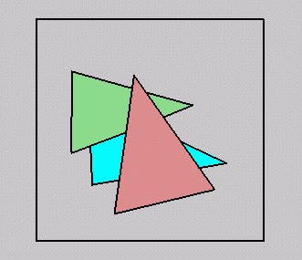
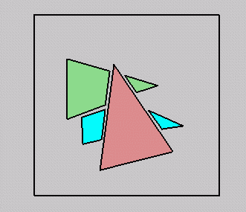
Depth-Sorting Method
Simple approach: render the polygons from back to front, “painting over” previous polygons:
  Draw blue, then green, then orange
Will this work in the general case?

Slide 53
Depth-Sorting Method
Intersecting polygons present a problem
Even non-intersecting polygons can form a cycle with no valid visibility order:
Intersecting
Cyclic overlapping

Slide 54
Depth-Sorting Method
First, assume that we are viewing along the z direction
All polygons in the scene are ordered according to the smallest z value on each polygon
The polygon P at the end of the list is then compared against all other polygons to see if there are any depth overlaps
If no overlaps occur then the polygon is scan converted as before and the process repeats with the next polygon

Slide 55
Depth Overlapping
z
z
z_{max}
z_{max}
S
S
z’_{max}
z_{min}
S’
z’_{max}
z_{min}
S’
z’_{min}
z’_{min}
x
x
No Depth Overlap
Depth Overlap

Slide 56
Depth-Sorting Method
When there is depth overlap, we make the following tests in the order listed and as soon as one is true we move on to the next polygon :
  The bounding rectangles for the two polygons do no overlap
    Test 0: The Z extents of polygon P and Q don’t overlap
    Test 1: The Y extents of polygon P and Q don’t overlap
    Test 2: The X extents of polygon P and Q don’t overlap

Slide 57
Depth-Sorting Method
  Polygon P is completely behind the overlapping polygon Q relative to the viewing position
    Test 3: All vertices of P lie on that side of the plane containing Q which is farthest from the view plane.
  The overlapping polygon Q is completely in front of P relative to the viewing position
    Test 4: All vertices of Q lie on that side of the plane containing P which is nearest from the view plane.
  The boundary edge projections of the two polygons onto the view plane do not overlap
    Test 5: The projections of P and Q onto XY-plane don't overlap.

Slide 58
Depth-Sorting Method
The algorithm
  Sort all polygons into polygon list according to Zmax. Starting from the end of the list assign priorities for each polygon P in order as follows:
  Find all Q preceding P, in the polygon list whose Z extents overlap that of P (Test 0).
  For each Q, perform Test 1 to 5 until TRUE
    3.1 If every Q passes scan convert P
    3.2 If false for some Q, swap P and Q and TAG(Q) = SWAPPED
    3.3 If Q was already SWAPPED then
    divide Q into Q1 and Q2 using P,
    Remove Q, Insert Q1 and Q2, Sort list,
    Continue loop

Slide 59
Depth-Sorting Method
Conclusion
  O(nlogn)
  Intersecting polygons must be subdivided
  Sort order has lots of frame-to-frame coherence during walkthroughs
  Must fully compute every pixel for every polygon
  Used most often with BSP or static list-ordering

Slide 60
Methods
  Back face detection
  Depth-buffer method
  A-buffer method
  Scan-line method
  Depth Sort method
  Sub division method
  BSP Tree method
  Octree methods

Slide 61
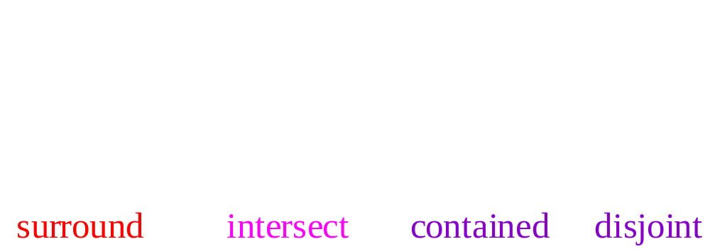
Area Subdivision
  Divide and conquer: the relationship of a display area and a polygon after projection is one of the four basic cases:

Slide 62
Area Subdivision
Starting from the entire display area, we check the following four cases. If none holds, we subdivide the area, otherwise, we stop and perform the action associated with the case
  If all polygons are disjoint w.r.t. the area then draw the background color
  If only 1 intersecting or contained polygon then draw background, and then draw the contained portion of the polygon
  If there is a single surrounding polygon then draw the entire area in the polygon’s color
  If there are more than one intersecting, contained, or surrounding polygons, but there is a front surrounding polygon then draw the entire area in the polygon’s color
The recursion stops when you are at the pixel level.

Slide 63
Area Subdivision
At single pixel level when the recursion stop and none of the four cases hold, we need to perform depth sort and draw the polygon (point) with the closest Z value
The algorithm is done at the object space level, except scan conversion and clipping are done at the image space level

Slide 64
Area Subdivision
Example

Slide 65
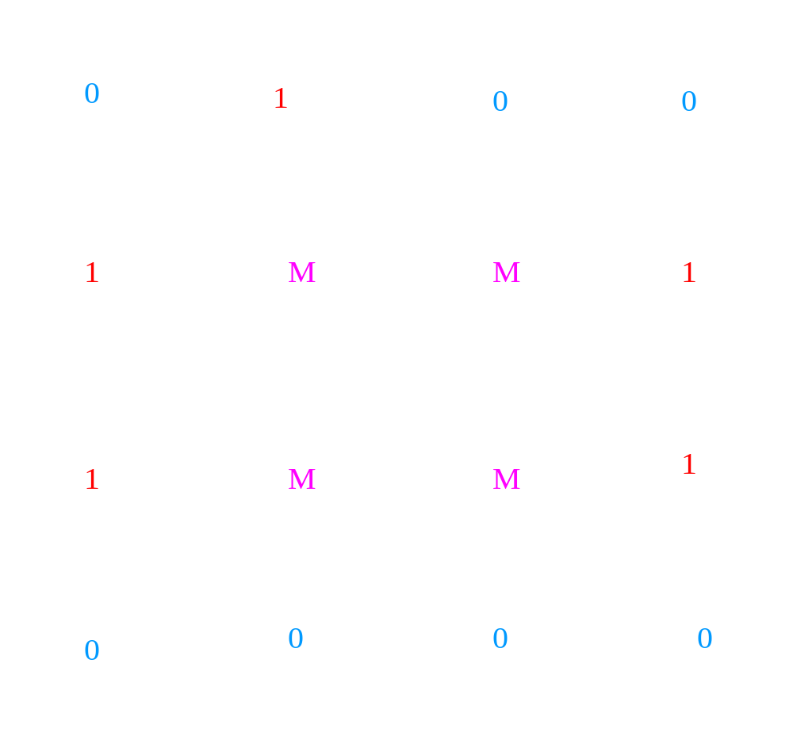
Area Subdivision
Example

Slide 66
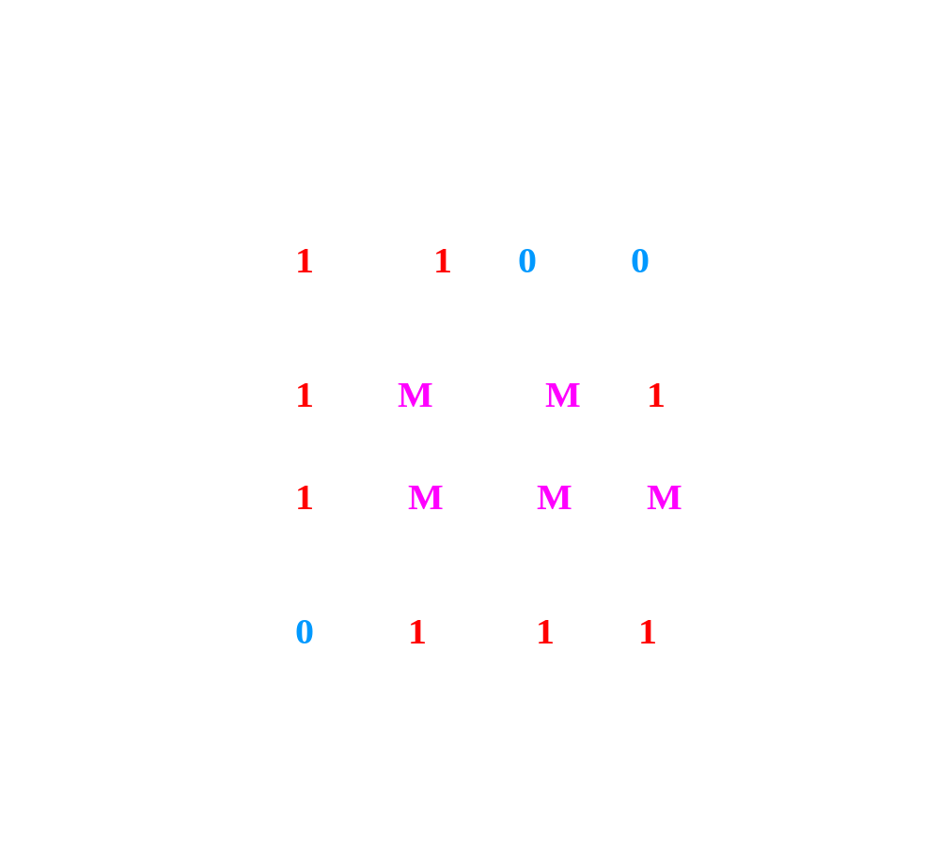
Area Subdivision
Example

Slide 67
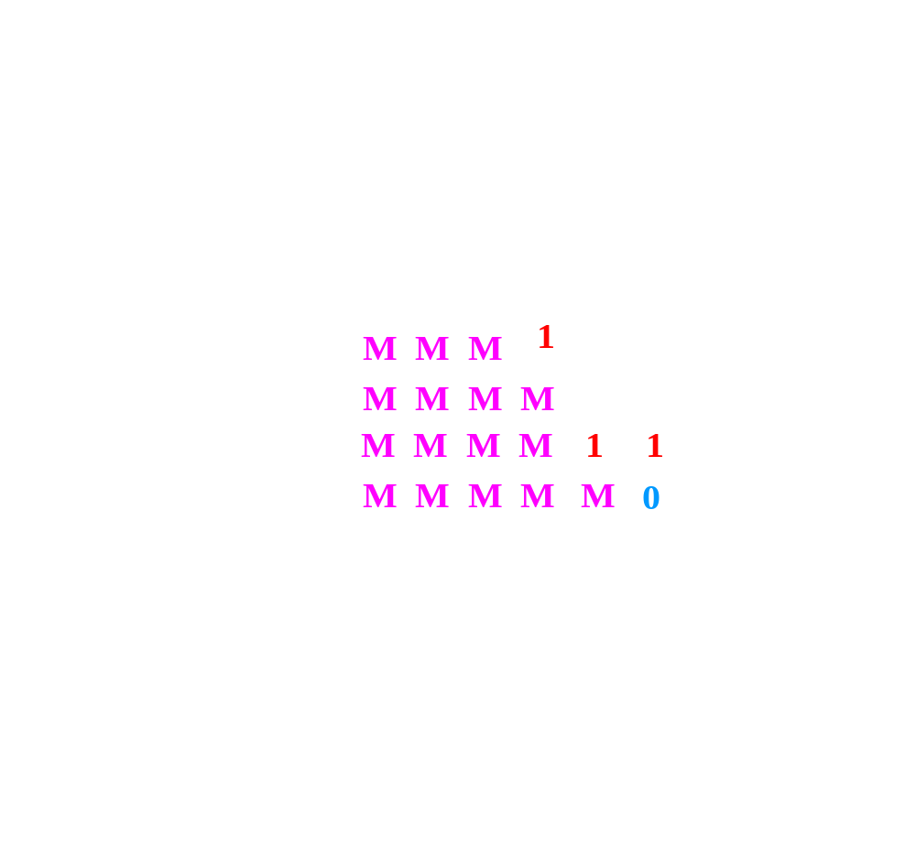
Area Subdivision
Example

Slide 68
Area Subdivision
Example

Slide 69
Any Question !

Slide 70
Methods
  Back face detection
  Depth-buffer method
  A-buffer method
  Scan-line method
  Depth Sort method
  Sub division method
  BSP Tree method
  Octree methods

Slide 71
BSP Tree Method
Binary Space Partition is a relatively easy way to sort the polygons relative to the eye point
To Build a BSP Tree
Choose a polygon, T, and compute the equation of the plane it defines.
Test all the vertices of all the other polygons to determine if they are in front of, behind, or in the same plane as T. If the plane intersects a polygon, divide the polygon at the plane.
Polygons are placed into a binary search tree with T as the root.
Call the procedure recursively on the left and right sub tree.

Slide 72
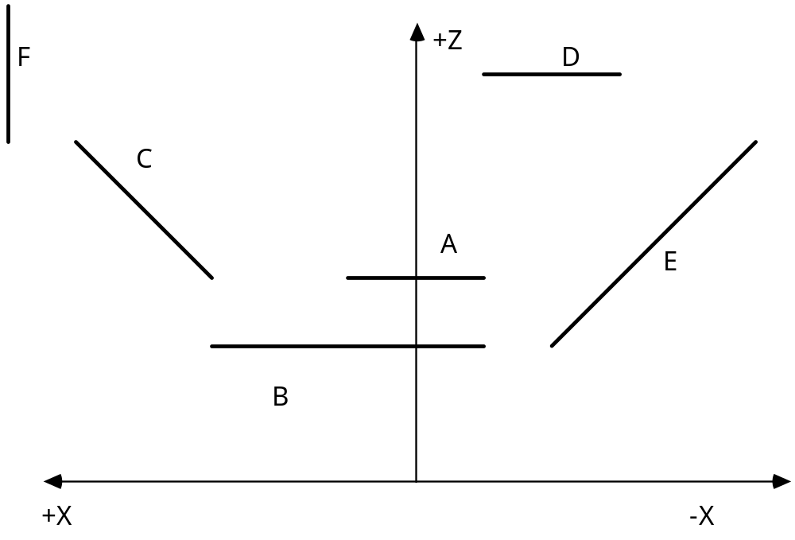
BSP Tree Method

Slide 73
BSP Tree Method
To Traverse a BSP Tree
Traverse the BSP tree such that the branch descended first is the side that is away from the eye point. This can be determined by substituting the eye point into the plane equation for the polygon at the root.
When there is no first branch to descend, or that branch has been completed then render the polygon at this node.
After the current node's polygon has been rendered, descend the branch that is closer to the eyepoint.

Slide 74
BSP Tree Method
EYE 1
A
F2
+Z
B
C
D
E1
F1
D
F1
C
E2
F2
E2
A
E1
B
+X
-X
EYE 2

Slide 75
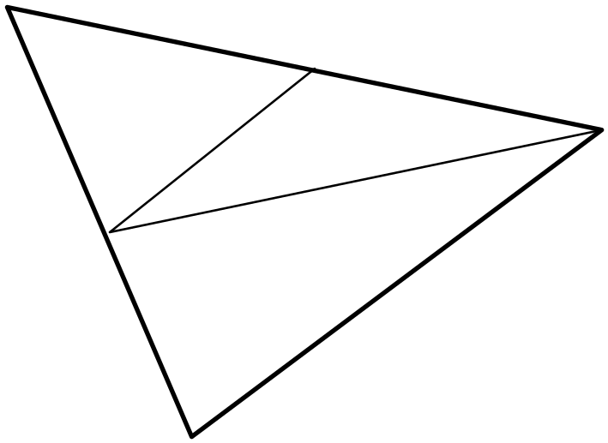
BSP Tree Method
Splitting Triangles
If all our polygons are triangles
then we always divide a triangle
into more triangles when it is
intersected by the plane.
It is possible for the number of triangles to increase exponentially but in practice it is found that the increase may be as small as two fold.
A heuristic to help minimize the number of fractures is to enter the triangles into the tree in order from largest to smallest.

Slide 76
BSP Tree Method
Pros:
  Simple, elegant scheme
  Only writes to framebuffer (no reads to see if current polygon is in front of previously rendered polygon, i.e., painters algorithm)
    Thus very popular for video games (but getting less so)
Cons:
  Computationally intense preprocess stage restricts algorithm to static scenes
  Slow time to construct tree
  Splitting increases polygon count

Slide 77
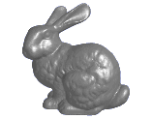
BSP Trees: Objects

Slide 78
BSP Trees: Objects

Slide 79
BSP Trees: Objects

Slide 80
BSP Trees: Objects

Slide 81
BSP Trees: Objects

Slide 82
BSP Tree Method (Example)
Split along the plane defined by any polygon from scene
Classify all polygons into positive or negative half-space of the plane
  If a polygon intersects plane, split polygon into two and classify them both
Recurse down the negative half-space
Recurse down the positive half-space

Slide 83
BSP Tree Method (Example)
No bunnies were harmed in my example
But what if a splitting plane passes through an object?
  Split the object; give half to each node
Ouch

Slide 84
BSP Tree Method (Example)
Nice demo:
  http://symbolcraft.com/graphics/bsp

Slide 85
Methods
  Back face detection
  Depth-buffer method
  A-buffer method
  Scan-line method
  Depth Sort method
  Sub division method
  BSP Tree method
  Octree methods

Slide 86
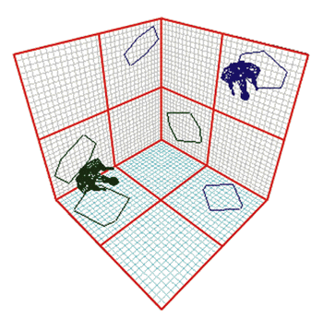
Octrees
Frequently used in modern video games
  A BSP tree subdivides space into a series of half-spaces using single planes
  An octree subdivides space into eight
  voxels using three axis-aligned planes
    A voxel is labeled as having
    polygons inside it or not

Slide 87
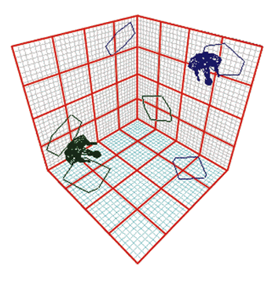
Octrees
  A voxel may have geometry inside it or subdivide
    Can have as many as eight children
  Thus we partition 3-D space into
  3-D cells
  Checking visibility with polygons is
  now faster due to only checking
  particular cells
  Quadtrees are a 2-D variant

Slide 88
Any Question !

