Slide 1
Chapter 2
Overview of Graphics Systems

Slide 2
Four Major Tasks
Four major task for rendering geometric objects
  modeling
  geometric processing
    transformations
    clipping
    shading
    hidden-surface removal
    projection
  Rasterization (Scan Conversion)
  Display
Modeling
Geometry
Rasterize
Display
Computer Graphics

Slide 3
Agenda
Input devices
Hard-copy devices
Video display devices
Graphics workstations and viewing systems
Computer Graphics

Slide 4
Input Devices
Input devices
  Keyboards, button boxes, dials
  Mouse devices
  Trackballs and space balls
  Joysticks
  Data gloves
  Digitizers
  Image scanners
  Touch panels
  Light pens
  Voice systems
Computer Graphics

Slide 5
Input Devices
Keyboards, button boxes, dials
  Standard keyboard
    Alphanumeric
    Function keys
  Button box
  set of input dials
Computer Graphics

Slide 6
Input Devices
Mouse devices
  Mechanical mouse
    One-button
    Rotating ball
    Two perpendicular shafts to capture rotation
  Optical mouse
    Optical sensor
    Laser
    Grid to detect movement
  Added widgets
    Buttons
    Trackball
    Thumbwheel.
Computer Graphics

Slide 7
Input Devices
Trackball
  A ball device that can be rotated with the fingers or palm of hand
Spaceball
  Six degrees of freedom
  Does not move, detects strain placed on the ball by trying to move it.
Computer Graphics

Slide 8
Input Devices
Joystick
  A small, vertical lever mounted on a base
  Movable joystick measures motion
  Stationary (isometric) joystick measures strain.
Data glove
  Used to grasp a virtual object
  Measures hand and finger position
  2D or 3D
  Can also be used as input device to detect surface
Computer Graphics

Slide 9
Input Devices
Digitizers
  Used for drawing, painting, or selecting positions
  Graphics tablet used to input 2D coordinates by activating a hand cursor or stylus at given positions on a flat surface
  Used to trace contours, select precise coordinate positions
    Hand held cursor
    Stylus
  Electromagnetic
    Grid of wires
    Electromagnetic pulses send an electrical signal in stylus or cursor
  Acoustic
    Sound waves to detect stylus position by microphones
    Can be 3D
Computer Graphics

Slide 10
Input Devices
Image scanners
  Used to store images on a computer
  Hand held
  Flatbed
  Drum.
Computer Graphics

Slide 11
Input Devices
Light pens
  Pen-shaped device to select screen positions by detecting lights coming from points on the CRT screen
  Used to capture position of an object or select menu options.
Computer Graphics

Slide 12
Input Devices
Voice systems
  Speech recognition systems to recognize voice commands
  Used to activate menu options or to enter data
  Uses a dictionary from a particular user (learning system).
Computer Graphics

Slide 13
Hard-copy Devices
Hard-copy devices
  Plotters
    2D moving pen with stationary paper
    1D pen and 1D moving paper
  Printers
    Impact devices
      Inked ribbon
    Non impact devices
      Laser, ink-jet, xerographic, electrostatic, electrothermal.
Computer Graphics

Slide 14
Video Display Devices
Cathode-ray tubes
  Raster-scan displays
  Random-scan displays
  Color CRT displays
  Direct View Storage Tubes
Flat-panel displays
Three-dimensional viewing devices
Stereoscopic and virtual-reality systems
Computer Graphics

Slide 15
Cathode-ray tubes
  Raster-scan displays
  Random-scan displays
  Color CRT displays
  Direct View Storage Tubes

Slide 16
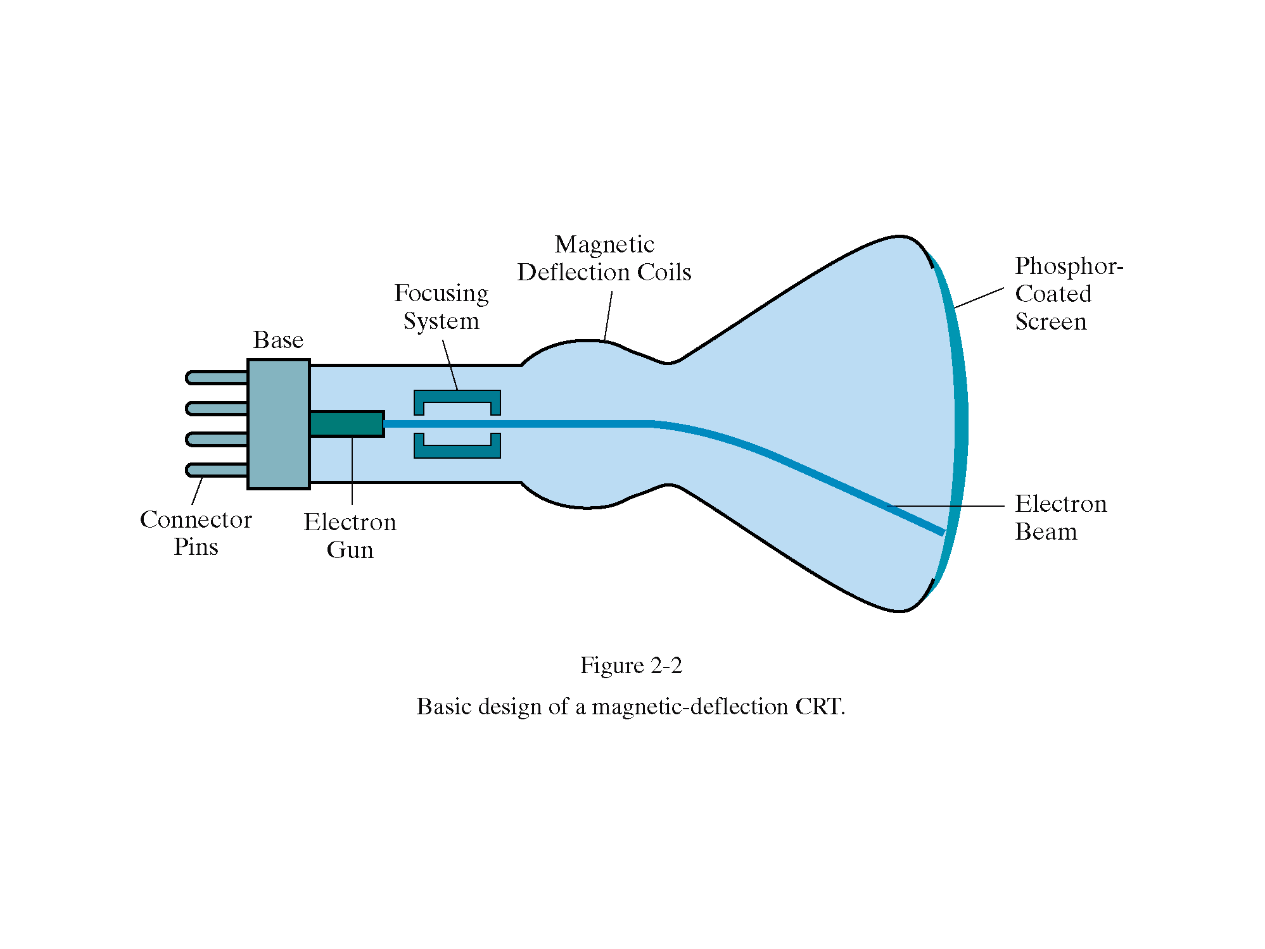
Cathode-Ray Tubes
Classical output device is a monitor.
Cathode-Ray Tube (CRT)
  Invented by Karl Ferdinand Braun (1897)
(from Donald Hearn and Pauline Baker)
Computer Graphics

Slide 17
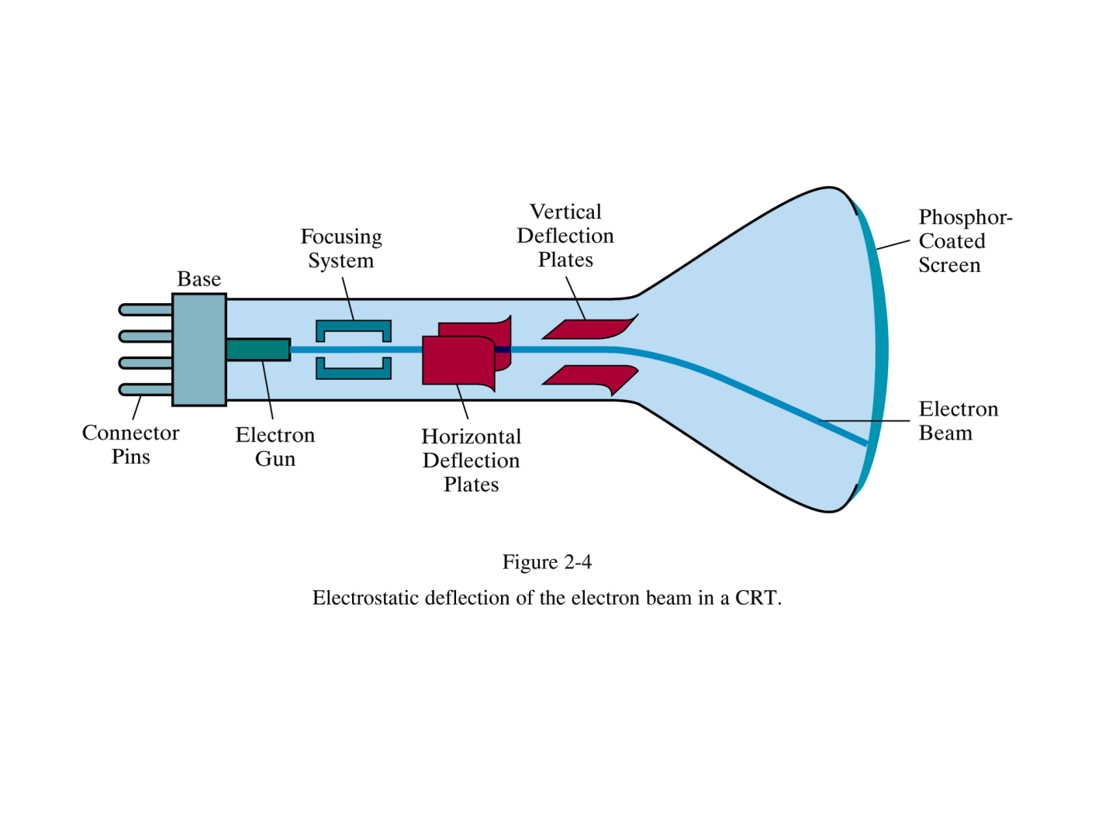
Cathode-Ray Tubes
(from Donald Hearn and Pauline Baker)
Computer Graphics

Slide 18
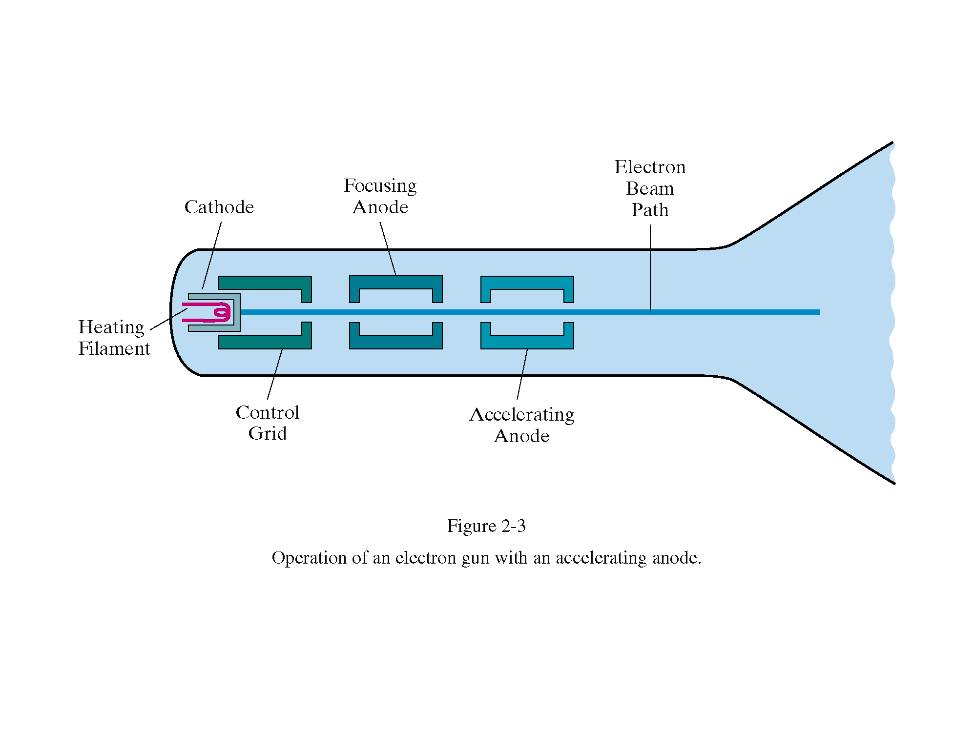
Cathode-Ray Tubes
(from Donald Hearn and Pauline Baker)
Computer Graphics

Slide 19
Cathode-Ray Tubes
1. Working of CRT
  Beam of electrons directed from cathode (-)to phosphor-coated (fluorescent) screen (anode (+))
  Directed by magnetic focusing and deflection coils (anodes) in vacuum filled tube
  Phosphor emits photon of light, when hit by an electron, of varied persistence (long 15-20 ms for texts / short < 1ms for animation)
  Refresh rate (50-60 Hz / 72-76 Hz) to avoid flicker / trail
  Phosphors are organic compounds characterized by their persistence and their color (blue, red, green).
Computer Graphics

Slide 20
Cathode-Ray Tubes
  Horizontal deflection and vertical deflection direct the electron beam to any point on the screen
  Intensity knob: regulates the flow of electrons by controlling the voltage at the control grid (high voltage reduces the electron density and thus brightness)
  Accelerating voltage from positive coating inside screen (anode screen) or an accelerating anode
2. Image maintenance
  Charge distribution to store picture information OR
  Refresh CRT: refreshes the display constantly to maintain phosphor glow.
Computer Graphics

Slide 21
Cathode-Ray Tubes
3. Focusing
  Focusing forces the electron beam to converge to a point on the monitor screen
  Can be electrostatic (lens) or magnetic (field)
4. Deflection
  Deflection directs the electron beam horizontally and/or vertically to any point on the screen
  Can be controlled by electric (deflection plates, slide 9) or magnetic fields (deflection coils, slide 5)
  Magnetic coils: two pairs (top/bottom, left/right) of tube neck
  Electric plates: two pairs (horizontal, vertical)
Computer Graphics

Slide 22
Cathode-Ray Tubes
Characteristics of Cathode-Ray Tube (CRT)
  Intensity is proportional to the number of electrons repelled in beam per second (brightness)
  Resolution is the maximum number of points that can be displayed without overlap; is expressed as number of horizontal points by number of vertical points; points are called pixels (picture elements); example: resolution 1024 x 768 pixels. Typical resolution is 1280 x 1024 pixels.
    High-definition systems: high resolution systems.
Computer Graphics

Slide 23
Cathode-Ray Tubes
  Persistence is defined as the time taken by the emitted light to decay one tenth of its original intensity.
    Max persistence 1 Sec, Min Persistence 10-60 μ sec
    Higher persistence ∼ Low refresh rate ∼ complex images
    Lower persistence ∼ High refresh rate ∼ Animations
  Refresh Rate (Hz) number of times screen drawn or refreshed per second.
    Usually 60 Hz (Why)
    Depends upon persistence
  Pixel Picture Element
    Mapping of phosphorus element to pixel
    Bit for monochrome
    Byte for 256 color levels
    3 Bytes to produce more than 16.7 million colors
Computer Graphics

Slide 24
Cathode-Ray Tubes
Aspect ratio
  Aspect ratio is the ratio of vertical pixels to horizontal pixels for an equal length line.
  A square plotted with same number of pixels with different aspect ratios will look as:
Ar < 1
Ar = 1
Ar > 1
Computer Graphics

Slide 25
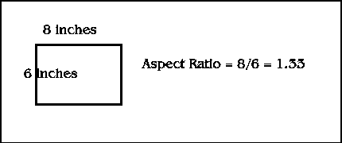
Cathode-Ray Tubes
It is also defined as the ratio of the vertical dimension over the horizontal dimension. If and resolution of 640 x 480 pixels:
Horizontal 640/8 = 80 pixels / inch
Vertical 480/6 = 80 pixels / inch
Square pixels (no distortion).
Computer Graphics

Slide 26
Cathode-ray tubes
  Raster-scan displays
  Random-scan displays
  Color CRT displays
  Direct View Storage Tubes

Slide 27
Raster-scan Displays
1. Introduction
  Raster-scan display is the most common type of monitor using a CRT.
  A raster is a matrix of pixels covering the screen area and is composed of raster lines.
  The electron beam scans the screen from top to bottom one row at a time. Each row is called a scan line.
  The electron beam is turned on and off to produce a collection of dots painted one row at a time. These will form the image.
Computer Graphics

Slide 28
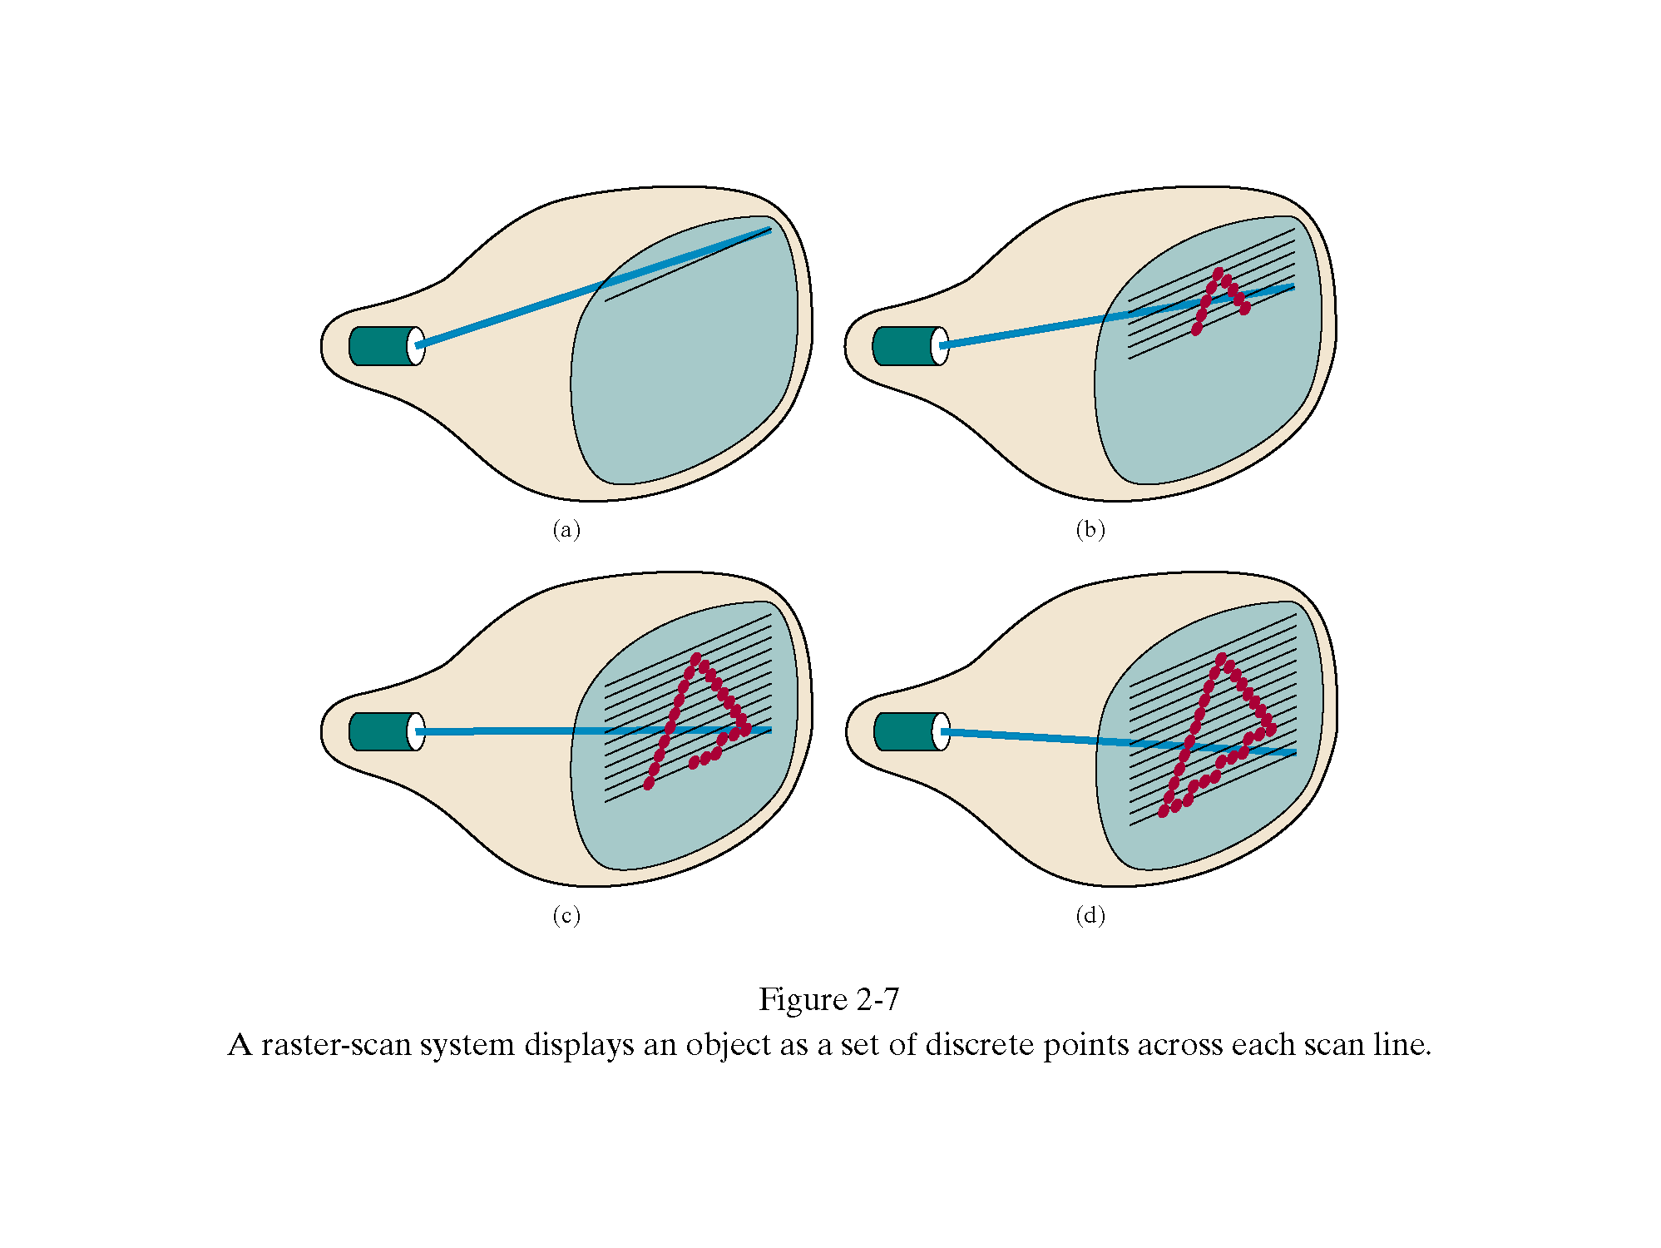
Raster-scan Displays
(from Donald Hearn and Pauline Baker)
Computer Graphics

Slide 29
Raster-scan Displays
2. Refresh Procedure
  Retracing
    Horizontal retrace – beam returns to left of screen
    Vertical retrace – bean returns to top left corner of screen
  Blanking
    Horizontal Retrace Blanking
    Vertical Retrace Blanking
  Interlacing
    display first even-numbered lines, then odd-numbered lines
    permits to see the image in half the time
    useful for slow refresh rates (30 Hz shows as 60 Hz).
Computer Graphics

Slide 30
Raster-scan Displays
  Over scanning
    Scan lines extended beyond visibility edge as there is limit on speed of sweep generator
    Avoid cracking at borders and distortion
    Top and Bottom Vertical Over scanning
    Left and Right Horizontal Over scanning
  Refresh rate
    24 is a minimum to avoid flicker, corresponding to 24 Hz (1 Hz = 1 refresh per second)
    Current raster-scan displays have a refresh rate of at least 60 frames (60 Hz) per second, up to 120 (120 Hz).
Computer Graphics

Slide 31
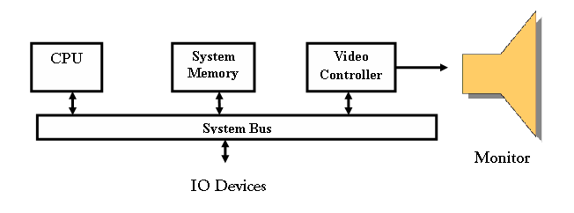
Raster-scan Displays
3. Architecture of Raster Scan System
  Simple architecture
(from Donald Hearn and Pauline Baker)
Computer Graphics

Slide 32
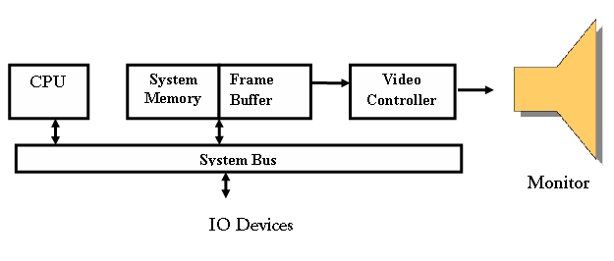
Raster-scan Displays
  Architecture with reserved Frame Buffer
(from Donald Hearn and Pauline Baker)
Computer Graphics

Slide 33
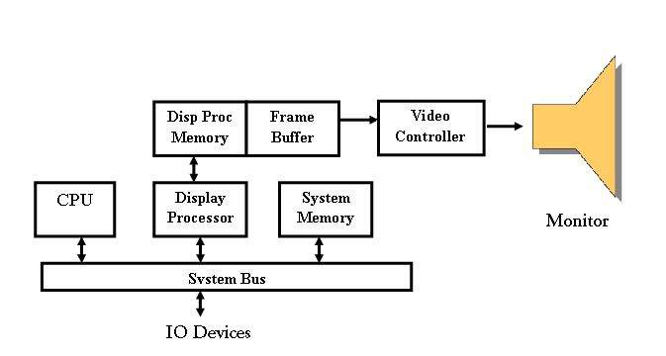
Raster-scan Displays
  Architecture with reserved Frame Buffer and separate Display Processor
(from Donald Hearn and Pauline Baker)
Computer Graphics

Slide 34
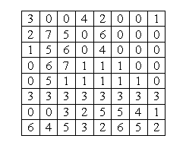
Raster-scan Displays
3.1 Frame Buffer
  Also called Refresh Buffer, contains picture definition
  The image is stored in a frame buffer containing the total screen area and where each memory location corresponds to a pixel.
  Consider it as 2-D memory array
  E.g. Frame buffer
    size 8x8
    Color depth 8 (values 0-7)
  Uses large memory:
    640x480 → 307200 bits → 38 kB
Computer Graphics

Slide 35
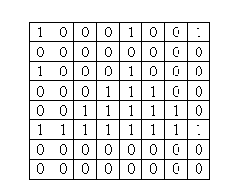
Raster-scan Displays
  Bitmap In a monochrome system, each bit is 1 or 0 for the corresponding pixel to be on or off making frame a bitmap.
  The display processor scans the frame buffer to turn electron beam on/off depending if the bit is 1 or 0.
  Example Bitmap
Computer Graphics

Slide 36
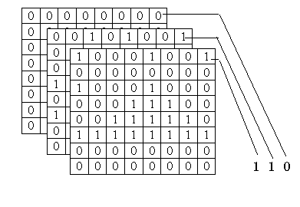
Raster-scan Displays
  Pixmap for color monitors, the frame buffer also contains the color of each pixel (color buffer) as well as other characteristics of the image (gray scale, …).
  Depth of the buffer area is the number of bits per pixel (bit planes), up to 24. 8 bits/pixel → 0..255
  Examples: television panels, printers, PC monitors
  8 level Pixmap
Computer Graphics

Slide 37
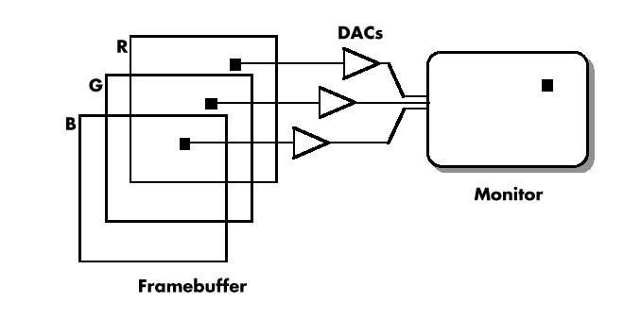
Raster-scan Displays
  3.2 Video Controller
  Also called scan controller
  display an image onto screen
  Read the frame buffer and display on screen
Video Controller
Computer Graphics

Slide 38
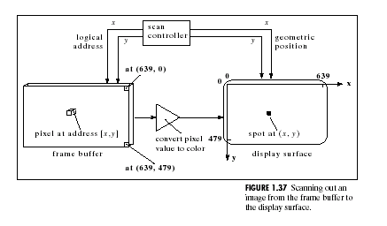
Raster-scan Displays
  How each pixel value in the frame buffer is sent to the right place on the display surface
Computer Graphics

Slide 39
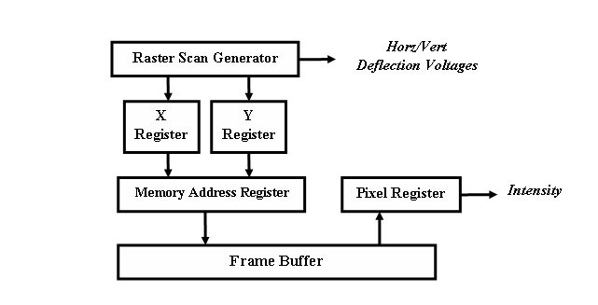
Raster-scan Displays
  Basic Operation of Video Controller/Scan Controller
(from Donald Hearn and Pauline Baker)
Computer Graphics

Slide 40
Raster-scan Displays
  3.3 Display Processor
  Relieves CPU from graphics chores
  It digitize the picture definition in the application program
  It does SCAN CONVERSION
  Define Graphic objects and characters to be displayed
Computer Graphics

Slide 41
Cathode-ray tubes
  Raster-scan displays
  Random-scan displays
  Color CRT displays
  Direct View Storage Tubes

Slide 42
Random-scan Displays
1. Introduction
  Random scan systems are also called
    Vector Displays
    stroke-writing, or
    calligraphic displays.
  The electron beam directly draws the picture in any specified order.
  A pen plotter is an example of such a system.
Computer Graphics

Slide 43
Random-scan Displays
  Picture is stored in a display list, refresh display file, vector file, or display program as a set of line drawing commands.
  Refresh rate depends upon the size of the file.
  Refreshes by scanning the list 30 to 60 times per second.
  More suited for line-drawing applications such as architecture and manufacturing
Computer Graphics

Slide 44
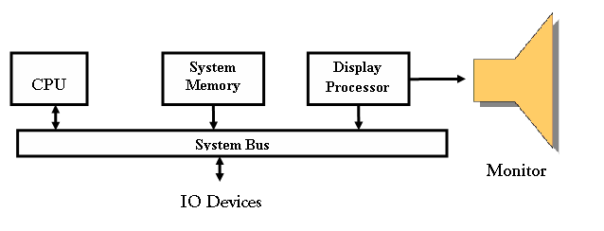
Random-scan Displays
2. Architecture of Random Scan System
  Simple architecture
(from Donald Hearn and Pauline Baker)
Computer Graphics

Slide 45
Random-scan Displays
3. Advantages:
  Good quality lines
  No need of scan conversion
  Easy animation and requires little memory
4. Disadvantages:
  Requires intelligent electron beam (processor controlled)
  Limited screen density, limited to simple, line-based images
  Limited color capability.
Improved in the 1960’s by the Direct View Storage Tube (DVST) from Tektronix.
Computer Graphics

Slide 46
Raster vs. Random-scan Displays
 | RASTER | RANDOM
DISPLAY MECHANISM | E-beam traces entire screen from upper left corner to bottom right | E-beam can highlight random positions on the screen
DRAWING UNIT | Pixel | Line
IMAGE STORAGE | Frame Buffer | Display File
IMAGE TYPES | Can display very complex images with greater accuracy | Wire Frame modeling
IMAGE QUALITY | May be Jagged due to digitization Diagonal Lines are produced with lower intensity | Smooth lines as e-beam directly follows the line path Diagonal Lines are produced with equal intensity
REFRESHING | Entire Screen has to be refreshed | Only selected portions are redrawn
REFRESH RATE | Maximum 80 Hz | Higher refresh rates.
ANIMATIONS | Supported | Not supporting
COLORS | Higher Color Depth | Lesser colors and shades
COLOR TECHNIQUE | Shadow Masking | Beam Penetration
Computer Graphics

Slide 47
Cathode-ray tubes
  Raster-scan displays
  Random-scan displays
  Color CRT displays
  Direct View Storage Tubes

Slide 48
Color CRT Monitor
1. Introduction
  Uses different phosphors, a combination of Red, Green, and Blue, to produce any color.
  Two methods:
    Beam penetration
    Shadow Masking
Computer Graphics

Slide 49
Color CRT Monitor
  2. Beam Penetration Method
  Random scan systems uses beam penetration.
  2 layers (Red, Green) phosphors; low speed electrons excite Red, high speed electrons excite Green.
  Intermediate speed excite both to get yellow and orange.
  Color is controlled by electron beam voltage.
  It is inexpensive
  Only produces a restricted set of colors.
  Quality of Picture is low
Computer Graphics

Slide 50
Color CRT Monitor
3. Shadow Masking Method
  Raster scan systems uses a shadow mask with three electron guns: Red, Green, and Blue (RGB color model).
  Color is produced by adjusting the intensity level of each electron beam.
  Produces a wide range of colors, from 8 to several millions.
  The arrangement of color components can be
    Delta-Delta arrangement
    In line arrangement
Computer Graphics

Slide 51
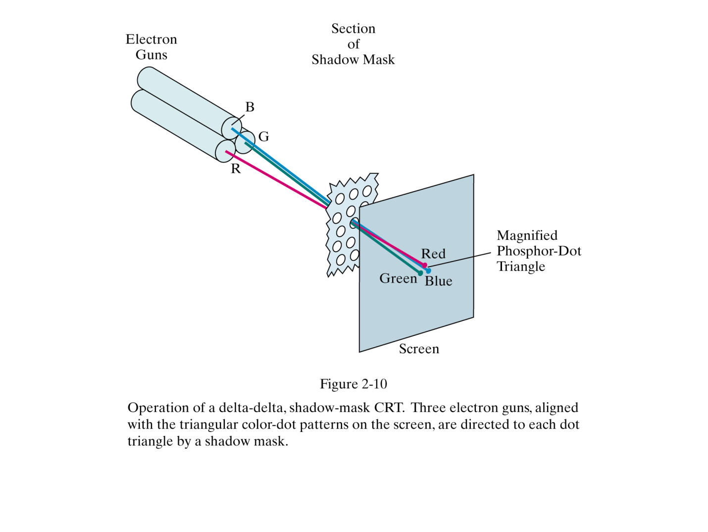
Color CRT Monitor
(Delta – Delta Arrangement)
Computer Graphics

Slide 52
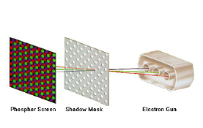
Color CRT Monitor
(In – line Arrangement)
Computer Graphics

Slide 53
Color CRT Monitor
R G B color
0 0 0 black
0 0 1 blue
0 1 0 green
0 1 1 cyan
1 0 0 red
1 0 1 magenta
1 1 0 yellow
1 1 1 white
Computer Graphics

Slide 54
Color CRT Monitor
  Color CRT’s are designed as RGB monitors also called full-color system or true-color system.
  Use shadow-mask methods with intensity from each electron gun (red, green, blue) to produce any color directly on the screen without preprocessing.
  Frame buffer contains 24 bits per pixel, for 256 voltage settings to adjust the intensity of each electron beam, thus producing a choice of up to 17 million colors for each pixel (256³).
Computer Graphics

Slide 55
Cathode-ray tubes
  Raster-scan displays
  Random-scan displays
  Color CRT displays
  Direct View Storage Tubes

Slide 56
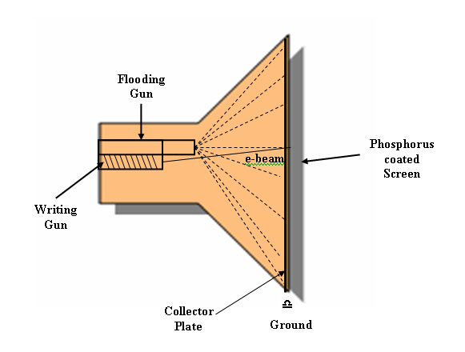
DVST Displays
1. Introduction
  Picture is stored inside the CRT
  No refreshing required
  Diagrammatically
Computer Graphics

Slide 57
DVST Displays
2. Components
  Flooding Gun to flood the entire screen and charge the collector plate
  Writing Gun is same as e-gun in CRT having heating filament, cathode, focusing anode and deflection yokes
  Collector Plate partly energized by the flooding gun, has background charge to keep fired phosphorus illuminated
  Phosphorus Screen higher persistence CRT screen
  Ground to discharge the collector to erase the screen
Computer Graphics

Slide 58
DVST Displays
3. Advantages/Disadvantages
  No Refreshing required
  It can draw complex images with higher resolution
  Does not display colors
  Selected part of the picture cannot be erased
  Animation not supported
Computer Graphics

Slide 59
Flat Panel Displays

Slide 60
Flat Panel Displays
1. Introduction
  Flat panel displays are video devices that are thinner, lighter, and require less power than CRT’s.
  Examples: wall frames, pocket notepads, laptop computer screens, …
2. Types of Flat Panel Displays
  Emissive panels convert electrical energy into light:
  plasma panels, thin-film electroluminescent display device, light-emitting diodes.
  Non-emissive convert light into graphics using optical effects:
  liquid-crystal device (LCD).
Computer Graphics

Slide 61
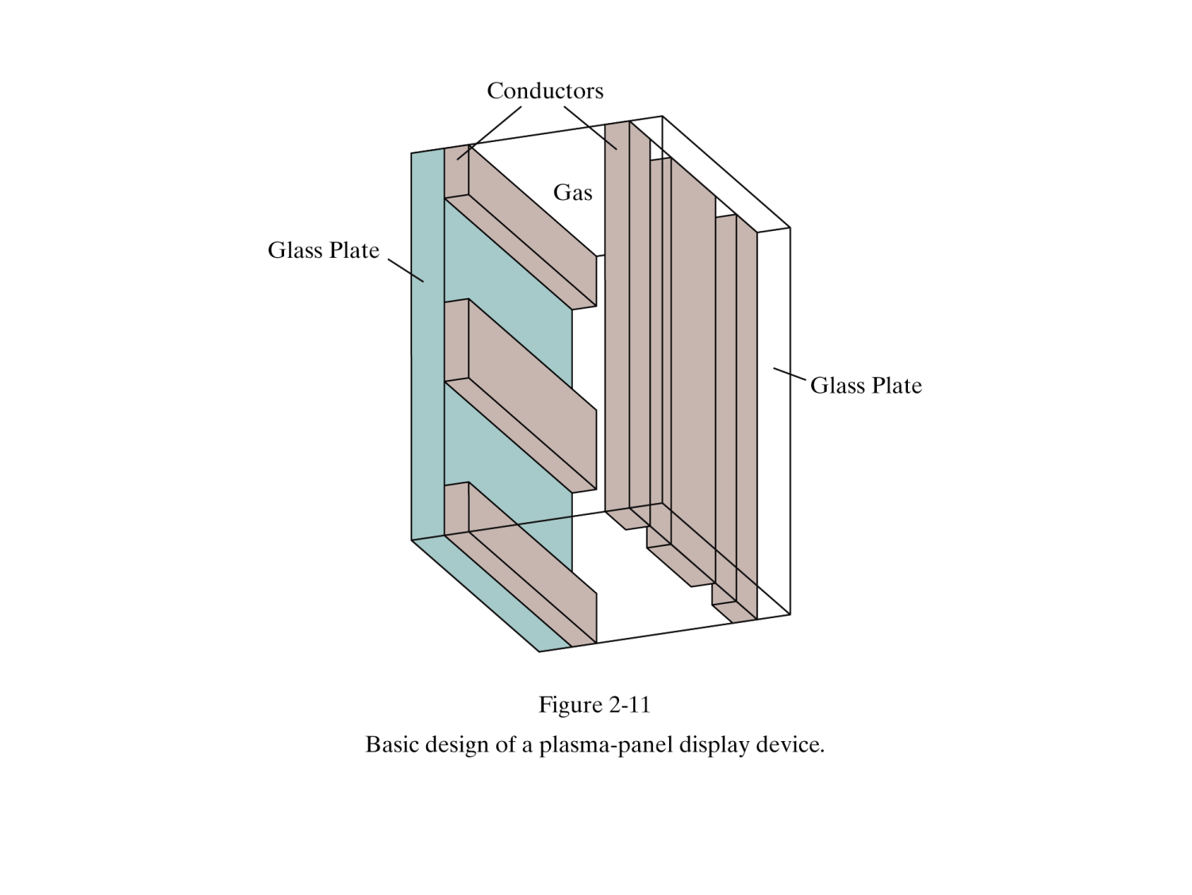
Flat Panel Displays
2.1 Plasma-panel display:
Horizontal
Anode (+ve)
Vertical
Cathode (-ve)
(from Donald Hearn and Pauline Baker)
Computer Graphics

Slide 62
Flat Panel Displays
Components of Plasma-panel displays
  Cathode Fine wires attached to glass plates deliver –ve voltage to gas cells on vertical axis
  Fluorescent cells Small pockets of gas liquid or solids to emit light in excited state
  Anode Fine wires attached to glass plates deliver +ve voltage to gas cells on horizontal axis
  Glass Plates to act as capacitors to maintain sustaining voltage
Computer Graphics

Slide 63
Flat Panel Displays
Working of Plasma-panel displays
  An array of small fluorescent gas lights
  Constructed by filling a mixture of gases (usually neon) between two glass plates
  vertical conducting ribbons are placed in one plate, and horizontal conducting ribbons are placed in the other plate
  voltage is applied to the two ribbons to transform gas into glowing plasma of electrons and ions.
Computer Graphics

Slide 64
Flat Panel Displays
  Two voltage levels
    Firing Voltage 60
    Sustaining Voltage 40
Advantages/Disadvantages:
  No need of refreshing
  Provides Fairly High resolution
  However MONOCHROME with few grey levels
Computer Graphics

Slide 65
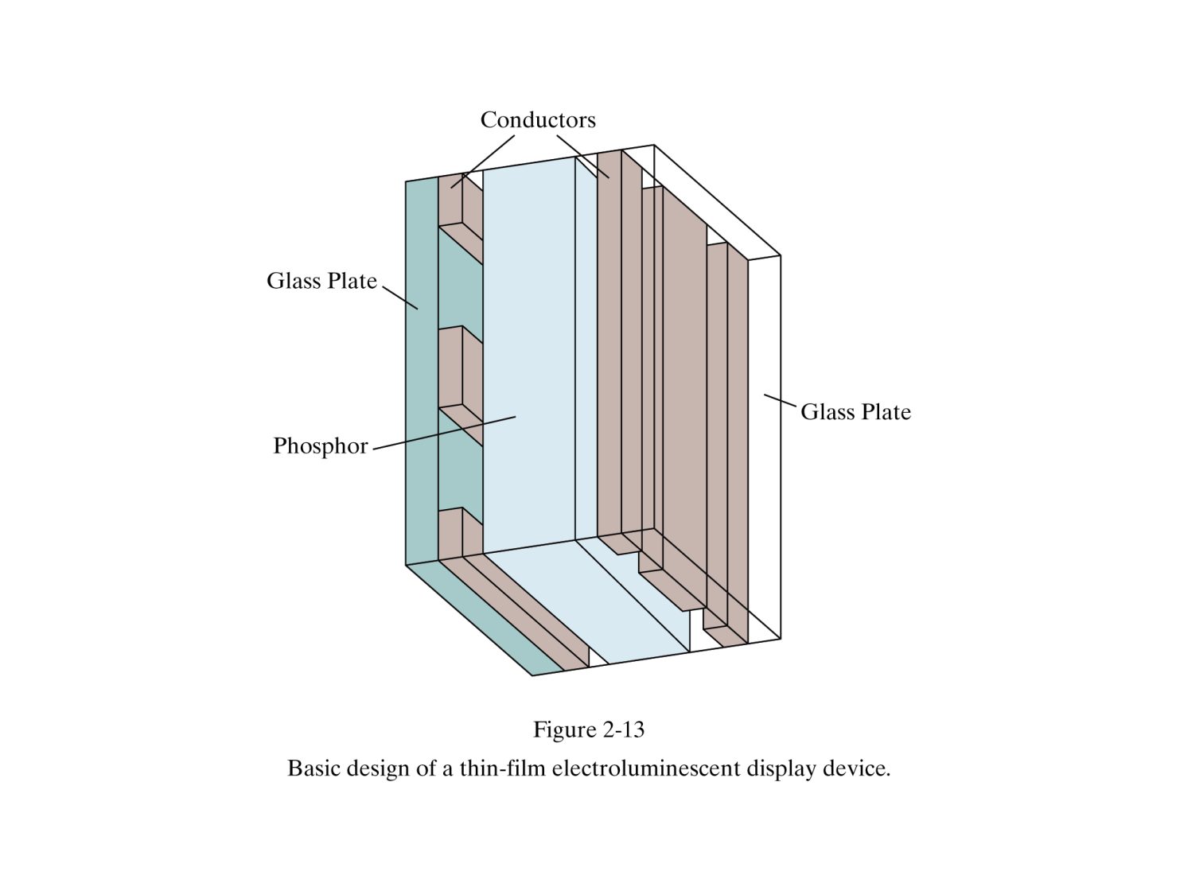
Flat Panel Displays
2.2 Thin-film electroluminescent display:
(from Donald Hearn and Pauline Baker)
Computer Graphics

Slide 66
Flat Panel Displays
Thin-film electroluminescent displays are
  similar devices except that the region between the plates is filled with phosphor instead of gas.
  Example: zinc sulfide with manganese
  voltage applied between the plates moves electrons to the manganese atoms that release photons of light.
Computer Graphics

Slide 67
Flat Panel Displays
2.3 Light-emitting diode:
  a matrix of diodes, one per pixel
  apply voltage stored in the refresh buffer
  convert voltage to produce light in the display.
Computer Graphics

Slide 68
Flat Panel Displays
2.4 Liquid-crystal displays (LCD):
  LCD screens are often used in small devices such as calculators and laptop monitors.
  non-emissive types of displays
  the picture produced by passing light from a light source through liquid-crystal material
  Liquid-crystal material contains crystals within a liquid
  nematic (thread-like) liquid-crystals have rod shape that can either align to with the light direction or not
  when voltage is applied to conductors.
  Liquid-crystal material can be programmed to either let the light through or not
Computer Graphics

Slide 69
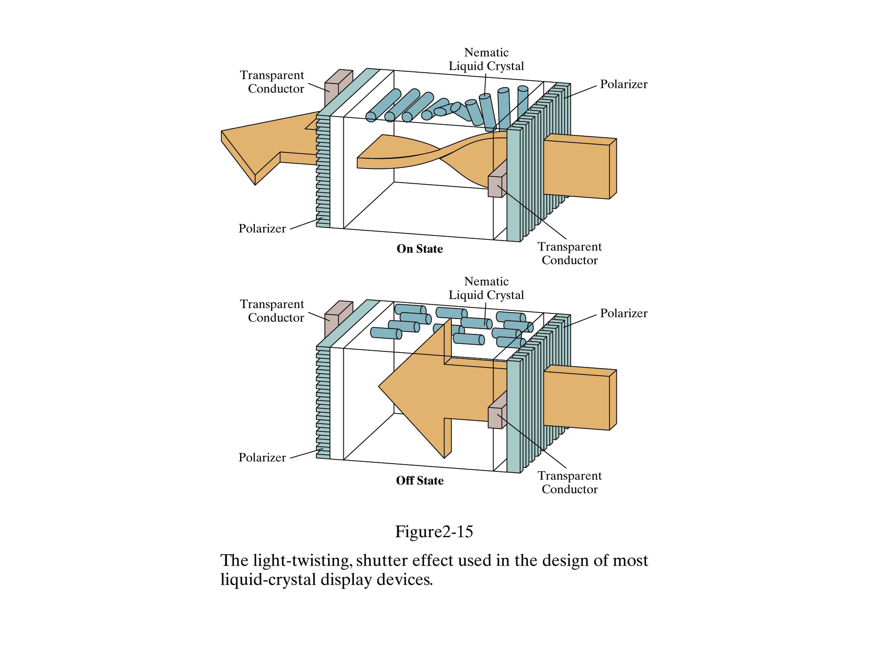
Flat Panel Displays
(from Donald Hearn and Pauline Baker)
Computer Graphics

Slide 70
Flat Panel Displays
Components of Liquid Crystal Displays
  Glass Plates contains the liquid crystal and serve as bonding surface for conductive coating.
  Transparent Conductor To apply voltage to two ribbons (across liquid crystals) to make plasma glow.
  Liquid Crystals Substance that polarize light when voltage is applied.
  Two Polarized Films Transparent sheet that polarize light.
  Reflectors
Computer Graphics

Slide 71
Flat Panel Displays
  ON STATE when light is twisted
  OFF STATE when block the light
  Passive matrix LCD have refresh buffer
  screen refreshed at 60 frames per second
  Active matrix LCD transistor stored at each pixel prevents charge from leaking out of liquid-crystals
  Temperature dependent, sluggish
  Require little power to operate
Computer Graphics

Slide 72
3-D Viewing Devices
For the display of 3D scenes.
Often using a vibrating, flexible mirror.
Scan alternate images in alternate frames.
Multiple stereo images (time multiplexing)
Computer Graphics

Slide 73
Stereoscopic and Virtual-Reality Systems
Another technique for the display of 3D scenes.
Not true 3D images, but provides a 3D effect.
Uses two views of a scene along the lines of right and left eye. Gives perception of a scene depth when right view is seen from right eye and left scene is seen from left eye (stereoscopic effect). Display each view at alternate refresh cycles.
Computer Graphics

Slide 74
Stereoscopic and Virtual-Reality Systems
Stereoscopic systems are used in virtual reality systems:
  Augmented reality
  Immersive reality
    Headset generates stereoscopic views
    Input devices (gloves, helmet, …) capture motion
    Sensing system in headset tracks user’s position
Scene projected on an arrangement of walls
Computer Graphics

Slide 75
Graphics Workstations
Graphics monitors use raster-scan displays (CRT or flat-panel monitors).
Graphics workstations provide more powerful graphics capability:
  Screen resolution 1280 x 1024 to 1600 x 1200.
  Screen diagonal > 18 inches.
Specialized workstations (medical imaging, CAM):
  Up to 2560 x 2048.
  Full-color.
360 degrees panel viewing systems.
Computer Graphics

Slide 76
Any Question !

