Slide 1
Chapter 5
2-D Transformations

Slide 2
Contents
  Homogeneous coordinates
  Matrices
  Transformations
  Geometric Transformations
  Inverse Transformations
  Coordinate Transformations
  Composite transformations

Slide 3
Homogeneous Coordinates
There are three types of co-ordinate systems
  Cartesian Co-ordinate System
    Left Handed Cartesian Co-ordinate System( Clockwise)
    Right Handed Cartesian Co-ordinate System ( Anti Clockwise)
  Polar Co-ordinate System
  Homogeneous Co-ordinate System
  We can always change from one co-ordinate system to another.

Slide 4
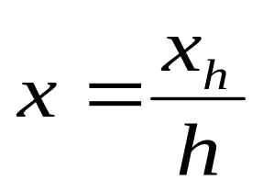
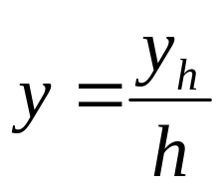
Homogeneous Coordinates
  A point (x, y) can be re-written in homogeneous coordinates as (x_{h}, y_{h}, h)
  The homogeneous parameter h is a non-zero value such that:
  We can then write any point (x, y) as (hx, hy, h)
  We can conveniently choose h = 1 so that
  (x, y) becomes (x, y, 1)

Slide 5
Homogeneous Coordinates
Advantages:
  Mathematicians use homogeneous coordinates as they allow scaling factors to be removed from equations.
  All transformations can be represented as 3*3 matrices making homogeneity in representation.
  Homogeneous representation allows us to use matrix multiplication to calculate transformations extremely efficient!
  Entire object transformation reduces to single matrix multiplication operation.
  Combined transformation are easier to built and understand.

Slide 6
Contents
  Homogeneous coordinates
  Matrices
  Transformations
  Geometric Transformations
  Inverse Transformations
  Coordinate Transformations
  Composite transformations

Slide 7
Matrices
Definition: A matrix is an n X m array of scalars, arranged conceptually in n rows and m columns, where n and m are positive integers. We use A, B, and C to denote matrices.
If n = m, we say the matrix is a square matrix.
We often refer to a matrix with the notation
A = [a(i,j)], where a(i,j) denotes the scalar in the ith row and the jth column
Note that the text uses the typical mathematical notation where the i and j are subscripts. We'll use this alternative form as it is easier to type and it is more familiar to computer scientists.

Slide 8
Matrices
Scalar-matrix multiplication:
αA = [α a(i,j)]
Matrix-matrix addition: A and B are both n X m
C = A + B = [a(i,j) + b(i,j)]
Matrix-matrix multiplication: A is n X r and B is r X m
r
C = AB = [c(i,j)] where c(i,j) = ∑ a(i,k) b(k,j)
k=1

Slide 9
Matrices
Transpose: A is n X m. Its transpose, A^{T}, is the m X n matrix with the rows and columns reversed.
Inverse: Assume A is a square matrix, i.e. n X n. The identity matrix, In has 1s down the diagonal and 0s elsewhere The inverse A⁻¹ does not always exist. If it does, then
A⁻¹ A = A A⁻¹ = I
Given a matrix A and another matrix B, we can check whether or not B is the inverse of A by computing AB and BA and seeing that AB = BA = I

Slide 10
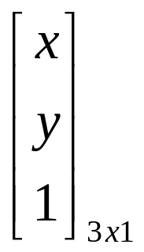
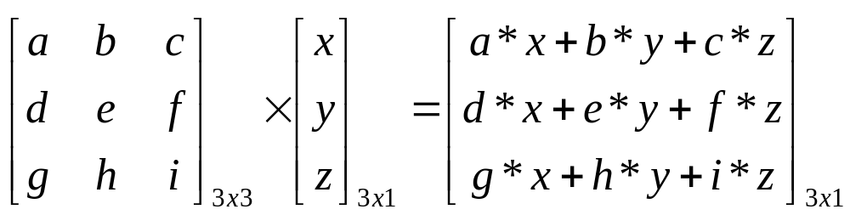
Matrices
  Each point P(x,y) in the homogenous matrix form is represented as
  Recall matrix multiplication takes place:

Slide 11


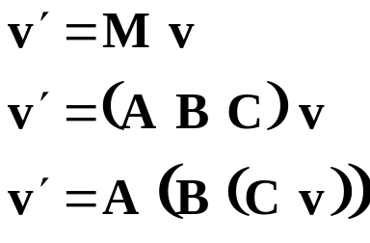
Matrices
Matrix multiplication does NOT commute:
Matrix composition works right-to-left.
  Compose:
  Then apply it to a column matrix v:
  It first applies C to v, then applies B to the result, then applies A to the result of that.

Slide 12
Contents
  Homogeneous coordinates
  Matrices
  Transformations
  Geometric Transformations
  Inverse Transformations
  Coordinate Transformations
  Composite transformations

Slide 13
Transformations
  A transformation is a function that maps a point (or vector) into another point (or vector).
  An affine transformation is a transformation that maps lines to lines.
  Why are affine transformations "nice"?
    We can define a polygon using only points and the line segments joining the points.
    To move the polygon, if we use affine transformations, we only must map the points defining the polygon as the edges will be mapped to edges!
  We can model many objects with polygons---and should--- for the above reason in many cases.

Slide 14
Transformations
  Any affine transformation can be obtained by applying, in sequence, transformations of the form
    Translate
    Scale
    Rotate
    Reflection
  So, to move an object all we have to do is determine the sequence of transformations we want using the 4 types of affine transformations above.

Slide 15
Transformations
  Geometric Transformations: In Geometric transformation an object itself is moved relative to a stationary coordinate system or background. The mathematical statement of this view point is described by geometric transformation applied to each point of the object.
  Coordinate Transformation: The object is held stationary while coordinate system is moved relative to the object. These can easily be described in terms of the opposite operation performed by Geometric transformation.

Slide 16
Transformations
  What does the transformation do?
  What matrix can be used to transform the original points to the new points?
  Recall--- moving an object is the same as changing a frame so we know we need a 3 X 3 matrix
  It is important to remember the form of these matrices!!!

Slide 17
Contents
  Homogeneous coordinates
  Matrices
  Transformations
  Geometric Transformations
  Inverse Transformations
  Coordinate Transformations
  Composite transformations

Slide 18
Geometric Transformations
  In Geometric transformation an object itself is moved relative to a stationary coordinate system or background. The mathematical statement of this view point is described by geometric transformation applied to each point of the object. Various Geometric Transformations are:
    Translation
    Scaling
    Rotation
    Reflection
    Shearing

Slide 19
Geometric Transformations
  Translation
  Scaling
  Rotation
  Reflection
  Shearing

Slide 20
Geometric Translation
Is defined as the displacement of any object by a given distance and direction from its original position. In simple words it moves an object from one position to another.
x’ = x + tx y’ = y + ty
y
6
5
4
3
2
V = txI+tyJ
1
0
1
2
3
4
5
6
7
8
9
10
x
Note: House shifts position relative to origin

Slide 21
Geometric Translation Example
Translation by 3I+2J
y
6
(5, 5)
5
4
(2, 3)
3
(6, 3)
(4, 3)
2
1
(1, 1)
(3, 1)
0
x
1
2
3
4
5
6
7
8
9
10
Notes:
Translate by (5, 3)
x’ = x + dx
y’ = y + dy

Slide 22
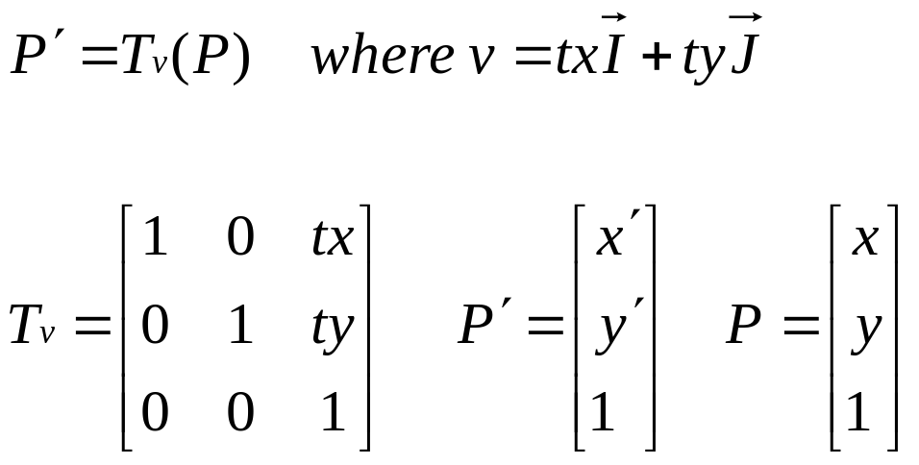
Geometric Translation
  To make operations easier, 2-D points are written as homogenous coordinate column vectors
  The translation of a point P(x,y) by (tx, ty) can be written in matrix form as:

Slide 23
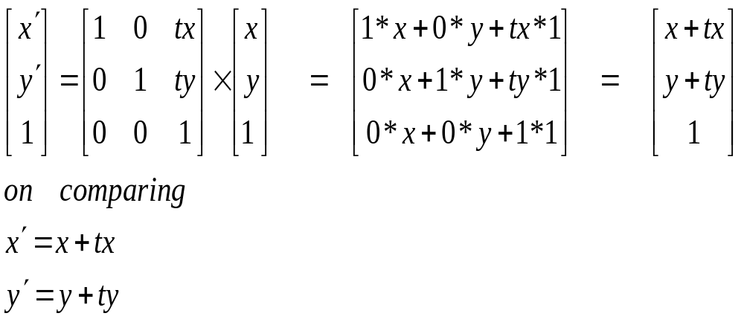
Geometric Translation
  Representing the point as a homogeneous column vector we perform the calculation as:

Slide 24
Geometric Transformations
  Translation
  Scaling
  Rotation
  Reflection
  Shearing

Slide 25




Geometric Scaling
Scaling is the process of expanding or compressing the dimensions of an object determined by the scaling factor.
Scalar multiplies all coordinates
x’ = Sx × x y’ = Sy × y
WATCH OUT:
  Objects grow and move!
y
6
5
4
3
2
1
0
1
2
3
4
5
6
7
8
9
10
x
Note: House shifts position relative to origin

Slide 26
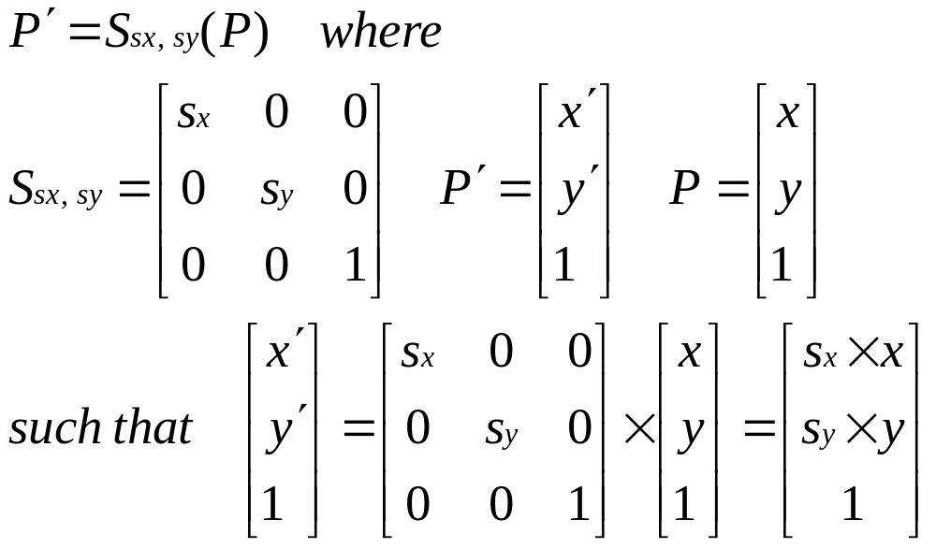
Geometric Scaling
  The scaling of a point P(x,y) by scaling factors Sx and Sy about origin can be written in matrix form as:

Slide 27
Geometric Scaling Example
Scale by (2, 2)
y
6
(4,6)
5
4
(2, 3)
3
2
(2, 2)
(6, 2)
1
(1, 1)
(3, 1)
0
1
2
3
4
5
6
7
8
9
10
Notes:
Scale by (2, 2)
x’ = sx*x
y’ = sy*y

Slide 28
Geometric Transformations
  Translation
  Scaling
  Rotation
  Reflection
  Shearing

Slide 29

Geometric Rotation
  The rotation of a point P (x,y) about origin, by specified angle θ (>0 counter clockwise) can be obtained as
  x’ = x × cosθ – y × sinθ
  y’ = x × sinθ + y × cosθ
  To rotate an object we have to rotate all coordinates
Let us derive these equations
y
y
6
5
(x',y')
4
•
3
θ
•
(x,y)
2
1
x
x
0
1
2
3
4
5
6
7
8
9
10

Slide 30
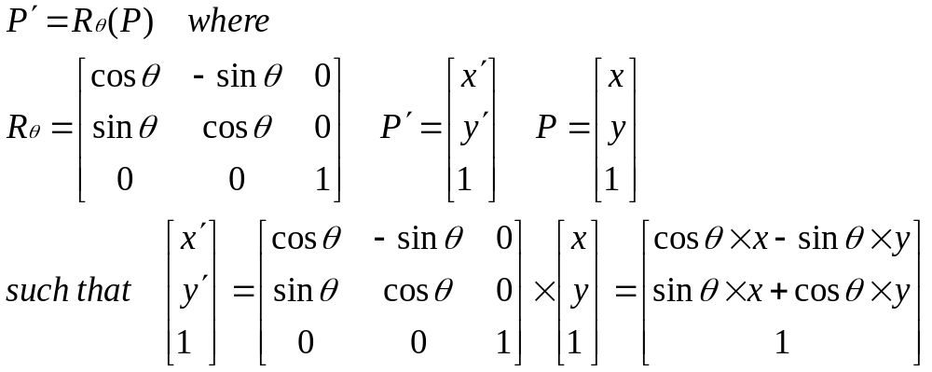
Geometric Rotation
  The rotation of a point P(x,y) by an angle θ about origin can be written in matrix form as:

Slide 31
Geometric Rotation Example
y
6
5
4
3
(2,1)
2
1
(0,0)
(2,0)
0
1
2
3
4
5
6
7
8
9
10
Notes:
x_{new} = x_{old} × cosθ – y_{old} × sinθ
y_{new} = x_{old} × sinθ + y_{old} × cosθ
1 radian = 180/π degrees
cos(π/6)=0.866
sin(π/6)=0.5
x’(4, 3) = 4*0.866 – 3*0.5 = 3.46 – 1.5 = 1.96
y’(4, 3) = 4*0.5 + 3*0.866 = 2.0 + 2.598 = 4.598
x’(3, 1) = 3*0.866 – 1*0.5 = 2.598 – 0.5 = 2.098
y’(3, 1) = 3*0.5 + 1*0.866 = 1.5 + 0.866 = 2.366
x’(5, 1) = 5*0.866 – 1*0.5 = 4.33 – 0.5 = 3.83
y’(5, 1) = 5*0.5 + 1*0.866 = 2.5 + 0.866 = 3.366

Slide 32
Geometric Transformations
  Translation
  Scaling
  Rotation
  Reflection
  Shearing

Slide 33
Geometric Reflection
  Mirror reflection is obtained about X-axis
  x’ = x
  y’ = – y
  Mirror reflection is obtained about Y-axis
  x’ = – x
  y’ = y
y
6
5
4
3
2
1
0
x
-10
-9
-8
-7
-6
-5
-4
-3
-2
-1
1
2
3
4
5
6
7
8
9
10

Slide 34
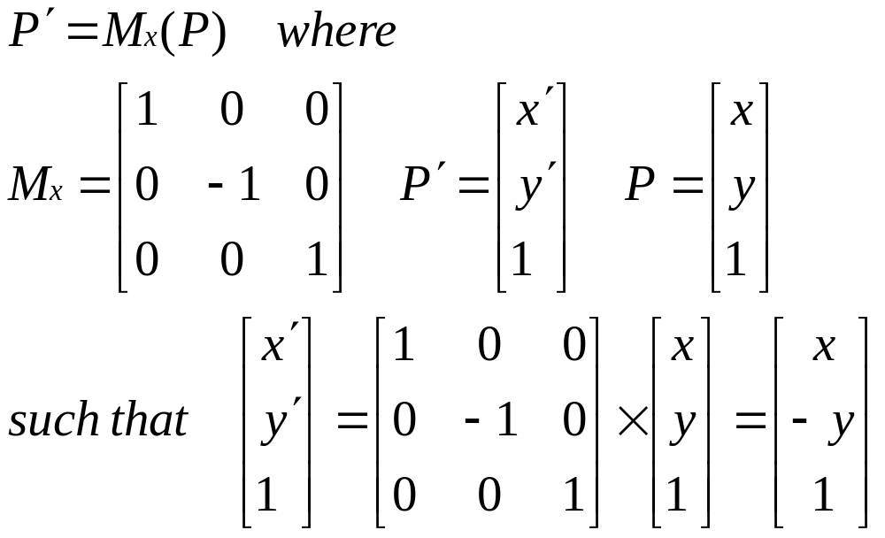
Geometric Reflection
  The reflection of a point P(x,y) about X-axis can be written in matrix form as:

Slide 35
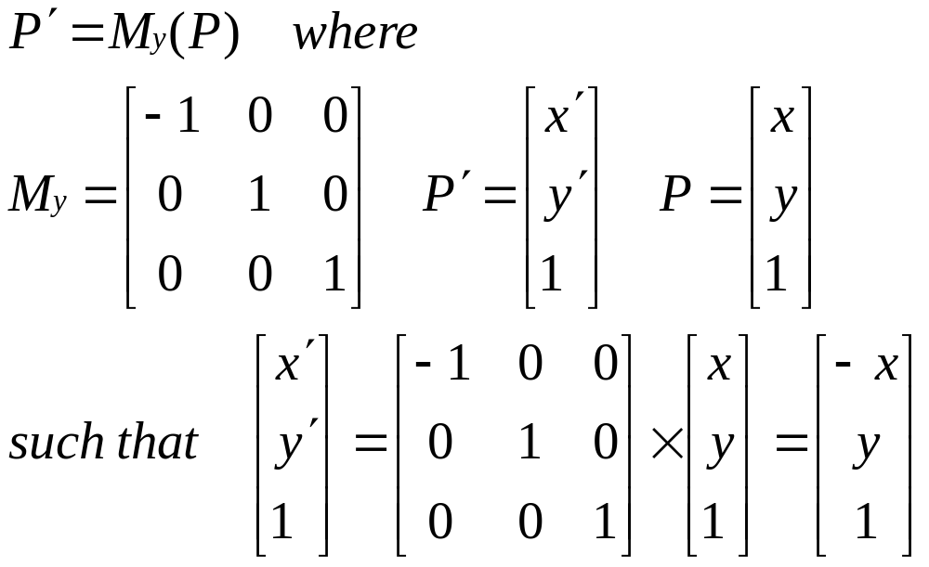
Geometric Reflection
  The reflection of a point P(x,y) about Y-axis can be written in matrix form as:

Slide 36
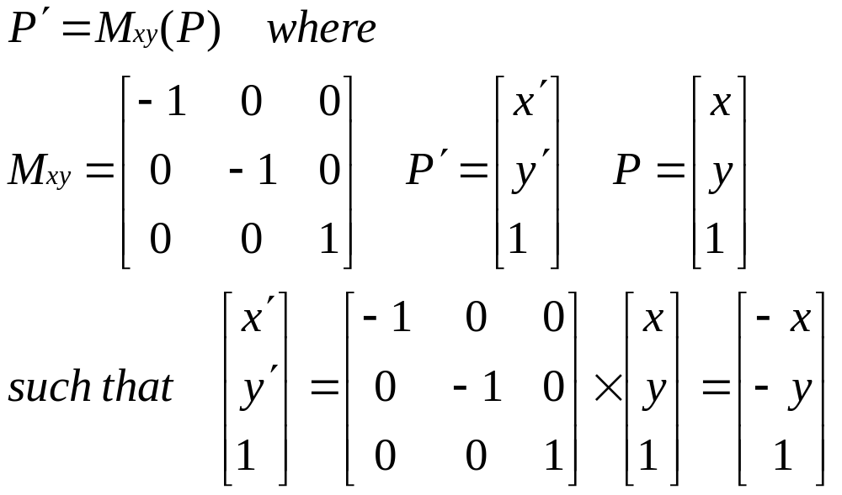
Geometric Reflection
  The reflection of a point P(x,y) about origin can be written in matrix form as:

Slide 37
Geometric Transformations
  Translation
  Scaling
  Rotation
  Reflection
  Shearing

Slide 38
Geometric Shearing
  It us defined as tilting in a given direction
  Shearing about y-axis
  x’ = x + ay
  y’ = y + bx
a = 2
b = 3
y
( 3,4)
4
y
( 1,3)
3
3
2
2
1
(1,1)
1
( 2,1)
0
x
0
x
1
2
3
4
5
1
2
3
4
5

Slide 39
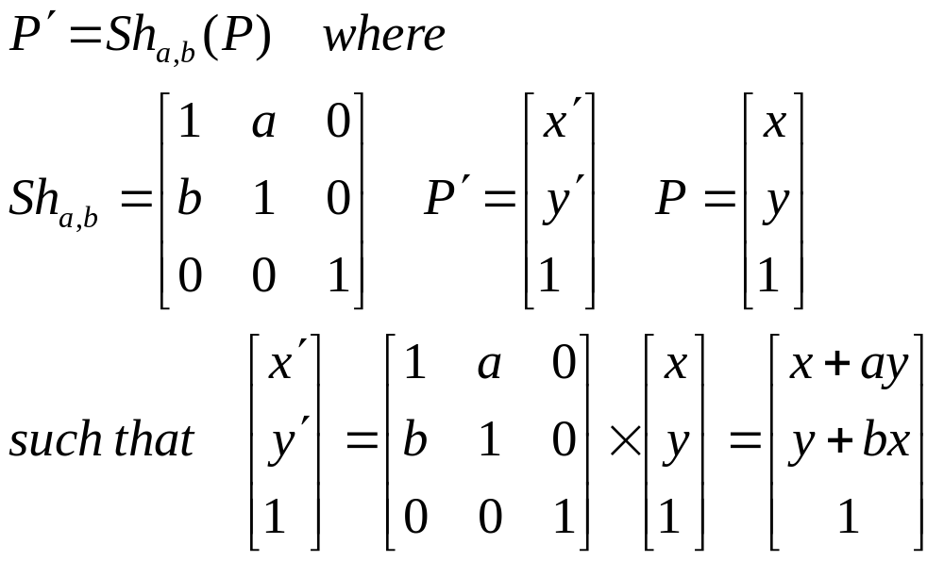
Geometric Shearing
  The shearing of a point P(x,y) in general can be written in matrix form as:

Slide 40
Geometric Shearing
  If b = 0 becomes Shearing about X-axis
  x’ = x + ay
  y’ = y
y
y
a = 2
3
3
2
2
( 2,1)
1
(1,1)
1
( 3,1)
0
x
0
x
1
2
3
4
5
1
2
3
4
5

Slide 41
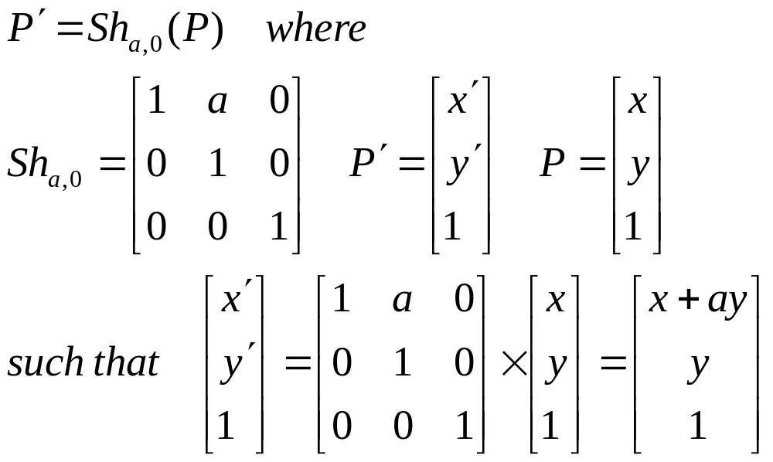
Geometric Shearing
  The shearing of a point P(x,y) about X-axis can be written in matrix form as:

Slide 42
Geometric Shearing
  If a = 0 it becomes Shearing about y-axis
  x’ = x
  y’ = y + bx
y
( 1,4)
4
y
b = 3
3
3
( 1,3)
2
2
1
(1,1)
1
0
x
0
x
1
2
3
4
5
1
2
3
4
5

Slide 43
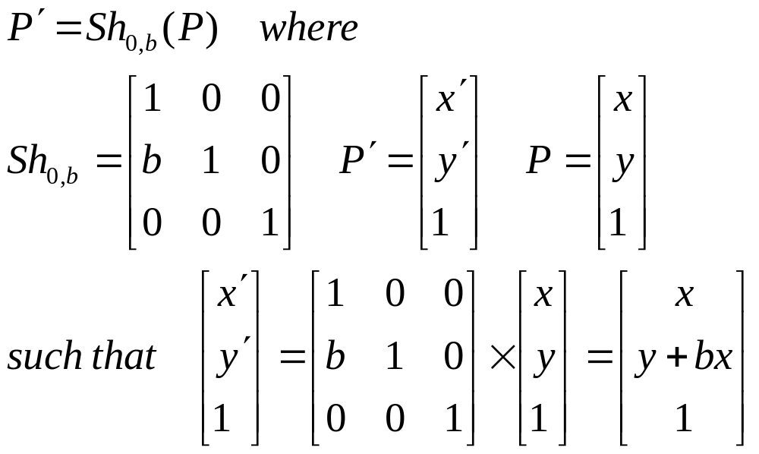
Geometric Shearing
  The shearing of a point P(x,y) about Y-axis can be written in matrix form as:

Slide 44
Contents
  Homogeneous coordinates
  Matrices multiplications
  Transformations
  Geometric Transformations
  Inverse Transformations
  Coordinate Transformations
  Composite transformations

Slide 45
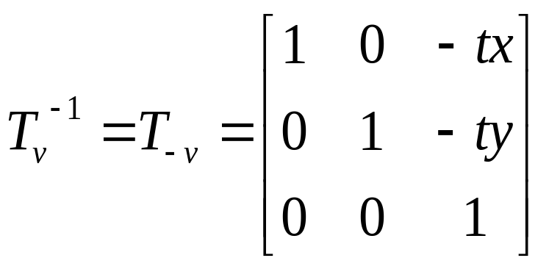
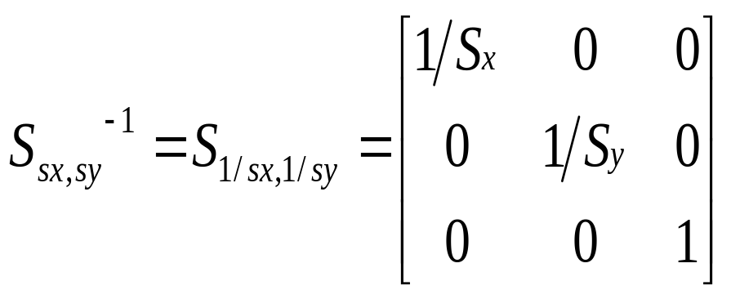
Inverse Transformations
  Inverse Translation: Displacement in direction of –V
  Inverse Scaling: Division by S_{x} and S_{y}

Slide 46
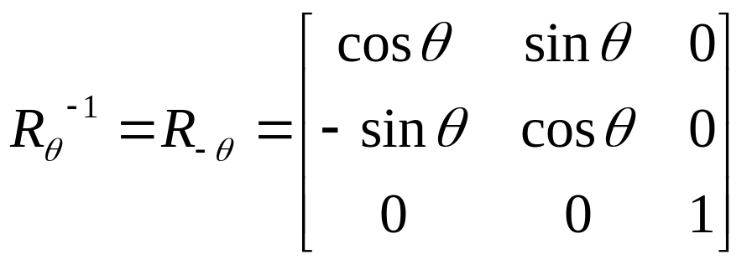
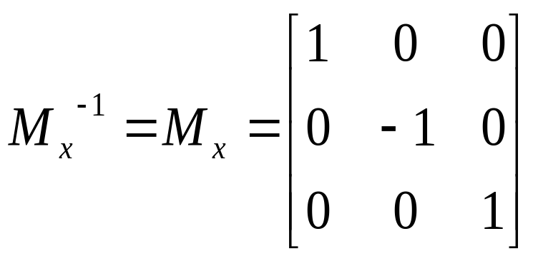
Inverse Transformations
  Inverse Rotation: Rotation by an angle of –θ
  Inverse Reflection: Reflect once again

Slide 47
Contents
  Homogeneous coordinates
  Matrices multiplications
  Transformations
  Geometric Transformations
  Inverse Transformations
  Coordinate Transformations
  Composite transformations

Slide 48
Coordinate Transformations
  Coordinate Transformation: The object is held stationary while coordinate system is moved relative to the object. These can easily be described in terms of the opposite operation performed by Geometric transformation.

Slide 49
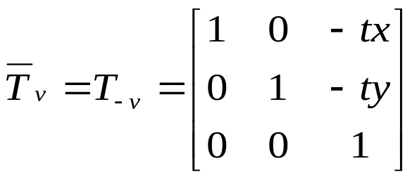
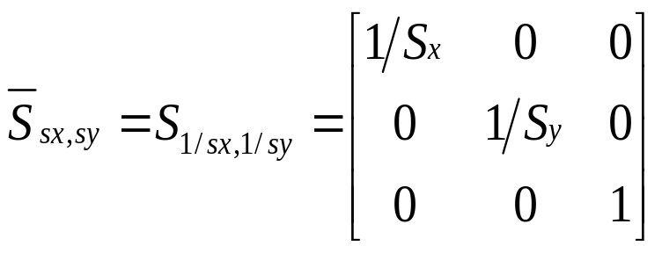
Coordinate Transformations
  Coordinate Translation: Displacement of the coordinate system origin in direction of –V
  Coordinate Scaling: Scaling an object by S_{x} and S_{y} or reducing the scale of coordinate system.

Slide 50
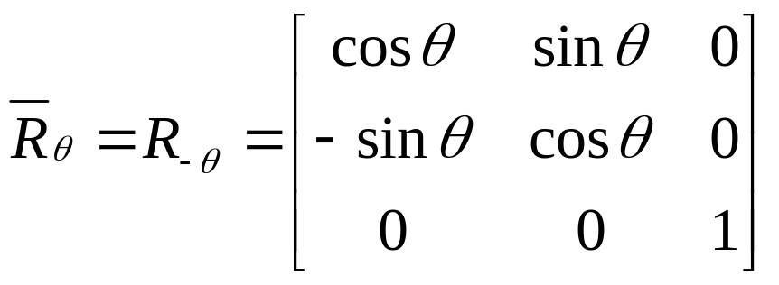
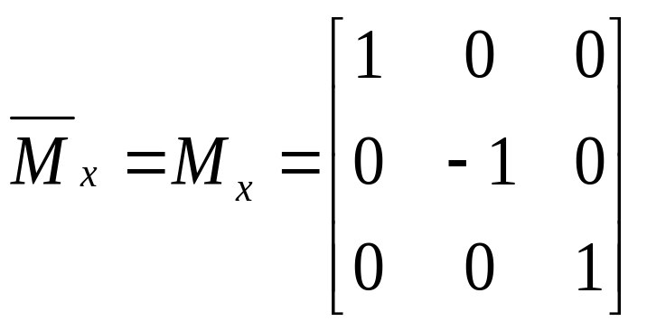
Coordinate Transformations
  Coordinate Rotation: Rotating Coordinate system by an angle of –θ
  Coordinate Reflection: Same as Geometric Reflection (why?)

Slide 51
Contents
  Homogeneous coordinates
  Matrices multiplications
  Transformations
  Geometric Transformations
  Inverse Transformations
  Coordinate Transformations
  Composite transformations

Slide 52
Composite Transformations
  A number of transformations can be combined into one matrix to make things easy
    Allowed by the fact that we use homogenous coordinates
  Matrix composition works right-to-left.
  Compose:
  Then apply it to a point:
  It first applies C to v, then applies B to the result, then applies A to the result of that.

Slide 53
Composite Transformations
  Rotation about Arbitrary Point (h,k)
  Imagine rotating an object around a point (h,k) other than the origin
    Translate point (h,k) to origin
    Rotate around origin
    Translate back to point

Slide 54




Composite Transformations
1
2
3
4

Slide 55
Composite Transformations
Let P is the object point whose rotation by an angle θ about the fixed point (h,k) is to be found. Then the composite transformation R_{θ,(h,k)} can be obtained by performing following sequence of transformations :
Translate (h,k) to origin and the new object point is found as
  P¹ = T_{V}(P) where V= – hI – kJ
Rotate object about origin by angle θ and the new object point is
  P² = R_{θ}(P¹)
Retranslate (h,k) back the final object point is
  P^{F} = T⁻¹_{V}(P²) = T_{-V} (P²)
The composite transformation can be obtained by back substituting
P^{F} = T⁻¹_{V}(P²)
= T_{-V} R_{θ}(P¹)
= T_{-V} R_{θ}T_{V}(P) where V = – hI – kJ
Thus we form the matrix to be R_{θ,(h,k)}= T_{-V}R_{θ}T_{V}

Slide 56
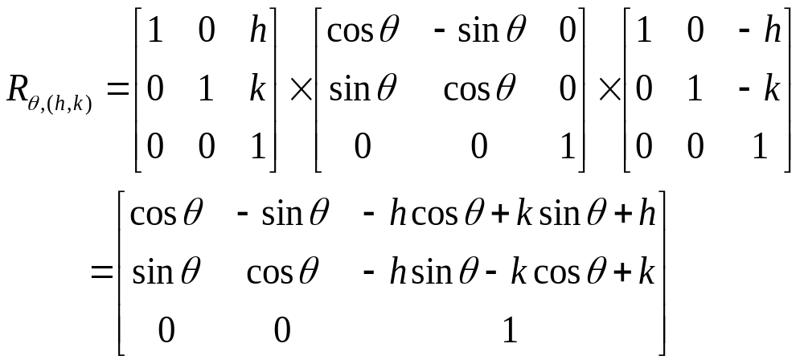
Composite Transformations
  The composite rotation transformation matrix is
REMEMBER: Matrix multiplication is not commutative so order matters

Slide 57
Composite Transformations
  Scaling about Arbitrary Point (h,k)
  Imagine scaling an object around a point (h,k) other than the origin
    Translate point (h,k) to origin
    Scale around origin
    Translate back to point

Slide 58
Composite Transformations
Let P is the object point which is to be scaled by factors sx and sy about the fixed point (h,k). Then the composite transformation S_{sx,sy,(h,k)} can be obtained by performing following sequence of transformations :
Translate (h,k) to origin and the new object point is found as
  P¹ = T_{V}(P) where V= – hI – kJ
Scale object about origin and the new object point is
  P² = S_{sx,sy}(P¹)
Retranslate (h,k) back the final object point is
  P^{F} = T⁻¹_{V}(P²) = T_{-V} (P²)
The composite transformation can be obtained by back substituting
P^{F} = T⁻¹_{V}(P²)
= T_{-V} S_{sx,sy}(P¹)
= T_{-V} S_{sx,sy}.T_{V}(P) where V = – hI – kJ
Thus we form the matrix to be S_{sx,sy,(h,k)}= T_{-V}S_{sx,sy}T_{V}

Slide 59
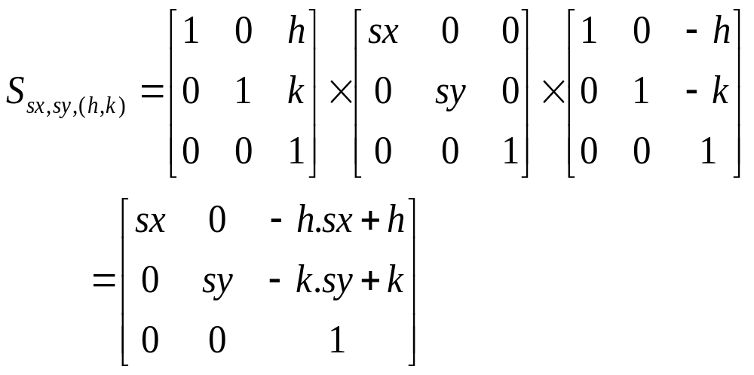
Composite Transformations
  The composite scaling transformation matrix is

Slide 60
Exercises 1
Translate the shape below by (7, 2)
y
6
5
4
(2, 3)
3
(1, 2)
(3, 2)
2
1
(2, 1)
0
x
1
2
3
4
5
6
7
8
9
10

Slide 61
Exercises 2
Scale the shape below by 3 in x and 2 in y
y
6
5
4
(2, 3)
3
(1, 2)
(3, 2)
2
1
(2, 1)
0
x
1
2
3
4
5
6
7
8
9
10

Slide 62
Exercises 3
Rotate the shape below by 30° about the origin
y
6
5
4
(2, 3)
3
(1, 2)
(3, 2)
2
1
(2, 1)
0
x
1
2
3
4
5
6
7
8
9
10

Slide 63
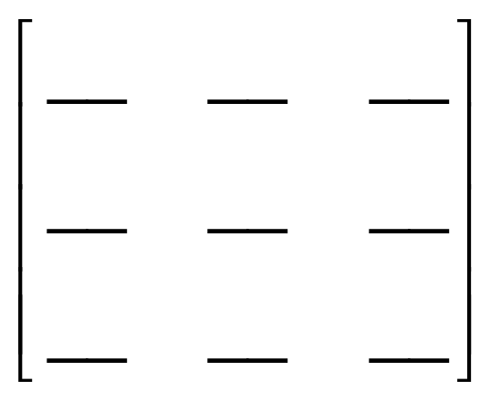
Exercise 4
Write out the homogeneous matrices for the previous three transformations
Translation
Scaling
Rotation

Slide 64
Exercises 5
Using matrix multiplication calculate the rotation of the shape below by 45° about its centre (5, 3)
y
5
(5, 4)
4
(4, 3)
(6, 3)
3
2
(5, 2)
1
0
x
1
2
3
4
5
6
7
8
9
10

Slide 65
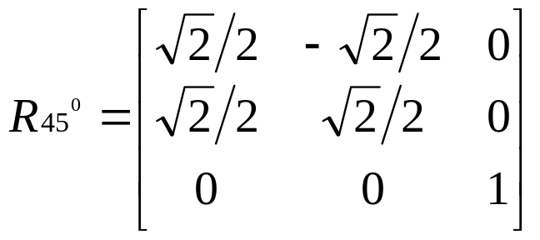
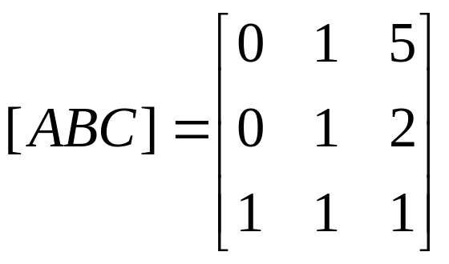
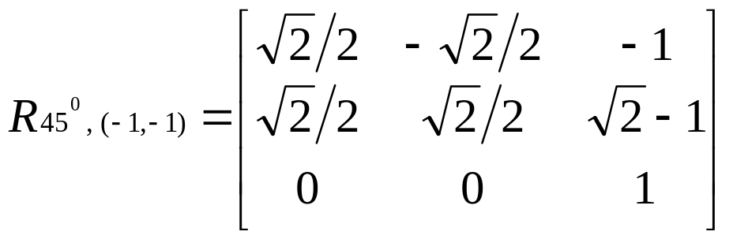
Exercise 6
Rotate a triangle ABC A(0,0), B(1,1), C(5,2) by 45⁰
About origin (0,0)
About P(-1,-1)

Slide 66
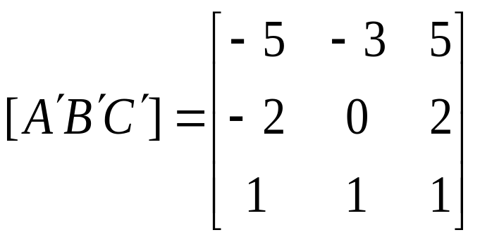
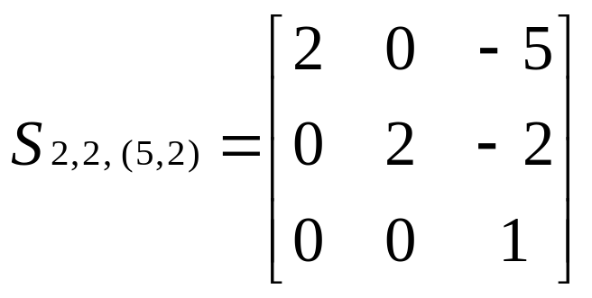
Exercise 7
Magnify a triangle ABC A(0,0), B(1,1), C(5,2) twice keeping point C(5,2) as fixed.

Slide 67
Exercise 8
Describe transformation M_{L} which reflects an object about a Line L: y=m*x+b.
Let P be the object point whose reflection is to taken about line L that makes an angle θ with +ve X-axis and has Y intercept as (0,b). The composite transformation M_{L} can be found by applying following transformations in sequence:
Y-axis
P(x,y)
Y=mx+b
(0,b)
P^{F}(x’,y’)
θ
X-axis

Slide 68
Exercise 8
Translate (0,b) to origin so that line passes through origin and P is transformed as
  P^{I} = T_{V}(P) where V = –hI –kJ
Rotate by an angle of –θ so that line aligns with +ve X-axis
  P^{II} = R_{-θ}(P^{I})
Now take mirror reflection about X-axis.
  P^{III} = M_{x}(P^{II})
Re-rotate line back by angle of θ
  P^{IV} = R_{θ} (P^{III})
Retranslate (0,b) back.
  P^{F} = T_{-V}(P^{IV})

Slide 69
Exercise 8
The composite transformation can be obtained by back substituting
P^{F} = T_{-V}(P^{IV})
= T_{-V}.R_{θ} (P^{III})
= T_{-V}.R_{θ} . M_{x}(P^{II})
= T_{-V}.R_{θ} . M_{x} . R_{-θ}(P^{I})
= T_{-V}.R_{θ} . M_{x} . R_{-θ}. T_{V}(P)
Thus we form the matrix to be M_{L}= T_{-V}.R_{θ} . M_{x} . R_{-θ}. T_{V}
where V = –0.I –b.J

Slide 70
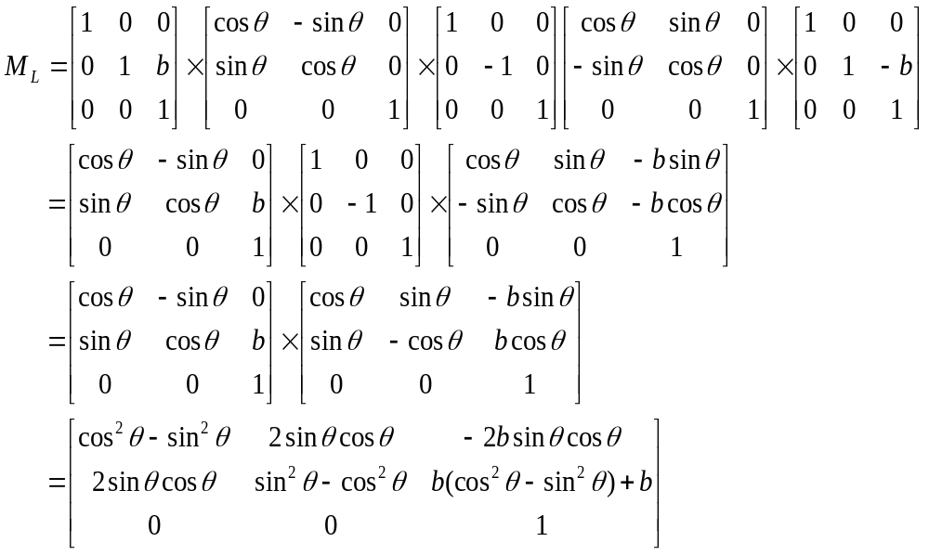
Exercise 8

Slide 71
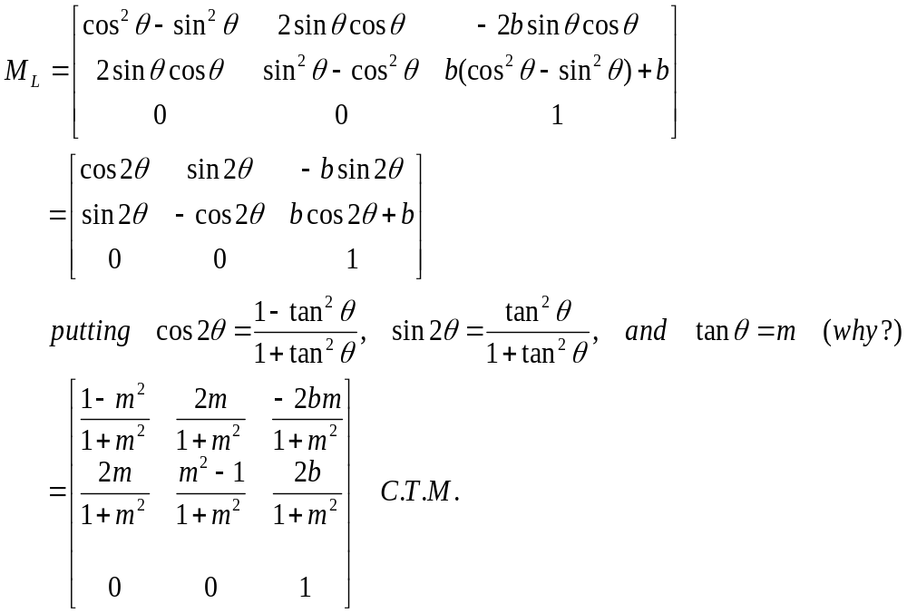
Exercise 8

Slide 72
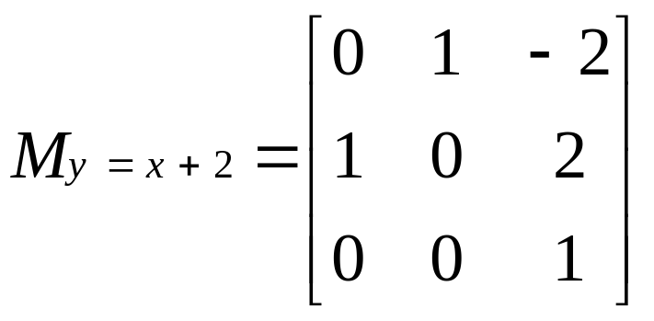
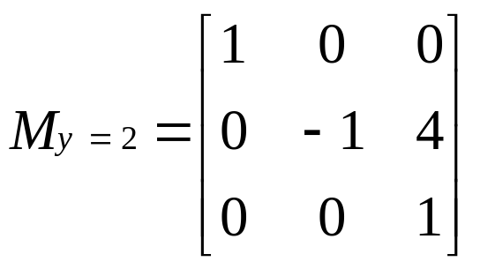
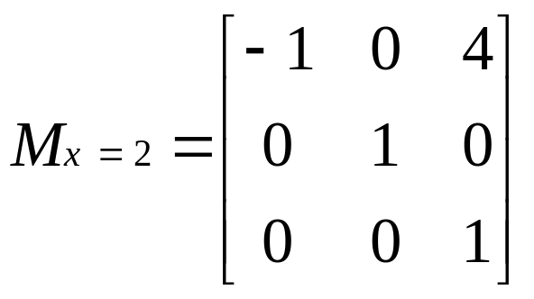
Exercise 9
Reflect the diamond shaped polygon whose vertices are A(-1,0) B(0,-2) C(1,0) and D(0,2) about
Horizontal Line y=2
Vertical Line x = 2
Line L: y=x+2.

Slide 73
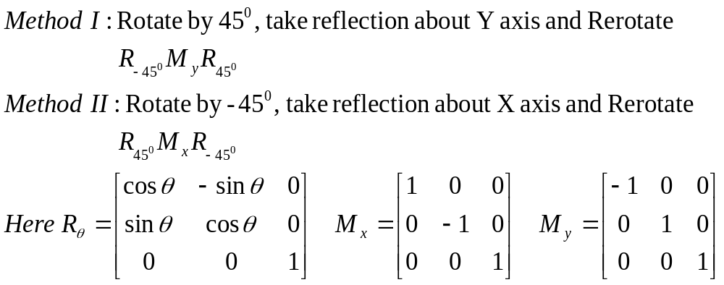
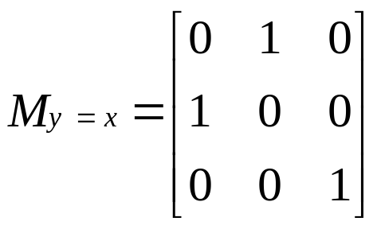
Exercise 10
Obtain reflection about Line y = x

Slide 74
Exercise 11
Prove that
Two successive translations are additive /commutative.
Two successive rotations are additive /commutative.
Two successive Scaling are multiplicative /commutative.
Two successive reflections are nullified /Invertible.
Is Translation followed by Rotation equal to Rotation followed by translation ?

Slide 75
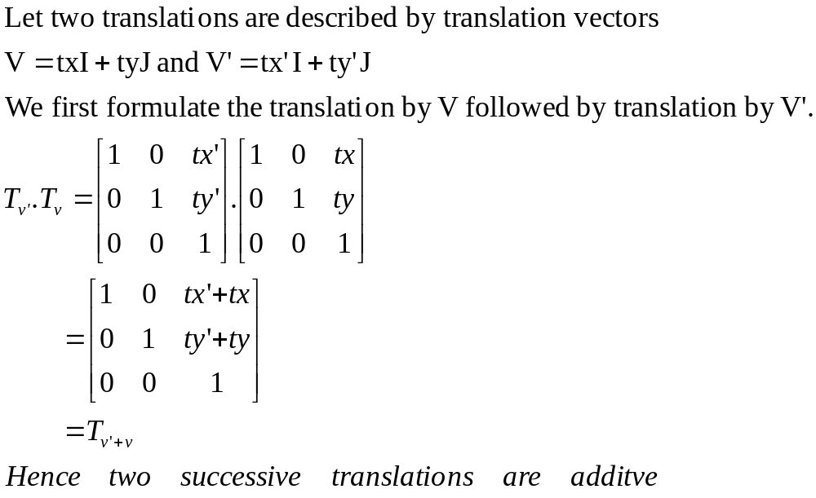
Exercise 11
a. Two Successive translations are additive/commutative.

Slide 76
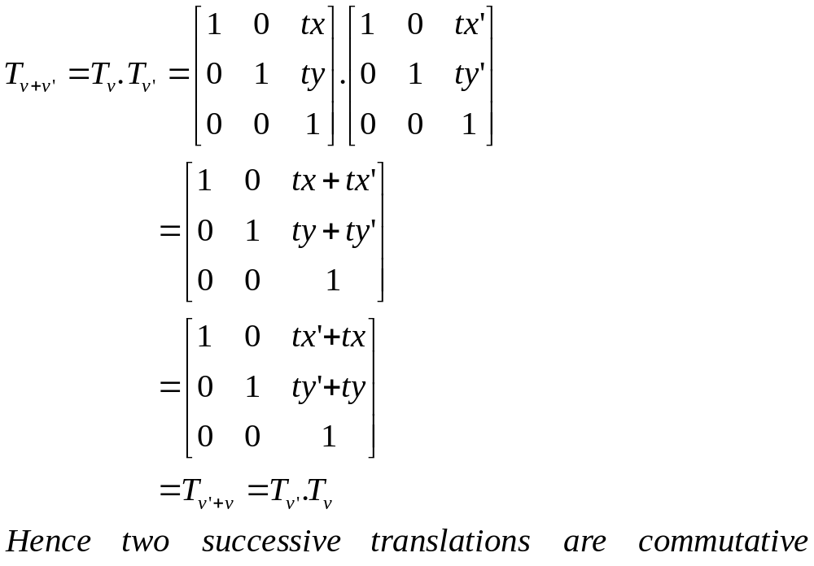
Exercise 11
Also,

Slide 77
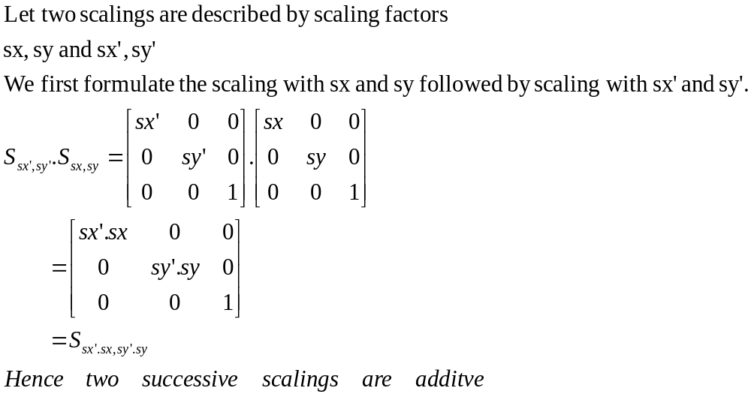
Exercise 11
b. Two Successive scaling are multiplicative/commutative.

Slide 78
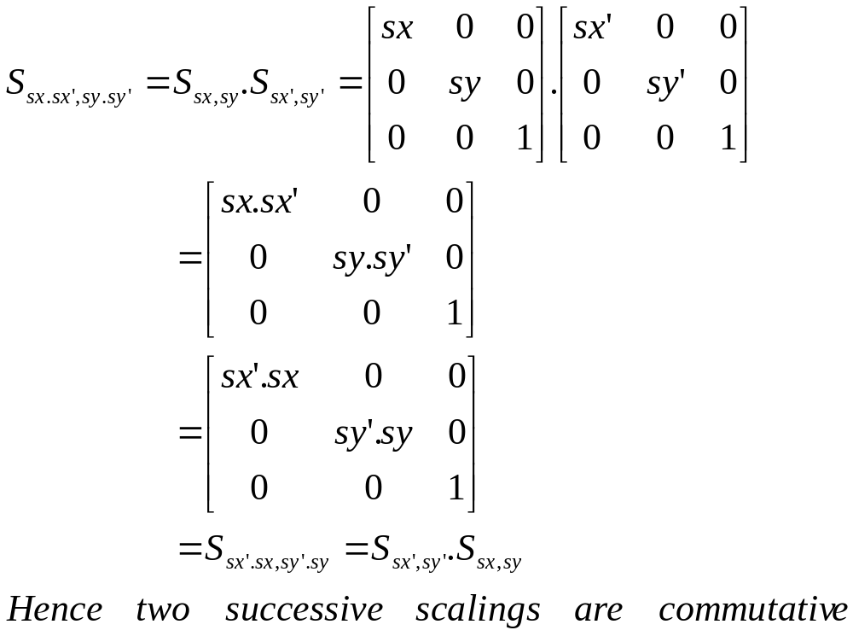
Exercise 11
Also,

Slide 79
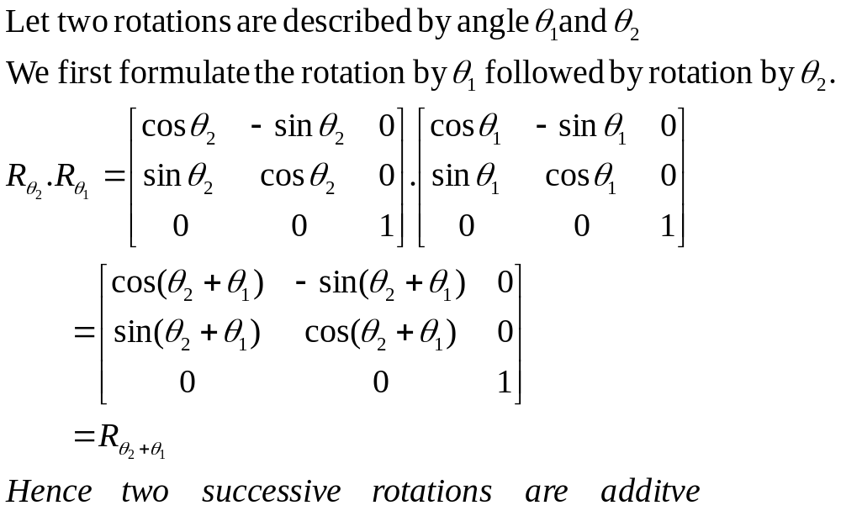
Exercise 11
c. Two Successive rotations are additive/commutative.

Slide 80
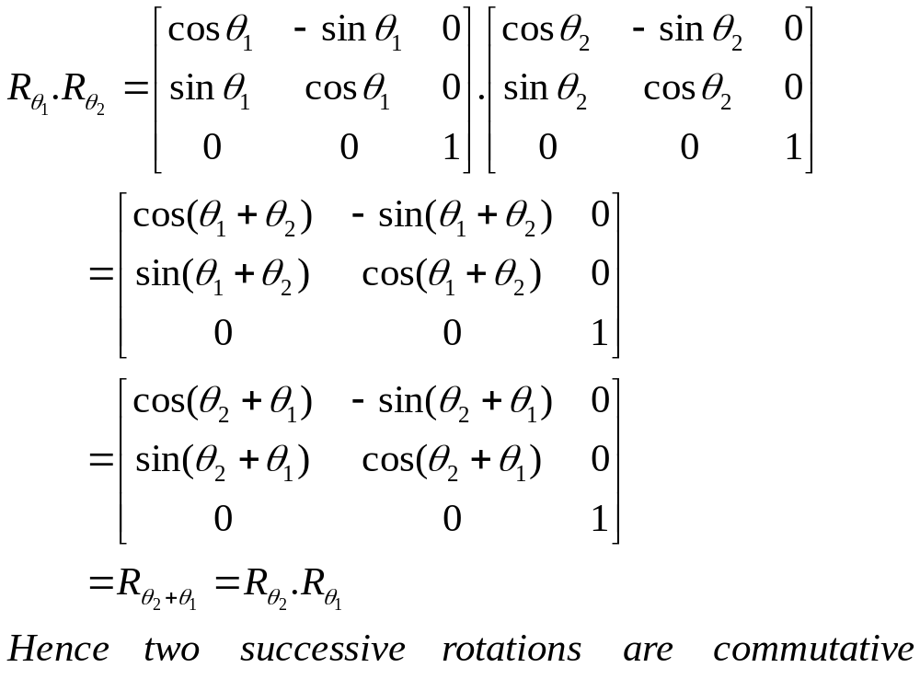
Exercise 11
Also,

Slide 81
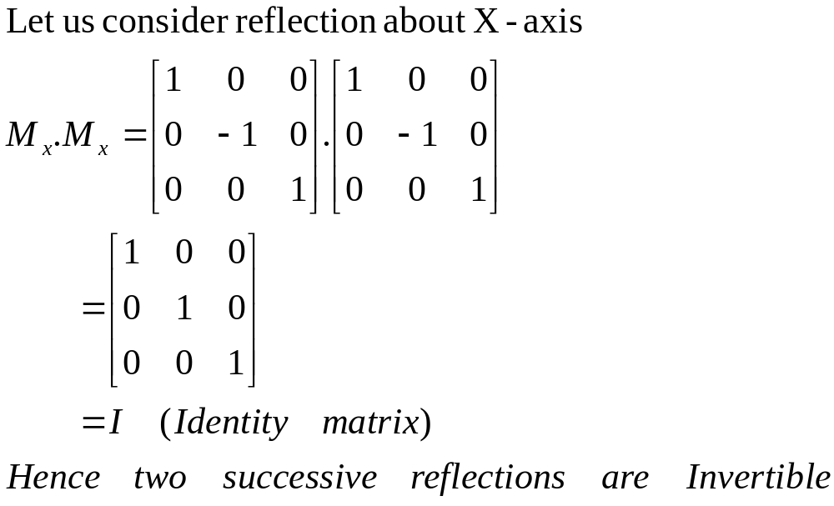
Exercise 11
d. Two Successive reflections are nullified/Invertible.

Slide 82
Any Question !

Slide 83
Scratch
y
6
5
4
3
2
1
0
1
2
3
4
5
6
7
8
9
10
x

