Slide 1
Chapter 8
3-D Transformations

Slide 2
3D Viewing Pipeline
Primitives
Object space
Modeling Transformation
World space
Viewing Transformation
Camera space
Hidden Surface Removal
Lighting & Shading
3D-Clipping
Projection
Normalized view space
Scan conversion, Hiding
Image space,
Device coordinates
Image

Slide 3
Contents
  3D Coordinate System
  Vector Fundamentals
  3D Homogeneous Coordinate
  3D Geometric Transformations
  3D Inverse Transformations
  3D Coordinate Transformations
  Composite transformations

Slide 4
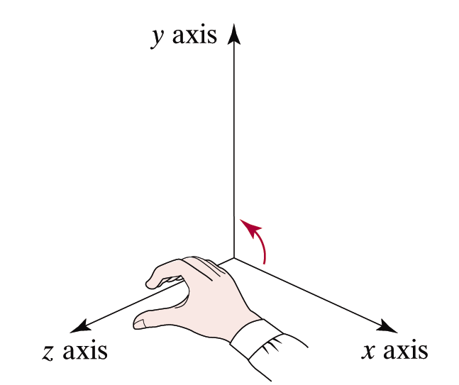
3D Coordinate System
3D coordinate system consists of a reference point called origin and three mutually perpendicular passing through origin.
y axis
y
P
z
x
Right-Hand
Reference System
z axis
x axis

Slide 5
3D Coordinate System
A point P(x,y,z) specifies that point is
  At a distance of x units from YZ-plane
  At a distance of y units from XZ-plane
  At a distance of z units from XY-plane
y axis
y
P
z
x
z axis
x axis

Slide 6
3D Coordinate System
Distance Formula
    D = sqrt((x₁ – x₀)² + (y₁ – y₀) ² +( z₁ – z₀) ²)
Equations of Line
  Parametric form:
    x = x₀+(x₁ – x₀).t
    y = y₀+(y₁ – y₀).t 0≤ t ≤1
    z = z₀+(z₁ – z₀).t
  Implicit Form:
    y = m₁x+b₁
    z = m₂x+b₂

Slide 7
3D Coordinate System
Equations of Curve
  Parametric form:
    x = f(t)
    y = g(t) 0≤ t ≤1
    z = h(t)
  Non Parametric Explicit Form:
    y = f(x)
    z = g(x)
  Non Parametric Implicit Form:
    F(x,y,z) = 0
    G(x,y,z) = 0

Slide 8
3D Coordinate System
Equations of Surface: Surface has both breadth and width
  Parametric form:
    x = f(s,t)
    y = g(s,t) 0≤s, t ≤1
    z = h(s,t)
  Non Parametric Explicit Form:
    z = f(x,y)
    e.g. z = ax+by+c
  Non Parametric Implicit Form:
    F(x,y,z) = 0
    Ax+By+Cz+D = 0

Slide 9
Contents
  3D Coordinate System
  Vector Fundamentals
  3D Homogeneous Coordinate
  3D Geometric Transformations
  3D Inverse Transformations
  3D Coordinate Transformations
  Composite transformations

Slide 10
Vector Fundamentals
In 3D there are 3 natural coordinate vectors I, J and K having unit along X, Y and Z axis respectively.
y axis
Any vector V = aI+bJ+cJ can be resolved into three components (a,b,c) that represent corresponding point when the tail of V is placed at the origin.
y
V=aI+bJ+cK
P
(a,b,c)
z
x
z axis
x axis

Slide 11
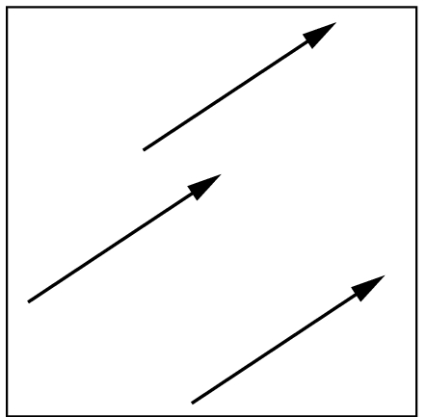
Vector Fundamentals
If P(x₀,y₀,z₀) and Q(x₁,y₁,z₁) are two points in space then
PQ = (x₁ – x_{o})I+ (y₁ – y_{o})J+ (z₁ – z_{o})K
Vector has two attributes:
  length- a scalar denoted by |v|
  direction in 3D space
Equality: Two vectors are equal if
they have same length and direction
y axis
y
V=aI+bJ+cK
P
(a,b,c)
z
x
z axis
x axis

Slide 12
Vector Fundamentals
Vector Addition: perform addition by the head-to-tail rule.
  Note u+v = v+u
u
v
v+u
u+v
u

Slide 13
Vector Fundamentals
Vector Subtraction: To perform subtraction, given u and v, we define u - v to be u + (-v):
Note u - v ≠ v – u
u
u
-v
v
u - v

Slide 14
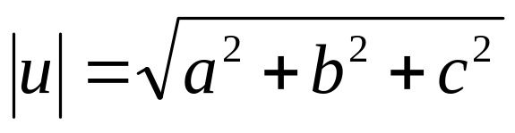
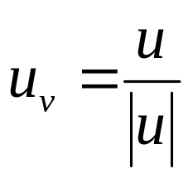
Vector Fundamentals
Zero Vector: i.e. vector with zero length and no direction.
v + (-v) = 0
Magnitude of Vector of a vector u = aI+bJ+cK is a scalar quantity defined as:
Unit vector for any vector u is a vector having direction of u and unit magnitude. It can be found as
v
-v

Slide 15
Vector Fundamentals
Scalar Multiplication: (Scalar times a vector ) Let α be a scalar and u a vector we define αu to be the vector with length | α ||u| with
  the direction of u if α > 0
  the opposite of u if α < 0
if α = 0, the vector is the zero vector or a point.
u
2u
-3u

Slide 16
Vector Fundamentals
Dot Product: Given two vectors u = a₁I+b₁J+c₁K and v = a₂I+b₂J+c₂K the dot product of the vectors is defined to be the scalar as follows
u.v = a₁.a₂+b₁. b₂+c₁.c₂
or u.v = |u| |v| cos θ , 0 ≤θ≤π
where θ is the angle between u and v
Also
  cos θ = u.v /|u| |v|
  Or θ = cos⁻¹(u.v /|u| |v|)
v
θ
u

Slide 17
Vector Fundamentals
The dot product is a scalar value that tells us something about the relationship between two vectors
  If u·v > 0 then 0<θ < 90º
    Vectors point in the same general direction
  If u·v < 0 then θ > 90º
    Vectors point in opposite direction
  If u·v = 0 then θ = 90º
    Vectors are perpendicular
    (or one or both of the vectors is degenerate (0,0,0))

Slide 18
Vector Fundamentals
Cross Product: Given two vectors u = a₁I+b₁J+c₁K and v = a₂I+b₂J+c₂K the cross product of the vectors is defined to be the new vector whose length is |u||v| sin θ, 0 ≤θ≤π and direction is given by the right hand rule.
u x v = (b₁.c₂ – c₁. b₂)I+ (c₁.a₂ – a₁. c₂)J+ (a₁.b₂ – b₁. a₂)K
or |u x v| = |u| |v| sin θ , 0 ≤θ≤π where θ is the angle b/w u & v
sin θ = |u x v| /|u| |v|
  Or θ = sin⁻¹(|u x v| /|u| |v|)
u
u
v
u X v
Notes:
Right hand rule: 1. With your right hand, make a gun with your index finger as the barrel, your thumb upright where the hammer would be, and your middle finger extended perpendicular to your palm. 2. Freeze those positions. 3. With u and v joined at the tail, lay the index finger along u and then the middle finger along v. 4. Your thumb will be in the direction of u X v.

Slide 19
Vector Fundamentals
In a Right handed coordinate System
  I x J = K
  J x K = I
  I x K = -J
  or K x I = J
J
K
I
Right-Hand
Reference System

Slide 20
Vector Fundamentals
Vector Equations of Line: If P(x₀,y₀,z₀) and Q(x₁,y₁,z₁) are two points in space then
PQ = (x₁ – x_{o})I+ (y₁ – y_{o})J+ (z₁ – z_{o})K
= t.aI+t.bt+t.ct = t(aI+bt+ct)
    ⇒ x = x₀+(x₁ – x₀).t = x₀+a.t
    y = y₀+(y₁ – y₀).t = y₀+b.t 0≤ t ≤1
    z = z₀+(z₁ – z₀).t = z₀+c.t

Slide 21


Vector Fundamentals
Vector Equations of Plane: A plane can be uniquely determined by specifying
  A reference point R₀(x₀,y₀,z₀) on the plane, and
  Normal vector N = n₁I+n₂J+n₃K
A vector N is said to be the normal vector to the plane if for any given directed line V in the plane V.N = 0.
•
P(x,y,z)
• R₀(x₀,y₀,z₀)
Notes:
A vector N is said to be the normal vector to the plane if for any given directed line V in the plane V.N = 0.

Slide 22
Vector Fundamentals
Let P(x,y,z) be any point on the plane so that vector R₀P lies on the plane.
since N ⊥ R₀P
∴ N . R₀P = 0
⇒ (n₁I+n₂J+n₃K). ((x-x₀)I+(y-y₀)J+(z-z₀)K) = 0
⇒ n₁(x-x₀)+n₂(y-y₀)+n₃(z-z₀) = 0
⇒ n₁x+n₂y+n₃z – (n₁x₀+n₂y₀+n₃z₀) = 0
which is in
Ax + By + cZ – D = 0 form
•
P(x,y,z)
• R₀
(x₀,y₀,z₀)
Notes:
A vector N is said to be the normal vector to the plane if for any given directed line V in the plane V.N = 0.

Slide 23
Contents
  3D Coordinate System
  Vector Fundamentals
  3D Homogeneous Coordinate
  3D Geometric Transformations
  3D Inverse Transformations
  3D Coordinate Transformations
  Composite transformations

Slide 24

3D Homogeneous Coordinates
Similar to the 2-D situation we can use homogeneous coordinates for 3-D transformations - 4 coordinate
column vector
All transformations can
then be represented
as matrices
y axis
y
P
P(x, y, z) =
z
x
z axis
x axis

Slide 25
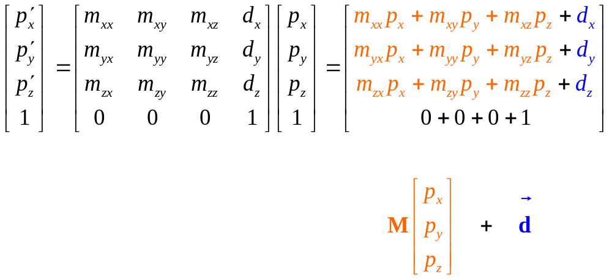
3D Homogeneous Coordinates
Transform a point:
  Top three rows are the affine transform!
  Bottom row stays 1

Slide 26
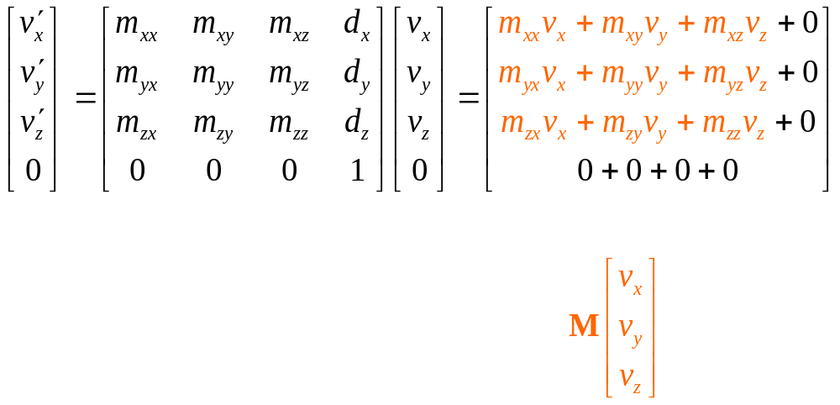
3D Homogeneous Coordinates
Transform a vector:
  Top three rows are the linear transform
    Displacement d is properly ignored
  Bottom row stays 0

Slide 27
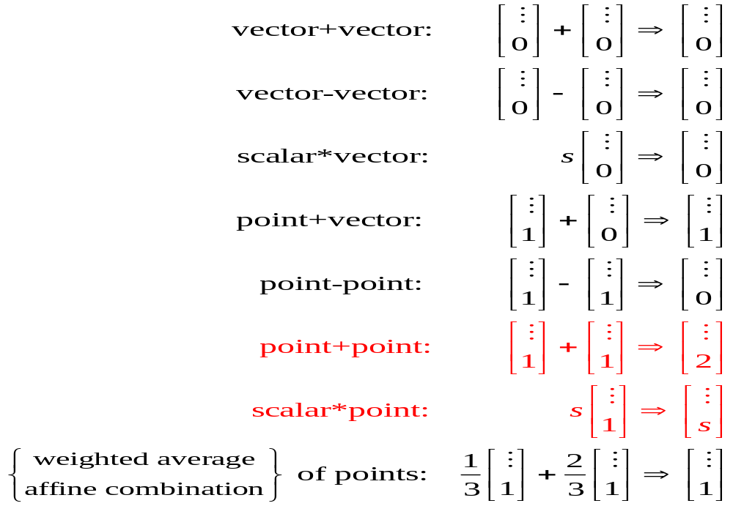
3D Homogeneous Coordinates
In Homogeneous arithmetic Legal operations always end in 0 or 1!

Slide 28
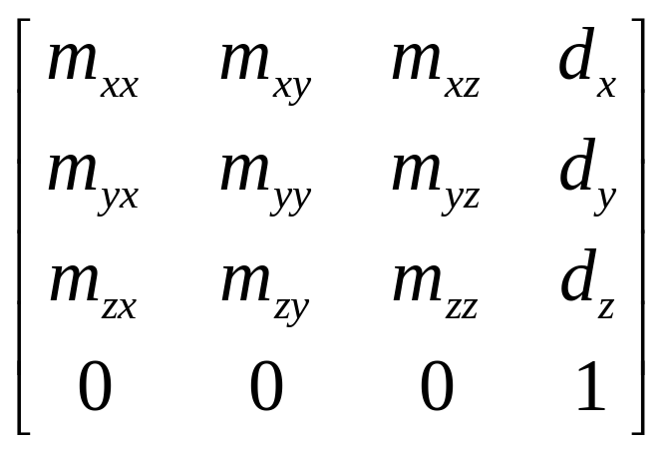
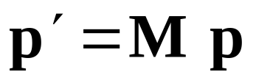
3D Homogeneous Coordinates
Rotation, Scale, and Translation of points and vectors unified in a single matrix transformation:
Where M =
Matrix has the form:
  Last row always 0,0,0,1
Transforms compose by matrix multiplication.

Slide 29
Contents
  3D Coordinate System
  Vector Fundamentals
  3D Homogeneous Coordinate
  3D Geometric Transformations
  3D Inverse Transformations
  3D Coordinate Transformations
  Composite transformations

Slide 30
3D Affine Transformations
Affine transformations transform parallel line segments into parallel line segments and a finite number of points into a finite number of points.
An affine transformation involve only translations, rotations, and reflections preserves angles, lengths, and parallel line segments.

Slide 31
3D Geometric Transformations
  Geometric Transformations: In Geometric transformation an object itself is moved relative to a stationary coordinate system or background. The mathematical statement of this view point is described by geometric transformation applied to each point of the object. Various Geometric transformations are:
      Translation
      Scaling
      Rotation
      Reflection
      Shearing

Slide 32
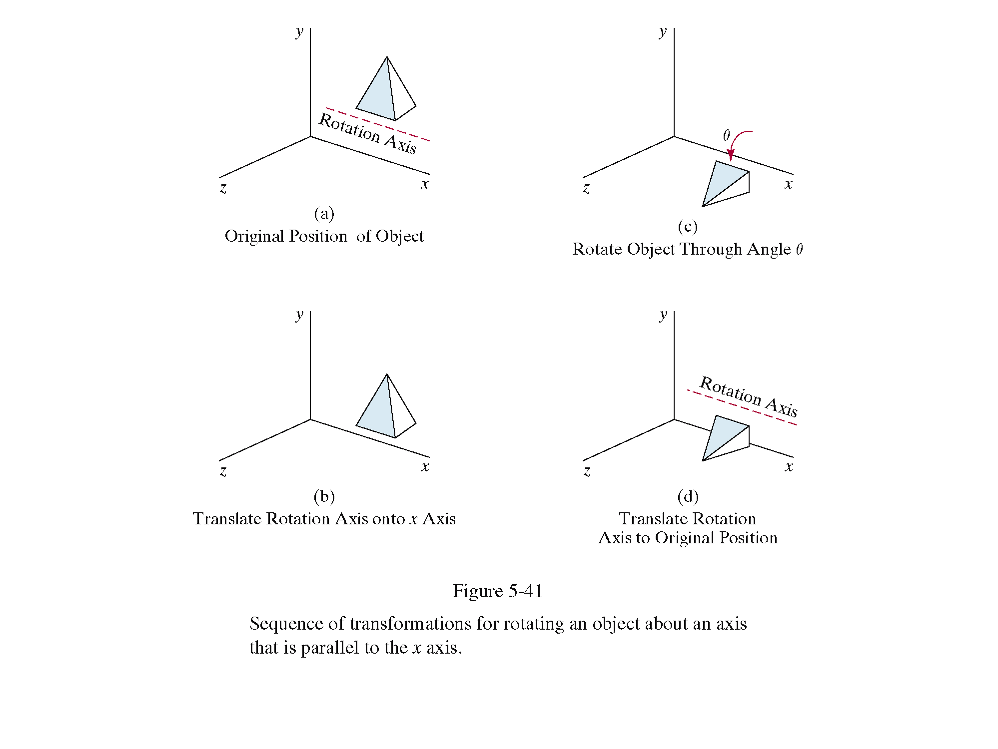
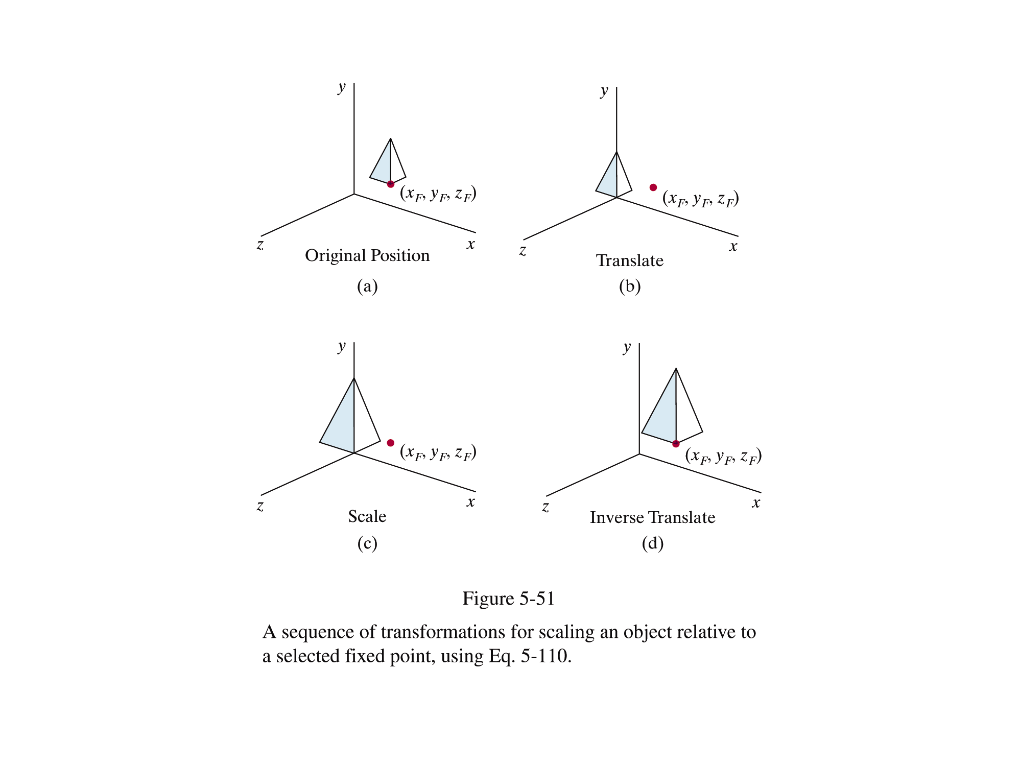
3D Geometric Transformations
Once we have an object described, transformations are used to move that object, scale it and rotate it

Slide 33
Geometric Transformations
  Translation
  Scaling
  Rotation
  Reflection
  Shearing

Slide 34
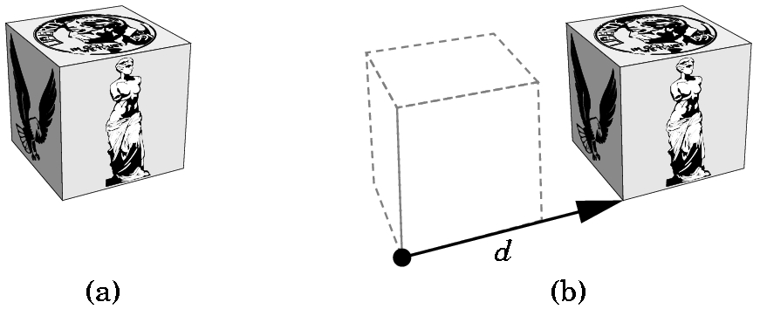
3D Geometric Translation
Translation is defined as the displacement of any object by a given distance and direction from its original position

Slide 35
3D Geometric Translation
To translate a point in three dimensions by tx, ty and tz simply calculate the new points as follows:
x’ = x + tx y’ = y + ty z’ = z + tz
(x, y, z)
(x’, y’, z’)
Translated Position

Slide 36
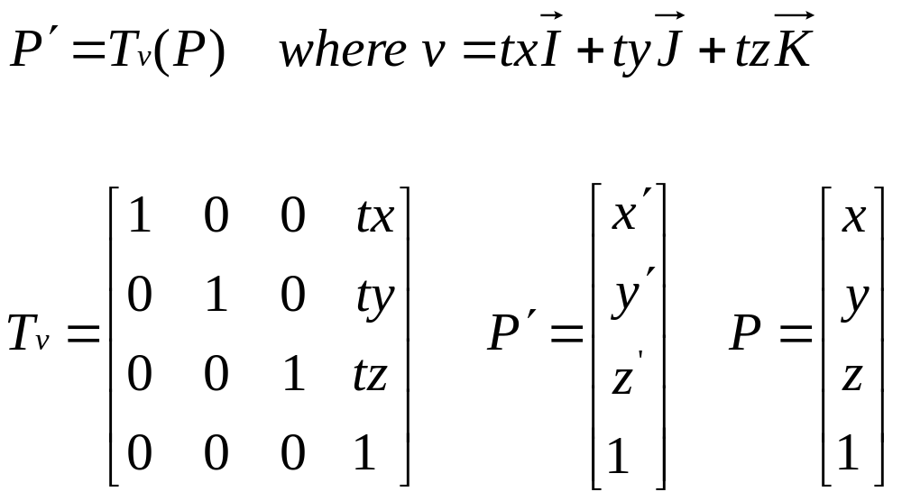
3D Geometric Translation
  The translation of a point P(x,y,z) by (tx, ty, tz) can be written in matrix form as:

Slide 37
Geometric Transformations
  Translation
  Scaling
  Rotation
  Reflection
  Shearing

Slide 38
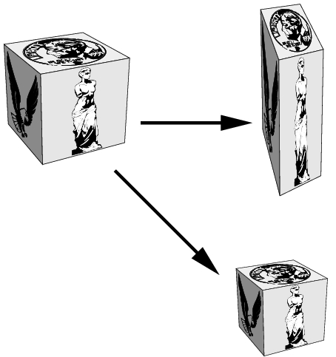
3D Geometric Scaling
Scaling is the process of expanding or compressing the dimensions of an object determined by the scaling factor.

Slide 39
3D Geometric Scaling
To scale a point in three dimensions by sx, sy and sz simply calculate the new points as follows:
x’ = sx*x y’ = sy*y z’ = sz*z
(x, y, z)
(x’, y’, z’)
Scaled Position

Slide 40
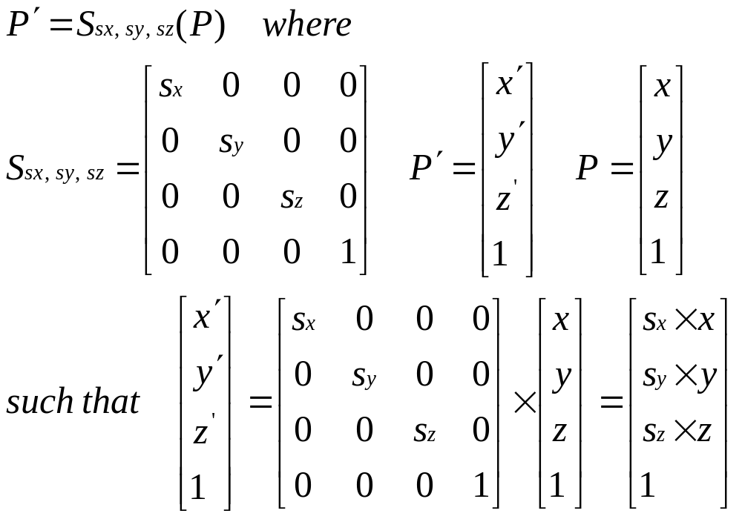
3D Geometric Scaling
  The scaling of a point P(x,y,z) by scaling factors Sx, Sy and Sz about origin can be written in matrix form as:

Slide 41
Geometric Transformations
  Translation
  Scaling
  Rotation
  Reflection
  Shearing

Slide 42
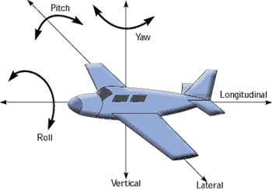
3D Geometric Rotations
When we performed rotations in two dimensions we only had the choice of rotating about the z axis
In the case of three dimensions we have more options
  Rotate about x – pitch
  Rotate about y – yaw
  Rotate about z - roll

Slide 43
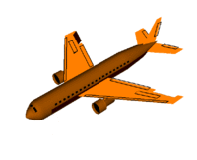
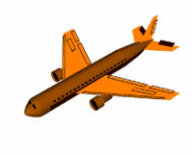
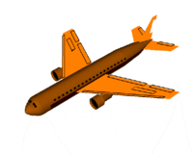
3D Geometric Rotations
Roll is known as the rising or dipping of the airplane's wing. The movement is done about Longitudinal axis. The Ailerons controlling the roll are located on the trailing edge of both wings.
Pitch refers to the movement of the airplane's nose either up or down. It movement is done about Lateral axis. The elevator controls the pitch is also located on the rear of the aircraft on the tail, along with the rudder.
Yaw allows the airplane to move towards the left or right while in flight. The movement is done about a ventricle axis. The yaw is controlled by the rudder located in the rear of the aircraft on the tail.
Roll
Pitch
Yaw

Slide 44
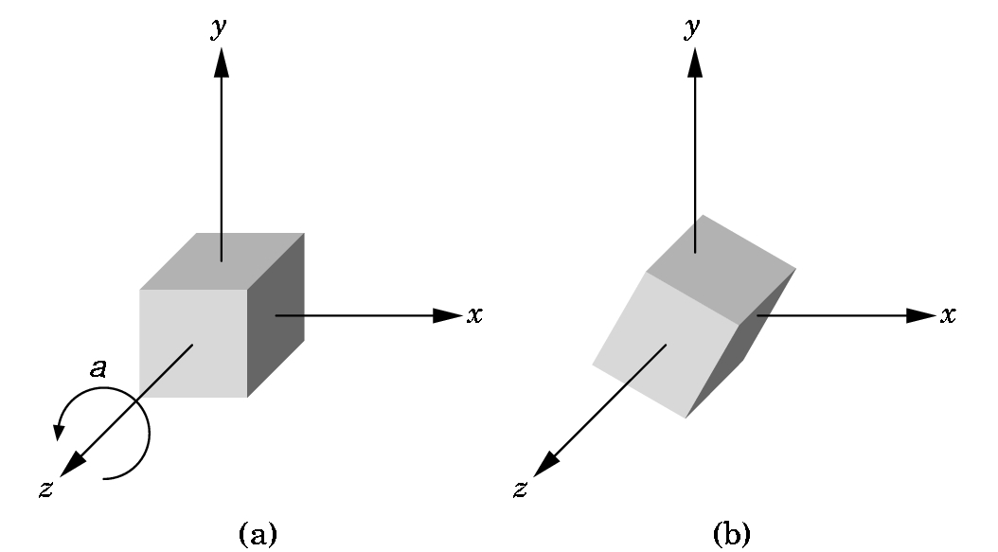
3D Geometric Rotations
Rotate about z – axis: The picture shows a z-axis rotation around the origin in a positive angle, (Anti-clockwise) as you look down the z-axis towards the origin. The angle is measured in the xy-plane from the x-axis, just as in 2D.

Slide 45
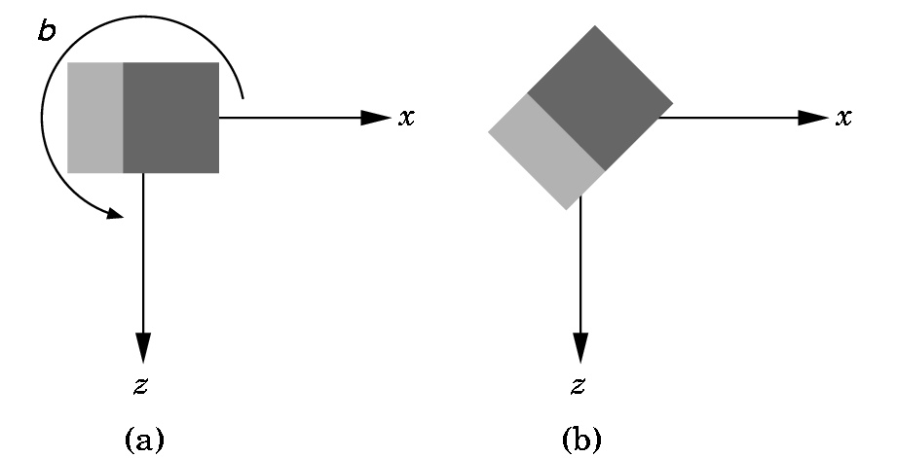
3D Geometric Rotations
Rotate about y – axis: You are looking down the y-axis which is not shown. A positive (counter-clockwise) angle is shown.

Slide 46
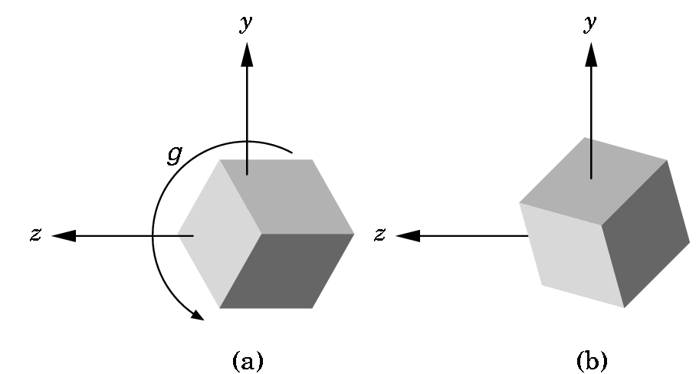
3D Geometric Rotations
Rotate about x – axis: You are looking down the x-axis which is not shown. A positive (counter-clockwise) angle is shown.

Slide 47
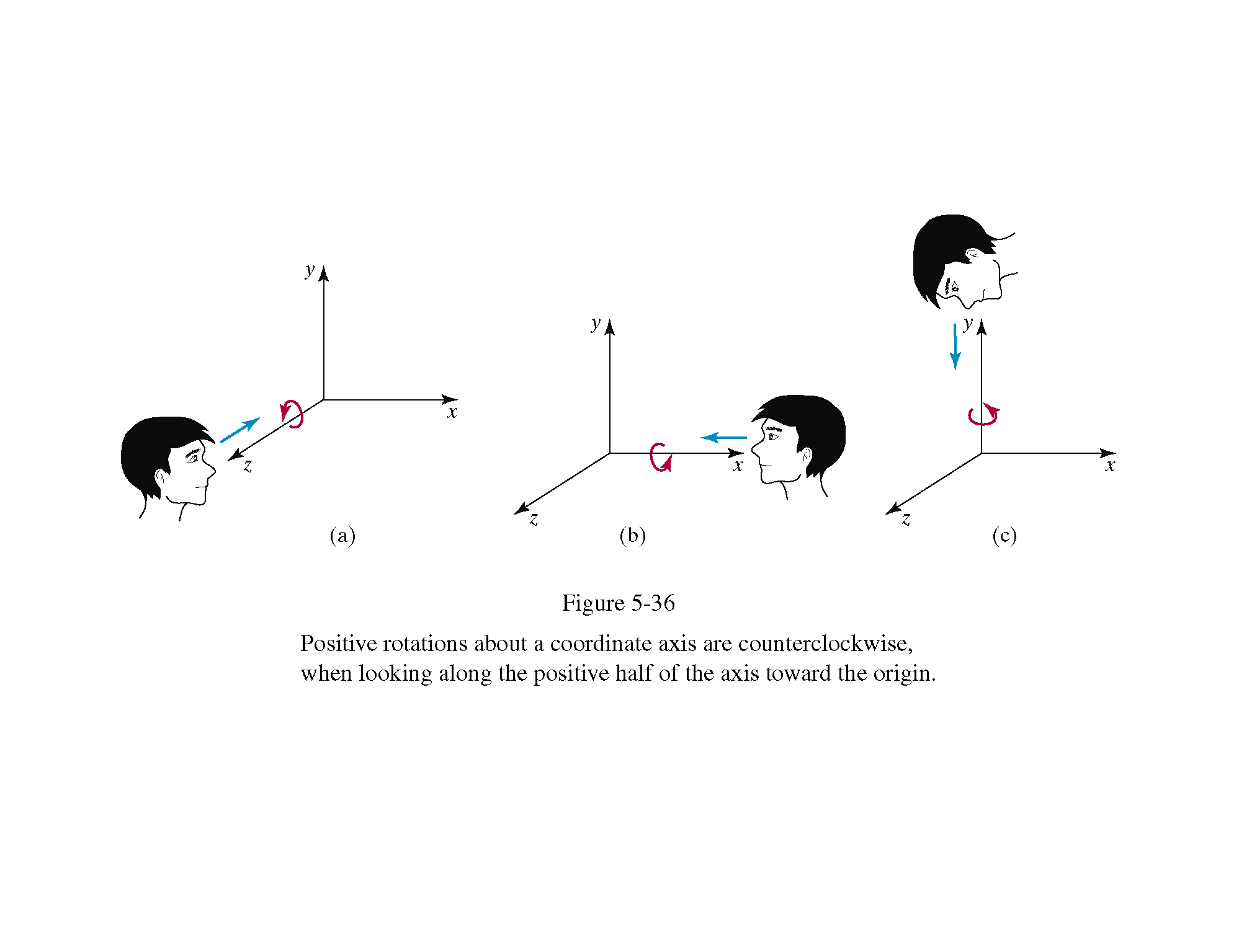
3D Geometric Rotations
The equations for the three kinds of rotations in 3-D are
x’ = x·cosθ - y·sinθ
y’ = x·sinθ + y·cosθ
z’ = z
x’ = x
y’ = y·cosθ - z·sinθ
z’ = y·sinθ + z·cosθ
x’ = z·sinθ + x·cosθ
y’ = y
z’ = z·cosθ - x·sinθ

Slide 48
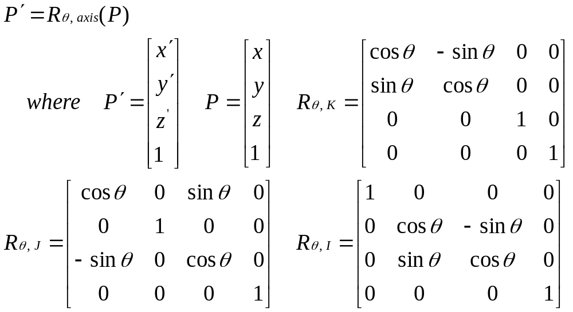
3D Geometric Rotations
  The scaling of a point P(x,y,z) by an angle of θ about different axis about origin can be written in matrix form as:

Slide 49
Geometric Transformations
  Translation
  Scaling
  Rotation
  Reflection
  Shearing

Slide 50
3D Geometric Reflections
We can perform reflections relative to a selected reflection axis or with respect to a reflection plane.
Reflections relative to a given axis are equivalent to 180° rotations about that axis.
Reflections with respect to a plane are equivalent to 180° rotations in 4D space.
3 standard Reflections are
  About z axis or with respect to xy plane
  About y axis or with respect to zx plane
  About x axis or with respect to yz plane

Slide 51
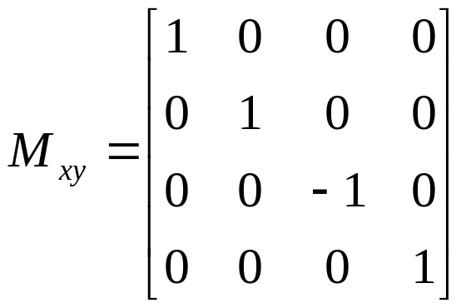
3D Geometric Reflections
Reflection about XY – plane: Reflection relative to the xy plane can be obtained from following set of equations:
x’ = x y’ = y z’ = – z
In homogenous matrix form
P' = M_{xy}(P) where
Reflections about other planes can also be obtained by symmetry.

Slide 52
3D Geometric Reflections
Reflection about XY – plane is a useful reflection as it converts a right-handed coordinate system into a left-handed coordinate system.
y
y
z
x
x
z

Slide 53
Geometric Transformations
  Translation
  Scaling
  Rotation
  Reflection
  Shearing

Slide 54
3D Geometric Shearing
These are not basic affine transformations, but they are important so we deal with them separately.
Each shear is characterized by a single angle θ which is the angle formed with the axis used for the shear.
Like Rotations we have 3 shears
  X – shear
  Y – shear, and
  Z – shear

Slide 55
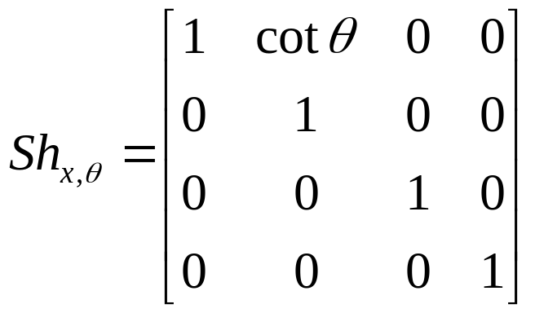
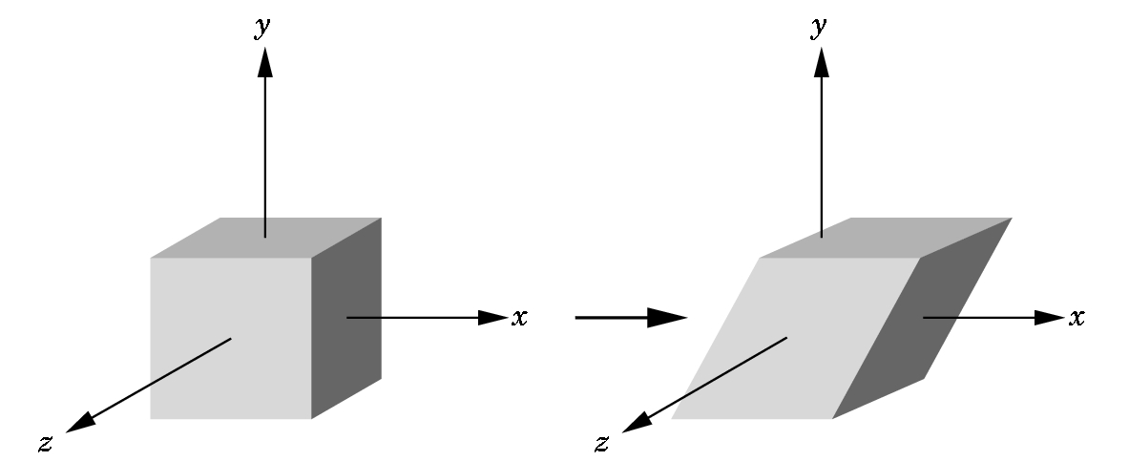
3D Geometric Shearing
Shearing about X-axis is obtained by following set of equations for X Shear
  x'= x + y cot θ
  y' = y
  z' = z

Slide 56
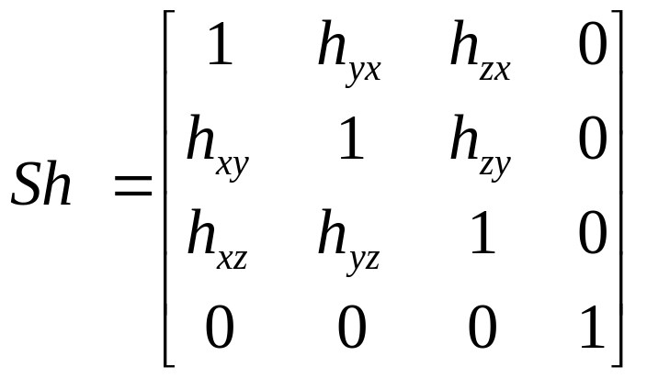
3D Geometric Shearing
Similarly we can obtain Y-shears and Z shears.
General Shearing Matrix is described in terms of %age

Slide 57
Contents
  3D Coordinate System
  Vector Fundamentals
  3D Homogeneous Coordinate
  3D Geometric Transformations
  3D Inverse Transformations
  3D Coordinate Transformations
  Composite transformations

Slide 58
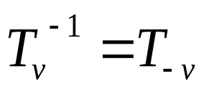
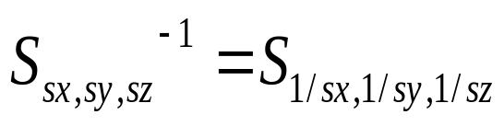
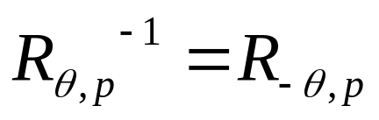
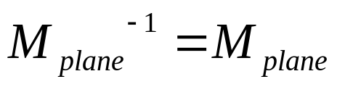
Inverse Transformations
  Inverse Translation:
  Inverse Scaling:
  Inverse Rotations:
  Inverse Reflections:

Slide 59
Contents
  3D Coordinate System
  Vector Fundamentals
  3D Homogeneous Coordinate
  3D Geometric Transformations
  3D Inverse Transformations
  3D Coordinate Transformations
  Combining transformations

Slide 60
3D Coordinate Transformations
  Coordinate Transformation: The object is held stationary while coordinate system is moved relative to the object. These can easily be described in terms of the opposite operation performed by Geometric transformation.

Slide 61
3D Coordinate Transformations
Imagine you are sitting so your eye is looking in the negative z direction towards the origin (reference point) in each frame. Where do you see the cube? To your left? In front of you? Does it appear when you switch frames that the cube has moved?
y
y
new frame
x
z
x
z
original frame
Although each activity is the same, it is often easier to think that you are moving objects. BUT, either visualization is fine!

Slide 62
3D Coordinate Transformations
y
Let us consider Translation
y
x
x
z
z
Keep the basis vectors the same, but move the reference point.
Keep remembering, transformations can be viewed as moving the coordinate system or moving the object!
Note that a coordinate translation clearly an inverse of Geometric Translation,
T(t_{x}, t_{y}, t_{z})⁻¹ = T(-t_{x}, - t_{y}, -t_{z})

Slide 63
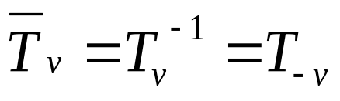
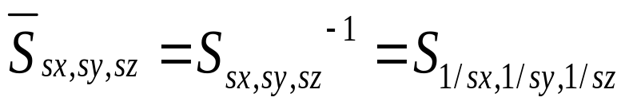
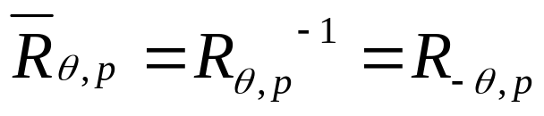
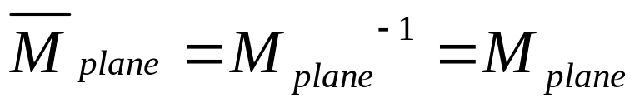
3D Coordinate Transformations
  Coordinate Translation:
  Coordinate Scaling:
  Coordinate Rotations:
  Coordinate Reflections:

Slide 64
Contents
  3D Coordinate System
  Vector Fundamentals
  3D Homogeneous Coordinate
  3D Geometric Transformations
  3D Inverse Transformations
  3D Coordinate Transformations
  Composite transformations

Slide 65


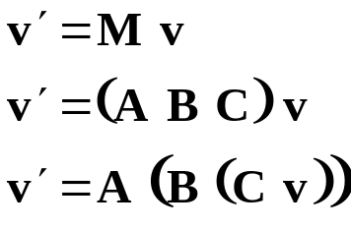
Composite Transformation
Matrix multiplication does NOT commute:
  (unless one or the other is a uniform scale)
  Try this: rotate 90 degrees about x then 90 degrees about z, versus
  rotate 90 degrees about z then 90 degrees about x.
Matrix composition works right-to-left.
  Compose:
  Then apply it to a vector:
  It first applies C to v, then applies B to the result, then applies A to the result of that.

Slide 66
Composite Transformation
Various composite transformations are
  Scaling about arbitrary point P
  Tilting as rotation about x-axis followed by y-axis
  Aligning vector V with K (Z – axis)
  Rotation about arbitrary axis L
  Mirror Reflection about arbitrary plane (N, R₀)

Slide 67
Exercise 1
Scaling about arbitrary point P
  Imagine scaling an object around a point (a,b,c) other than the origin
    Translate point (a,b,c) to origin
    Scale around origin
    Translate back to point

Slide 68
Exercise 1

Slide 69
Exercise 1
Let P is the object point which is to be scaled by factors sx, sy and sz about the fixed point (a,b,c). Then the composite transformation S_{sx,sy,sz,(a,b,c)} can be obtained by performing following sequence of transformations :
Translate (a,b,c) to origin and the new object point is found as
  P¹ = T_{V}(P) where V= – aI – bJ– cK
Scale object about origin and the new object point is
  P² = S_{sx,sy,sz}(P¹)
Retranslate (a,b,c) back the final object point is
  P^{F} = T⁻¹_{V}(P²) = T_{-V} (P²)
The composite transformation can be obtained by back substituting
P^{F} = T⁻¹_{V}(P²)
= T_{-V} S_{sx,sy,sz}(P¹)
= T_{-V} S_{sx,sy}.T_{V}(P) where V= – aI – bJ– cK

Slide 70
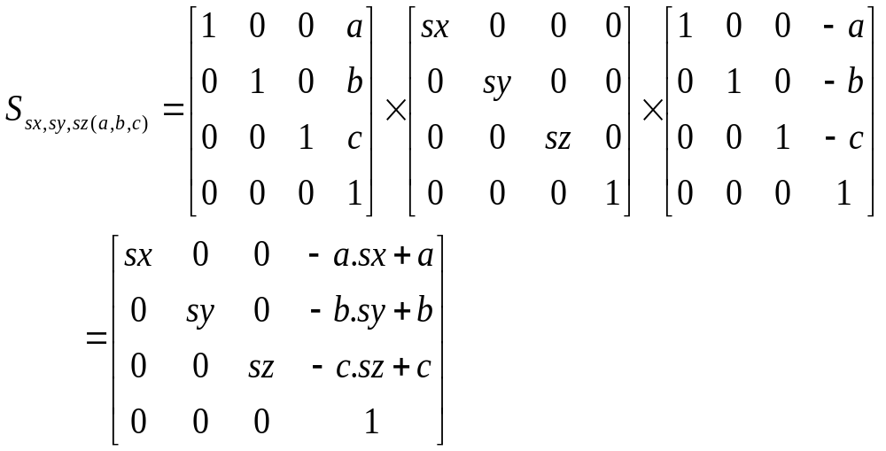
Exercise 1
Thus we form the matrix to be S_{sx,sy,sz(a,b,c)}= T_{-V}S_{sx,sy,sz}T_{V}
  And the composite scaling transformation matrix is

Slide 71
Exercise 2
Define tilting as rotation about the x-axis followed by a rotation about y-axis.
  Find the tilting matrix T = R_{θy,J} x R_{θx,I}
  Does order of rotation matters ?

Slide 72
Exercise 3
Z axis
Aligning vector V with Vector K
Let V = aI+bJ+cK then the alignment can be performed by following sequence of operations:
Rotate V about X-axis by an angle of θ₁, so that V rotates into upper -half of the xz – plane. V’= R_{θ1,I}(V)
Rotate V’ about Y-axis by an angle of -θ₂, so that V’ rotates and align with Z – axis. V”= R _{-θ2,J}(V ’).
How to get these two angles???
P(a,b,c)
c
V
a
b
Y axis
X axis

Slide 73
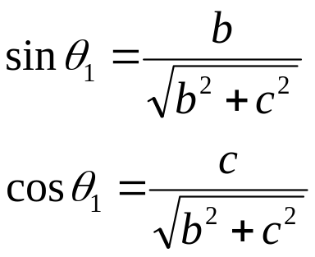
Exercise 3
Z axis
Step1: Rotate V about X-axis by an angle of θ₁, so that V rotates into upper -half of the xz – plane. V’= R_{θ1,I}(V)
Let P’ be projection of P(a,b,c) in YZ plane.
P’↔(0,b,c). If θ₁ be the angle that OP
makes with +ve Z-axis, then from ΔOP’C
V’
C
P’(0,b,c)
Q(a,0,√b²+c²
P(a,b,c)
V
θ₁
O
B
Y axis
A
X axis

Slide 74
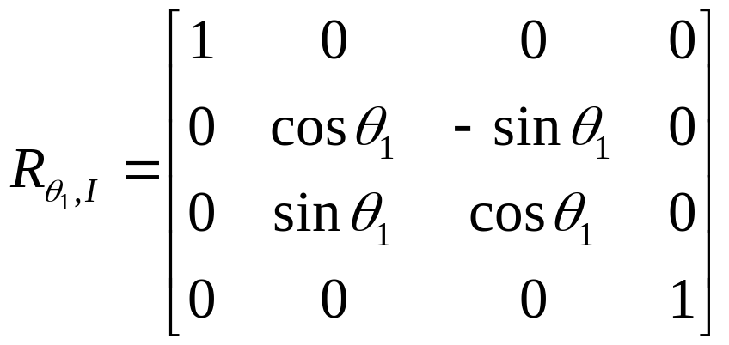
Exercise 3
Rotate vector V about X-axis by an angle of θ₁
V’= R_{θ1,I}(V) or Q = R_{θ1,I} (P)
Where
Does V have rotated into upper -half of the xz – plane?
Notes:
Check that after transformation Q lies in XZ plane and magnitudes of V’ is same as that of V

Slide 75
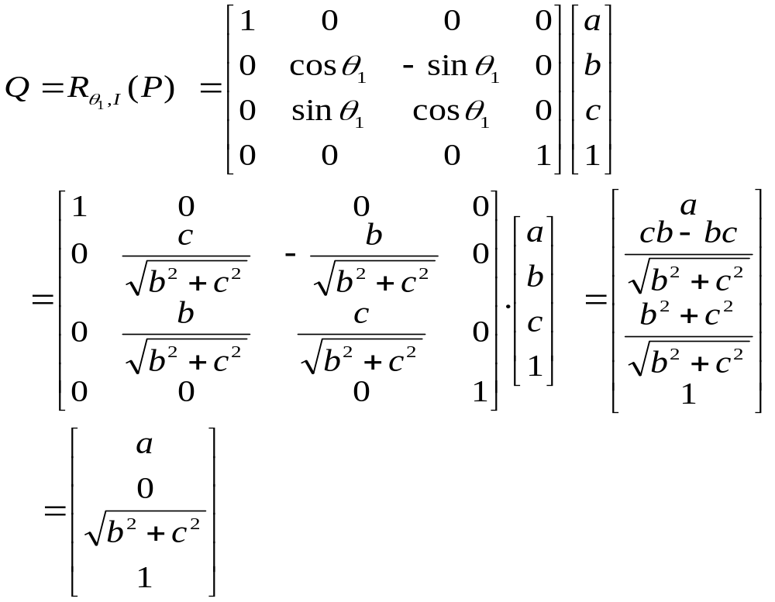
Exercise 3
Notes:
Check that after transformation Q lies in XZ plane and magnitudes of V’ is same as that of V

Slide 76
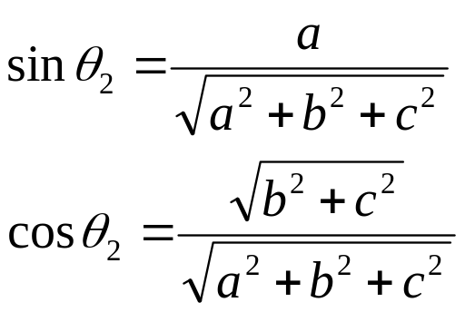
Exercise 3
Z axis
R(0,0,√a²+b²+c²)
Step2: Rotate V’ about Y-axis by an angle of – θ₂ , so that V’ aligns with +ve Z axis. V”= R_{θ1,I}(V)
Let Q’ be projection of Q(a,0,√b²+c²) on Z axis, Q’↔(0,0, √b²+c² ). If θ₂ be the angle that OQ’ makes with +ve Z-axis, then from ΔOQQ’
Q’(0,0,√b²+c²)
V’
a
P’(0,b,c)
Q(a,0,√b²+c²)
C
P(a,b,c)
θ₂
V
O
B
Y axis
A
X axis

Slide 77
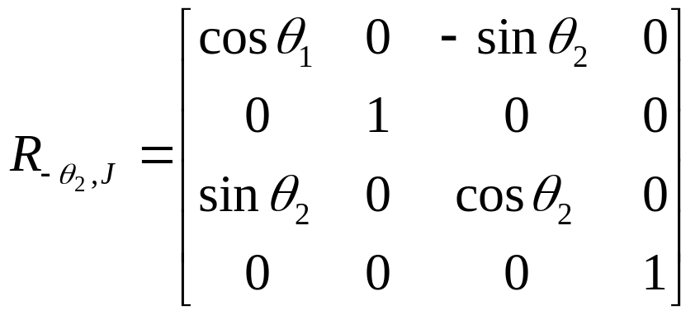
Exercise 3
Rotate vector V’ about Y-axis by an angle of – θ₂
V”= R_{-θ2,J}(V’) or R = R_{-θ2,J} (Q)
Where
Does V have aligned Z axis?
Notes:
Check that after transformation Q lies in XZ plane and magnitudes of V’ is same as that of V

Slide 78
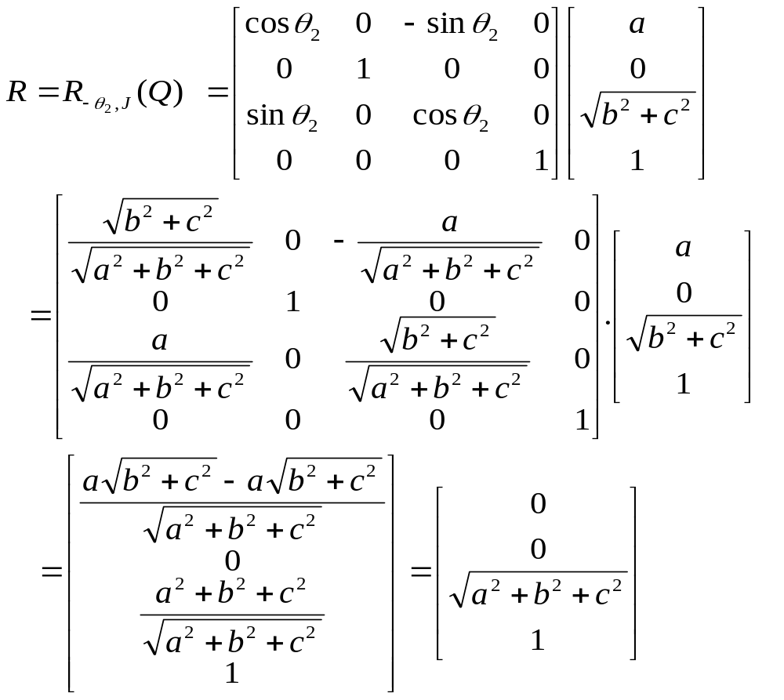
Exercise 3
Notes:
Check that after transformation Q lies in XZ plane and magnitudes of V’ is same as that of V

Slide 79
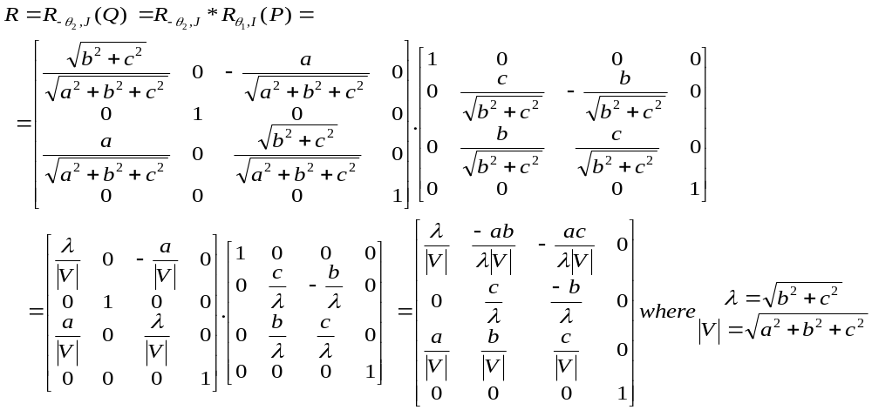
Exercise 3
Composite Matrix A_{V,K} can be found as
Notes:
Check that after transformation Q lies in XZ plane and magnitudes of V’ is same as that of V

Slide 80
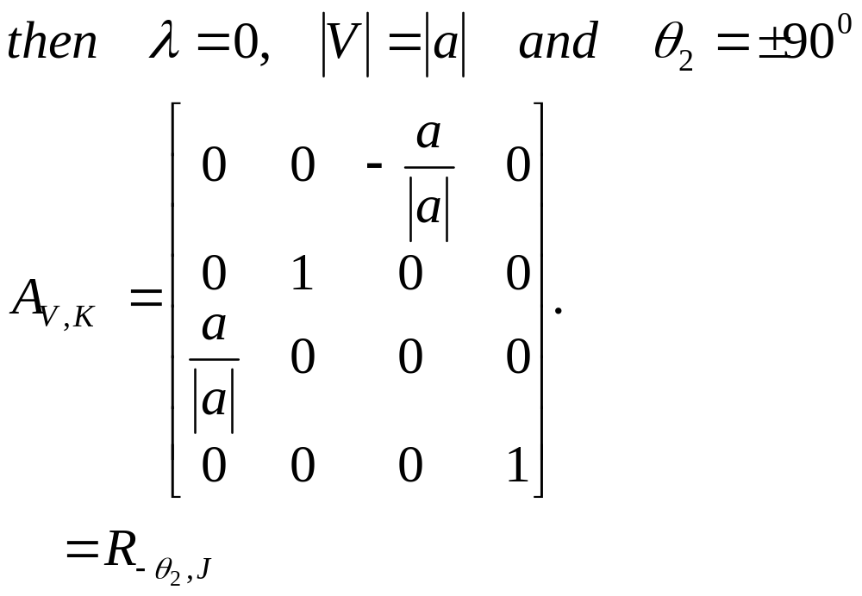
Exercise 3
Corollary I: If both b = c =0
Notes:
Check that after transformation Q lies in XZ plane and magnitudes of V’ is same as that of V

Slide 81
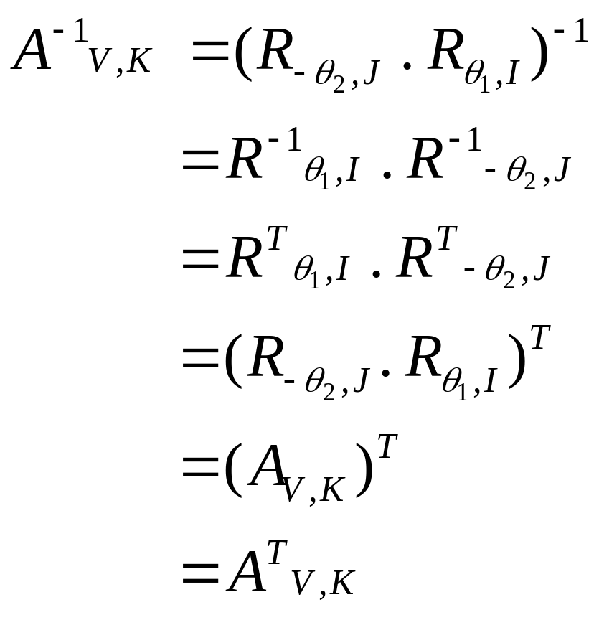
Exercise 3
Corollary II: The inverse of A_{V,K} can be found as
Notes:
Check that after transformation Q lies in XZ plane and magnitudes of V’ is same as that of V

Slide 82
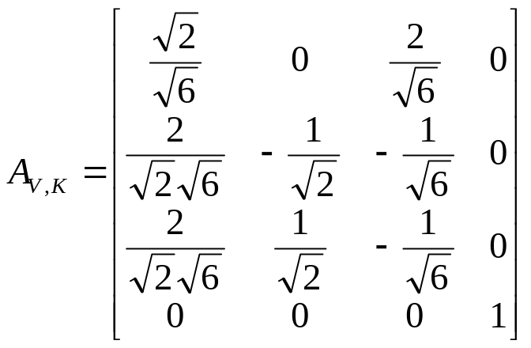
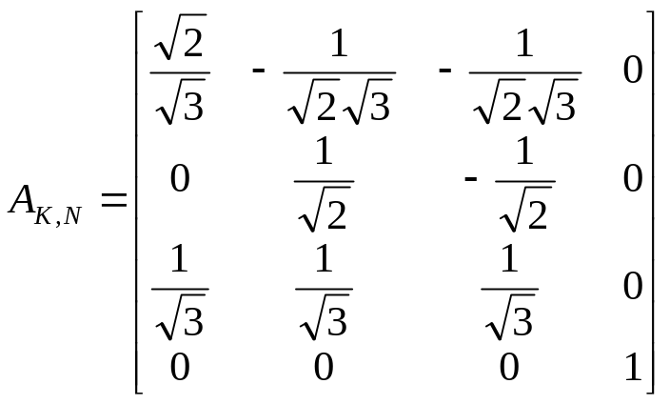
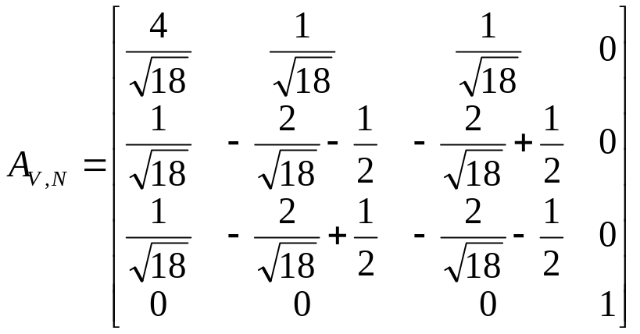
Exercise 4
Find transformation A_{V,N} that aligns vector V = 2I – J – K with another N = I+J+K.

Slide 83

Exercise 5
Rotation by an angle θ about arbitrary axis L specified by a direction vector V and fixed point P₀.
The transformation can be found as:
  Translate P₀ to origin.
  Align Vector V with K.
  Rotate object about Z axis by angle θ.
  Realign vector V back.
  Retranslate P₀ back.

Slide 84
Exercise 5
If P is the object point the sequence of transformations is:
Translate P₀ to origin ⇒ P¹ = T_{-P0}(P)
Align Vector V with K. ⇒ P² = A_{V,K}(P¹)
Rotate object about Z axis by angle θ. ⇒ P³ = R_{θ,K}(P²)
Realign vector V back. ⇒ P⁴ = A⁻¹_{V,K}(P³)
Retranslate P₀ back. ⇒ P⁵ = T⁻¹_{-P0}(P⁴)
Thus P⁵ = T⁻¹_{-P0}(P⁴)
= T⁻¹_{-P0}.A⁻¹_{V,K}(P³)
= T⁻¹_{-P0}.A⁻¹_{V,K}. R_{θ,K}(P²)
= T⁻¹_{-P0}.A⁻¹_{V,K}. R_{θ,K}. A_{V,K}(P¹)
= T⁻¹_{-P0}.A⁻¹_{V,K}. R_{θ,K}. A_{V,K}. T_{-P0}(P)
Thus we form the matrix to be R_{θ,L}= T⁻¹_{-P0} A⁻¹_{V,K} R_{θ,K} A_{V,K}T_{-P0}

Slide 85

Exercise 5

Slide 86


Exercise 6
The pyramid is defined by A(0,0,0), B(1,0,0), C(0,1,0) and D(0,0,1) is rotated by 45⁰ about line L in the direction of V = J+K passing through P(0,1,0). Find the coordinates of rotated figure.

Slide 87
Exercise 7
Find the transformation for mirror reflection with respect to given plane specified by normal vector N and reference point R₀.
The transformation can be found as:
  Translate R₀ to origin.
  Align Vector N with K.
  Reflect about XY plane.
  Realign vector N back.
  Retranslate R₀ back.
z
N
R₀
y
x

Slide 88
Exercise 7
If P is the object point the sequence of transformations is:
Translate R₀ to origin ⇒ P¹ = T_{-R0}(P)
Align Vector N with K. ⇒ P² = A_{N,K}(P¹)
Reflect object about XY plane. ⇒ P³ = M_{xy}(P²)
Realign vector N back. ⇒ P⁴ = A⁻¹_{N,K}(P³)
Retranslate R₀ back. ⇒ P⁵ = T⁻¹_{-R0}(P⁴)
Thus P⁵ = T⁻¹_{-R0}(P⁴)
= T⁻¹_{-R0}.A⁻¹_{N,K}(P³)
= T⁻¹_{-R0}.A⁻¹_{N,K}. M_{XY}(P²)
= T⁻¹_{-R0}.A⁻¹_{N,K}. M_{XY}. A_{N,K}(P¹)
= T⁻¹_{-R0}.A⁻¹_{N,K}. M_{XY}. A_{N,K}. T_{-R0}(P)
Thus we form the matrix to be M_{N,R0}= T⁻¹_{-R0} A⁻¹_{N,K} M_{XY} A_{N,K}T_{-R0}

Slide 89

Exercise 8
Find the mirror reflection of the Pyramid with respect to plane passing through origin and having a normal vector N: I+J+K.

Slide 90
Any Question !

